Slide 1
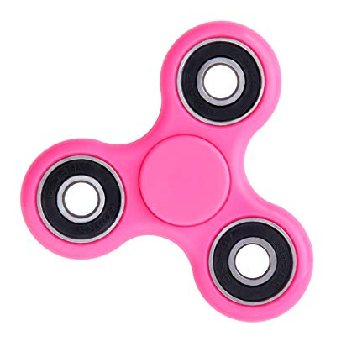
Attitude Determination & Control
Frames and Requirements
ADCS Architecture
Results
Daniel Alvarez Cosme
Cédric Belmant
Paula Marin Banqué

Slide 2
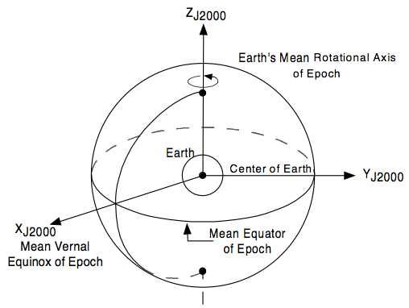
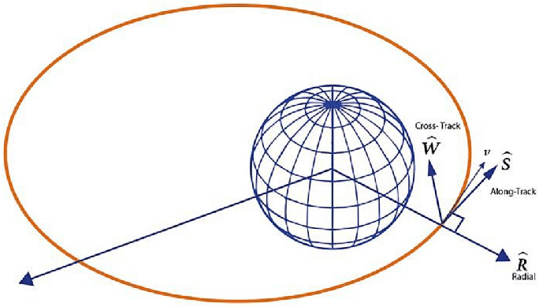
Frames and requirements
RSW and J2000 frames
Requirements for payload:
GNSS: 54º field of view with respect to zenith
No requirements for Iridium and platform
Phases:
Detumbling
Mission
Power collection
Key input data for simulations: altitude and inertia
I. Frames and requirements

Slide 3
ADCS architecture
Sensors
3-axis MEMS Gyroscope (high freq)
Accuracy: medium-low
Mass and power: low
3-axis Magnetometer (low freq)
MEMS Gyro specs
Bias stability (3𝛔) over 24h | <5 deg/h
Angular random walk | <0.2 deg/√h
Range | Up to 20 deg/s
Extended Kalman Filter (Sensor fusion)
II. ADCS Architecture

Slide 4
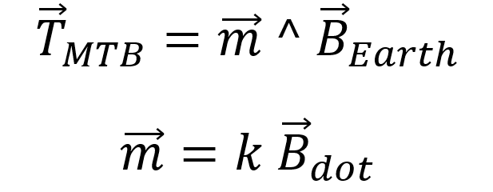
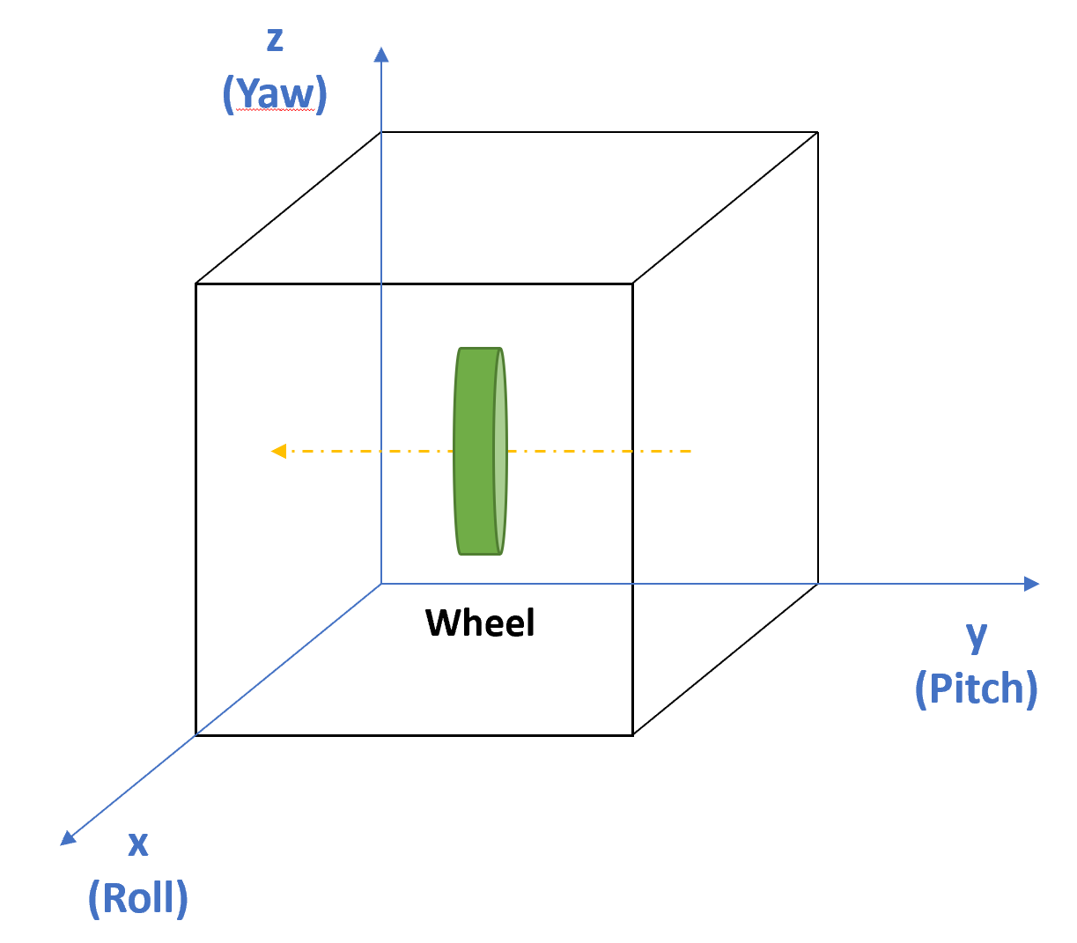
ADCS architecture
MTB:
Detumbling (Bdot) and wheel dampening
Momentum wheel:
Spin stabilization around pitch axis
Gravity gradient torque:
Iyy (pitch) > Ixx (roll) > Izz (yaw)
Actuators
3-axis Magnetorquer
1 Momentum wheel
II. ADCS Architecture

Slide 5
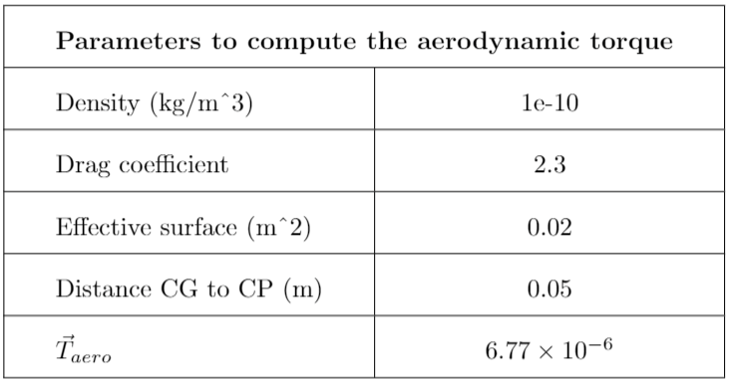
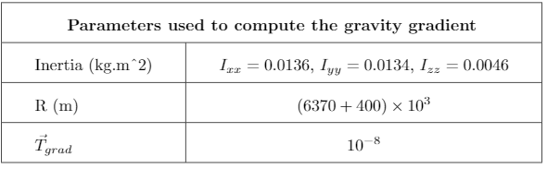
Results
Exterior torques
Calculation of aerodynamic and gravity gradient torques
III. Results

Slide 6
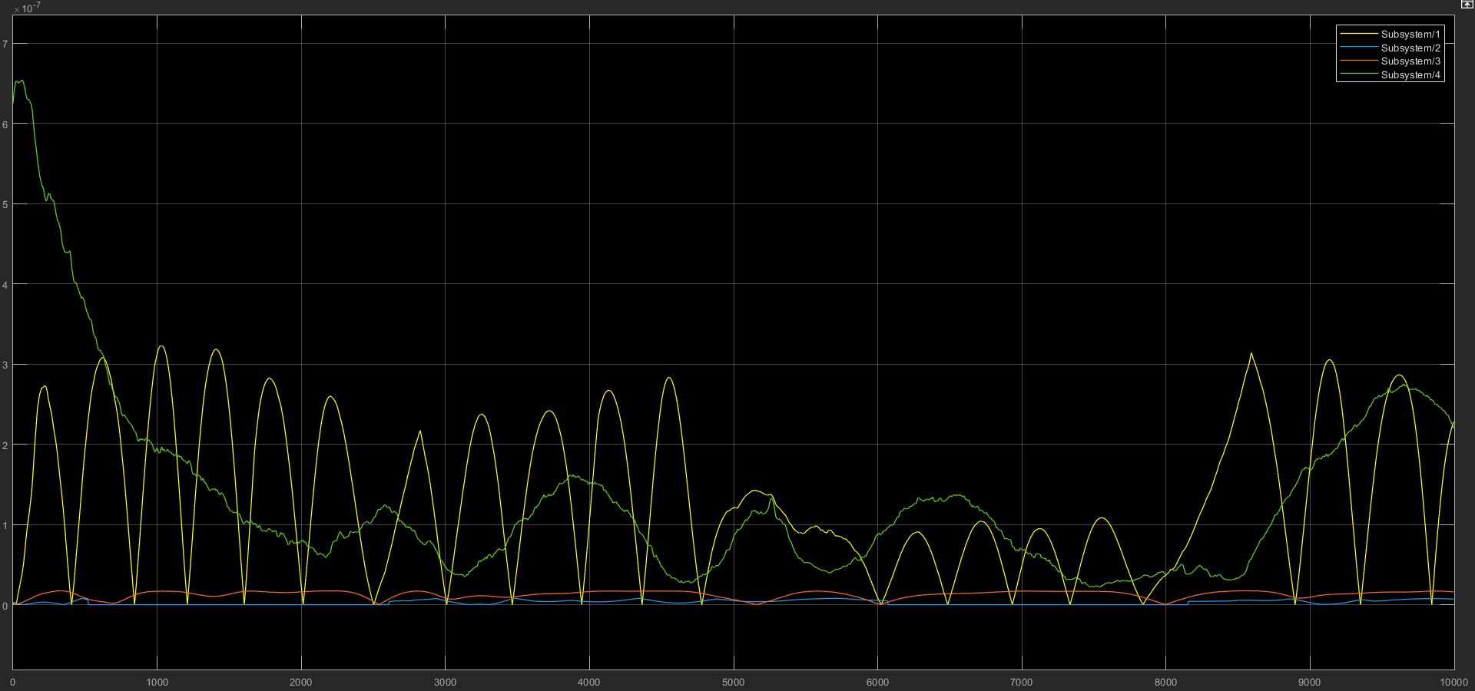
Results
Exterior torques with MTB Bdot: aerodynamic torque is comparable to magnetic torque
Sun Torque
Gravity Gradient Torque
Aerodynamic Torque
Magnetic Torque
Bdot control with very low initial angular speed (0.03°/s)
III. Results

Slide 7
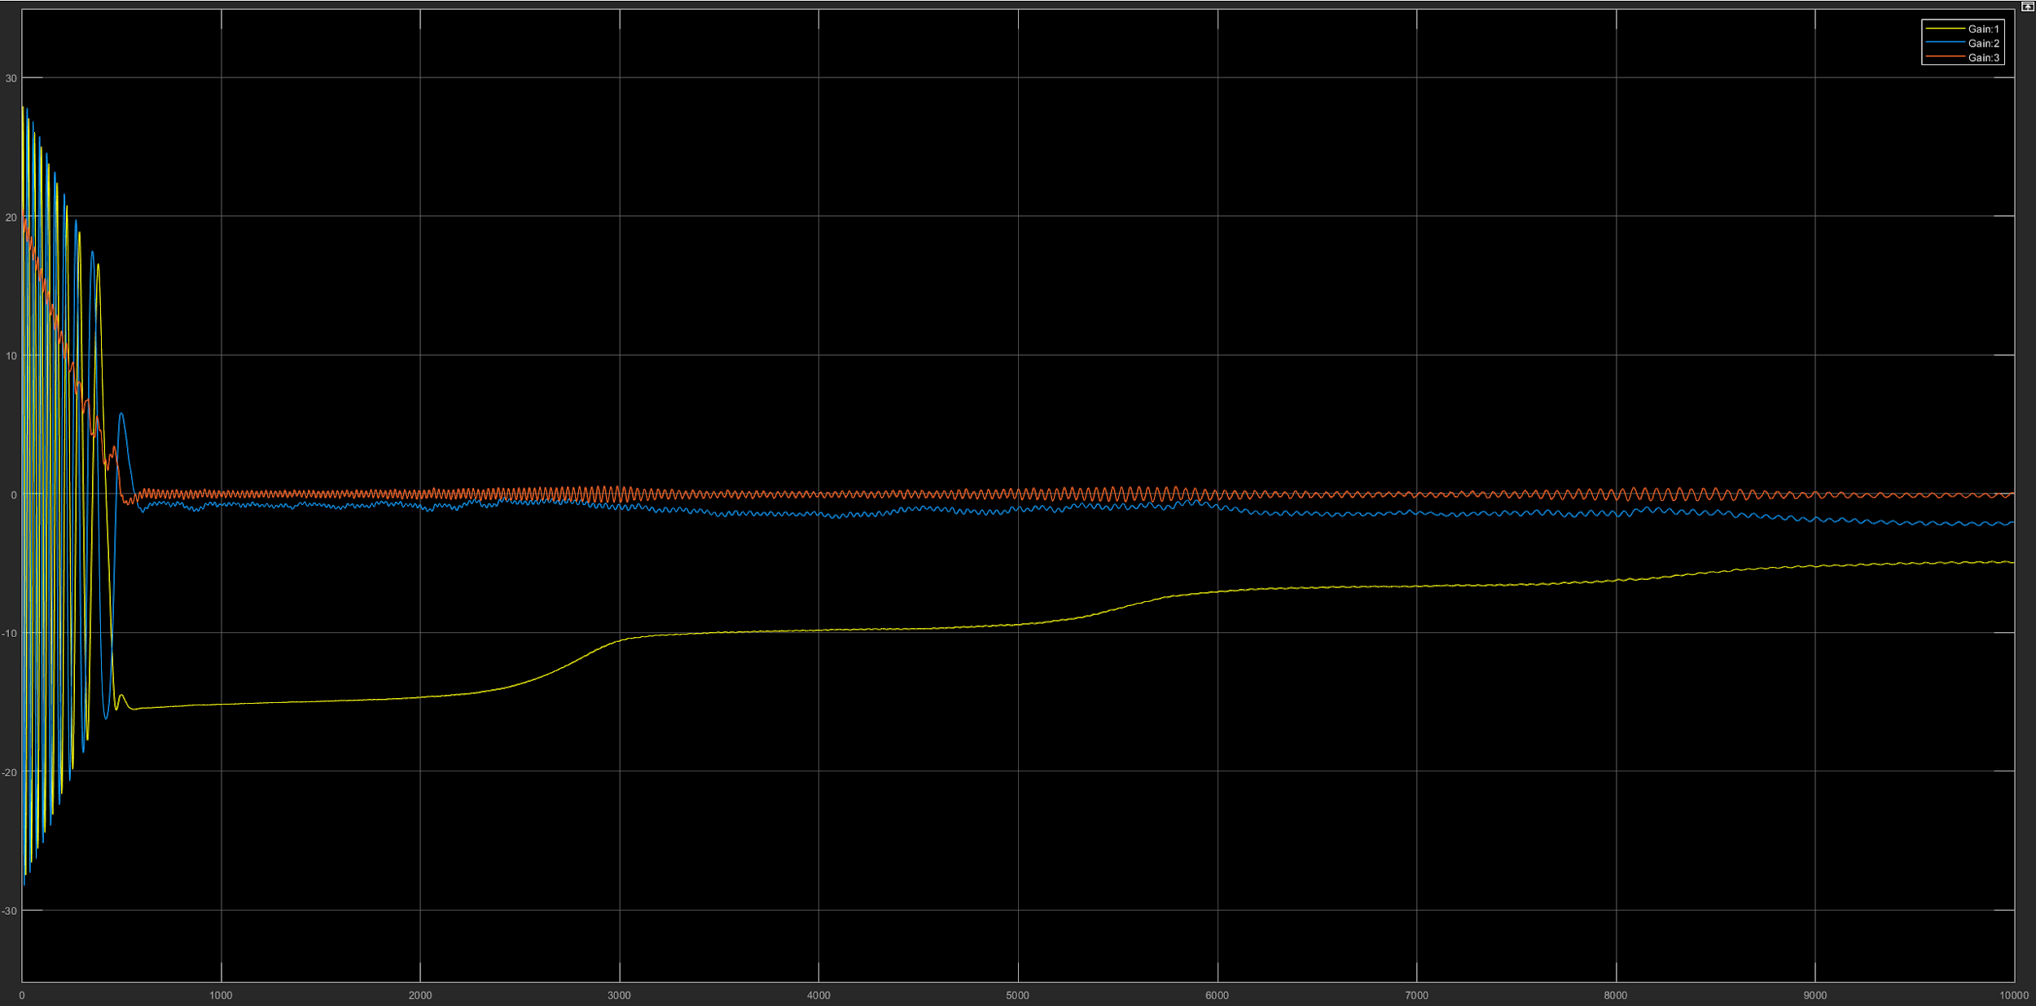
Results
Detumbling: 20°/s on all axes, rotation speed < 5°/s after 10 000s
10 000s
5°/s
III. Results

Slide 8
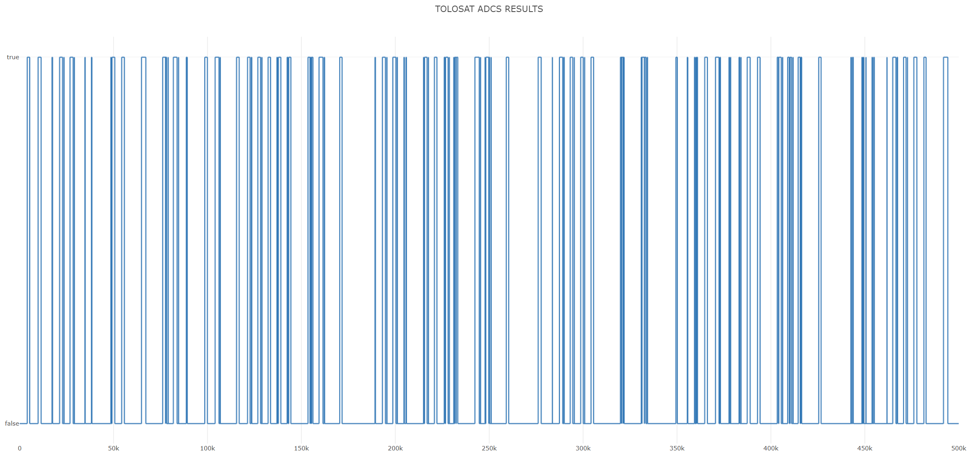
Results
Visibility windows: 17.9% coverage for ~ 100 orbits with MTB Bdot
III. Results

Slide 9
Conclusions
•Current model:
Attitude Determination:
Gyroscope (very small, and small consumption)
Magnetometer (in Magnetorquer)
Attitude Control:
Magnetorquer (for detumbling and reaching low angular rates)
•Detumbling mode:
We should be able to point the zenith (+/- 54 degrees) for about 15% of orbit time

Slide 10
Future work
Kalman filter implementation
Make sure the noise of the components is correct.
Momentum wheel: “mise en vitesse” around y-axis

Slide 11
BACK-UP SLIDES
Altitude | Aero | Grav grad | Sun | Magn
350 | 1.246E-05 | 3.944E-08 | 6.175E-09 | 1.976E-06
400 | 5.551E-06 | 3.859E-08 | 6.178E-09 | 1.891E-06
450 | 2.477E-06 | 3.775E-08 | 6.18E-09 | 1.853E-06
500 | 1.104E-06 | 3.693E-08 | 6.179E-09 | 1.843E-06
Exterior torques as a function of altitude (Bdot active)

Slide 12
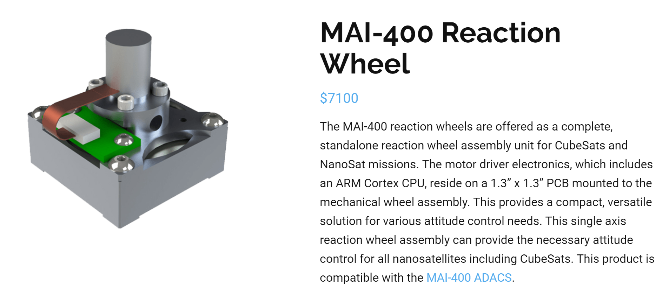
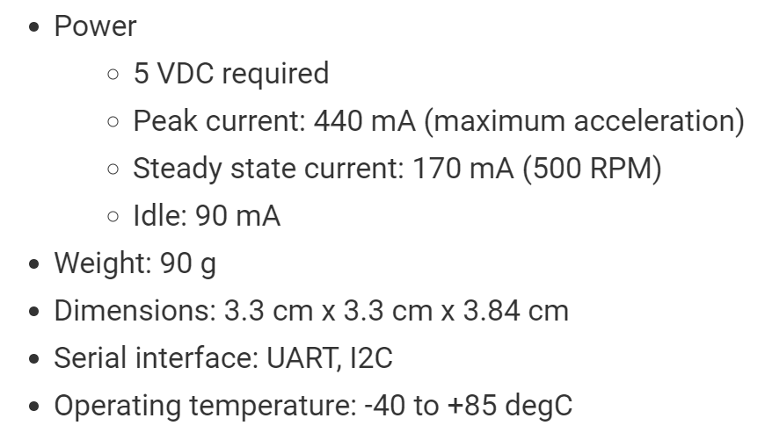
BACK-UP SLIDES
Nominal power consumption: 0.85 W

Slide 13
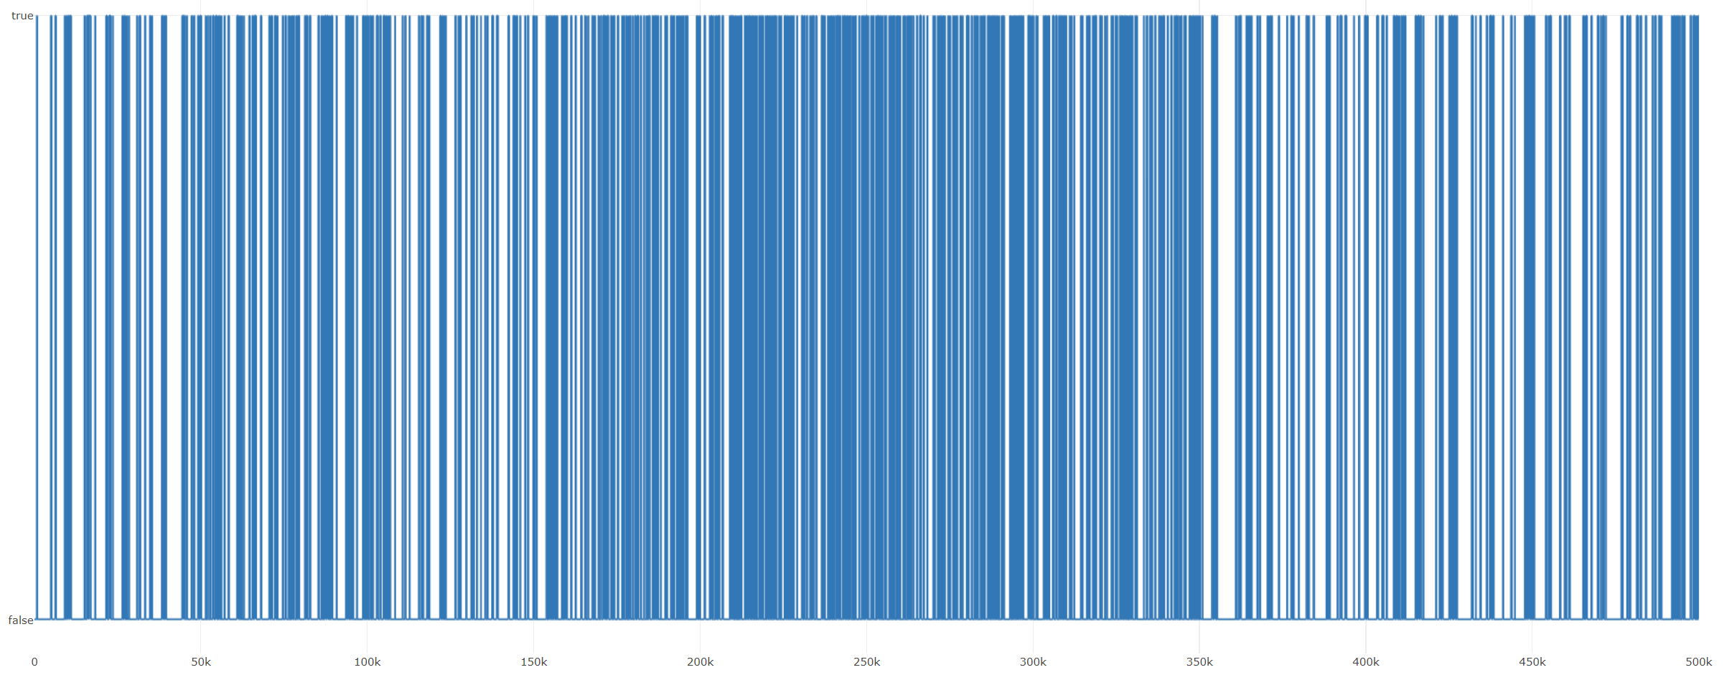
BACK-UP SLIDES
Visibility windows: 14.9% coverage for ~ 100 orbits without MTB

