Slide 1
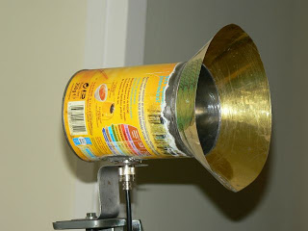
Communications
Frequency selection
Link Budget Breakdown
Losses
Components
Léa Vallat - ENSEEIHT
Vishal Singh – ISAE

Slide 2
Frequency Selection
Uplink Frequency: 145.8 MHz (VHF range 144 -146MHz) Amateur Radio 2 meter band (ITU Region :Europe, Russia, Africa)
Downlink Frequency: 437.45 MHz (UHF range 430 to 438MHz)
Amateur satellite use
Reason:
Losses are nearly independent of atmospheric temperatures, humidity and mean density etc. below 2 GHz[1]
Most CubeSat mission use such bands
I. Frequency Selection

Slide 3
Link Budget
Assumed spacecraft temperature to be at 6 deg C [as we decrease temperature margin increases and vice versa]
Uplink Kourou ToloSat
Ground station EIRP: dBW | Link Losses: La+Lp dB | Figure of Merit: Ga/Ts dB/K | 1/k dB/K/Hz | Carrier to Noise Ratio: S/No dBHz | Eb/No: dB | Link Margin dB
29.7 | 141 | -24.1 | -228.6 | 91.8 | 61.0 | 46.6
Atmospheric loss: not much idea (figure similar to Eyesat 2.1dB)
Rest of the losses insignificant
Data rate is kept to be maximum offered by the transceiver: 1200 bps
Modulation scheme: Non Coherent FSK: (Eb/No Threshold = 14.4 dB)
Uplink Supaero ToloSat
Ground station EIRP: dBW | Link Losses: La+Lp dB | Figure of Merit: Ga/Ts dB/K | 1/k dB/K/Hz | Carrier to Noise Ratio: S/No dBHz | Eb/No: dB | Link Margin dB
21.7 | 141 | -24.1 | -228.6 | 83.8 | 53.0 | 38.6
II. Link Budget Breakdown

Slide 4
Link Budget
Downlink ToloSat Kourou, Supaero
Ground station EIRP: dBW | Link Losses: La+Lp dB | Figure of Merit: Ga/Ts dB/K | 1/k dB/K/Hz | Carrier to Noise Ratio: S/No dBHz | Eb/No: dB | Link Margin dB
7.7 | 141 | -24.1 | -228.6 | 69.6 | 29.7 | 20.1
Assumed ground station feedline temperature to be at 15 deg C
Data rate is kept to be maximum offered by the transceiver: 9600 bps
Modulation scheme: BPSK: (Eb/No Threshold = 9.6 dB)
Also supported by the chosen transceiver
II. Link Budget Breakdown

Slide 5
Losses
Atmospheric Losses :
First considered as negligible
Need to be revised
Ionospheric Losses :
Still incomplete informations
Need to get a physical model
Probably most influencing losses
III. Losses

Slide 6
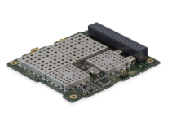
Chosen Transceiver
ISIS TRXVU : VHF Uplink / UHF Downlink
Low power consumption
Higher power and frequency for the Downlink
Frequency re-configuration in-flight
Can operate in commercial and amateur bands
Low mass
System data rate : Until 9600 bps in transmitter and receiver mode
IV. Components

Slide 7
Modulation and Demodulation Methods
Transmitter Configuration (Downlink) : Binary Phase Shift Keying (BPSK)
Receiver Configuration (Uplink) : Frequency Shift Keying (FSK)
Methods proposed by the Transceiver, available in groundstations and understood
IV.Components

Slide 8
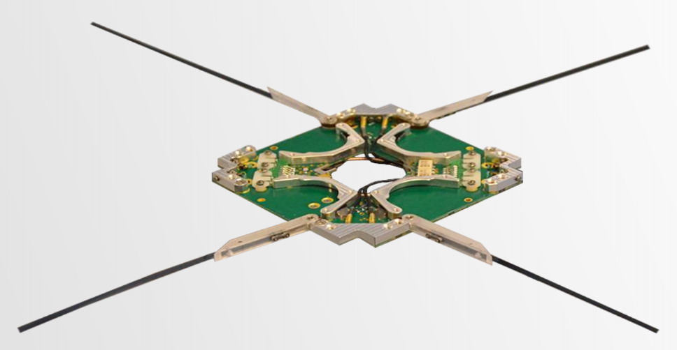
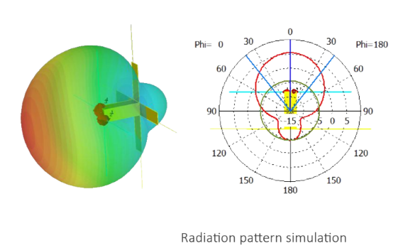
Chosen Antenna : Spacecraft
ISIS deployable antenna
77-85g depending on configuration
Antenna length : UHF : 17cm VHF : 55cm
Nominal power consumption : < 40 mW
Operational temperature range : -20° to +60°C
Turnstyle
Works in UHF and VHF communications
Automated sequential deployment
Individual antenna element deployment
IV. Components

Slide 9
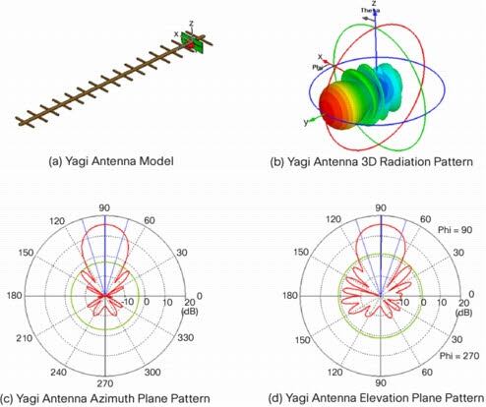
Ground stations Antenna
Supaero and Kourou : Yagi Antenna
Multiband antenna
Radioamateur bands
IV. Components

Slide 10
Conclusion
Link Margin
Kourou -> ToloSat : 46.6 dB
Supaero -> ToloSat : 38.6 dB
ToloSat -> Ground Station : 20.1 dB
With error : +/- 3dB
V. Conclusion

Slide 11
References
Jorge Cantero Gómez, Communication link design at 437.5 MHz for a nanosatellite, Aalto University

