Slide 1
Computer Science 425
Distributed Systems
(Fall 2009)
Lecture 5
Multicast Communication
Reading: Section 12.4
Klara Nahrstedt

Slide 2
Acknowledgement
The slides during this semester are based on ideas and material from the following sources:
  Slides prepared by Professors M. Harandi, J. Hou, I. Gupta, N. Vaidya, Y-Ch. Hu, S. Mitra.
  Slides from Professor S. Gosh’s course at University o Iowa.

Slide 3
Administrative
Homework 1 posted
  Deadline, September 17 (Thursday)
MP1 posted today
  Deadline, September 25, Friday

Slide 4
Plan for Today
Reliable Multicast
Ordered Multicast
  Total ordering
  Causal ordering
  FIFO ordering

Slide 5
Reliable Multicast
Integrity: A correct (i.e., non-faulty) process p in a group(m) delivers a multicast message m at most once.
  Safety property: any message delivered is identical to the one that was sent
Validity: If a correct process multicasts (sends) message m, then it will eventually deliver m.
  Guarantees liveness to the sender.
  Liveness property: any message is eventually delivered to destination
Agreement: If a correct process delivers message m, then all the other correct processes in group(m) will eventually deliver m.
  Property of “all or nothing.”
  Validity and agreement together ensure overall liveness: if some correct process multicasts a message m, then all correct processes deliver m too.

Slide 6
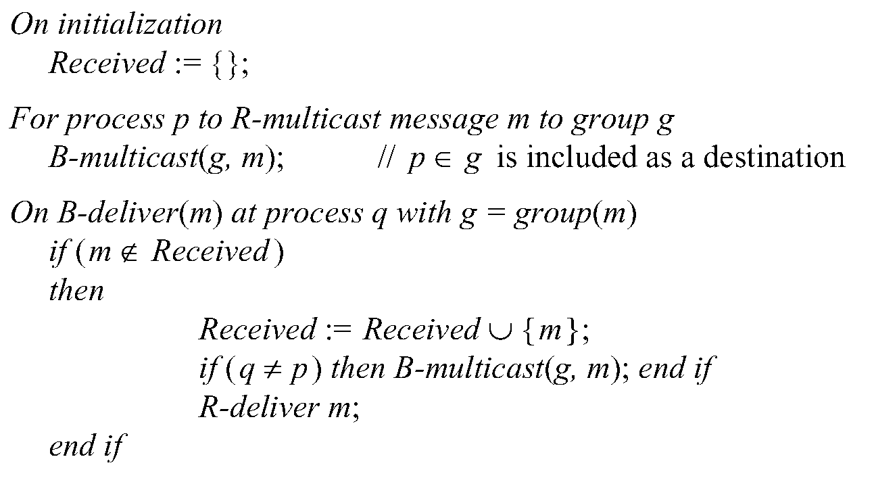
Reliable Multicast Algorithm
R-multicast
“USES”
B-multicast
“USES”
reliable unicast

Slide 7
Reliable Multicast Algorithm (R-multicast)
Integrity
Agreement
Integrity, Validity
  if some correct process B-multicasts a message m, then,
  all correct processes deliver m too. If no correct process
  B-multicasts m, then no correct processes deliver m.

Slide 8
Ordered Multicast
FIFO ordering: If a correct process issues multicast(g,m) and then multicast(g,m’), then every correct process that delivers m’ will have already delivered m.
Causal ordering: If multicast(g,m) → multicast(g,m’) then any correct process that delivers m’ will have already delivered m.
Total ordering: If a correct process delivers message m before m’, then any other correct process that delivers m’ will have already delivered m.

Slide 9
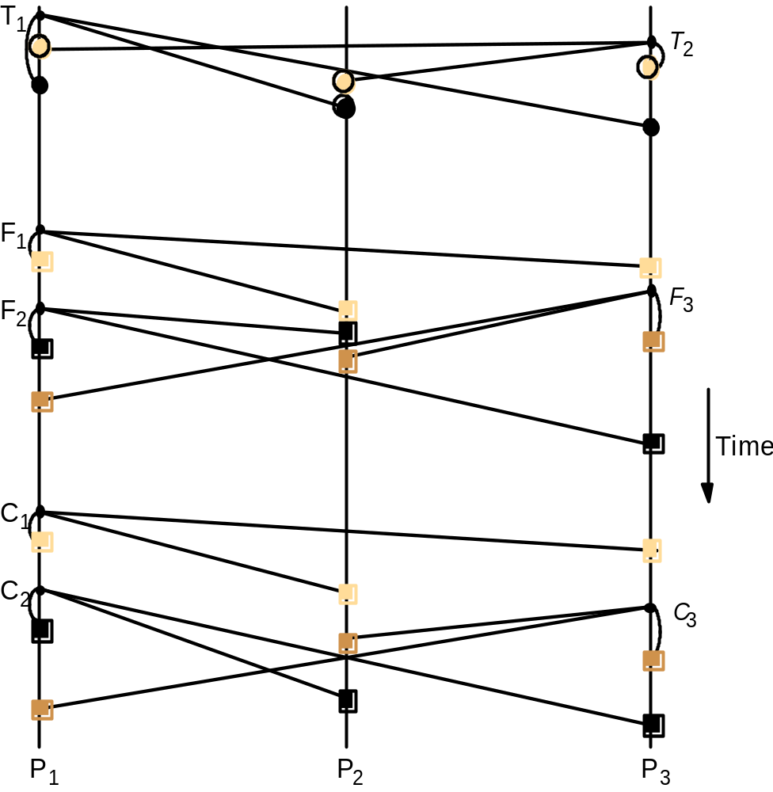
Total, FIFO and Causal Ordering
Totally ordered messages T₁ and T₂.
FIFO-related messages F₁ and F₂.
Causally-related messages C₁ and C₃
Causal ordering implies FIFO ordering
Total ordering does not imply causal ordering.
Causal ordering does not imply total ordering.
Hybrid mode: causal-total ordering, FIFO-total ordering.
Totally-ordered
FIFO-ordered
Causal-
ordered

Slide 10
Example: Display From Bulletin Board
Program
User 1
Post to Bulletin Board
User 2
Bulletin board:
os.interesting
Post to Bulletin Board
Item
From
Subject
23
A.Hanlon
Mach
24
G.Joseph
Microkernels
25
A.Hanlon
Re: Microkernels
26
T.L’Heureux
RPC performance
27
M.Walker
Re: Mach
end
What is the most appropriate ordering for this application?
(a) FIFO (b) causal (c) total

Slide 11
FIFO-ORDERED MULTICAST

Slide 12
Providing Ordering Guarantees (FIFO)
Process messages from each process in the order they were sent:
  Each process keeps a sequence number for each other process.
  Messages are sent with local sequence number
  When a message is received,
  as expected (next sequence), accept
higher than expected, buffer in a queue
  lower than expected, reject
If Message# is

Slide 13
Hold-back Queue for Arrived Multicast
Messages: received yet undelivered messages
Message
processing
FO-deliver
deliver
Hold-back
queue
Delivery queue
When delivery
guarantees are
met
Incoming
messages

Slide 14
Implementing FIFO Ordering (FIFO-ordered multicast)
S^{p}_{g}: count of messages p has sent to g.
R^{q}_{g}: the recorded sequence number of the latest message that p has delivered from q to the group g.
For p to FO-multicast m to g
  p increments S^{p}_{g} by 1
  p “piggy-backs” the value S^{p}_{g} onto the message.
  p B-multicasts m to g.
At process p, upon receipt of m from q with sequence number S:
  p checks whether S= R^{q}_{g}+1. If so, p FO-delivers m and increments R^{q}_{g}
  If S > R^{q}_{g}+1, p places the message in the hold-back queue until the intervening messages have been delivered and S= R^{q}_{g}+1.
  If S < R^{q}_{g}+1, then drop the message (we have already seen the message)

Slide 15
Example: FIFO Multicast
(do NOT confuse with vector timestamps)
Physical Time
Reject: 1 < 1 + 1
Accept: 2 = 1 + 1
P1
1 0 0
2 0 0
2 1 0
2 1 0
0 0 0
1
2
2
1
1
1
P2
0 0 0
1 0 0
2 0 0
2 1 0
Accept
1 = 0 + 1
Reject: 1 < 1 + 1
1
P3
0 0 0
0 0 0
1 0 0
2 1 0
2 0 0
Accept 1 = 0 + 1
2 0 0
Accept: 1 = 0 + 1
Buffer 2 > 0 + 1
Accept Buffer
2 = 1 + 1
0 0 0
Sequence Vector for P1
0 0 0
Sequence Vector for P2
S¹_{g}
R²_{g}
R³_{g}
R¹_{g}
S²_{g}
R³_{g}

Slide 16
CAUSAL-ORDERED MULTICAST

Slide 17
Causal Multicast
Let us focus on multicast group g
Each process iєg maintains a vector V^{g}_{i} of length |g| where
  V^{g}_{i}[j] counts the number of group g messages from j to i
Messages multicast by process i are tagged with the vector timestamp V^{g}_{i}
Recall rule for receiving vector timestamps
  Max(V_{receiver}[j] , V_{message}[j]), if j is not self
  V_{receiver}[j] + 1 otherwise
i.e. when process i receives a <m,V^{g}_{j}> from j, then
  V^{g}_{i}[k] = max(V^{g}_{i}[k], V^{g}_{j}[k]) if k ≠ i
  V^{g}_{i}[k] = V^{g}_{i}[k] + 1 if k = i
Remember V(a) < V(b) iff a happens before b
V_{receiver}[j] =

Slide 18
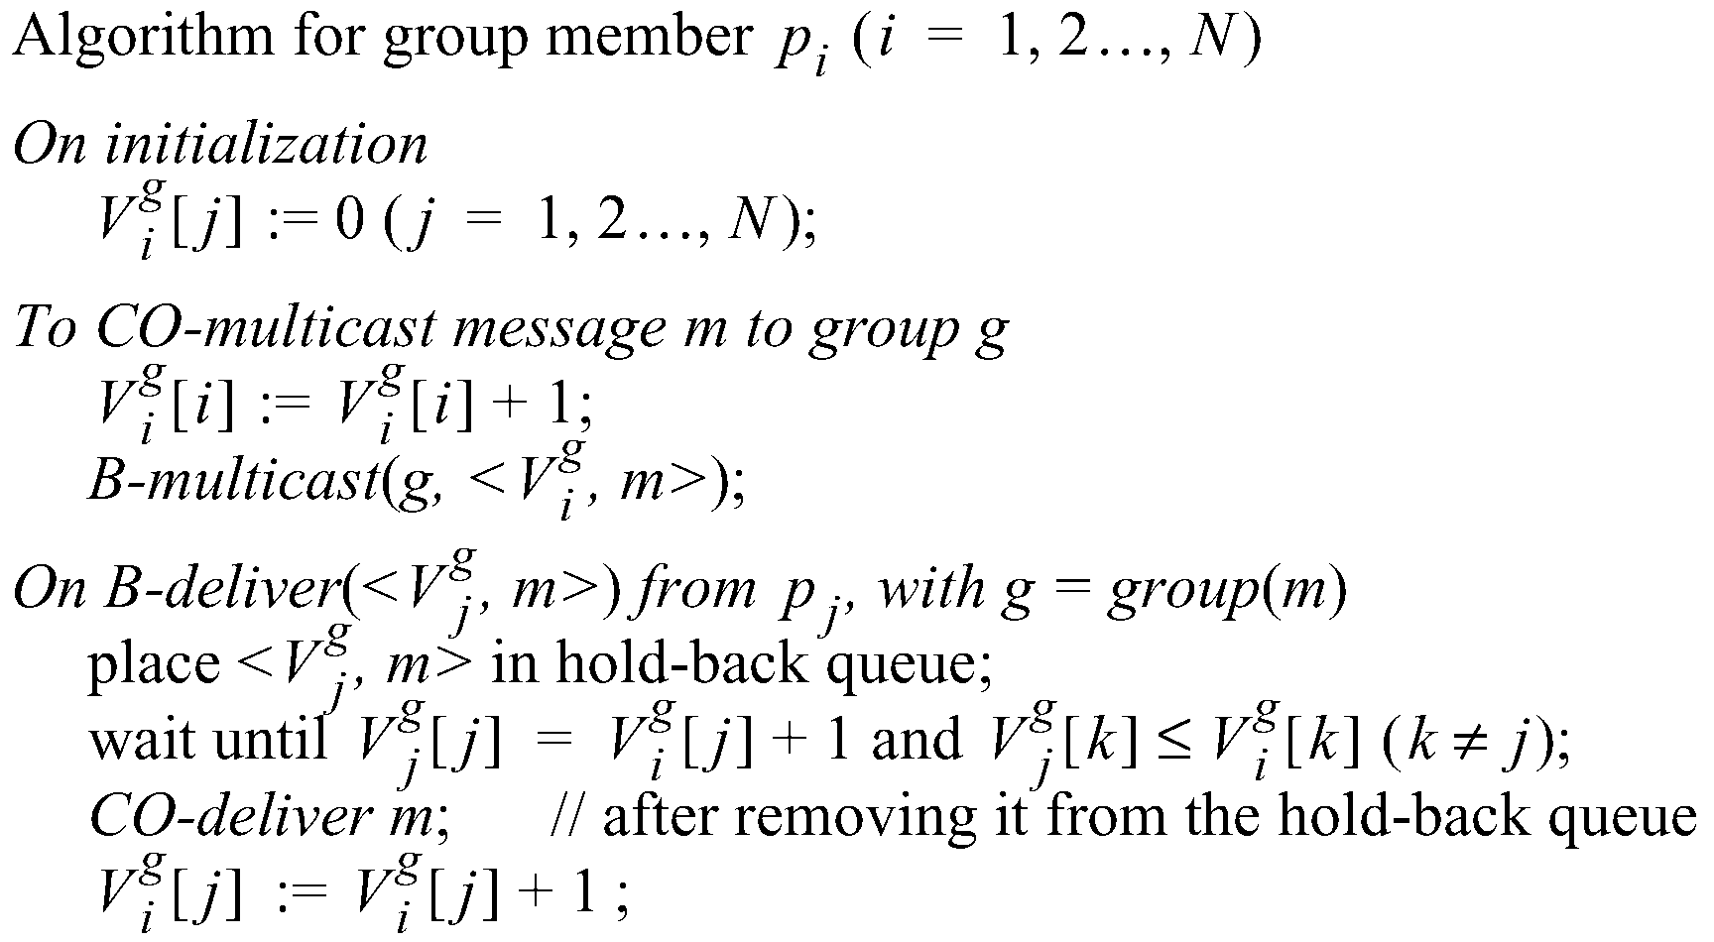
Causal Ordering using vector timestamps
The number of group-g messages
from process j that have been seen at
process i so far
Guarantees
Causal ordering

Slide 19
Example: Causal Ordering Multicast
Reject:
Accept
P1
1,0,0
1,1,0
1,1,0
0,0,0
(1,0,0)
(1,1,0)
(1,1,0)
P2
0,0,0
1,0,0
1,1,0
(1,1,0)
(1,0,0)
P3
0,0,0
1,0,0
1,1,0
1,1,0
Accept
Accept
Accept Buffered message
Buffer
missing P1(1)
(1,1,0) >(1,0,0)
Physical Time

Slide 20
TOTAL-ORDERED MULTICAST

Slide 21
1st Method - Using Sequencer
Delivery algorithm similar to FIFO
Except that processes maintain group specific sequence number (as opposed to process specific sequence number)
Sender attaches unique id ‘i’ to each message m and sends <m,i> to the sequencer(g) as well as to group g
Sequencer maintains group specific sequence number S_{g} (consecutive and increasing) and B-multicasts order messages to g

Slide 22
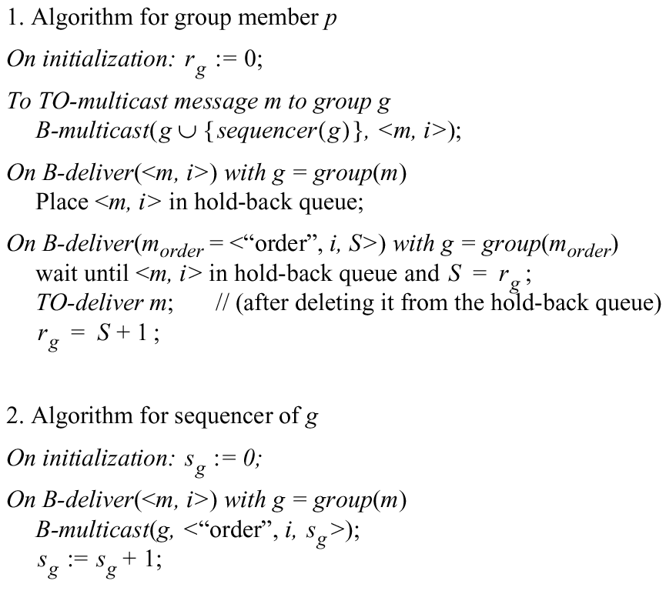
Total Ordering Using a Sequencer (Method 1)
P1
sequencer
<m,i>
unique msg id
S_{g}
, S_{g}+1
<m,i>
<m,i>
<order, i, S_{g}>
<order, i, S_{g}>
P2
P3
rg
rg
Group g: P1, P2, P3
Sequencer (g) :
Single point of failure
Bottleneck

Slide 23
2nd Method - ISIS Algorithm
Processes collectively agree on sequence numbers (priority) in three rounds
Sender sends message m with its id to all receivers;
Receivers suggest priority (sequence number) and reply to sender with proposed priority;
Sender collects all proposed priorities; decides on final priority (breaking ties with process ids), and resends the agreed final priority for message m
Receivers deliver message m according to decided final priority

Slide 24
ISIS algorithm for total ordering (Method 2)
P
2
1 Message
3
2
P
2
2 Proposed Seq
4
1
3 Agreed Seq
1
2
P
Group g: P1, P2, P3, P4
1
3
P
3

Slide 25
ISIS algorithm for total ordering
sender p B-multicasts <m,i> with message m and unique id i to everyone.
On receiving m (first time)
  m is added to a priority queue and tagged as undeliverable
  reply to sender with proposed priority, i.e., a sequence number
    seq number = 1 + largest seq number heard so far, suffixed with the recipient’s process ID
  priority queue is always sorted by priority
Sender
  collects all responses from the recipients,
  calculates their maximum, and
  re-multicasts (B-multicast) original message with this as the final priority for m
On receiving m (with final priority)
  mark the message as deliverable,
  reorder the priority queue, and
  deliver the set of lowest priority messages that are marked as deliverable.

Slide 26
Proof of Total Order (By Contradition)
For m₁, consider the first process p that delivers m₁
  At p, let m₁ have the agreed sequence number (finalpriority(m₁)) and marked deliverable (at the front of the hold-back priority queue)
  Let m₂ be another message that has not yet been delivered
    i.e., m₂ is on the same queue (it has not been assigned its sequence number) or has not been seen yet by p
  Then
    finalpriority(m₂) ≥ proposedpriority(m₂) due to: “max” operation at sender &
    proposedpriority(m₂) ≥ final priority (m₁) due to: proposed priorities by p only increase (m₁ is ahead of the queue)
Suppose there is some other process q that delivers m₂ before it delivers m₁. Then at q
  Finalpriority(m1) ≥ proposedpriority(m1) ≥ finalpriority (m2)
Contradiction !

Slide 27
Summary
Multicast is operation of sending one message to multiple processes
  Basic multicast
    Uses reliable unicast
    Guarantees integrity, validity but not agreement
  Reliable multicast
    Uses basic multicast
    Guarantees agreement (no ordering)
Ordering – FIFO, total, causal
  FIFO-multicast uses sequence number for each process and a queue
  Causal-multicast uses vector time stamps
  Total order- multicast uses a sequencer or agreement on sequence numbers

