Slide 1
Computer Science 425
Distributed Systems
CS 425 / ECE 428
Spring 2014
Multicast
© 2013, I. Gupta, K. Nahrtstedt, S. Mitra, N. Vaidya, M. T. Harandi, J. Hou

Slide 2
Communication Modes in Distributed System
Unicast
  Messages are sent from exactly one process to one process.
  Best effort: if a message is delivered it would be intact; no reliability guarantees.
  Reliable: guarantees delivery of messages.
Broadcast
  Messages are sent from exactly one process to all processes on the network.
  Broadcast protocols are not practical.
Multicast
  Messages broadcast within a group of processes.
  A multicast message is sent from any one process to the group of processes on the network.
  Reliable multicast can be implemented “above” (i.e., “using”) a reliable unicast.
    This lecture!

Slide 3
What’re we designing in this class
Application
(at process p)
One process p
send
multicast
deliver
multicast
(upcall)
MULTICAST PROTOCOL
Incoming
messages

Slide 4
Basic Multicast (B-multicast)
Let’s assume the all processes know the group membership
A straightforward way to implement B-multicast is to use a reliable one-to-one send (unicast) operation:
  B-multicast(group g, message m):
  for each process p in g, send (p,m).
  receive(m): B-deliver(m) at p.
A “correct” process= a “non-faulty” process
A basic multicast primitive guarantees a correct process will eventually deliver the message, as long as the sender (multicasting process) does not crash.
  Can we provide reliability even when the sender crashes (after it has sent the multicast)?

Slide 5
Reliable Multicast
Integrity: A correct (i.e., non-faulty) process p delivers a message m at most once.
Validity: If a correct process multicasts (sends) message m, then it will eventually deliver m itself.
  Guarantees liveness to the sender.
Agreement: If some one correct process delivers message m, then all other correct processes in group(m) will eventually deliver m.
  Property of “all or nothing.”
  Validity and agreement together ensure overall liveness: if some correct process multicasts a message m, then, all correct processes deliver m too.

Slide 6
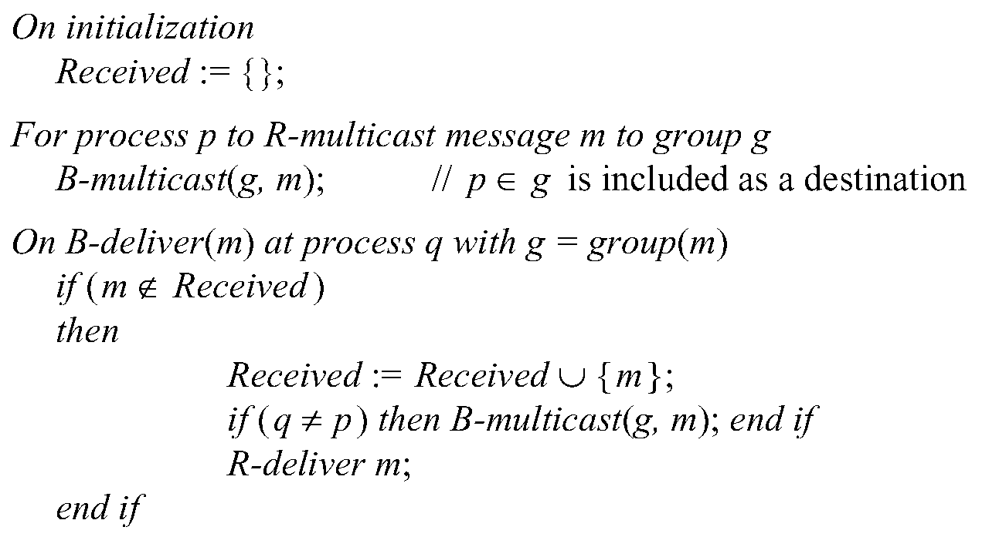
Reliable R-Multicast Algorithm
R-multicast
“USES”
B-multicast
“USES”
reliable unicast

Slide 7
Reliable Multicast Algorithm (R-multicast)
Integrity
Agreement
Integrity, Validity
  if some correct process B-multicasts a message m, then,
  all correct processes R-deliver m too. If no correct process
  B-multicasts m, then no correct processes R-deliver m.

Slide 8
What about Multicast Ordering?
FIFO ordering: If a correct process issues multicast(g,m) and then multicast(g,m’), then every correct process that delivers m’ will have already delivered m.
Causal ordering: If multicast(g,m) → multicast(g,m’) then any correct process that delivers m’ will have already delivered m.
Total ordering: If a correct process delivers message m before m’ (independent of the senders), then any other correct process that delivers m’ will have already delivered m.

Slide 9
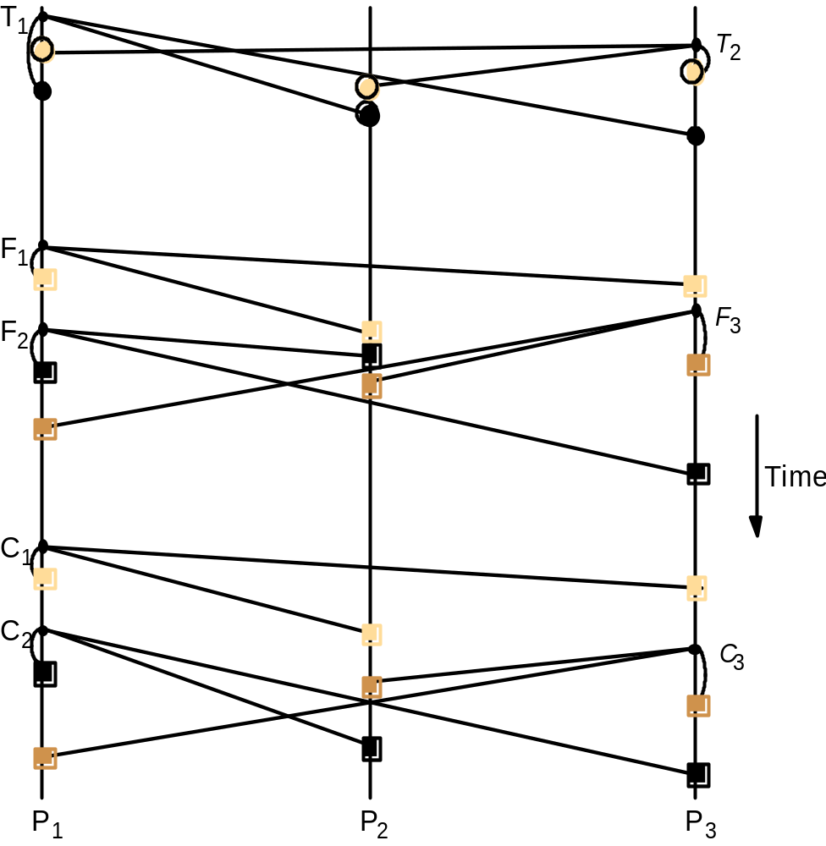
Total, FIFO and Causal Ordering
Totally ordered messages T₁ and T₂.
FIFO-related messages F₁ and F₂.
Causally related messages C₁ and C₃
Causal ordering implies FIFO ordering (why?)
Total ordering does not imply causal ordering.
Causal ordering does not imply total ordering.
Hybrid mode: causal-total ordering, FIFO-total ordering.

Slide 10
Display From Newsgroup
Newsgroup:
os.interesting
Item
From
Subject
23
A.Hanlon
Mach
24
G.Joseph
Microkernels
25
A.Hanlon
Re: Microkernels
26
T.L’Heureux
RPC performance
27
M.Walker
Re: Mach
end
What is the most appropriate ordering for this application?
(a) FIFO (b) causal (c) total

Slide 11
Providing Ordering Guarantees (FIFO)
Look at messages from each process in the order they were sent:
  Each process keeps a sequence number for each other process (vector)
  When a message is received,
  as expected (next sequence), accept
higher than expected, buffer in a queue
  lower than expected, reject
If Message# is

Slide 12
Implementing FIFO Ordering
S^{p}_{g}: the number of messages p has sent to g.
R^{q}_{g}: the sequence number of the latest group-g message that p has delivered from q (maintained for all q at p)
For p to FO-multicast m to g
  p increments S^{p}_{g} by 1.
  p “piggy-backs” the value S^{p}_{g} onto the message.
  p B-multicasts m to g.
At process p, Upon receipt of m from q with sequence number S:
  p checks whether S= R^{q}_{g}+1. If so, p FO-delivers m and increments R^{q}_{g}
  If S > R^{q}_{g}+1, p places the message in the hold-back queue until the intervening messages have been delivered and S= R^{q}_{g}+1.
  If S < R^{q}_{g}+1, reject m

Slide 13
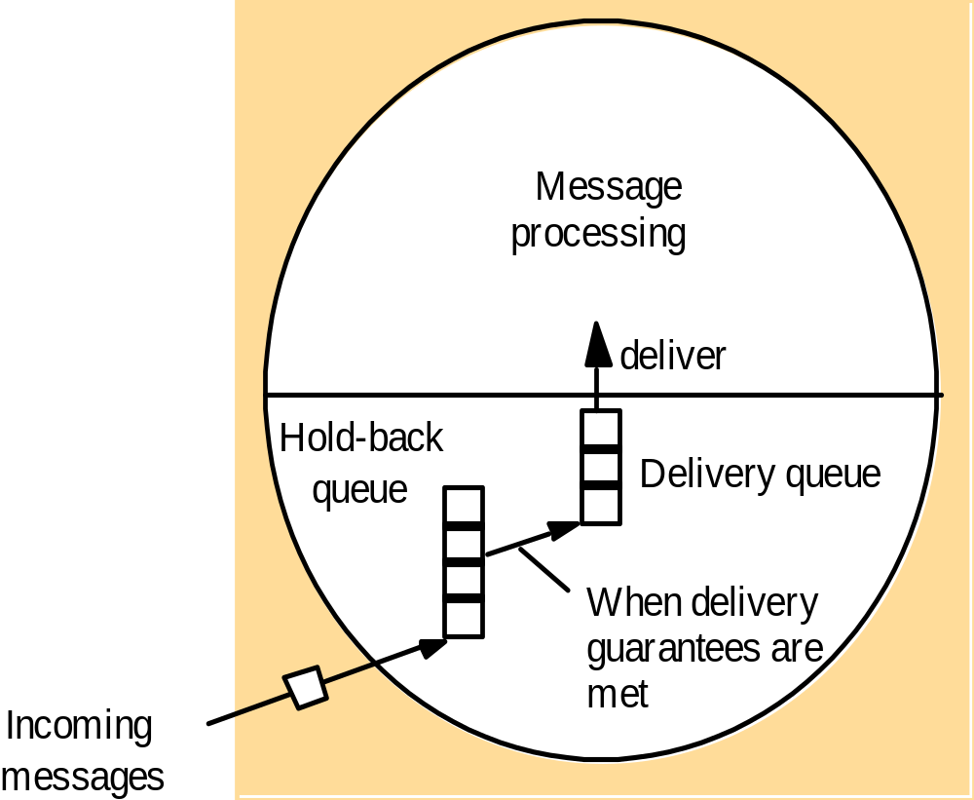
Hold-back Queue for Arrived Multicast
Messages

Slide 14
Example: FIFO Multicast
(do NOT confuse with vector timestamps)
“Accept” = Deliver
Physical Time
Reject: 1 < 1 + 1
Accept: 2 = 1 + 1
P1
1 0 0
2 0 0
2 1 0
2 1 0
0 0 0
1
2
2
1
1
1
P2
0 0 0
1 0 0
2 0 0
2 1 0
Accept 1 = 0 + 1
Reject: 1 < 1 + 1
1
P3
0 0 0
0 0 0
1 0 0
2 1 0
2 0 0
Accept 1 = 0 + 1
2 0 0
Accept: 1 = 0 + 1
Buffer 2 > 0 + 1
Accept Buffer 2 = 1 + 1
0 0 0
Sequence Vector

Slide 15
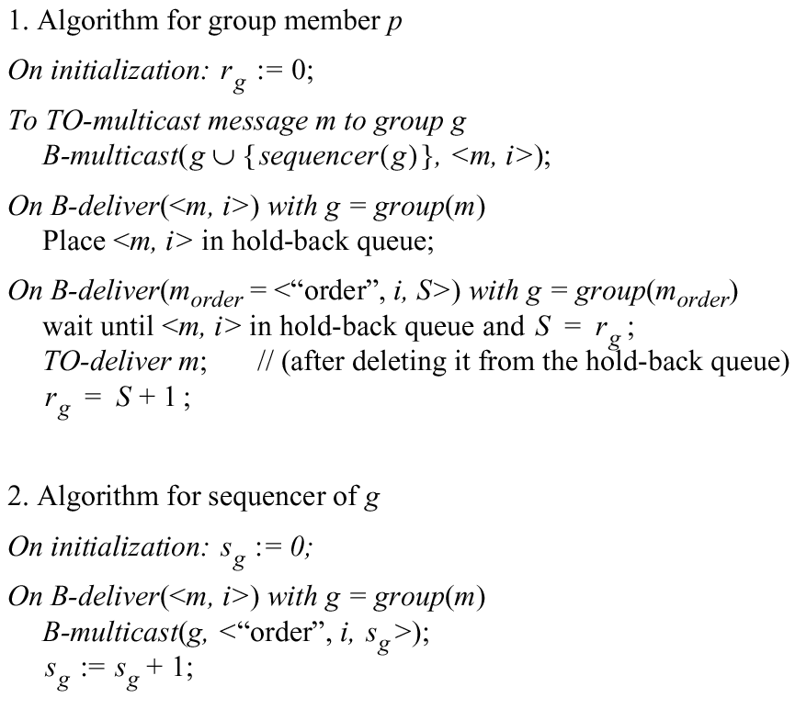
Total Ordering Using a Sequencer
Sequencer = Leader process

Slide 16
ISIS: Total ordering without sequencer
P
2
1 Message
3
2
P
2
2 Proposed Seq
4
1
3 Agreed Seq
1
2
P
1
3
P
3

Slide 17
ISIS algorithm for total ordering
The multicast sender multicasts the message to everyone.
Recipients add the received message to a special queue called the priority queue, tag the message undeliverable, and reply to the sender with a proposed priority (i.e., proposed sequence number). Further, this proposed priority is 1 more than the latest sequence number heard so far at the recipient, suffixed with the recipient's process ID. The priority queue is always sorted by priority.
The sender collects all responses from the recipients, calculates their maximum, and re-multicasts original message with this as the final priority for the message.
On receipt of this information, recipients mark the message as deliverable, reorder the priority queue, and deliver the set of lowest priority messages that are marked as deliverable.

Slide 18
Proof of Total Order
For a message m1, consider the first process p that delivers m1
At p, when message m1 is at head of priority queue
Suppose m2 is another message that has not yet been delivered (i.e., is on the same queue or has not been seen yet by p)
finalpriority(m2) >=
proposedpriority(m2) >
finalpriority(m1)
Suppose there is some other process p’ that delivers m2 before it delivers m1. Then at p’,
finalpriority(m1) >=
proposedpriority(m1) >
finalpriority(m2)
a contradiction!
Due to “max” operation at sender
and since proposed priorities by process p only increase
Since queue ordered by increasing priority
Due to “max” operation at sender
Since queue ordered by increasing priority

Slide 19
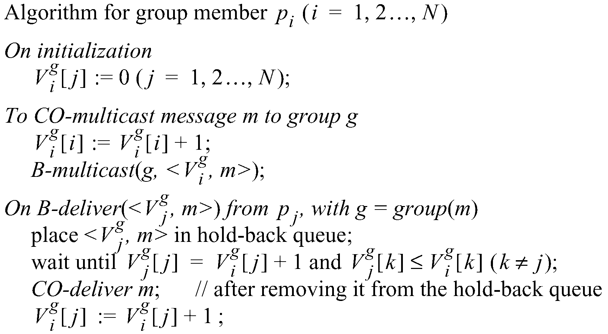
Causal Ordering using vector timestamps
The number of group-g messages
from process j that have been seen at
process i so far

Slide 20
Example: Causal Ordering Multicast
Reject:
Accept
P1
1,0,0
1,1,0
1,1,0
0,0,0
(1,0,0)
(1,1,0)
(1,1,0)
P2
0,0,0
1,0,0
1,1,0
(1,1,0)
(1,0,0)
P3
0,0,0
1,0,0
1,1,0
1,1,0
Accept
Accept:
Accept Buffered message
Buffer, missing P1(1)
Physical Time

Slide 21
Summary
Multicast is operation of sending one message to multiple processes in a given group
Reliable multicast algorithm built using unicast
Ordering – FIFO, total, causal

