Slide 1
Taiwan Weather
電機四乙10828241陳大荃

Slide 2
OUTLINE
Introduction
System Architecture
Features
Program Flow
Result
Video

Slide 3
INTRODUCTION

Slide 4






SYSTEM ARCHITECHTURE
SpeechSynthesis

Slide 5
FEATURES
Full feature of individual APIs.
Backup solution if APIs are down.
Present the latest data.
Read user-selected item.
Scalable code structure.
Can reset to resolve unexpected issues or errors.
Flexible UI.

Slide 6
PROGRAM FLOW - INITIALIZE
Load Resources
Initialize Webpage
Wait for Event
DB Content Illegal
T
API Down
Initialize Sources
Request API Update DB
S
F
F
T
Initialize Reader Elements
DB Content Outdated
T
E
Request DB
F
Initialize API Elements

Slide 7
PROGRAM FLOW - EVENT
API Location and Item Selected
Extract Value from Data
Update Element
Reader Available
T
Read Value

Slide 8
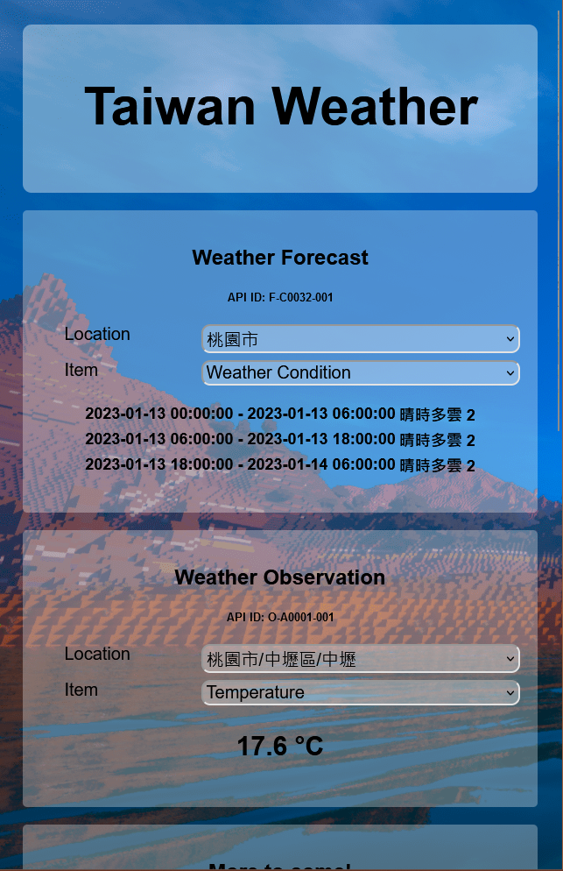
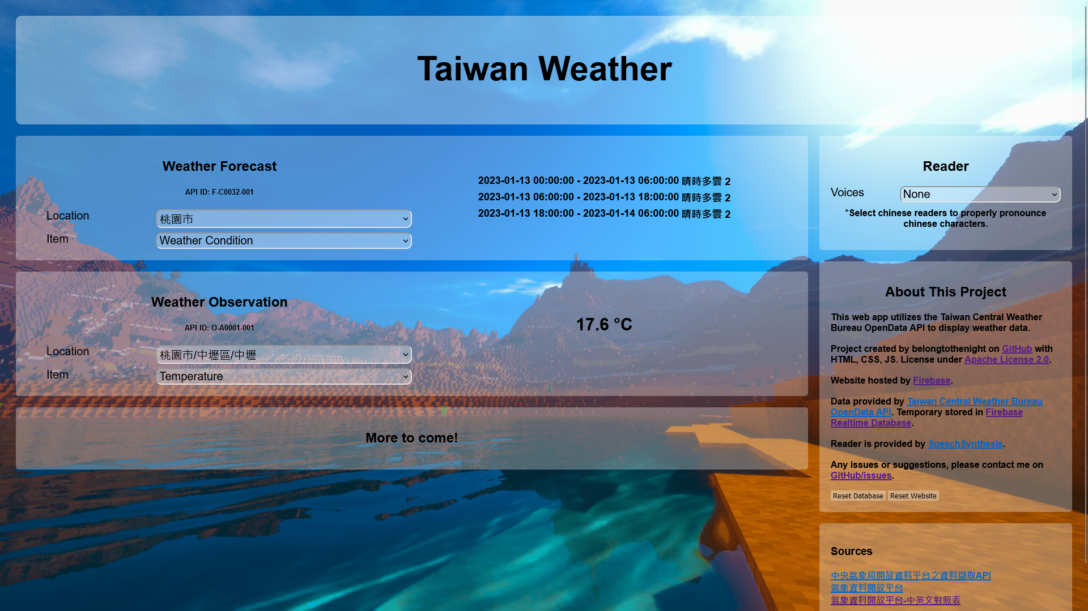
RESULTS
Horizontal UI Display
Vertical UI Display

Slide 9
VIDEO

