Slide 1
My world in frames
By Iliyana Vitanova
and Beloslava Nedelcheva

Slide 2
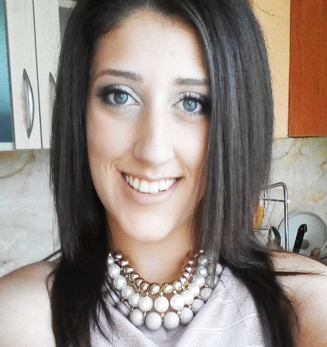
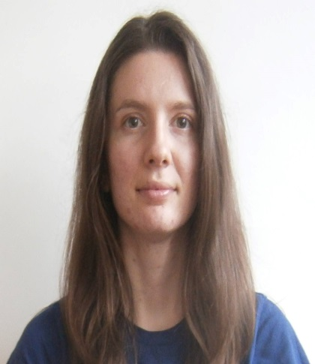
Who are we?
Iliyana Vitanova
Beloslava
Nedelcheva

Slide 3
What did we do?
We have done a web application for people who want to share their pictures with others.
It is also a good place to view different memories and great pictures from many people.
When you want to see a good photography you can see it in our page.

Slide 4
What does it do?
It helps people to share photos.
It is great to explore new photos.
You can write comments for the posts you like.
You can like/dislike photos and comments.
You can see posts from different categories.
You can see the 10 most liked posts from our page.
You can follow people.
You can see posts from your followed users.

Slide 5
What technologies does it use?
Back-End
Spring
MySQL
JDBC
Front-End
HTML
CSS
JavaScript
JQuery

Slide 6
Future plans
Make the project more secure and faster.
Add chat
Add more fields.
Improve the design.

Slide 7
Thank you for your attention!

