Slide 1
The Chip Design “Agent” Engineer of the Future - Between Ambition and Reality
Sandro Belfanti, Summer School 2025, Villach

Slide 2
Outline
Who I am & Why I care
AI Agents for RTL: Where are we now?
Where are we headed?
The engineer of the future
Skills and ways of working

Slide 3

Who I am & Why I Care
Background
Studied & PhD in Zurich
Digital design, signal processing, and AI
Semiconductor Industry
OnSemi, then Infineon
Digital design for wireless communication
10+ years of experience, 20+ tape-outs
Chipmind
Founded in 2025, CTO
Mission: Let AI do the Chips
Building autonomous AI agents for digital chip design.

Slide 4
How Do We Know Where We Are?
We need a way to measure AI’s ability
Solution: benchmarks (collections of curated design & verification tasks)
NVIDIA CVDP (Comprehensive Verilog Design Problems)
783 tasks
13 categories (RTL generation, verification, debugging, spec alignment…)
Authored by experienced hardware engineers
Evaluates both one-shot prompts and multi-step agent workflows - mini designs with a few files.
Datasets on huggingface, github repo for runners
Comprehensive Verilog Design Problems: A Next-Generation Benchmark Dataset for Evaluating Large Language Models and Agents on RTL Design and Verification Nathaniel Pinckney et al. June 2025

Slide 5
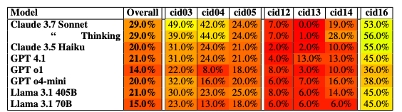
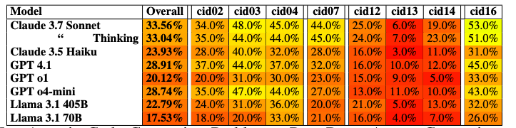
CVDP Results
What works
Debugging / Bug fixing (cid16)
Spec-to-RTL (cid03) and RTL modification (cid04)
And what doesn’t
Verification
cid12 testbench stimulus generation
cid13 testbench checker generation
cid14 assertion generation
Agentic Results
Non-agentic Results
All results from https://arxiv.org/pdf/2506.14074v1

Slide 6
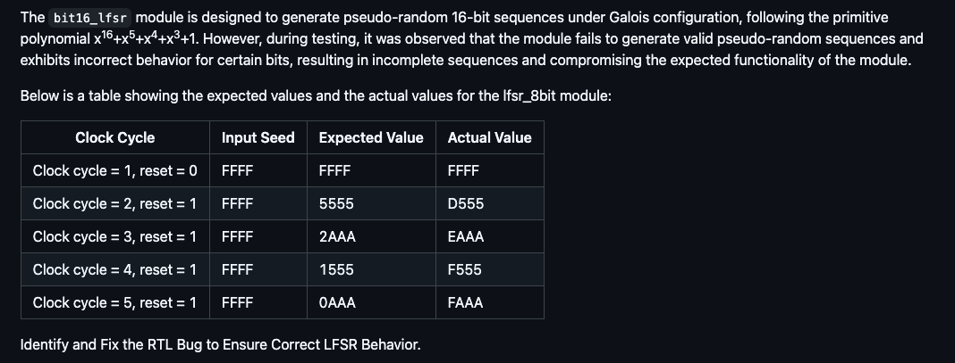
A Closer Look - We can Solve Easy Bugfix Tasks

Slide 7
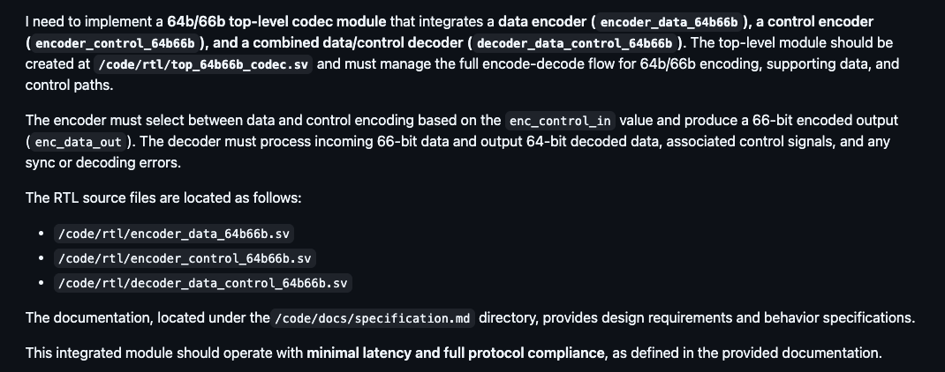
A Closer Look - What does spec to RTL look like?

Slide 8
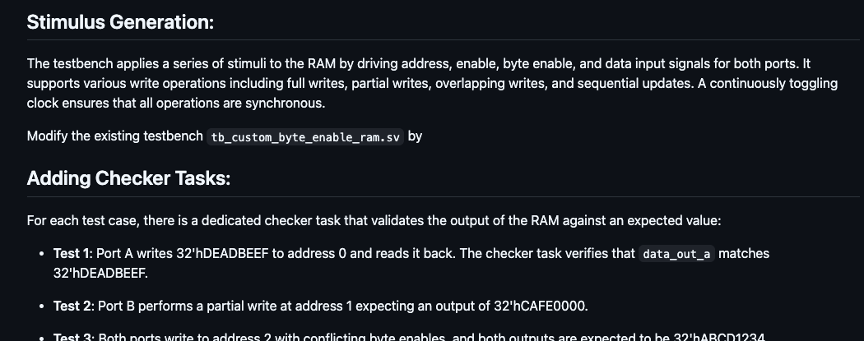
A Closer Look - Verification is Challenging

Slide 9
What is next - Autonomy Levels
Self driving cars? It’s not that simple.
Learning from autonomous driving
Autonomy Levels
Level | Name | Description
0 | No Automation | Driver does everything
1 | Driver Assistance | Single function (cruise control, lane keeping, parking assistant)
2 | Partial Automation | Combined functions, but human must monitor (Tesla Autopilot)
3 | Conditional Automation | Car drives itself under certain conditions, human fallback required
4 | High Automation | Fully autonomous in defined scenarios
5 | Full Automation | Car drives everywhere, under all conditions, without human intervention

Slide 10
Autonomy Levels for Digital Design
What could autonomy levels look like for digital design?
Level | Function | Description
1 | HDL Co-Pilot
2 | Task Agent | AI autonomously completes a specific design or verification task
3 | Design Agent | AI can create, modify, and integrate design elements based on provided requirements, making localized design decisions while still operating within a human-defined architecture.
4 | Decision-Making Design Agent | AI can make architectural decisions, generate entiere modules, interpret high-level goals without explicit human step-by-step direction.
5 | Agent Engineers | Fully autonomous AI capable of inventing architectures and optimizing the design process itself

Slide 11

The Agent Engineer of the Future
Imagine:
We have AI agents that can work somewhat independently.
Agents handle most design & verification tasks
What remains for us?
Will our skills need to change?
Will our focus have to shift?
(Image generated by ChatGPT)

Slide 12
Core Skills - Left Shift or Completely New Way of Working?
Left Shift
Same skills, but needed earlier, different focus
Communication, decomposition = today’s lead skills
With agents, juniors need them from day one
New Way
New practices emerge
Prompting, context engineering, guiding agent workflows
Daily human–agent collaboration = a new discipline

Slide 13
Core Skill - Communication
Interfacing with LLMs is not that different from interfacing with colleagues
Writing clear, unambiguous specifications
Providing enough context
Structuring and splitting problem
Documenting assumptions, interfaces, and constraints
Explaining design intent
But there are new aspects
Prompting: framing tasks for LLMs in precise, testable ways
Context engineering: selecting relevant files, signals, specs to feed into an agent
Iterative refinement: guiding an agent through multiple improvement loops

Slide 14
Core Skill - Judgement and Critical Thinking
Familiar Skills, Needed Earlier
Reviewing design options and trade-offs
Spotting inconsistencies or missing corner cases
Balancing short-term fixes vs. long-term maintainability
Knowing when to escalate or dig deeper
Applying engineering intuition to ambiguous requirements
AI-Specific Critical Thinking - Know your tools and their limitations
Know your tools (the agents) and their limitations
Know when NOT to use AI
Distinguishing between plausible-sounding vs. correct AI output
Differentiate prompting issues from agent limitations
Deciding when to trust automation and when to intervene manually

Slide 15
Between Ambition and Reality - Summary
Where we are today
Ambition: “One prompt, one chip”
Benchmarks show strengths in bugfix & spec-to-RTL and hugh promise.
Frameworks for progress
Autonomy levels (driving analogy → chip design levels)
The Agent Engineer of the Future
Working with new tools requires new skills, but
Are these just senior skills earlier (left shift)… or entirely new skills (new approach)?

Slide 16

Questions and Answers
linkedin.com/in/sandrobelfanti chipmind.ai
(Image generated by ChatGPT)

