Slide 1

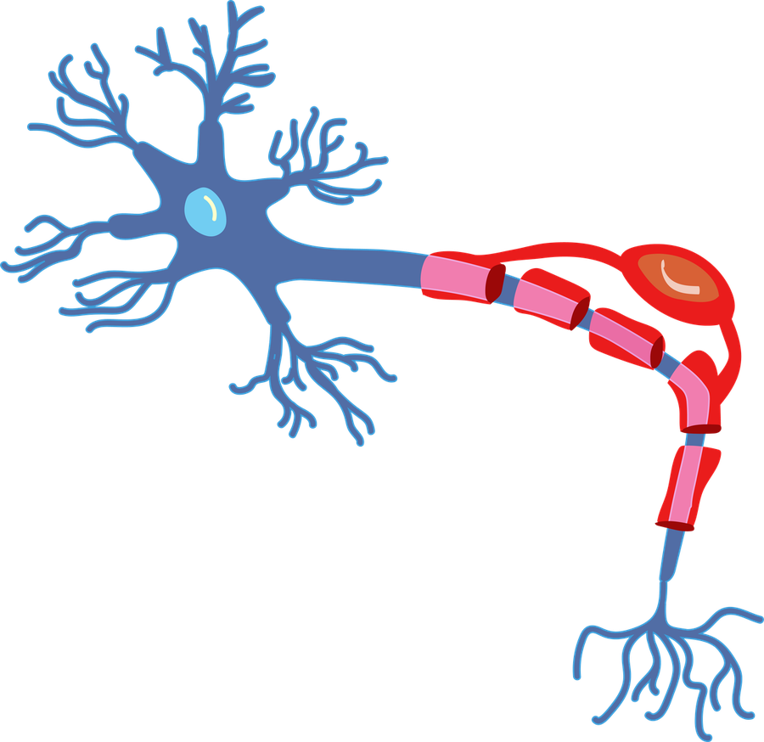
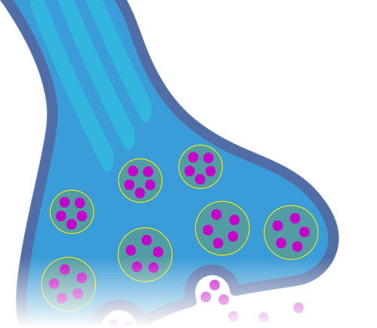
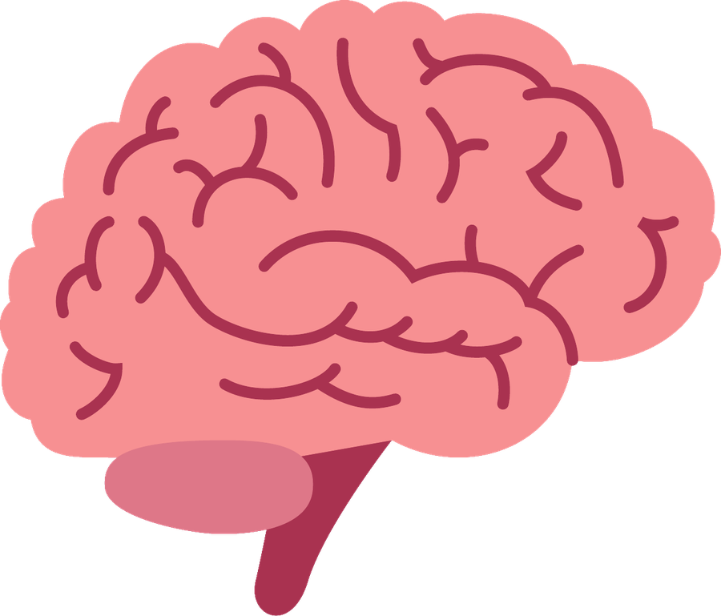
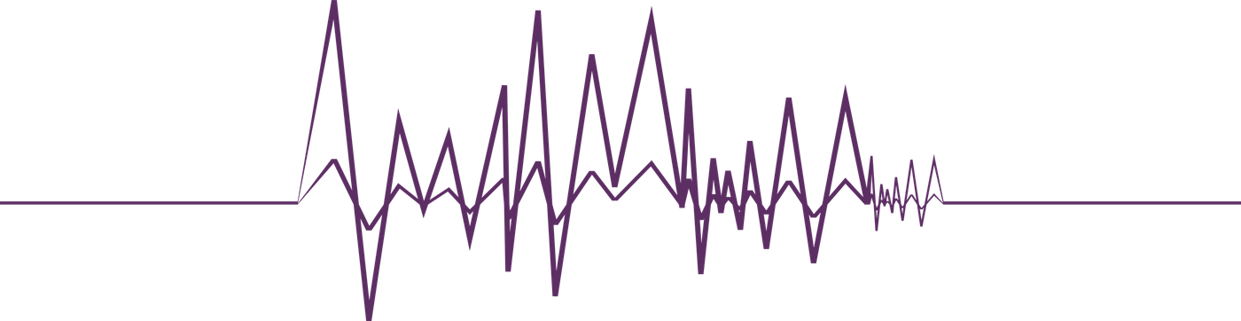


Epileptic
Seizure
Prediction
Deep learning on EEG signals
Belsem Jemai & Mohamed Ramez Mabrouk
Supervised by Dr. Asma Baghdadi
ENIT · 3ATEL1.DSIC · 2026-2027
Reproduction and adaptation of Georgis-Yap, Popovic & Khan (2024)
Notes:
[0:20] Good morning everyone. We are Belsem and Mohamed, third-year telecommunications engineering students at ENIT, supervised by Dr. Asma Baghdadi. Our project is 'track B': predicting epileptic seizures a few minutes before they happen, using deep learning on EEG signals. It is a reproduction and adaptation of the 2024 paper by Georgis-Yap, Popovic and Khan.

Slide 2

Why Predict Seizures?
Unpredictable by nature
Epilepsy affects about 50 million people worldwide (WHO).
Prediction horizon
30–60 min
reference paper
5 min
this project (short horizon)
Our target
Tell the preictal state (just before a seizure) from normal interictal EEG.
Our framing
TUSZ has a median of only ≈ 2.2 min of clean EEG before onset, so we use a 5-min window.
Notes:
[0:50] Seizures strike without warning, and about 50 million people live with epilepsy worldwide. If we could recognise the minutes just before a seizure, the preictal state, we could warn the patient or trigger an intervention. So our target is to distinguish preictal EEG from normal, interictal EEG. One important point: the reference paper predicts 30 to 60 minutes ahead. But when we audited the TUSZ clinical corpus, no seizure had 30 minutes of clean EEG before it; the median was only about 2.2 minutes. We therefore adopted a 5-minute preictal window. This is a short-horizon prediction, and it is not directly comparable to the paper's long-horizon numbers.

Slide 3

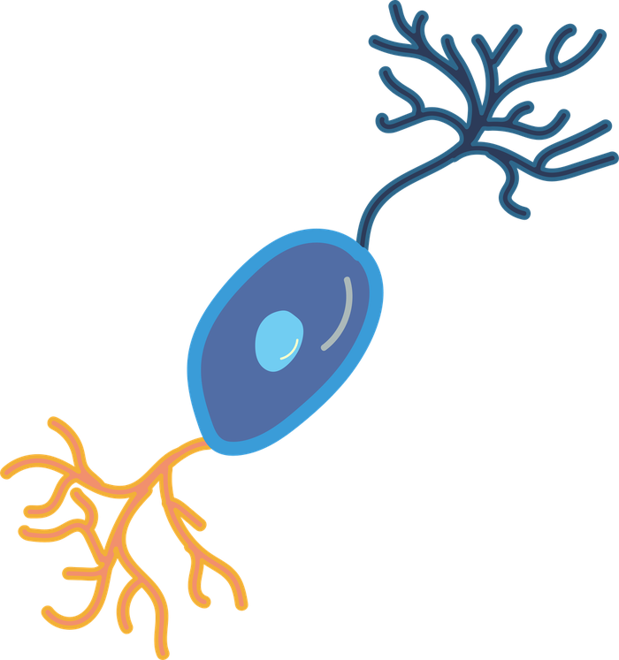
The Data
8,140
recordings in TUSZ v2.0.6 (2,664 seizures)
29
patients kept: ≥ 3 seizures, ≥ 5 min of usable EEG, 01_tcp_ar montage
175
seizures in the final dataset
≈ 6.5k
windows: ≈ 3,325 preictal and ≈ 3,205 interictal
Each window: 30 s · 20 channels · 250 Hz
Notes:
[0:45] We work on the TUH EEG Seizure Corpus, version 2.0.6: 8,140 recordings and 2,664 seizures. To train patient-specific models we kept patients with at least three seizures, each with at least five minutes of usable EEG before onset. After restricting to one common electrode montage, 29 patients remained. The final dataset has 175 seizures and about 6,500 windows, split almost evenly between preictal and interictal. Each window lasts 30 seconds, has 20 channels and is sampled at 250 hertz.

Slide 4

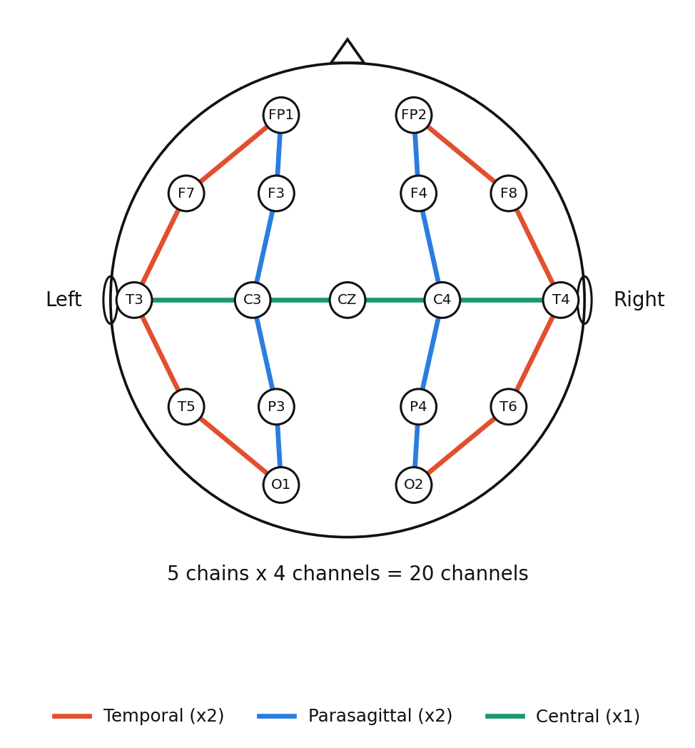
The 20-Channel Montage
Bipolar montage
20 channels (01_tcp_ar): differences between neighbouring electrodes
Filtering
Band-pass 0.5–40 Hz and 60 Hz notch
Resampling
250 Hz for every recording
Windowing
Non-overlapping 30 s windows
5 chains × 4 channels = 20 tracks, always in the same order
Notes:
[0:50] Every recording is converted to the same fixed bipolar montage with 20 channels. A channel is simply the electrical difference between two neighbouring electrodes, for example F7 minus T3. They form five chains of four channels: two temporal, two parasagittal and one central, shown here in orange, blue and green. So for every patient, the model always receives the same 20 tracks in the same order. We then filter between 0.5 and 40 hertz, remove the 60 hertz mains noise, resample to 250 hertz and cut the signal into 30-second windows.

Slide 5
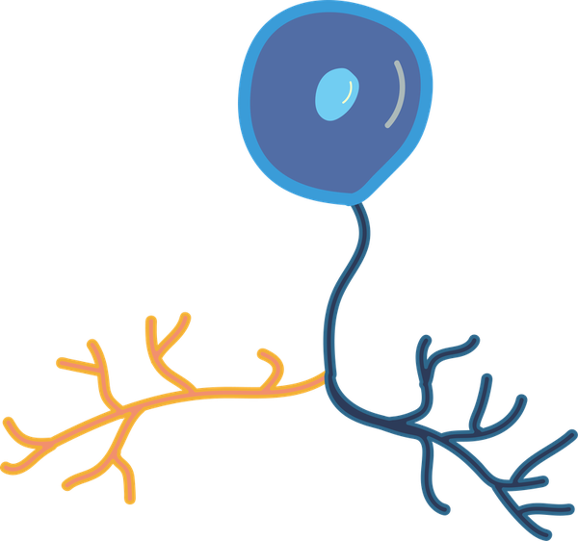
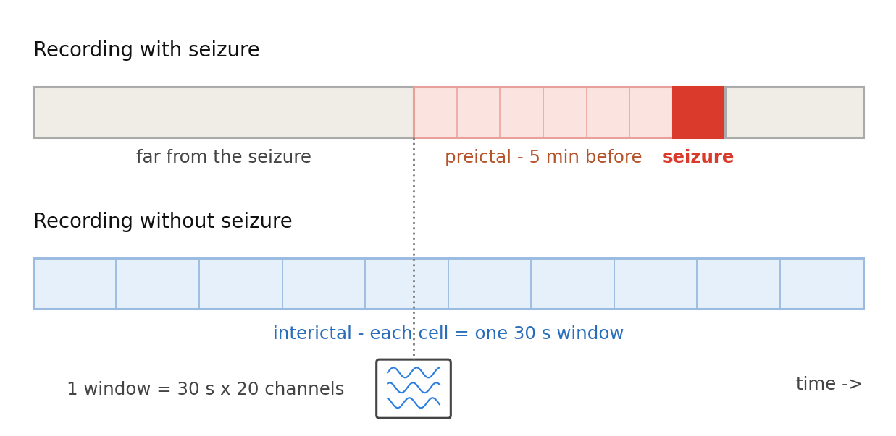
Preictal vs Interictal
Preictal
The 5 min before onset, cut into 30 s windows
Seizure excluded
We predict before it happens, not during
Interictal
From seizure-free recordings; classes balanced
Notes:
[0:50] Here is how we label the data. For recordings with a seizure, the five minutes just before the onset are cut into 30-second windows: these are our pre-seizure examples. The seizure itself is excluded, because we want to predict it before it happens. The normal examples, the interictal class, come from recordings that contain no seizure at all, and we keep the same number of examples in each class. This choice has a side effect that we will discuss in the limitations.

Slide 6
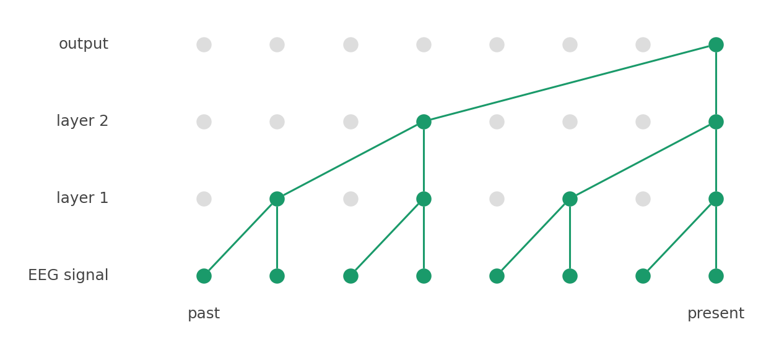
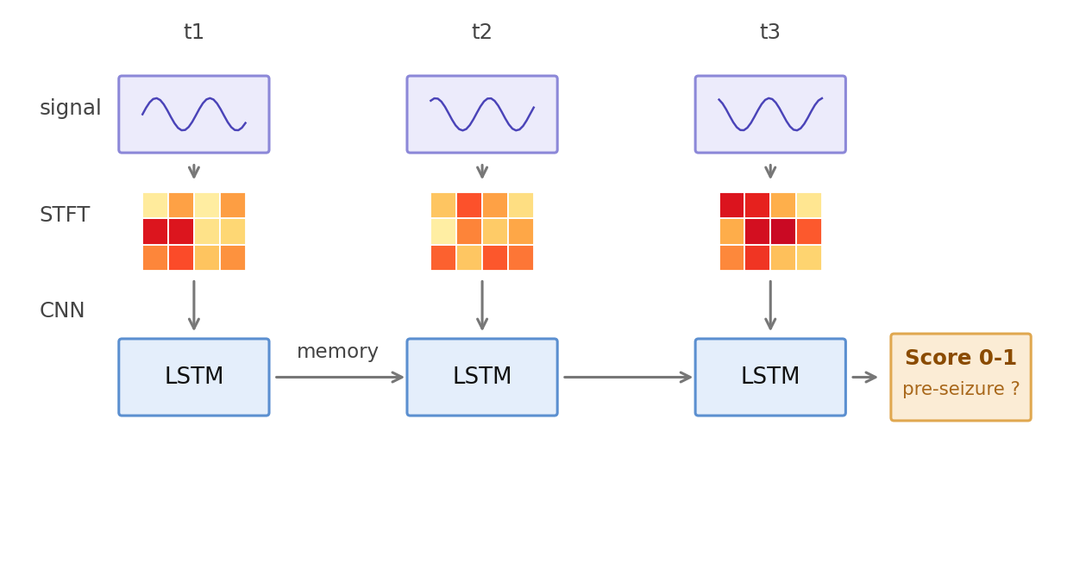
Two Ways to Read EEG
Same input window (20 channels × 30 s) → a score between 0 and 1
TCN: reads the raw signal
CNN-LSTM: reads images
Dilated causal convolutions (gaps 1, 2, 4, …): the output sees the whole window, never the future.
Each sub-window becomes an STFT image, summarised by a CNN; an LSTM keeps memory and outputs the score.
Notes:
[1:30] We compare the two architectures of the reference paper, fed with exactly the same window. On the left, the TCN, a temporal convolutional network, works directly on the raw signal. By stacking convolution layers whose gap doubles at each level, the output point ends up seeing almost the whole 30-second window: it captures both brief events and slow trends. It is causal, so it never looks at the future. On the right, the CNN-LSTM first transforms each sub-window into a time-frequency image with an STFT, a kind of photo showing which frequencies are present and when. A CNN summarises each image, and an LSTM reads these summaries in order, keeping a memory to follow the evolution and produce the final score. In short: the TCN reads the signal, the CNN-LSTM reads images.

Slide 7

Evaluation Protocol
Patient-specific
One model per patient (29 patients)
Leave-one-seizure-out
Every seizure is held out once for testing
No data leakage
Standardization fitted on the training set only; class weighting
Metrics
ROC AUC and PR AUC
Notes:
[0:40] The evaluation is patient-specific: we train one model per patient. We use leave-one-seizure-out cross-validation, so every seizure is held out once and used only for testing. To avoid leakage, the standardization is fitted on the training set only, and we use class weighting. We report two metrics: the area under the ROC curve and the area under the precision-recall curve.

Slide 8
Code & Reproducibility
1 · Audit
Measures the lead-in before each seizure (feasibility check)
2 · Selection
Lists LOSO-eligible patients (≥ 3 usable seizures)
3 · Preprocessing
EEG → clean, labelled 30 s windows, saved as one .npz per patient
4 · Training & demo
Patient-specific LOSO training (AUC) + a live prediction test

Slide 9
Results
Model | ROC AUC | PR AUC
TCN | 0.761 ± 0.172 | 0.774 ± 0.119
CNN-LSTM | 0.736 ± 0.172 | 0.751 ± 0.139
Mean ± std over 29 patients. Chance level for ROC AUC = 0.50
Both clearly beat chance
The TCN gap (≈ 0.02) is far smaller than the ± 0.17 spread across patients.
Notes:
[1:00] Here are the results, averaged over the 29 patients. The TCN reaches a ROC AUC of 0.761 and a PR AUC of 0.774; the CNN-LSTM reaches 0.736 and 0.751. Both are clearly above chance, which is 0.5 for the ROC AUC. The TCN is slightly ahead, but the difference of about 0.02 is much smaller than the standard deviation of 0.17 across patients, so we cannot say that one model is really better.

Slide 10
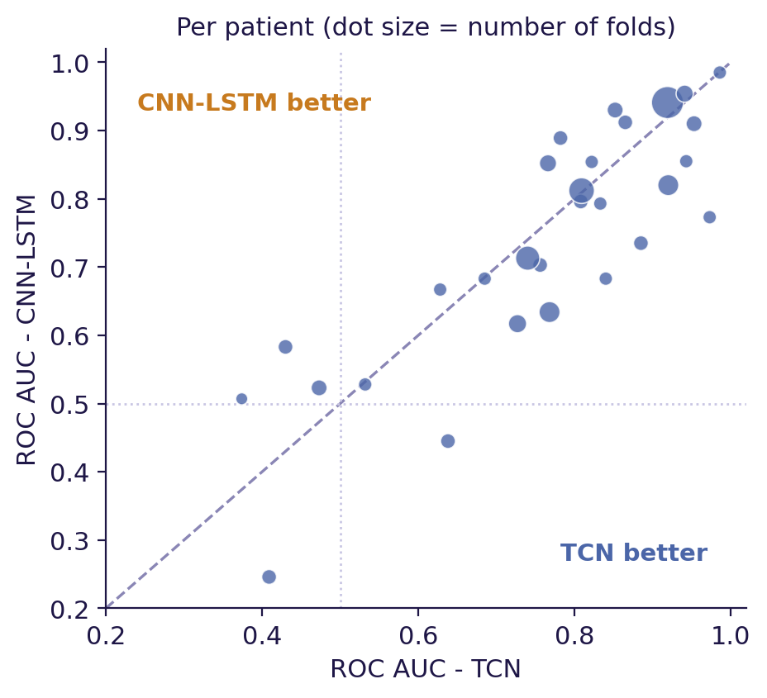
No Clear Winner
Models are very close
Each one wins on about half of the patients
Strong patient variability
ROC AUC ranges from ≈ 0.25 to 0.99
Low scores: small patients
2–4 folds and/or little interictal data: unstable AUC
Matches the reference paper
No clearly better model, high inter-patient variability
Notes:
[0:55] This plot compares the two models patient by patient: each dot is a patient, and points on the diagonal mean equal performance. The dots are spread on both sides, so each model wins on about half of the patients. Performance varies a lot from one patient to another, from about 0.25 to 0.99. The weakest cases are patients with only two to four folds and sometimes too little interictal data, where the AUC is unstable. This is exactly the conclusion of the reference paper: no clearly better model and strong inter-patient variability.

Slide 11
Limits & Next Steps
Limitations
Next steps
Short horizon (5 min): not comparable to the paper's 30–60 min
Inter-recording bias: preictal and interictal come from different sessions
Noisy estimates for patients with only 2–4 seizures
Longer training: 100 epochs, learning rate 1e-4
Add a plain CNN to compare 3 models
Correct the inter-recording bias for more conservative scores
Notes:
[0:45] Three limitations. First, the 5-minute horizon is imposed by the data, so our numbers are not directly comparable to the paper's. Second, there is an inter-recording bias: preictal windows come from sessions with a seizure and interictal windows from sessions without one, so part of the signal the models use may reflect differences between recordings rather than the true preictal state. Third, patients with two to four seizures give noisy estimates. Next, we plan longer training with 100 epochs and a learning rate of 1e-4, a plain CNN as a third model, and a correction of the inter-recording bias, which should give more conservative scores.

Slide 12
Key Takeaways
A complete pipeline: TUSZ preprocessing, preictal/interictal labelling, two deep models, rigorous patient-specific LOSO evaluation
Short-horizon (5 min) seizure prediction is feasible: AUC ≈ 0.75 for both models
TCN (0.76) and CNN-LSTM (0.74) are very close: the gap is smaller than the ± 0.17 spread across patients
The strong inter-patient variability of the reference paper is reproduced
Notes:
[0:40] To conclude. We built a complete pipeline, from TUSZ preprocessing and labelling to two deep architectures and a rigorous patient-specific evaluation. The results, with an AUC of about 0.75, show that short-horizon seizure prediction is feasible. The TCN and the CNN-LSTM are very close, and the strong variability between patients matches the reference paper. Thank you for your attention; we are happy to take your questions.

Slide 13
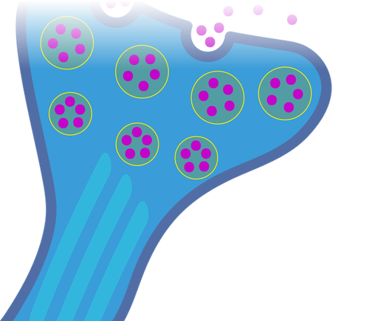
Thank You
For your attention · Questions?
Notes:
[0:10] Thank you for your attention. We would be happy to answer your questions.

