Slide 1
Pine Wood Derby Track with IR Reflective Sensors
Chris and Jeff's Mad House
Accelerometer utilization in starting gate

Slide 2

It's for the kids right?

Slide 3
Challenges Addressed
Physical/Mechanical design
  Mounting IR Sensors
Ground, Ground, Ground
  Need common ground for all parts
  Need solid connection to ground for things to work right
Wires Everywhere – Where does this one go?
Did you commit everything to the repo?
Circuit Design
Hard Fault – what does that mean? You can't reference Addr 0?

Slide 4
Most Serious Challenge
There are nine external devices that generate interrupts. There are only 4 configurable external interrupts on the LPC1769; one of which has conflicts with the mode the board boots into.
How to handle 9 external interrupts with only 3 modules?
Use two four-channel MUX's to handle the IR sensors; one for each lane. That takes up EINT2 and EINT3. This solves two problems:
  Shortage of EINT hardware for the project
  Filters out spurious triggers from IR sensors
Put the ADXL external interrupt on EINT1

Slide 5

It really is for the kids, right?

Slide 6
Hardware Components
LPC1769 ARM Cortex M3 board
LPC Xpresso Base Board
MUX
IR Sensors – TCND 5000 from Vishay Semiconductor
ADXL345
7-segment LED Displays
Lots of resistors, LEDs, OP Amps, and capacitors
PC boards
Power Supplies, Wall worts, wires, wires, ...

Slide 7
Firmware
Display Task – displays a given decimal value to the correct display
UART Task – Sends output over RS232 port to PC
Reset Task – Handles button press and resets for another race.
IR Sensor trigger interrupt handler
ADXL345 interrupt handler
Timer interrupt handlers
UART interrupt handler
Initialization and SPI code

Slide 8
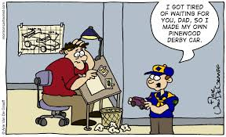
It's for the CHILDREN!!!

Slide 9
Racing Flow
Motion of gate triggers accelerometer interrupt starting timing logic
As car passes over IR sensor
  IR Sensor triggers interrupt
  IR Sensor interrupt handler places struct with ID and time value into Display Task queue
  IR Sensor interrupt handler places same struct on UART Task queue
Display task receives struct from queue and displays time on display with ID corresponding to IR sensor ID

Slide 10
Task Priorities
The Display and Reset tasks have priority 1
The UART task has priority 2
  Doesn't matter if it takes extra time for the UART to send data to the PC
  Sending on the serial port is more resource intensive than displaying times and resetting
This way UART gets whatever is left over and doesn't slow down the time critical functionality

Slide 11
External Interrupt Handlers
IR Sensor external interrupt handlers (2)
  One for each lane
  Captured time for sensor and placed ID and time on Display task and UART task queues
  Advance MUX to next IR sensor
ADXL 345 external interrupt handler
  Sets timer reference value

Slide 12
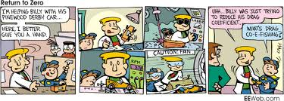
Questions?

