Slide 1
FINGERPRINT RECOGNITION USING WAVELET
BELTAGY AND FELIPE

Slide 2
WHAT IS WAVELET ? !
Firstly we need to know what is STFT

Slide 3
WHAT IS STFT ? !
is a Fourier-related transform used to determine the sinusoidal frequency and phase content of local sections of a signal as it changes over time.

Slide 4

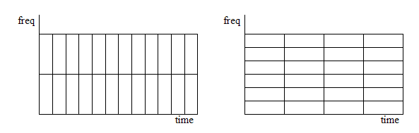
STFT
Notes:
what is the problem about STFT

Slide 5
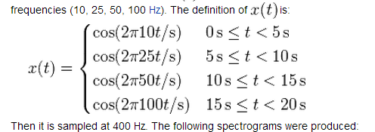
STFT

Slide 6
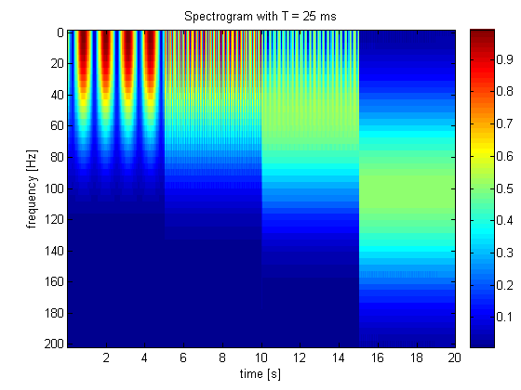
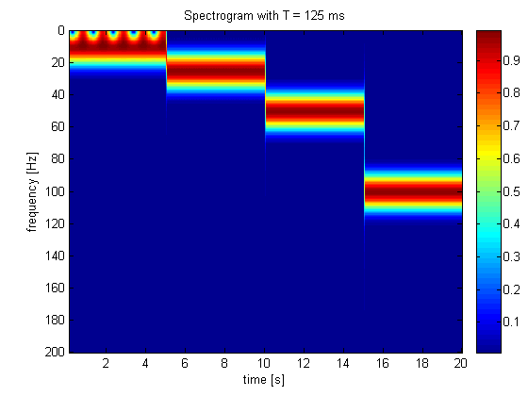
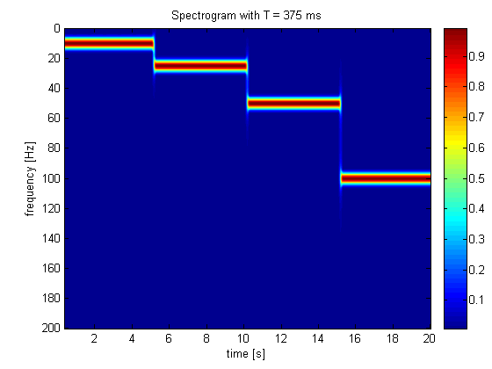
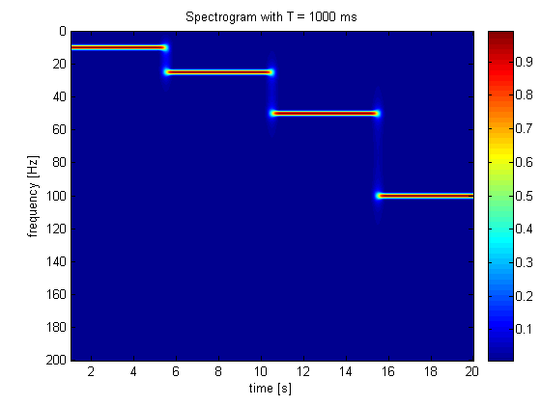
STFT WITH DIFFERENT TIME FRAME

Slide 7
STFT
The 25 ms window allows us to identify a precise time at which the signals change but the precise frequencies are difficult to identify. At the other end of the scale, the 1000 ms window allows the frequencies to be precisely seen but the time between frequency changes is blurred.

Slide 8
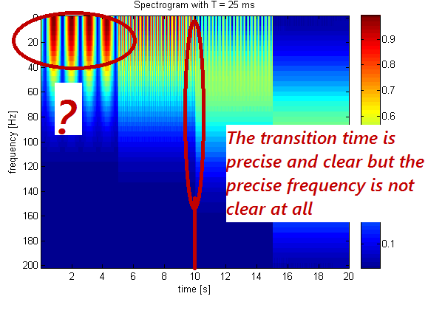
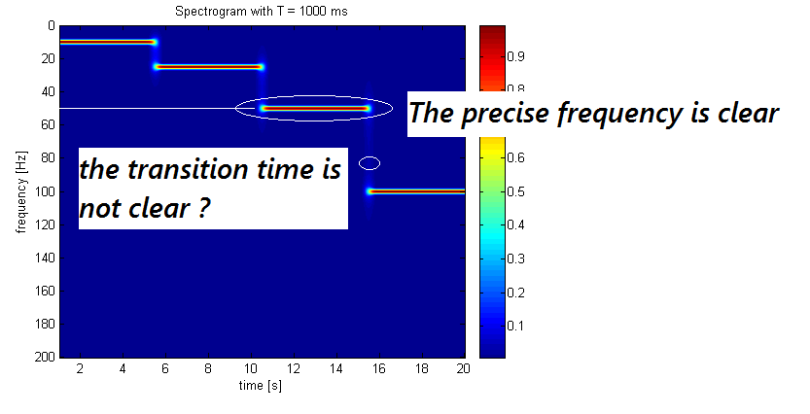
STFT

Slide 9
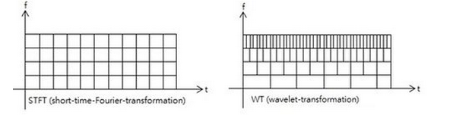
DIFFERENCE BETWEEN WAVELET AND STFT
Notes:
Wavelet solves this
the wavelet overcome the resolution problem

Slide 10
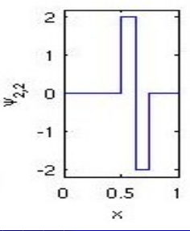
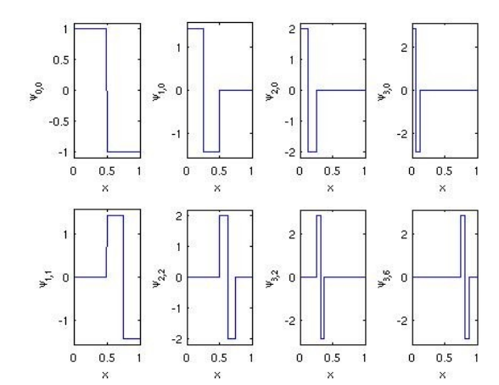
HAAR WAVELET

Slide 11
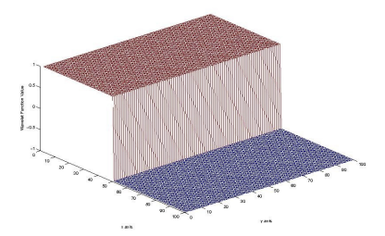
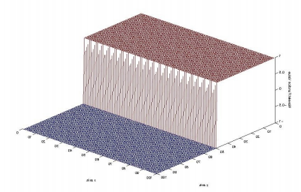
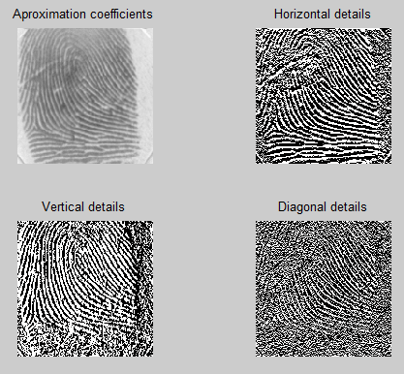
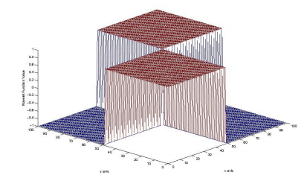
DIRECTIONALITY OF WAVELETS
Notes:
% Directional sensitivity
name='FBD/Train/Train5.tif';
f=imread(name);
imshow(f);
[CA,CH,CV,CD] = DWT2(f,'haar');
figure;
subplot(2,2,1),imshow(CA/512);
title('Aproximation coefficients');
subplot(2,2,2),imshow(CH);
title('Horizontal details');
subplot(2,2,3),imshow(CV);
title('Vertical details');
subplot(2,2,4),imshow(CD);
title('Diagonal details');

Slide 12
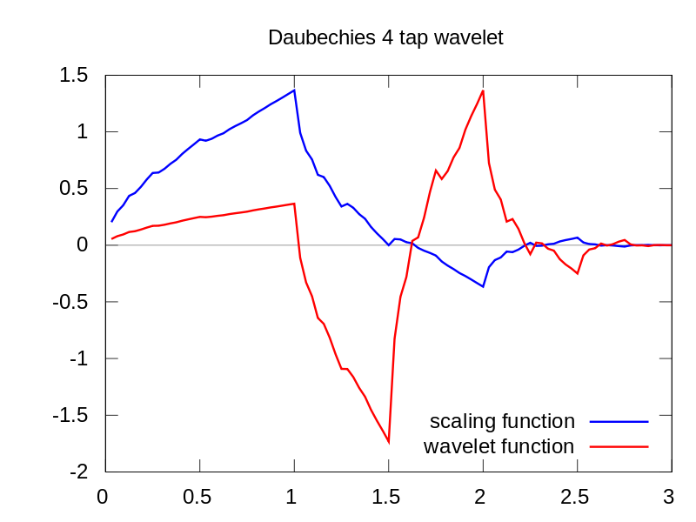
DAUBECHIES WAVELET A CONTINUOUS WAVELET
are a family of orthogonal wavelets defining a discrete wavelet transform and characterized by a maximal number of vanishing moments for some given support

Slide 13
APPROACHES [1]
Wavelets is a general tool to analyse signals.
Approaches fingerprint recognition
Classical approach - The Henry System
Minutiae Based Approach
Total Pattern Recognition Approach
Notes:
Wavelets is a tool to analyse signals, we can use wavelets in differents ways, since the conditioning of the signal until the comparison of coefficient. We will introduce some of the well known approaches to fingerprint recongnition using wavelets.

Slide 14
CLASSICAL APPROACH - THE HENRY SYSTEM
The Henry Classification System allows for logical categorization of ten-print fingerprints records into primary groupings based on fingerprint pattern types.
Notes:
The Henry Classification System allows for logical categorization of ten-print fingerprints records into primary groupings based on
fingerprint pattern types.

Slide 15
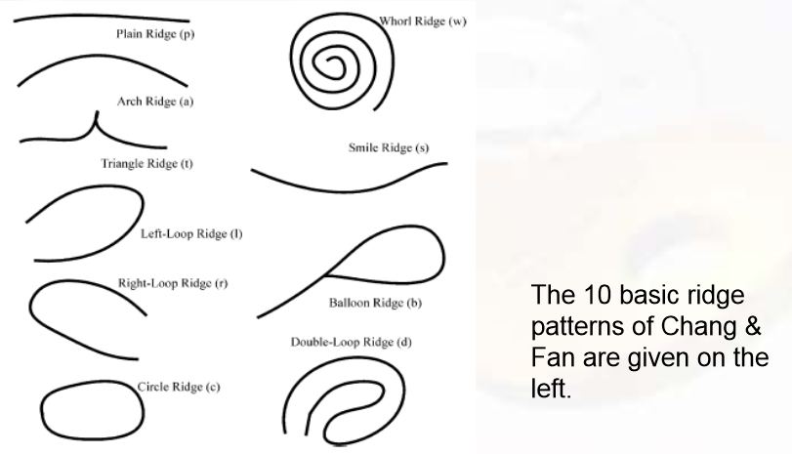
CHARACTERISTICS

Slide 16
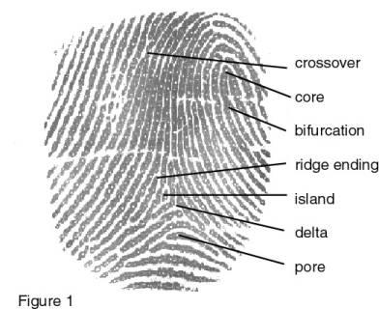
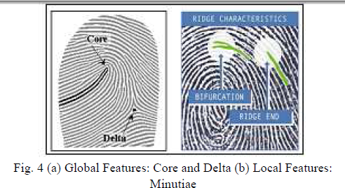
MINUTIAE BASED APPROACH
Global Features: Core and delta
Local features (minutiae):Characteristics of minutiae position, angle
Notes:
- These systems require high quality fingerprint images.
- Minutiae based systems are slow for real time applications.
- These systems have low recognition rates.
Image took from: http://www.biometrics.gov/images/Fingerprint/fingerprint_3.jpg

Slide 17
PATTERN RECOGNITION
Data generation
Preprocessing
Feature extraction
Classification
Evaluation
Notes:
Multiscale with wavelets
Approaches
1. System-component-oriented
2. Application-task-oriented

Slide 18
WAVELETS: COMPRESSION
The fingerprinter recognition is used with a larger database.
The FBI developed a lossy compression technique for fingerprint images.

Slide 19
WAVELETS: PRE - POST PROCESSING
Denoising
Image reconstruction
Features extraction
Comparison between vector features

Slide 20




IMAGE FEATURES EXTRACTION USING QWT
Mean of the wavelet coefficients
Standard deviation
Norm entropy
Energy of the wavelet

Slide 21
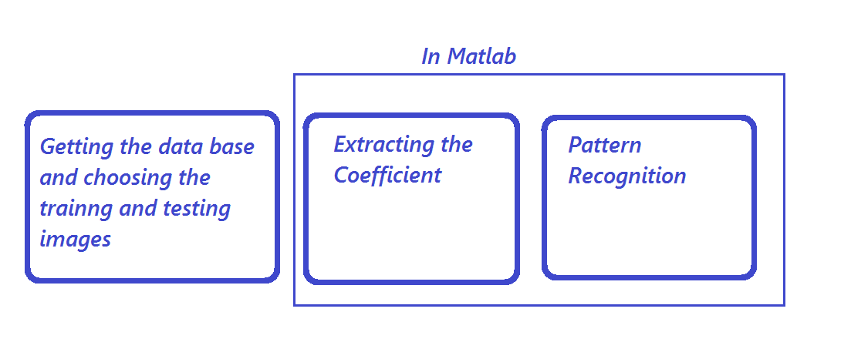
FLOW CHART

Slide 22
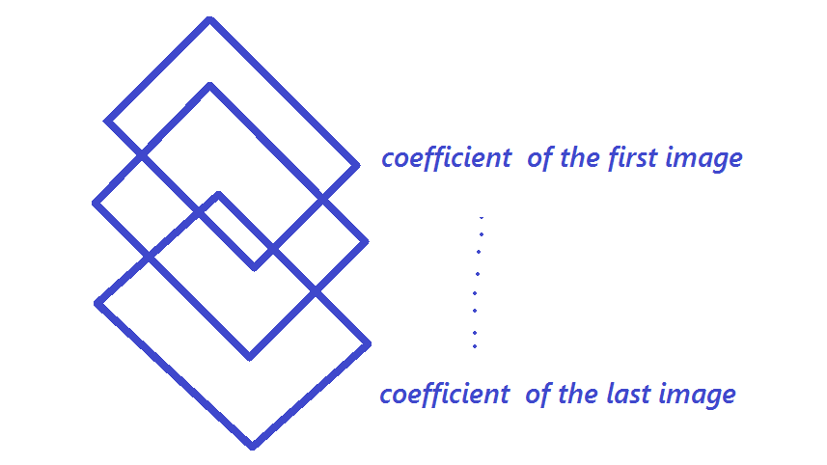
OUR APPROACH
We stored the wavelet coefficient of the pictures in a 3D matrix as shown

Slide 23
ALGORITHM AND DATABASE
We used the coefficient of the wavelet as the feature of the images
The database used is FVC2004

Slide 24
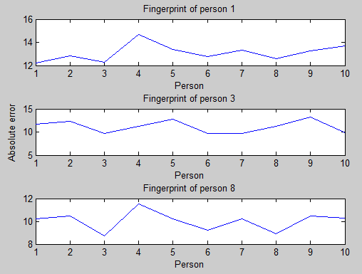
RESULTS
Notes:
% Clasify three fingerprints
nameBegin='FBD/Train/Train';
nameEnd='.tif';
im=zeros(300,300,13);
img=zeros(300,300,13);
% For 4, 'sym8'
cv1=zeros(10,107731);
cv2=zeros(3,107731);
% For 4, 'haar'
% cv1=zeros(10,90151);
% cv2=zeros(3,90151);
% For 4, 'db4'
% cv1=zeros(10,97474);
% cv2=zeros(3,97474);
% Read the person pattern
for i=1:1:10
name=[nameBegin num2str(i) nameEnd];
im(:,:,i)=imread(name);
img(:,:,i)=double(im(:,:,i));
[c,s]=wavedec2(img(:,:,i),4,'sym8');
cv1(i,:)=c;
end
nameBegin='FBD/Test/Test';
nameEnd='.tif';
index=[1 3 8];
% Read the person tests
for i=1:1:3
name=[nameBegin num2str(index(i)) nameEnd];
im(:,:,i)=imread(name);
img(:,:,i)=double(im(:,:,i));
[c,s]=wavedec2(img(:,:,i),4,'sym8');
cv2(i,:)=c;
end
SDv=zeros(3,10);
for i=1:1:3
for j=1:1:10
SDv(i,j)=compare(cv2(i,:),cv1(j,:));
end
end
figure
subplot(3,1,1),plot(SDv(1,:));
title('Fingerprint of person 1');
xlabel('Person');
%ylabel('Absolute error');
subplot(3,1,2),plot(SDv(2,:));
title('Fingerprint of person 3');
xlabel('Person');
ylabel('Absolute error');
subplot(3,1,3),plot(SDv(3,:));
title('Fingerprint of person 8');
xlabel('Person');
%ylabel('Absolute error');

Slide 25
FUTURE WORK
Analysis multinivel
Characterization with clusters and neural networks
Include pre processing

Slide 26
REFERENCES
http://en.wikipedia.org/wiki/Short-time_Fourier_transform
http://en.wikipedia.org/wiki/Wavelet_transform
Rakesh Verma, Anuj Goel,"Wavelet Application in Fingerprint Recognition", International Journal of Soft Computing and Engineering (IJSCE) ISSN: 2231-2307, Volume-1, Issue-4, September 2011
http://www.cse.msu.edu/~cse802/Papers/802_FPClassification.pdf

Slide 27
REFERENCES
Jun-hai Zhai, Su-Fang Zhang,Li-Juan Liu, “Image recognition based on wavelet transform and artificial neural networks”,Proceedings of the Seventh International Conference on Machine Learning and Cybernetics, Kunming, 12-15 July 2008
Rafael C,Richard E, Steven L;Digital Image Processing Using Matlab,Pearson, ISBN 0-13-008519-7
http://cseweb.ucsd.edu/classes/sp09/cse262/Lectures/WAVELET.pdf

