Slide 1
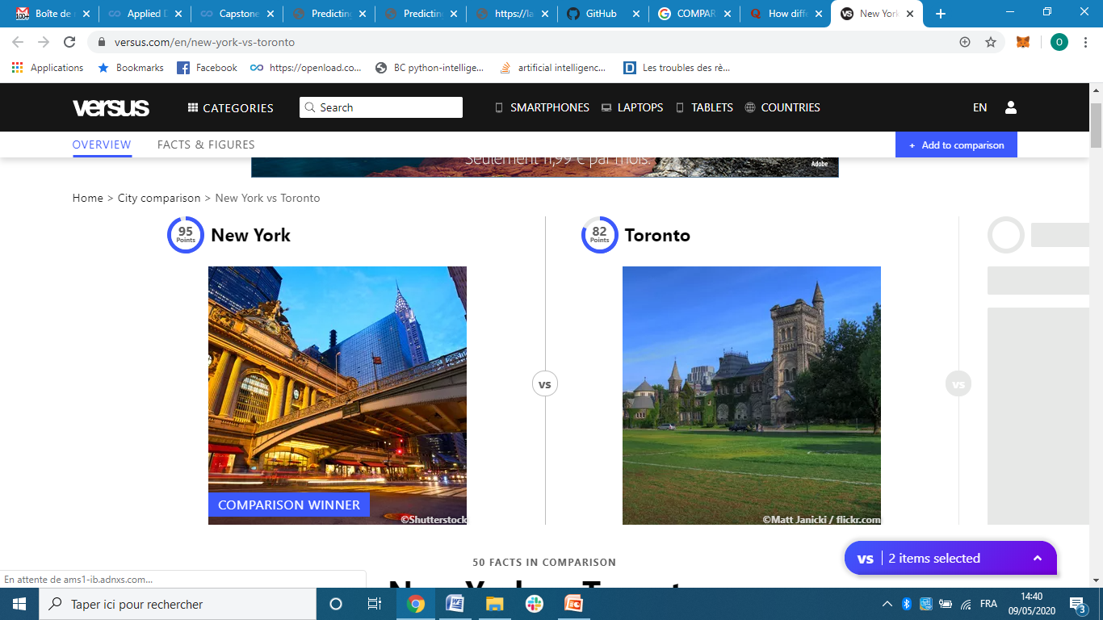
A comparative study between Canadian cities and United-States cities
Olfa BELTAIEF

Slide 2
INTRODUCTION
Tourism is one of the pillar industries in Toronto and New York;
they have accumulated a set of more perfect and mature management system in travel agency and operation mechanism.
The comparative study of Toronto and New York will promote our tourism industry management process.
The study focuses on the difference of the Toronto and New York’s venues categories.

Slide 3
Business Problem
We suppose that a person who wants to choose the best place to travel during his vacation,
so the chosen place should represent his preferences as much as possible.

Slide 4
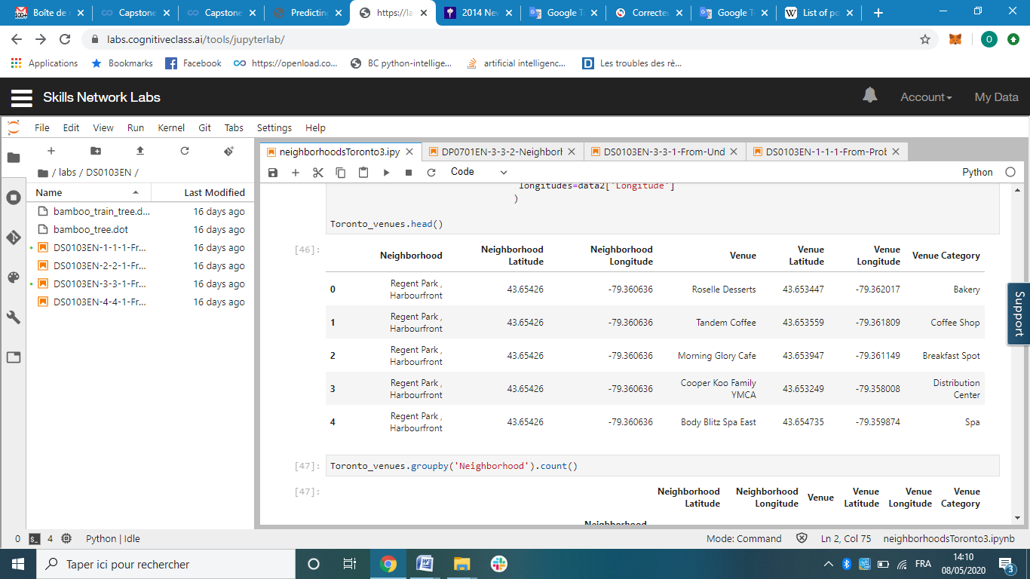
Data acquisition and cleaning
Toronto Dataset was downloaded and scraped from multiple sources and combined into one table.

Slide 5
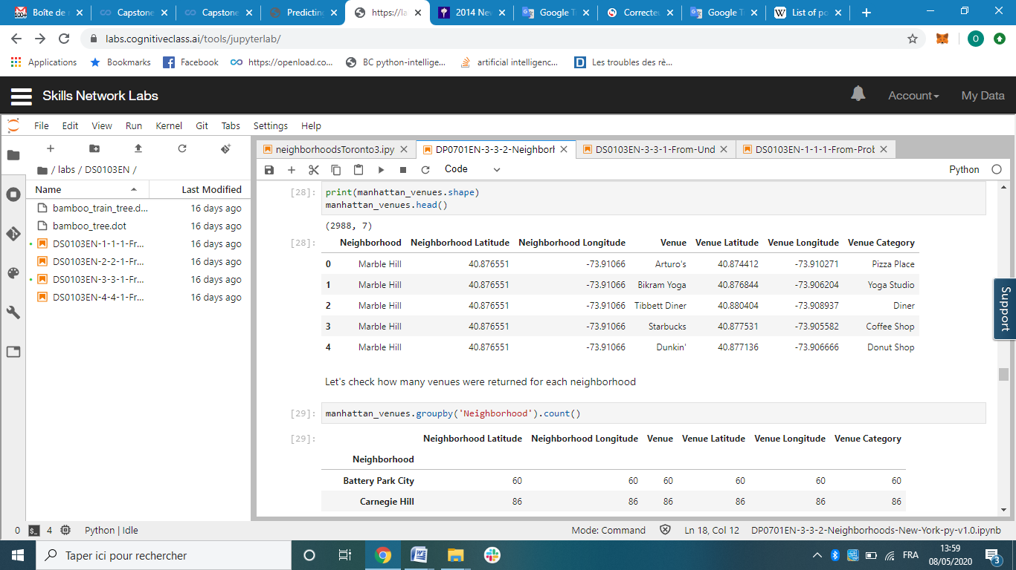
Data acquisition and cleaning
New York Dataset was downloaded from multiple sources and combined into one table.

Slide 6
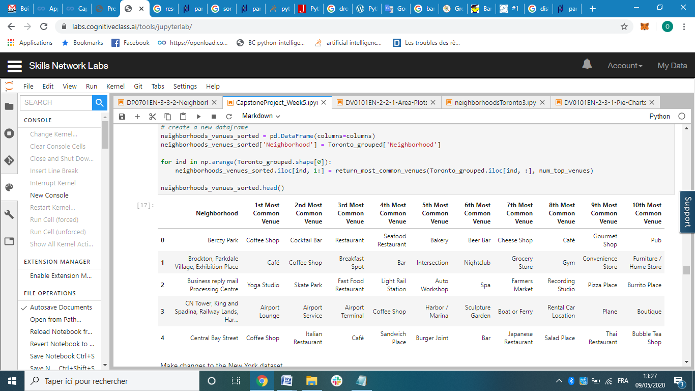
Exploratory Data Analysis
Comparing the most popular Toronto Venues categories by neighborhood

Slide 7
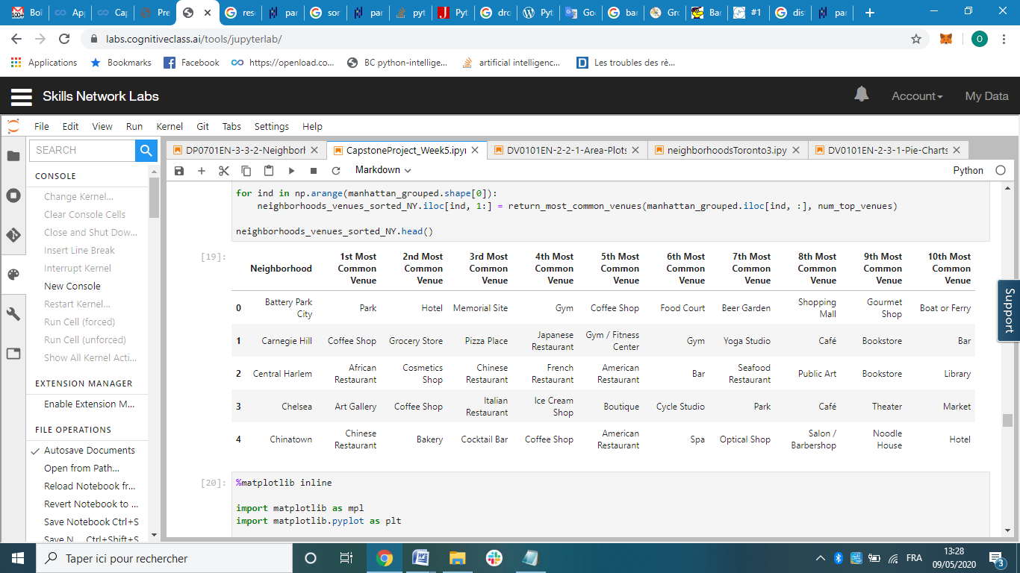
Exploratory Data Analysis
Comparing the most popular New York Venues categories by neighborhood

Slide 8
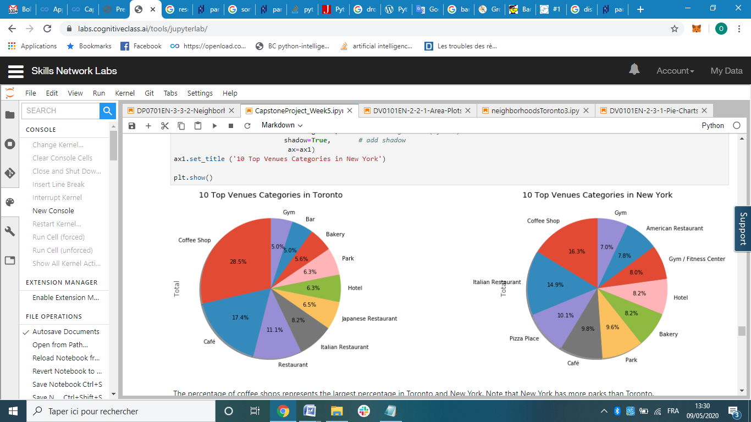
Exploratory Data Analysis
Comparing the top 10 popular Venues categories in New York and Toronto

Slide 9
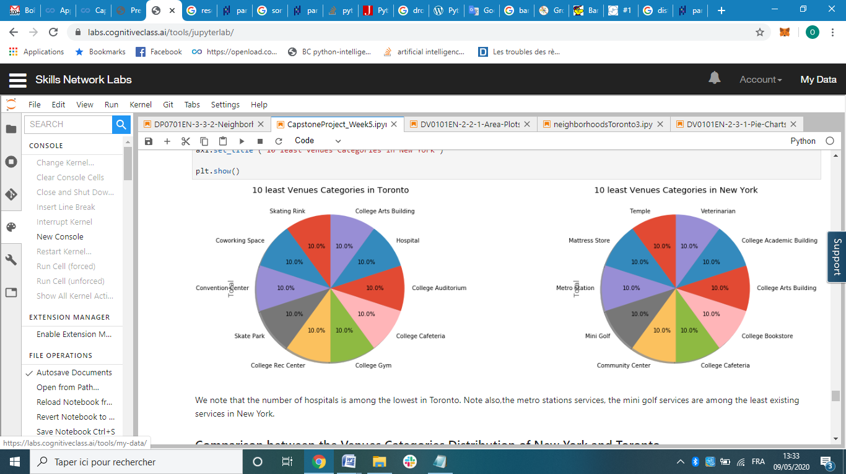
Exploratory Data Analysis
Comparing the 10 least Venues categories in New York and Toronto.

Slide 10
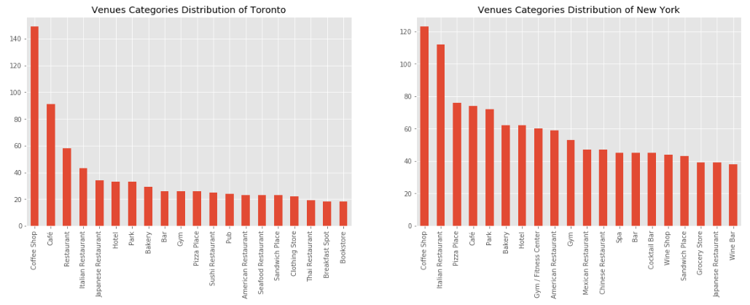
Exploratory Data Analysis
Comparison between the Venues Categories Distribution of New York and Toronto.

Slide 11
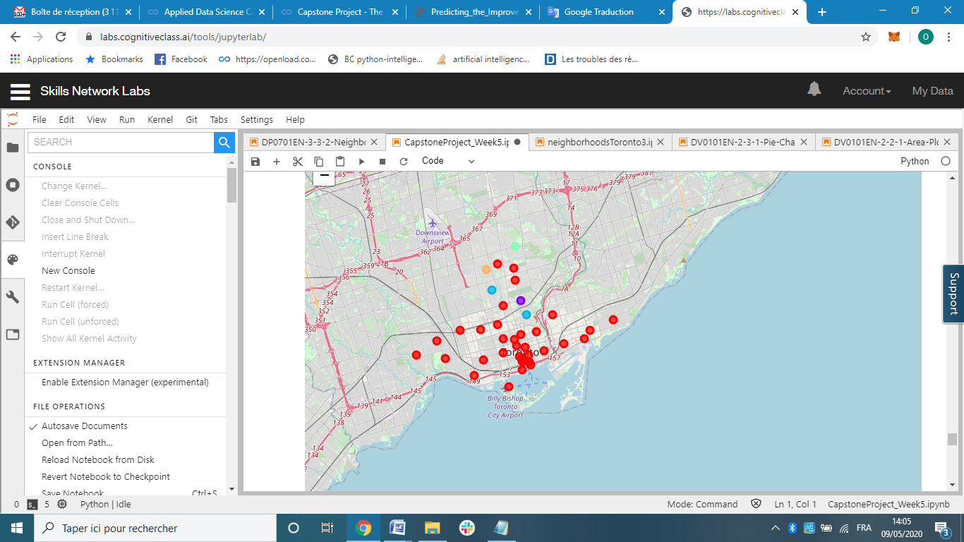
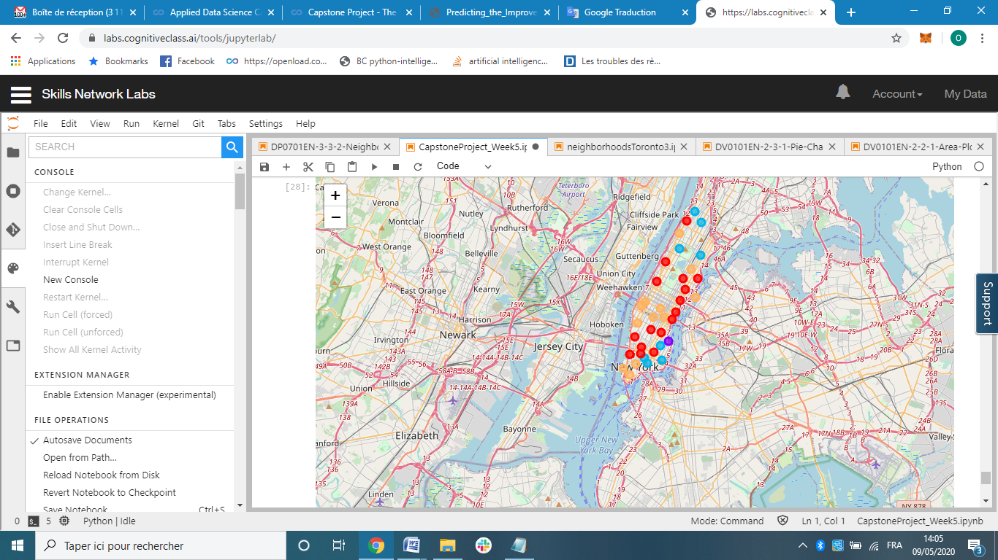
Clustering
Toronto Clustering
New York Clustering
Note that the most popular cluster in the two maps is the red cluster.

Slide 12
Conclusions
This study can allow travelers to determine the right place to travel depending on their preferences.
This study shows us the most popular services by neighborhood.
This study shows us the least existing venues categories in Toronto and in New York.
In this way, the traveler can easily detect the place that best meets their needs.
Finally, we showed the different clusters in a map for Toronto and also for New York.

Slide 13
Perspectives
It is very important to note that we focused in this study only in the comparison of Toronto and New York .
For future study, we can compare between more Canadian cities and more United-States cities.

