Slide 1
Absolute, Relative and Attributable Risks
International Society for Nurses in Genetics
May 2007
Jan Dorman, PhD
University of Pittsburgh
Pittsburgh, PA USA
Notes:
Please feel free to contact Dr. Dorman in you have any questions regarding this presentation (jsd@pitt.edu or 412-624-8392).

Slide 2
Objectives
Define measures of absolute, relative and attributable risk
Identify major epidemiology study designs
Estimate absolute, relative and attributable risks from studies in the epidemiology literature
Interpret risk estimates for patients and apply them in clinical practice
Notes:
The objectives of this lecture are described on this slide.

Slide 3
Clinical Epidemiology is
Science of making predictions about individual patients by counting clinical events in similar patients, using strong scientific methods for studies of groups of patients to ensure that predictions are accurate
Important approach to obtaining the kind of information clinicians need to make good decisions in the care of their patients
Sounds like evidence based practice!
Fletcher, Fletcher & Wagner, 1996
Notes:
Clinical epidemiology differs from clinical observation.

Slide 4
Considerations
Patient’s prognosis is expressed as probabilities – estimated by past experience
Individual clinical observations can be subjective and affected by variables that can cause misleading conclusions
Clinicians should rely on observations based on investigations using sound scientific principles, including ways to reduce bias
Fletcher, Fletcher & Wagner, 1996

Slide 5
Epidemiology is
Process by which public health problems are detected, investigated, and analyzed
  Risk estimates
Based on large populations, not patients or their caregivers
  Potential bias and confounding are major issues to be considered
Scientific basis of public health
Notes:
When reviewing the medical literature, epidemiology studies often provide the most accurate estimates of risks. Epidemiology is truly the scientific basis of public health and a great source of medical evidence, particularly when the focus is on disease risk.

Slide 6
Objectives of Epidemiology
To determine the rates of disease by person, place and time
  Absolute risk (incidence, prevalence)
To identify the risk factors for the disease
  Relative risk (or odds ratio)
To develop approaches for disease prevention
  Attributable risk/fraction
Notes:
Incidence and prevalence are formally defined on slide 7. Birth and death rates are also estimates of absolute risk.
Risk factors are identified by determining whether they significantly increase or decrease the risk of developing a disease. The magnitude of increased/decreased risk is expressed as a relative risk or odds ratio, which are defined in slide 8.
Attributable risk/fraction is defined on slide 9, and represents the incidence/proportion of disease risk that is attributable to the risk factor. It represents the amount that could be prevented if the risk factor was eliminated.

Slide 7
To determine the rates of disease by person, place, & time
Absolute risk (incidence, prevalence)
  Incidence = number of new cases of a disease occurring in a specified time period divided by the number of individuals at risk of developing the disease during the same time
  Prevalence = total number of affected individuals in a population at a specified time period divided by the number of individuals in the population at the time
  Incidence is most relevant clinically
Notes:
Example:
In 2006, 4 new cases of an incurable viral disease were diagnosed in a population with 100 individuals. That brought the total number of affected individuals in the population to 16.
The incidence of this disease in this population in 2006 was 4/(100-16). The number at risk was 84 since 16 were already affected.
The prevalence of this disease in this population in 2006 was 16/100.

Slide 8
To identify the risk factors for the disease
Relative risk (RR), odds ratio (OR)
  RR = ratio of incidence of disease in exposed individuals to the incidence of disease in non-exposed individuals (from a cohort/prospective study)
    If RR > 1, there is a positive association
    If RR < 1, there is a negative association
  OR = ratio of the odds that cases were exposed to the odds that the controls were exposed (from a case control/retrospective study) – is an estimate of the RR
    Interpretation is the same as the RR
Notes:
Relative risks are estimated from prospective studies, which are described on slide 16. Individuals who are exposed (and not exposed) to a risk factor are identified at baseline. Overtime, those who develop the disease of interest are identified. The incidence of the disease is determined, separately, for the groups who were and were not exposed to the risk factor. The ratio of these rates is generated. If the ratio is statistically significantly different from 1.0, then the risk factor is said to be associated with the disease.
Example:
The incidence of lung cancer among smokers is 0.96/1000/yr. The incidence of lung cancer among non-smokers is 0.07/1000/yr. The relative risk associated with smoking in this population is 0.96/100/yr divided by 0/.07/1000/yr = 13.7. Therefore, smokers are ~14 times more likely to develop lung cancer than non-smokers.

Slide 9
To identify the risk factors for the disease
Relative risk (RR), odds ratio (OR)
  RR = ratio of incidence of disease in exposed individuals to the incidence of disease in non-exposed individuals (from a cohort/prospective study)
    If RR > 1, there is a positive association
    If RR < 1, there is a negative association
  OR = ratio of the odds that cases were exposed to the odds that the controls were exposed (from a case control/retrospective study) – is an estimate of the RR
    Interpretation is the same as the RR
Notes:
Odds ratios are calculated from case control studies, which are described on slide 14. Odds ratios are only estimates of relative risks, since true incidence rates cannot be determined from case control studies. Examples of odds ratio calculations are described on slide 43.

Slide 10
To develop approaches for disease prevention
Attributable risk (AR)/fraction (AF)
  AR = the amount of disease incidence that can be attributed to a specific exposure
    Difference in incidence of disease between exposed and non-exposed individuals
    Incidence in non-exposed = background risk
    Amount of risk that can be prevented
  AF = the proportion of disease incidence that can be attributed to a specific exposure (among those who were exposed)
    AR divided by incidence in the exposed X 100%
Notes:
In general, all individuals, whether they have or have not been exposed to a risk factor, have some chance of developing a disease if no prevention measures have been taken. The AR/AF estimates the risk above and beyond this baseline risk that all people have. It is graphically represented on slide 11. Formulas for calculating AR and AF are described on slides 11 and 12, respectively.
Example:
Using the data presented in slide 8, the attributable risk associated with smoking is 0.96/1000/yr – 0.7/1000/yr = 0.89/1000/yr. The incidence of lung cancer attributed to smoking is 0.89/1000/yr.
The proportion of lung cancer cases that could be prevented in this population of smokers if they would quit smoking is 0.89/1000/yr divided by 0.96/1000/yr = 92.7%.

Slide 11
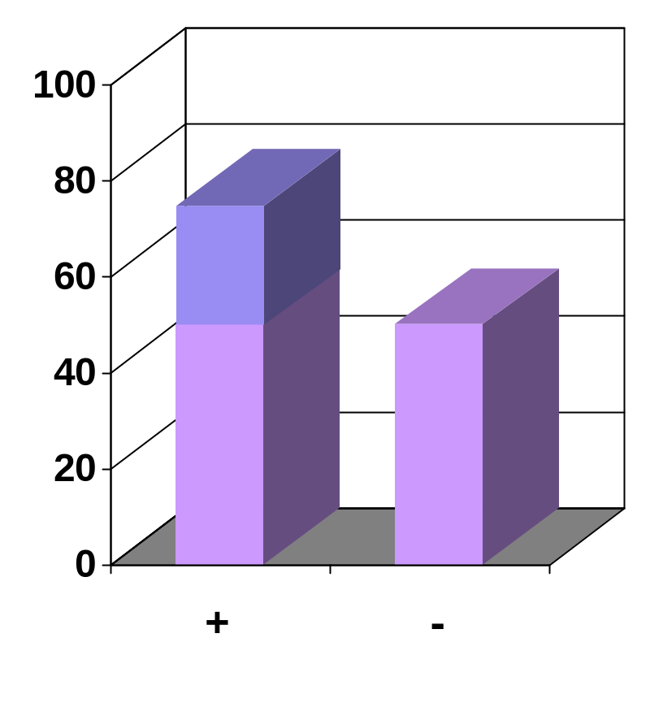
Attributable Risk
Excess Risk
AR =
Risk
Risk among risk factor positives
Risk among risk factor negatives
Risk Factor

Slide 12
Attributable Fraction
-
Risk among risk factor positives
Risk among risk factor negatives
AF =
X 100%
Risk among risk factor positives

Slide 13
Major Epidemiology Study Designs
Case Control (retrospective)
Cohort (prospective)
Cross sectional (one point in time)

Slide 14
Case Control/Retrospective Studies
Identify affected and unaffected individuals
Risk factor data is collected retrospectively
Risk factor +
Risk factor -
Risk factor +
Risk factor -
Disease
No Disease
Disease
No Disease
Notes:
Case control or retrospective studies begin by identifying individuals who do and do not have the disease under investigation. It is important to consider how these individuals are identified to avoid potential selection bias. Then we determine which individuals were exposed to a particular risk factor by asking them to recall the exposure, going back into medical records where the exposure may have been documented, or using a biomarker to measure the exposure. These different methods of documenting exposures may not be equally accurate.
Example:
An investigator identifies 100 individuals with multiple sclerosis (MS) (cases) and 100 individuals who do not have MS (controls). Controls are often group-matched by age, gender and race so they are comparable to the cases. Ten of the cases had been exposed to a particular toxin during childhood. Only 1 of the controls reported a similar exposure. The prevalence of the exposure among cases and controls is 10% and 1%, respectively. Because this is statistically significant, this exposure is considered to be a risk factor for MS.

Slide 15
Case Control/Retrospective Studies
Advantages
  Inexpensive
  Relatively short
  Good for rare disorders
  Measures of risk
    Odds ratio
    Attributable risk (if incidence is known)
Disadvantages
  Selection of controls can be difficult
  May have biased assessment of exposure
  Cannot establish cause and effect

Slide 16
Cohort/Prospective Studies
Identify unaffected individuals
Risk factor data collected at baseline
Follow until occurrence of disease
Risk factor +
Risk factor -
Risk factor +
Risk factor -
Disease
No Disease
Disease
No Disease
Notes:
An example of a cohort or prospective study is described in the notes for slide 8. Prospective studies are needed to establish incidence rates and determine relative risks.

Slide 17
Cohort/Prospective Studies
Advantages
  Establishes cause and effect
  Good when disease is frequent
  Unbiased assessment of exposure
  Measures of risk
    Absolute risk (incidence)
    Relative risk
    Attributable risk
Disadvantages
  Expensive
  Large
  Requires lengthy follow-up
  Criteria/methods may change over time

Slide 18
Cohort and Case Control Studies
Past Present Future
Risk factor?
Disease?
Cohort Studies
Risk factor?
Disease?
Case-Control Studies
Notes:
This slide compares the temporal approaches to data collection and assessment of risk factors and affection status in cohort and case control studies.

Slide 19
Cross Sectional Studies
Defined Population
Risk Factor +
Risk Factor -
No disease
Disease
No disease
Disease
Determine presence of disease and risk factors at the same time – “snapshot”
Notes:
Another commonly used design used in epidemiology is a cross sectional study. With this design, assessments of disease and risk factors are performed at the same time. This gives you a ‘snapshot’ of the prevalence of disease and potential risk factors in a community at a particular time.
Example:
Individuals who were diagnosed with type 1 diabetes between 2000 and 2007 were recruited from a large outpatient clinic. The were examined to determine if they had diabetes retinopathy (DR) and had ever smoked cigarettes. The prevalence of DR in this population was 40%. The prevalence of smoking among those with and without DR was 10% and 12%, respectively. Therefore, in this population, smoking did not appear to be a risk factor for DR.

Slide 20
Cross Sectional Studies
Advantages
  Assessment of disease/risk factors at same time
  Measures of risk
    Absolute risk (prevalence)
    Odds ratio
    Attributable risk (if incidence is known)
Disadvantages
  May have biased assessment of exposure
  Cannot establish cause and effect

Slide 21
Interpreting Study Results
No such thing as a ‘perfect’ study
Recognize the limitations and the strengths of any one study
Critiquing the epidemiology literature:
  Are they comparable in terms of demographic and other characteristics?
  Are they representative of the entire population?
  Are the measurement methods comparable (e.g., eligibility and classification criteria, risk factor assessment)?
  Could associations be biased or confounded by other factors that were not assessed?
Notes:
This slide describes what issues should be considered when critiquing the epidemiology literature and determining which studies would provide the most appropriate evidence to guide clinical practice.

Slide 22
Genetic Epidemiology of Type 1 Diabetes
Example of assessing absolute, relative and attributable risks
Notes:
This part of the presentation focuses on my genetic epidemiology research on type 1 diabetes. Examples of how absolute, relative and attributable risks were estimated from my case control studies are provided. These examples are not intended to replace risk estimates generated from prospective studies, but illustrate how case control studies, which are much more common than prospective studies, can be used for clinical purposes.

Slide 23
Type 1 Diabetes
One of most frequent chronic childhood diseases
  Prevalence ~ 2/1000 in Allegheny County
  Incidence ~ 20/100,000/yr in Allegheny County
Due to autoimmune destruction of pancreatic β cells
  Etiology remains unknown
Epidemiologic research may provide clues
  1979 – began study at Pitt, GSPH
Notes:
Our research team has been investigating the epidemiology of T1D at the University of Pittsburgh, Graduate School of Public Health since 1979. I have been fortunate to be part of this team since our studies began.

Slide 24
Type 1 Diabetes Registries
Children’s Hospital of Pittsburgh Registry
  All T1D cases seen at CHP diabetes clinic since 1950
  May not be representative of all newly diagnosed cases
Allegheny County Type 1 Diabetes Registry
  All newly diagnosed (incident)T1D cases in Allegheny County since 1965
Notes:
The foundations of our research are two T1D registries. One registry is based on the CHP diabetes clinics and includes all cases seen at CHP within one year of diagnosis who were less than 17 years of age at diagnosis.
The second registry includes all newly diagnosed T1D cases (<20 years of age) in Allegheny County, PA since 1965. Most cases are diagnosed at CHP – but this registry includes children diagnosed at the other hospitals in Allegheny County. We use this registry to determine the incidence and characterize the descriptive epidemiology of T1D since it is unbiased.

Slide 25
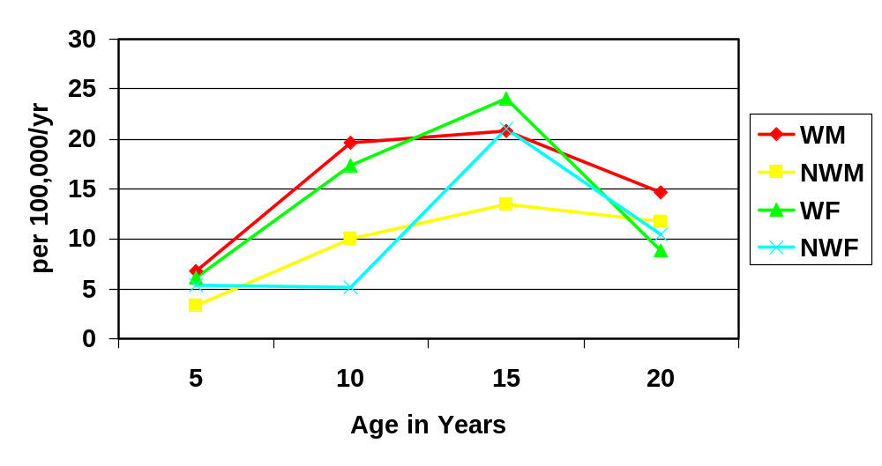
Type 1 Diabetes Incidence
Allegheny County, PA
Notes:
The next few slides illustrate the descriptive epidemiology of T1D in Allegheny Country, PA. The incidence of T1D is higher among whites than non-whites. There is no difference in incidence by gender. The peak incidence of T1D is at puberty.

Slide 26
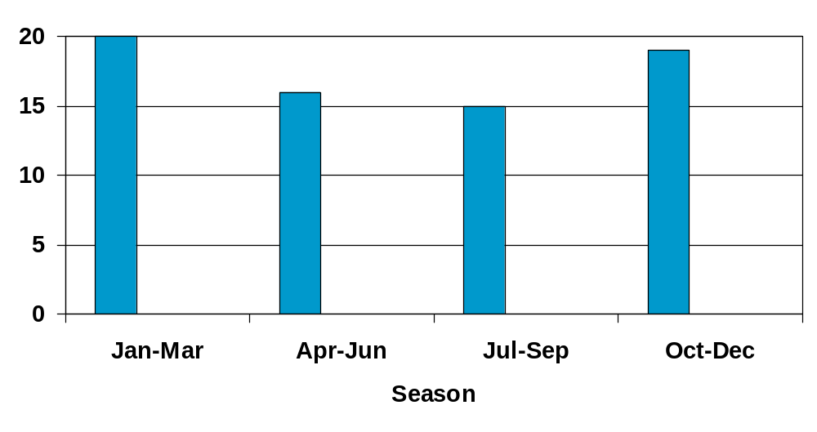
Type 1 Diabetes Incidence Allegheny County, PA
Notes:
T1D follows a seasonal pattern – more cases are diagnosed in the cold winter months than during the summer. This trend has been reported in many countries.

Slide 27
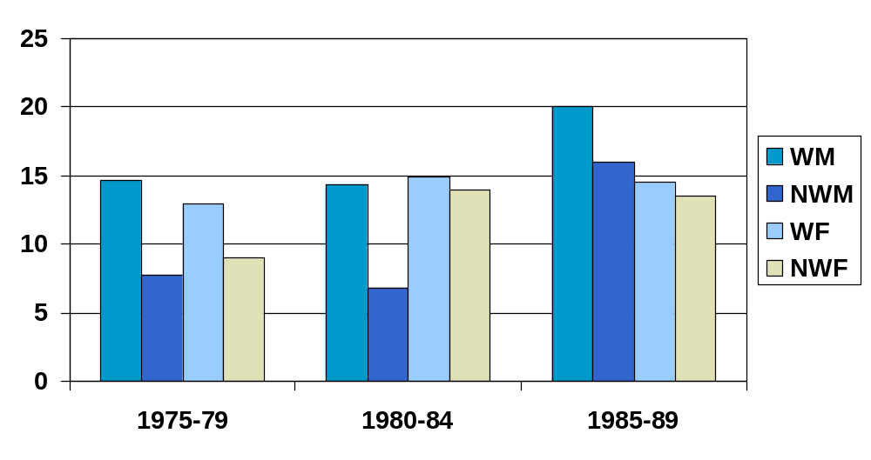
Type 1 Diabetes Incidence Allegheny County, PA
Notes:
The incidence of T1D is Allegheny County, PA has been steadily increasing since the 1970s. The most significant rise has been among non-white males. Again, this increase in T1D incidence has been reported worldwide.

Slide 28
Evidence for Environmental Risk Factors
Seasonality at onset
Increase in incidence worldwide
Migrants assume the risk of host country
Environmental risk factors
- May act as initiators or precipitators
- Viruses, infant nutrition, stress
Notes:
There is considerable evidence that environmental risk factors contribute to the development of T1D.

Slide 29
Evidence for Genetic
Risk Factors
Increased risk for 1st degree relatives
  Risk for siblings ~6%
Concordance in MZ twins 20 - 50%
Strongly associated with genes in the HLA region of chromosome 6
  DRBQ-DQB1 haplotypes
Notes:
However, there is also much evidence to support that genetic factors are also important.

Slide 30
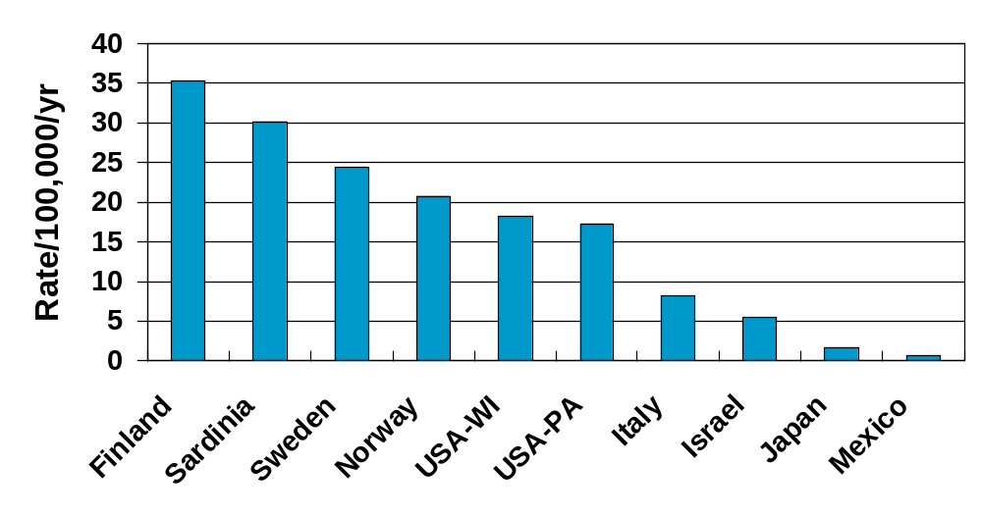
Type 1 Diabetes Incidence Worldwide
Notes:
One of the most interesting features of the descriptive epidemiology of T1D is the tremendous differences in incidence across countries, with more than a 50-fold increase in risk for the Finnish population compared to the Mexican population.

Slide 31

WHO Collaborating Center
for Disease Monitoring, Telecommunications and the Molecular Epidemiology of Diabetes Mellitus University of Pittsburgh, GSPH
Directors, Drs. Ron LaPorte, Jan Dorman
Notes:
One research center has been designated as a WHO Collaborating Center because of our extensive international epidemiologic research regarding T1D.

Slide 32
WHO Multinational Project for Childhood Diabetes (DiaMond)
Collect standardized international information on:
  Incidence (1990 – 2000)
  Risk Factors
  Mortality
Evaluate health care and economics of T1D
Establish international training programs
Coordinating Centers: Helsinki and Pittsburgh
Notes:
The foundation of this work is the WHO DiaMond Project. DiaMond stands for ‘Diabetes Mondiale’, which is French for diabetes worldwide. DiaMond is based on the development of standardized T1D incidence registries in more than 60 countries across the world. From these registries, investigators have studied the incidence, risk factors and mortality associated with T1D. Because the registries were based on a standard methodology, the results obtained from these populations are directly comparable. Other objectives of DiaMond are to evaluate health care and the economics of T1D and to conduct international training programs on the epidemiology of diabetes.

Slide 33
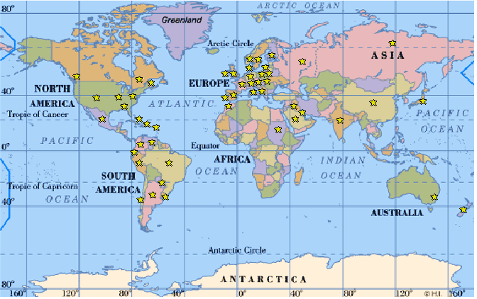
Type 1 Diabetes Registries – 60+ Countries by 1989
Notes:
The stars show areas with a DiaMond T1D registry.

Slide 34
What is Causing the Geographic Difference in T1D Incidence
Environmental risk factors
Susceptibility genes
  More than 20 genes associated with T1D
  HLA region – chromosome 6 is most important
Notes:
Given the tremendous geographical differences in the incidence of T1D, one is obviously interested in trying to determine what is causing these patterns No doubt, environmental differences contributes to the variation in T1D incidence rates. However, my work has been to investigate the contribution of genetic differences to the geographical patterns of T1D incidence. Although more than 20 genes have been associated with T1D, those in the HLA region of chromosome 6 confer the strongest risk.

Slide 35
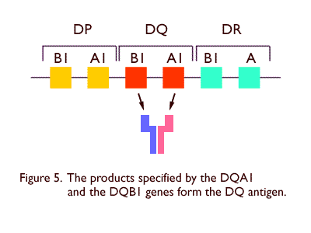
Notes:
Multiple genes in the HLA region of chromosome 6 are known to increase the risk of developing T1D. However, if you can only select one molecule to study, it would be best to study the HLA-DQ antigen. HLA-DQ antigens are found on the surface of cells involved in immune response. Since T1D is an autoimmune disease, it is likely that the reason these antigens increase susceptibility to the disease is because they can sometimes have a ‘negative’ impact on the immune system.
The HLA-DQ antigen is comprised of 2 molecules – the β chain and the α chain. These are encoded by the DQB1 and DQA1 genes, respectively. Because everyone has 2 chromosomes, they will have 2 DQA1 alleles and 2 DQB1 alleles.

Slide 36
HLA-DQ Locus
Chromosome 1
Chromosome 2
DQA1 Gene
  for the  chain
DQB1 Gene
  for the  Chain
DQ  haplotype determined from patterns of linkage disequilibrium
Notes:
The DQA1 and DQB1 genes are extremely close to each other on chromosome 6. For this reason, there has been little recombination between these genes. This is commonly observed in the HLA region and is known as ‘linkage disequillibrium’. Therefore, when you genotype an individual and identify their 2 DQB1 and 2 DQA1 alleles, you can almost always determine which DQB1 and DQA1 alleles are on the same chromosome. This combination of DQB1 and DQA1 alleles are known as DQ haplotypes.

Slide 37
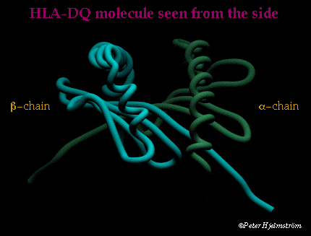
Notes:
This is a picture of the HLA-DQ antigen, with the α chain and the β chain. Together, they form a cleft, which is the biologically active site of the antigen. The many DQA1 and DQB1 alleles differ in DNA sequence, particularly in the cleft region. These sequence differences slightly change the structure of the cleft, and therefore impact how it functions immunologically.

Slide 38
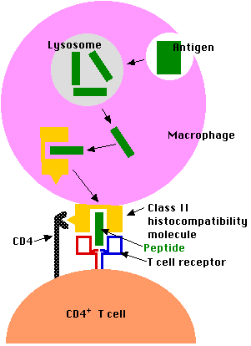
Notes:
The HLA-DQ antigen here is on the surface of a macrophage. Its job is to present ‘digested’ peptides to T-cells to initiate an immune response. Different DQ antigens have different clefts and, therefore, may present only certain peptides to T-cells, or may present them in a manner that can impact the strength of the immune response that is subsequently generated. Thus, the differences in DNA sequence in DQA1 and DQB1 alleles impacts the function of the molecule.

Slide 39
WHO DiaMond Molecular Epidemiology Sub-Project
Hypothesis
Geographic differences in T1D incidence reflect population variation in the frequencies of T1D susceptibility genes
Case control design - international
Focus on HLA-DQ genotypes
Notes:
The hypothesis we tested for the WHO DiaMond Molecular Epidemiology was that geographic differences in T1D incidence reflect population variation in the frequencies of T1D susceptibility genes. In other words, we hypothesized that one reason that the rates of T1D were so high in Finland was because more Finnish individuals carried DQA1 and DQB1 susceptibility alleles. Alternatively, we hypothesized that the rates of T1D in Mexico were low because the frequencies of the DQA1 and DQB1 susceptibility alleles were low in that population.

Slide 40
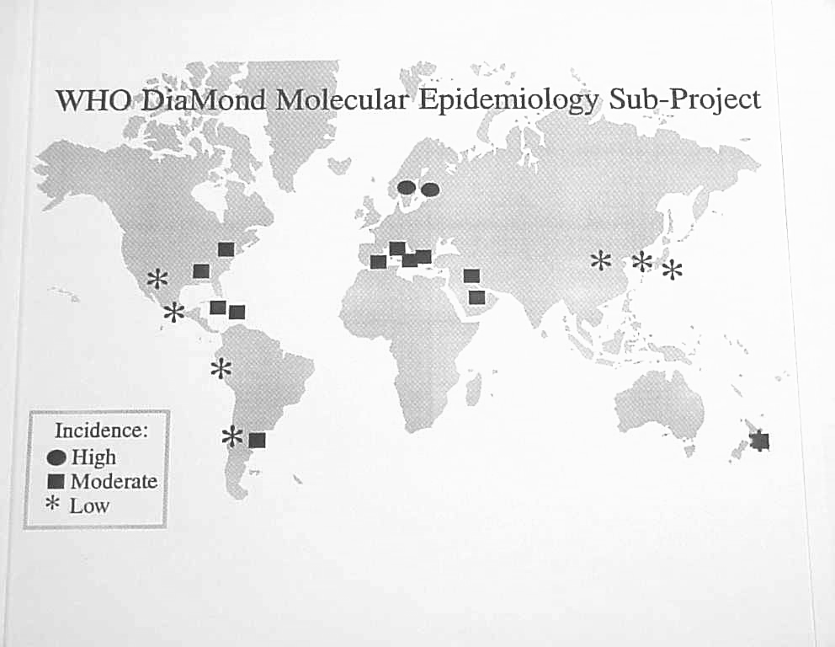
Notes:
This slide shows the DiaMond centers that participated in the Molecular Epidmeiology Project. Each center recruited 100 T1D cases from their incidence registry, as well as 100 group-matched non-diabetic controls.

Slide 41
WHO DiaMond Molecular Epidemiology Sub-Project
Within country analysis
Odds ratios
Absolute risks
Attributable risks
Across country analysis
Allele/haplotype frequencies
Absolute risks
Notes:
Within each country, our goal was to estimate the absolute, relative (odds ratios) and attributable risks for T1D that were associated with DQA1-DQB1 susceptibility haplotypes.

Slide 42
Susceptibility Haplotypes for Type 1 Diabetes
DRB1- DQA1- DQB1 Ethnicity
*0405 -*0301- *0302 W, B, H, C
*0301 - *0501- *0201 W, B, H, C
*0701 - *0301- *0201 B
*0901 - *0301- *0303 J
*0405 - *0301- *0401 C, J
White, Black, Hispanic, Chinese, Japanese
Notes:
The nomenclature used to define DQA1 and DQB1 alleles are based on a numerical system. The different numbers have no biological significance – rather they reflect the order in which the alleles were discovered. So, numbers like *0201 and *0301 were discovered first – and therefore, are among the most common DQA1 and DQB1 alleles.

Slide 43
Distribution of Genotypes
Cases
Controls
S = DQA1-DQB1 haplotypes that are more prevalent in cases vs. controls (p < 0.05) for each ethnic group separately
2S
a
b
1S
c
d
0S
e
f
Notes:
This slide illustrates the table that is used for odds ratio calculations. Typically, 1 column is used for cases, the 2nd column is for controls. The rows relate to the presence/absence of the risk factor. In this case, there are 3 levels of genetic susceptibility – the presence of 0, 1 or 2 susceptibility haplotypes. This makes it possible to estimate a ‘dose-response’ effect.

Slide 44
Odds Ratios for T1D
Cases
Controls
OR2S = af / be
2S
a
b
OR1S = cf / de
1S
c
d
OR0S = 1.0
0S
e
f
Baseline
Notes:
Boxes a and b reflect the number of cases and controls, respectively, who have 2 susceptibility haplotypes. Boxes c and d represent the number of cases and controls, respectively, with 1 susceptibility haplotype. Boxes e and f represent cases and controls, respectively, with 0 susceptibility haplotypes. Since these groups are at lowest genetic risk – they serve as the baseline, which will first be compared to the 1S groups to calculate the OR associated with the presence of 1 susceptibility haplotype. Then the 2S groups are compared to the baseline to calculate the OR associated with 2 susceptibility haplotypes. The formulas for the OR calculations are shown above.

Slide 45
Odds Ratios for T1D
Population 2S 1S
Finland 51.8* 10.2*
PA-W 15.9* 5.6*
PA-B >230* 8.4*
AL-B 14.6* 5.6*
Mexico 57.6* 3.0*
Japan 14.9* 5.4*
China >75.0* 6.9*
Notes:
The method described on slide 14 was used to determine the OR associated with 2S and 1S haplotypes in the seven different populations listed above. An “*” is used to represent statistical significance (p<0.05). In each country, there was a significant dose response – with a relative increasing level of risk with increasing number of susceptibility haplotypes. However, across countries – there was considerable variation – particularly for the 2S groups. This in part was due to small samples sizes. For example, in our PA-black population, we found no control with 2S haplotypes.

Slide 46
How to Estimate Genotype-Specific Incidence from a Case Control Study?
for individuals with 2S, 1S and 0S genotypes
Notes:
While estimates of RR (OR) are useful for determining the magnitude of an increase risk, they are not particularly useful from a clinical perspective. Rather, a genotype-specific incidence rate, which estimate absolute risk, is easier for clinicians and patients to interpret because it can be expressed as a percent.

Slide 47
Overall Population Incidence (R)
Is an average of the genotype-specific risks (R2S, R1S, R0S)
Weighted by the genotype distribution (proportion) among the controls
Notes:
To do this, you need to know the overall incidence of the disease in the general population. Because of the DiaMond project and the development of standardized incidence registries in each of the countries, T1D incidence data was readily available. For other disorders, I would refer you to epidemiologic literature regarding population incidence rates.
As we saw on slide 11, the overall incidence rate in a population is a weighted average of the rates specific to the subgroups of that population that have and do not have the risk factor of interest. In this situation, we have 3 subgroups – those with 2S, 1S and 0S haplotypes. The overall T1D incidence rate in a population depends on the individual incidence rates for the 3 genotype groups and the proportion of the population that the 3 genotype groups represent.

Slide 48
?
?
?
R = R2S P2S + R1S P1S + R0S P0S
R = Population incidence
P2S, P1S, P0S = Genotype proportions among controls
R2S, R1S, R0S = Genotype- specific incidence
Notes:
Therefore, we can use the following equation to describe the relationship between the overall T1D incidence in the population, and the 3 genotpye-specific risks, which are weighted by the genotype proportions among the controls. According to the above formula, we know R, P2S, P1S and P0S. We need to determine the genotype-specific risks R2S, R1S and R0S.

Slide 49
Odds Ratios Approximate Relative Risks (RR)
OR2S  RR2S = R2S / R0S
OR1S  RR1S = R1S / R0S
OR0S  RR0S = R0S / R0S
Notes:
We can do this because we know that OR are estimate of RR, which are ratios of incidence rates. So, OR2S is an estimate of RR2S, which is the ratio R2S / R0S. The other ORs are also estimates of their corresponding RRs. Since we know the ORs already – we can use them in the equation by simple algebraic manipulations.

Slide 50
R = R2SP2S + R1SP1S + R0SP0S
Can be re-written as:
= R0S [(R2S/R0S)P2S + (R1S/R0S)P1S + P0S]
Substitute OR for RR:
= R0S [OR2SP2S + OR1SP1S + P0S]
Solve for R0S
Notes:
If we re-write the formula as shown above, we can substitute the ORs for the RRs and solve for R0S.

Slide 51
R = R2SP2S + R1SP1S + R0SP0S
OR2S  R2S / R0S
- OR2S and R0S are known,
Solve for R2S
OR1S  R1S / R0S
- OR1S and R0S are known,
Solve for R1S
R was used to estimate cumulative incidence rates through age 35 years (R x 35) so risk estimates could be interpreted as percents
Notes:
Then we can solve for the other 2 genotype-specific risks (R2S and R1S) as shown above. We can use a cumulative incidence rate rather than the annual T1D incidence rate by multiplying the annual rate by the number of years desired. In this situation, we wanted to know the cumulative T1D risk through age 35 years.

Slide 52
Absolute T1D Risks Through Age 35 Yrs
Population 2S 1S
Finland 7.1% 2.3%
PA-W 2.6% 0.9%
PA-B 28.7% 1.2%
AL-B 1.7% 0.6%
Mexico 1.0% 0.1%
Japan 0.3% 0.1%
China 0.7% 0.1%
Notes:
The cumulative genotype-specific risks for the populations under investigation are shown above. These risk estimates are much easier to interpret clinically than relative risks. For example, a Finnish child with 2S haplotypes has a 7.1% chance of developing T1D through age 35 years. If he/she had 1S haplotypes, their risk would be 2.3%. So, even when individuals carry these susceptibility genes, their actual likelihood of developing T1D is really quite low.

Slide 53
Attributable Fraction for
T1D – Public Health Implications
Population 2S
Finland 29%
PA-W 33%
PA-B 55%
AL-B 31%
Mexico 44%
Japan 26%
China 31%
Notes:
We also estimated the attributable fractions for 2S haplotypes in these populations. This means that if genes could be altered such that none of the individuals with 2S haplotypes actually had 2S hapltoypes, the incidence of T1D in Finland, for example, could be reduced by 29%.

Slide 54
Absolute Risk (Incidence)
Does not indicate whether there is a significant positive or negative association
May be more important than odds ratio, particularly when they can be estimated as a percent
Has important clinical implications for individuals and practitioners

Slide 55

Genetic Information for Testing Type 1 Diabetes GIFT-D
Developing and evaluating a theory-based web education and risk communication program for families with T1D
Notes:
To illustrate how we used these genotype-specific risks for clinical research, I will talk about the GIFT-D project, which was funded by the Department of Defense. Predictive genetic testing for T1D is being performed for several natural history studies. Therefore, we developed a theory-based web education and risk communication program for families with T1D. Our concern was with the ethics of performing HLA testing on healthy children who have a sibling with T1D, given that the disease cannot be prevented. Therefore, we wanted to make sure that families were well informed of the risks and benefits of predictive genetic testing for T1D.

Slide 56
T1D Risk Algorithm
Based on regression analysis from genetic epidemiologic research conducted by our research group
  Age
  Family history of T1D
  Sibling’s HLA-DQ genotype
  Similarity of genotype with T1D proband’s genotype
Translation research
T1D ~42 yrs
Notes:
We developed a risk algorithm, which considered a child’s age, their family history of T1D, their HLA-DQ genotype and the similarity of their genotype to the T1D child’s genotype using data from a family study we conducted several years ago. This study was based on families with a least 1 T1D child. However, the T1D individuals were ~42 years of age when the families were studied. Therefore, any sibling who was going to develop T1D had likely already had done so – since the peak age of T1D onset is at puberty. Therefore, our T1D risk estimates were as accurate as possible.

Slide 57
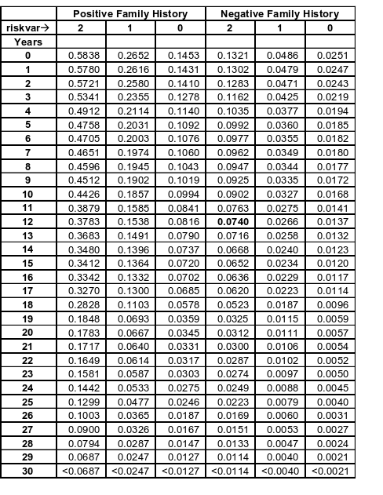
T1D Risk Algorithm
A 12 year old child who shares both DQ haplotypes with her T1D sister has a ~7% chance of developing T1D by age 30 years if neither parent has T1D
Risk increases to ~38% if both parents have T1D
Notes:
Here you can see how much the T1D estimates varied, depending on the factors shown in the previous slide.

Slide 58
Encourage you to use genetic epidemiologic literature to estimate absolute, relative and attributable risk
Important for evidence based nursing practice in the post-genome era
Notes:
I encourage all of you to explore the genetic epidemiologic literature and help estimate and communicate your patients’ genetic risk of developing diseases. This will become increasingly important for evidence-based nursing practice in the post-genome era.

Slide 59
Thank you!

Slide 60
References
Dorman JS and Bunker CH. HLA-DQ locus of the Human Leukocyte Antigen Complex and type 1 diabetes: A HuGE review. Epidemiol Rev 2000; 22:218-227
Dorman JS, Charron-Prochownik, D, Siminerio L, Ryan C, Poole C, Becker D, Trucco M. Need for Genetic Education for Type 1 Diabetics. Arch Pediatr Adolesc Med 2003; 157:935-936

Slide 61
References
Fletcher RH, Fletcher SW, Wagner EH. Clinical epidemiology: the essentials, Lippincott Williams and Wilkins, 1996.
Gordis L. Epidemiology. WB Saunders Co., Philadelphia, 1996.

