Slide 1
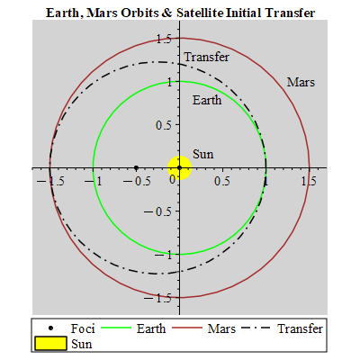
Graphics credit, Jeff Belue, 2022
Spacecraft Mission Design Project
(OrbWin, the Project Guidance)
Status #2
2022 September

Slide 2
Presentation Outline
Outline the trials & tribulations of mission planning code development
Project Goal:
    Develop code for spacecraft mission trajectory planning & timing
      For example, what does it take to get from Earth->Moon, Earth->Mars, etc.
Part 1: Computer Issues
    a) old computer now corrupted
Part 2: New Code Development
    Begin code development using VBA (visual basic for applications) and MS Windows Excel; allows quick testing with an effective IDE (integrated development environment)
Next Steps
Backup slides

Slide 3
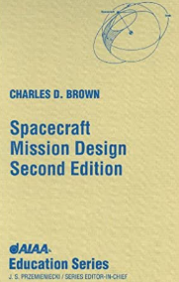
Project Goal: guidance C.D. Brown Book
(Spacecraft Mission Design, 2nd ed.; trajectory planning & timing)
I chose this book & software since I used it before
  Reasonably intuitive, results provide mission feasibility results, with enough theory to make credible conclusions
Reference book & old / obsolete software; circa 1998
  Book provides development focus & software as test bed
    Use book & ref material to verify new software development results
Yes, there is software with similar mission planning
  Both free (GMAT (NASA developed), …) and $$ (STK, …)
    Some based on Matlab, C, C++, Python, Excel, even Fortran, etc.
  Open source software platforms; commercial & governmental (US & ESA)
My rational for this project:
  TO ME, many software packages are not as user friendly as I need, AND customizing outputs and calculations are difficult – since you need detailed knowledge of associated base code – sometimes a lifetime effort
  I chose Excel and it’s associated VBA (visual basic for applications)
    VBA provides an easy user interface; spreadsheet & PowerPoint & MS products
    Of course the huge and very active user base helps with code development

Slide 4
Part 1 a) – My Older Computer Corrupted
Hoped to run the old mission planning software to act as development template
  OrbWin, custom code as an .exe with some supporting files; circa 1998
My old mission planning software, OrbWin, needs Windows 3.1
Planned to attempt simulation old/unsupported versions of windows (3.1)
  Downloaded OS simulation software (winevdm) on my "old computer“
  NOW I can only get my "old computer" to operate in safe-mode. Yuck, how annoying! Especially since I was using this computer as my home data collector
  Local computer fix-it shop (Click Computers) could not get the computer to operate!
    Click Computers gave up since my computer (Dell XPS 15) is 10 years old
    Drivers are no longer available from Dell to reload the old computer
  I am not 100% certain the downloaded software is the cause, but I cannot think of what else caused the problem
I’ve given up on Windows 3.1 simulation (2022, late)
  My old computer is now painful to use…
  Simulation not required to complete this project, but the test bed would be nice

Slide 5
Part 1 b) – Work-horse Computer Excel Issue
(issue fixed; personal macro file corrupted – 9 years of work)
While VBA coding (within Excel), momentary blank screens, then Excel crashes; next Excel will not launch in normal mode (safe-mode only)
    All my files were backed up
    At the time of Excel crash: Excel, VBA IDE, and Chrome were open
    When similar happened before, soft-boot or power restart and I get back to coding
    My MS Office (2019) was all up-to-date & initially nothing on Google (or MS) helped
    I got Excel to open in safe-mode & I accessed the VBE IDE, but I did not have assess to my many years of VBE code
      However, in save-mode I did not have access to Personal Workbook VBE files
        VBSTART is the location of the personal collection of VBE macro’s
        "C:\Users\belue\AppData\Roaming\Microsoft\Excel\XLSTART\PERSONAL.XLSB“
My other MS Office applications ran fine, including opening their respective VBA IDE
    I suspected an Excel registry problem – got regedit help from Microsoft online
Solution:
    Move PERSONAL.XLSB from Excel startup directory; open Excel in normal mode; close Excel; right-click .XLSB, then open, disable macros, open VBA IDE, save .XLSB, move .XLSB back to startup directory --- now good to go

Slide 6
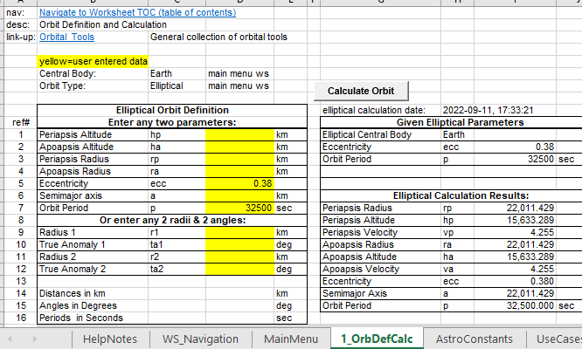
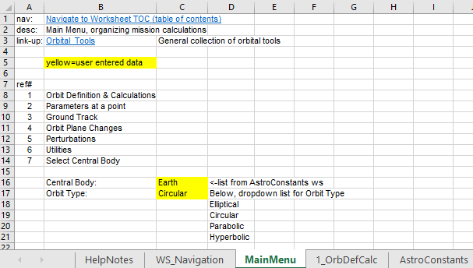
Part 2 – Code Development Plan
(sheet 1 of 3, detailed schedule at the end of backup slides)
Code could be developed with any language; I chose VBA with Excel
Start; Main Menu hyper-links user options; 7 options shown – left graphic
    User enters central body and orbit type; limited options for now
Develop orbit definitions and calculations worksheet (ws)
    Coding begins with Ellipse; parse user entered data & calculate orbit parameters
1) MainMenu worksheet (ws),
hyper-link to ws to carry out needed functions / calculations
2) User enter orbit parameters
3) Calculate button calls macro:
takes user entries, calculates orbital parameter results; also, results used in later developed worksheets

Slide 7
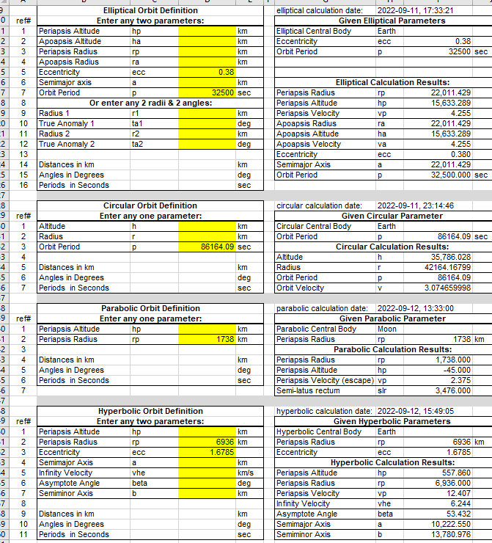
Part 2 – Code Development Plan
(sheet 2 of 3)
Orbit Definition and Calculation ws (worksheet) – examples shown below
Includes all orbit types:
  All conic sections (2-body motion)
    Elliptical
    Circular
    Parabolic
    Hyperbolic
Math is not the coding challenge; it’s been worked out for a long time (century +)
Coding challenges involve parsing/testing user inputs
  Displaying/outputting easy to read calculation results that feed trajectory & timing
Output a calculation path, showing calculation steps for orbital transfers
  Example; transfer from Earth to Mars

Slide 8
Part 2 – Code Development Plan
(sheet 3 of 3)
The following will be selected from the Main Menu worksheet (ws)
    User clicks on desired function; then hyper-links to associated ws
Orbit Definition & Calculations (all conic sections, 2-body motion):
    Calculations begin with ellipse, then circle, then parabola, then hyperbola
    Once ellipse coding is figured out, the other orbit types will be faster…
    90% of coding is error checking and moving data – fits the age old stats
Parameters at a point (pap)
    Needs orbit calculation data to calculate the various pap’s
    In the distant future I expect to add additional pap’s from that defined in the book
Ground Track
    A Graphic may be problematic for Excel; cross that bridge when I/we get to it
Orbit Plane Changes – as u know, it is expensive to make plane changes
Perturbations
    The distant goal for this is to keep this code simple; can get very complicated
Utilities – geometry; date/time, unit conversions; field of view; etc.
Select Central Body
    This module will probably go away; just have to see

Slide 9
Part 2 – Coding Challenges
Moving data around inside Excel with VBA – see code fragment below
  Using data headers allow data sections to evolve; get bigger/smaller
    Stay away from absolute addressing where ever practical; complicates coding during development changes
Parsing & limit testing user inputs
Multi-parameter inputs use different formula’s
  Many combinations of user inputs for parameter calculations
    i.e. 2-parameter entry out of 7 choices (elliptical orbit) = 21 combinations
    Many combinations specifically coded; generally coded with; if, elseif structure
Design macro to accommodate easy changes astro constants ws
If gpArray(1, 2) = "ecc" And _
gpArray(2, 2) = "p" Then
'get period from given parameter Array, gpArray()
p = gpArray(2, 3) 'period
'calculate semi-major axis, a
a = (((mu * p ^ 2) / (2 * pi) ^ 2)) ^ (1 / 3)
***
ElseIf gpArray(1, 2) = "ecc" And _
gpArray(2, 2) = "a" Then
ecc = gpArray(1, 3) 'eccentricity
***
End If
'find user given elliptical orbit definition values
strSearch = "Elliptical Orbit Definition"
Set fCel = eWS.Range("A1:AA500").Find( _
what:=strSearch, _
After:=eWS.Range("A1"), _
LookIn:=xlValues, _
lookat:=xlWhole, _
MatchCase:=True)
If fCel Is Nothing Then 'header not found
MsgBox ("Elliptical orbit definition header not found." & vbCrLf & _
"Verify proper ws" & vbCrLf & vbCrLf & _
"** exit calcEOrb() macro **")
GoTo ex_sub 'exit close-out gracefully
End If

Slide 10
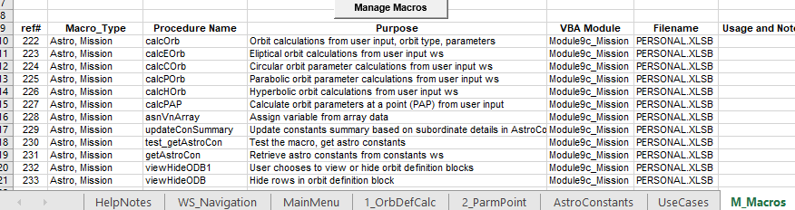
Part 2 – Coding To-Date
(sheet 1 of 3)
For anyone interested, I can use help with this project
Operation & Coding Process – note mission specific macros in graphic:
    Plan for use case: earth->mars, earth->venus, earth observation, geosync., …
    MainMenu: choose from list (1) central body, i.e. gravity center, (2) orbit type
      Hyperlink or Goto, 1_OrbDefCalc ws (worksheet) - no code related to this ws
    1_OrbDefCalc: user input orbit parameters; “Calculate Orbit”, “View or Hide Data”
      Macro’s/procedures: calcOrb->calcEOrb or calcCOrb or calcPOrb or calcHOrb
        Sub-macros: getAstroCon, viewHideODB
      Click button “Calculate Orbit”: then Goto, 2_ParmPoint ws
    2_ParmPoint: user input orbit position parameter to compute specific metrics
      Macro’s/procedures: calcPAP->getAstroCon, asnVnArray
      Click button “Parameters @ Point”

Slide 11
Part 2 – Coding To-Date
(sheet 2 of 3)
Operation & Coding Process: … continued
    AstroConstants ws: orbit and astronomical constants; Table1, Table2
      This ws helps make adding/removing orbit and Astro constants “easy”
      Click “Update Constants Summary” takes details in Table2 to update Table1
      Macro’s/procedures: UpdateConSummary
    UseCases ws: under construction, to document use cases to validate calculations
    M_Macros ws: stands for manage macros
      Click “Manage Macros” uses macros from my Utilities macros
      Presently I need to manually manipulate the list generated by “Manage Macros” button
  Thus far, mission tool development highlights the need to augment process defined in the book
Principle code inter-relations; code initiated by buttons in respective ws’s
  “Calculate Orbit” button in the 1_OrbDefCalc ws
    Macro, calcOrb: verify proper ws’s exists
    Parse user inputs & test limits
      View/Hide orbit type data blocks
      Based on orbit type (1 of 4) call orbit calculation macro
        Macro’s, CalcEOrb or CalcCOrb or CalcPOrb or CalcHOrb
        getAstroCon – retrieve astronomical constants
        Write orbit parameters to ws

Slide 12
Part 2 – Coding To-Date
(sheet 3 of 3)
Principle code inter-relations; … continued
  “Parameters @ Point” button in the 2_ParmPoint ws
    calcPAP: verify proper ws’s exists
    Parse user inputs & test limits
      Based on orbit type (1 of 2) calculate parameters related to the orbit point
        Write orbit parameters to ws
“Utility” macros used reside in separate VBA module
    sheetExist, viewHideODB (orbit definition block)
So far, ~1703 lines of code written for this project
    This includes BOTH source code and comment lines; I comment very liberally
    I estimate 500 lines of source code; keep in mind, some source code is repetitious
      Header searches, ws existence tests, error messages, …
I you are interested, equation relationship examples shown in backup slides

Slide 13
Next Steps
Only some of the orbit definition parameter combination calculations are presently done – next step, finish combinations
    Catalog variable names – orbital mechanics has tons of-em
Finish parameters at a point for the hyperbolic case
    Code user tests: circular and parabolic not presently used in the book, but there are parameter results I will want to include
Begin the other processes/ws’s identified in the MainMenu ws
Return to specific use cases defined in the book to get a better handle of both the 1) parametric calculation results and 2) user inputs
Figure out the calculation output method; an “automated” method to document the initial mission plan (trajectory)
    The book implies a documentation method that may work well
    This task is called “Mission Plan Report Develop” in the schedule on the last slide

Slide 14
Backup Slides
Backup slides hold supporting theory, calculations, and data, useful for a technically informed reader not fluent in the subtleties of the presentation topics
    In this case, backup slides help tie coding goals to the physics of orbital mechanics/astrodynamics
Orbital mechanics, astrodynamics background – a primer/teaser
Reference materials
Use cases – focused on central body & orbit type
Schedule overview – using ganttproject to manage schedule

Slide 15
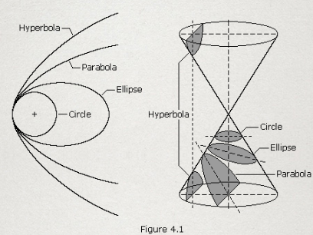
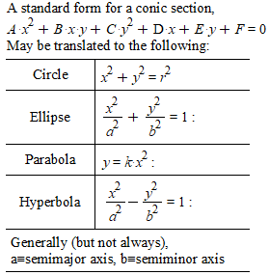
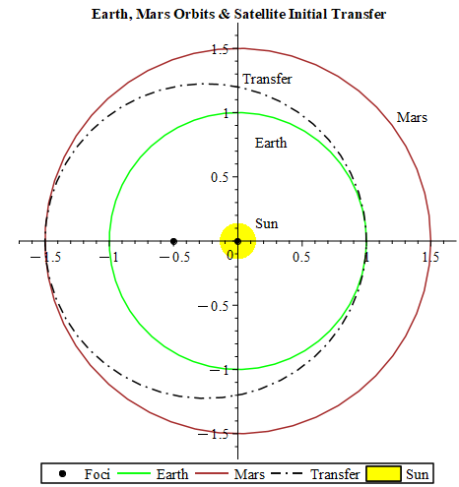
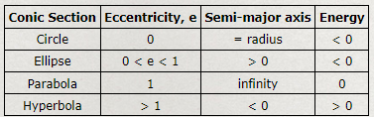
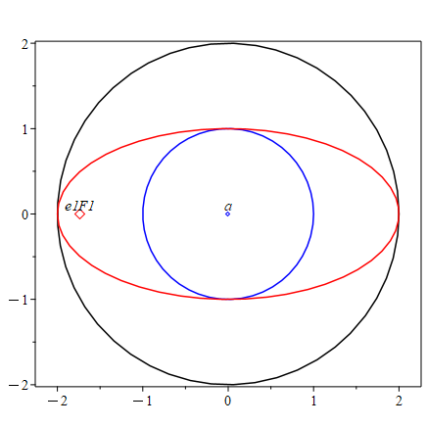
Backup: Basic Orbital Transfer Geometry
I leave orbital mechanics for the reader to explore. The reference slides below may help, as you explore on your own
Circle-Circle-Ellipse Trajectory
- Hohmann Transfer -
Graphics credit,
Robert A. Braeunig, http://www.braeunig.us/space/ , Part III Orbital Mechanics
Graphics credit, Jeff Belue, 2022

Slide 16
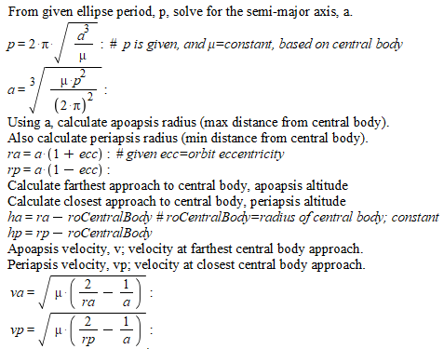
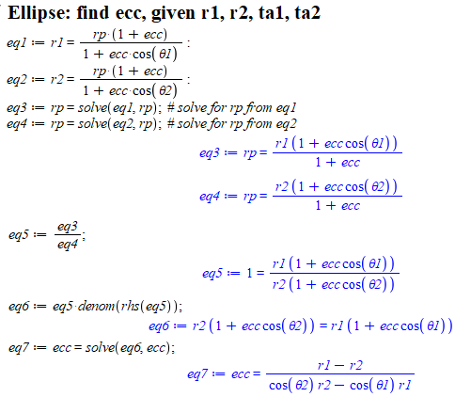
Backup: Example Orbital Formulas
I can update the formula relationships, below, if anyone is interested…
    Some definitions for the formulas below:
      P=orbital period, a=semimajor axis length, µ=gravitational constant * central mass
      rp=periapsis radius, ra=apoapsis radius, r0=central body radius
      hp=periapsis altitude, ha=apoapsis altitude
      θ=true anomaly (angle from periapsis)
      ecc=eccentricity – defines conic section “shape”

Slide 17
Reference: Mission Planning Software
Finding mission planning software that works for you, can be overwhelming and a big rabbit hole for your time
  Trust results? I always look for validation use-cases that I understand
Specialized tools I’ve used at one point or another:
  STK (satellite tool kit) - commercial
    Very powerful, widely used in industry through out the world
    Interfaces with many languages: Matlab, C++, Fortran, Python, Excel
    Several add-on packages for specialized study, $$
  GMAT (general mission analysis tool) – NASA, free
    One of several mission and trajectory analysis tools from NASA
    Code and reasonable documentation available on-line
  FreeFlyer
JPL has Monte, as an astrodynamics Python library
  Looks promising, but I’ve not used since I’ve only dabbled in Python

Slide 18
References: Text I Recommend
If you are interested in some orbital mechanics text; elementary and advanced – in my preference order; they are all great choices
    Orbital Mechanics for Engineering Students, 2nd ed, H.D. Curtis
      Matlab and some Excel associated code on-line
    Fundamentals of Astrodynamics and Applications, 4th ed, D.A. Vallado
      Detailed examples, including algorithm detailed explanations
    SMAD (Space Mission Analysis and Design), I prefer 3rd ed, J.R. Wertz
      Great for system engineering rigor – processes often used by NASA centers
    Fundamentals of Astrodynamics, 2nd ed, Bate, Mueller, White, (Saylor)
      Original circa 1971; generally known as BMW; Saylor was a later author
      Great book, generally considered a classic; an inexpensive Dover book
Even more serious texts:
    “Space books” in the AIAA Educational Series; including R.H. Battin’s book
    Widely known authors: J. Meeus, J.M.A. Danby, Duffet-Smith, R.A. Braeuning
Fun texts:
    The Sheer Joy of Celestial Mechanics, N. Grossman
    Adventures in Celestial Mechanics, V.G. Szebehely
    Newtons Gravity, Douglas W. MacDougal

Slide 19
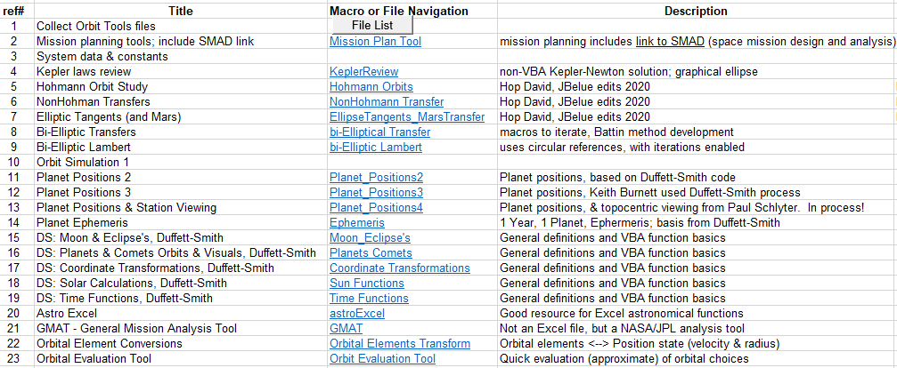
Reference: Orbital Mechanics Tools
Many useful Excel tools address individual orbital mechanics needs
  Generally, there is not an integrated Excel orbital mechanics package
  On-line, Hop David has spreadsheets I’ve used with my personal edits
    See next slide for Hop David on-line link
  Below, my desperate list of files, Excel et.al.; many with macros (275+ total…)
    My personal on-going file/application management tool – in Excel

Slide 20
Reference: Resources
Below, are some noteworthy resources to inspire you to poke around
MIT Astrodynamics: on-line course, generally based on R.H. Battin
    https://ocw.mit.edu/courses/16-346-astrodynamics-fall-2008/pages/lecture-notes/
On-line learning with spreadsheets
  Hop David: on-line, interesting collection,
    http://clowder.net/hop/railroad/sched.html
    Hohmann, non-Hohmann, Mars transfer, cleaver ellipse tangents calculation
  Atomic Rockets: several authors; also, explores space society building
    http://projectrho.com/public_html/rocket/calculators.php
As a reminder of the basic space flight science, I suggest a quick look at Part III – Orbital Mechanics, of the following link
    http://www.braeunig.us/space/
Many, many, many, more orbital mechanics and astrodynamics learning resources available on-line
    I have yet to find reasonable beginner to expert launch-to-landing and return software resource

Slide 21
Use Cases
Use cases being worked out, generally following the book
  Geosynchronous / earth observation (remote sensing)
  Earth->Venus
  Earth->Mars
  Venus Observation
Orbit definition
  Ellipse; central body - Earth, Sun
    eccentricity, period, C.D. Brown, page 137, 138
  Circle; central body - Earth, Sun

Slide 22
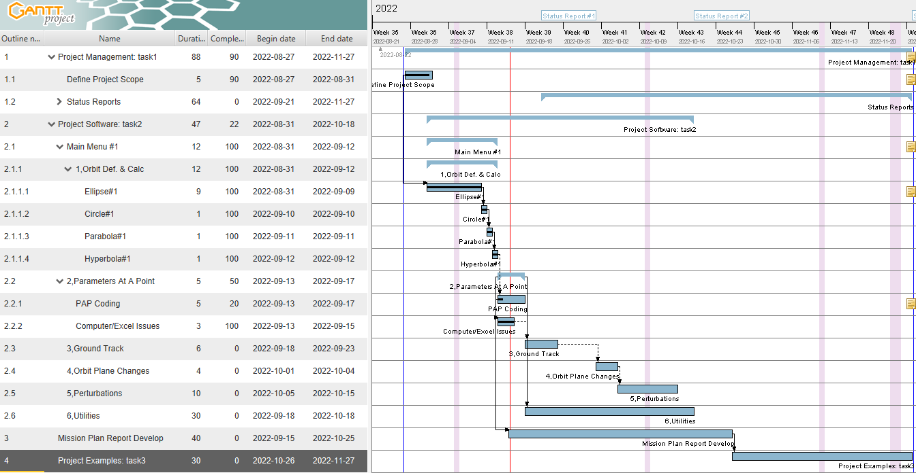
Project Schedule
(GanttProject software)
On-line free software; easier than MS Project, or Excel add-ins
    https://www.ganttproject.bz/download
    My experience with GanttProject helps expedite schedule/project management

