Slide 1
Stroke Prediction
Zhang Haorui P02 (2101806D)

Slide 2
Background
The topic theme selected is neuro health.
According to the World Health Organization (WHO) stroke is the 2nd leading cause of death globally, responsible for approximately 11% of total deaths.
This dataset is used to predict whether a patient is likely to get stroke based on the input parameters like gender, age, various diseases, and smoking status.
Each row in the data provides relevant information about the patient.

Slide 3
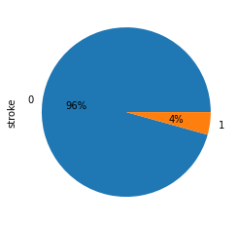
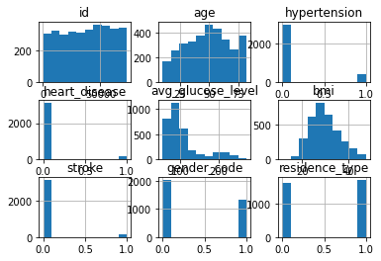
Dataset
Dataset is collected from Kaggle.
Dataset has 5110 rows and 12 columns.
Source of dataset: fedesoriano
Data cleaning will be needed as there are missing values in the dataset.
Data transformation will be needed as there are categorical values found in the dataset.
Dataset is also not well-represented.
96% of participants had a stroke while only 4% did not had a stroke.
This can also be seen for hypertension and heart_disease columns.
df['stroke'].value_counts().plot(kind='pie',autopct='%1.0f%%')
df_smoke.hist()

Slide 4
Data Dictionary
1) id: unique identifier 2) gender: "Male", "Female" or "Other" 3) age: age of the patient 4) hypertension: 0 if the patient doesn't have hypertension, 1 if the patient has hypertension 5) heart_disease: 0 if the patient doesn't have any heart diseases, 1 if the patient has a heart disease 6) ever_married: "No" or "Yes" 7) work_type: "children", "Govt_jov", "Never_worked", "Private" or "Self-employed" 8) Residence_type: "Rural" or "Urban" 9) avg_glucose_level: average glucose level in blood 10) bmi: body mass index 11) smoking_status: "formerly smoked", "never smoked", "smokes" or "Unknown"* 12) stroke: 1 if the patient had a stroke or 0 if not *Note: "Unknown" in smoking_status means that the information is unavailable for this patient

Slide 5
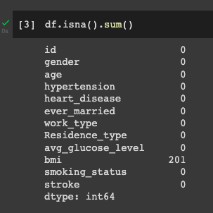
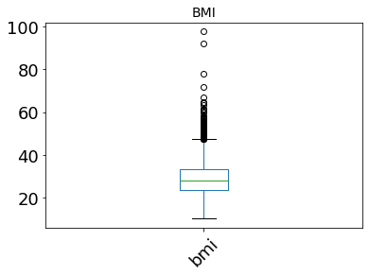
Data Cleaning
Missing values that were found at the bmi column were removed.
Values in the bmi column are missing completely at random.
Assumption of bmi values will have a biased data.
Unrepresentative Data (bmi column)
Many outliers in the bmi column as shown in the boxplot.
Removal of mild outliers using the formula q3 + 1.5*iqr .
Unrepresentative Data (stroke, heart_disease, hypertension columns)
As shown in the histogram, only a few participants who had hypertension, heart disease and stroke.
Leads to biased data as it is not well represented.
Machine Learning models may not be able to capture and train the minority data points.
Oversample the data, which duplicates the minority data points to obtain a balanced. (No data deleted)

Slide 6
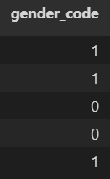
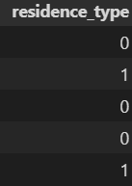
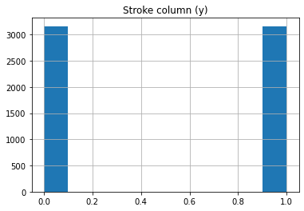
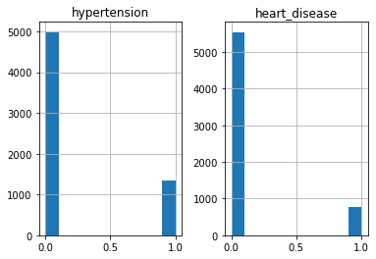
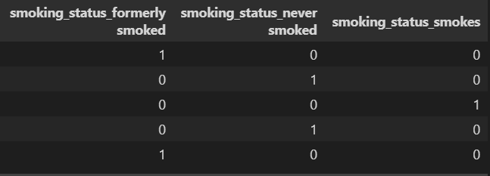
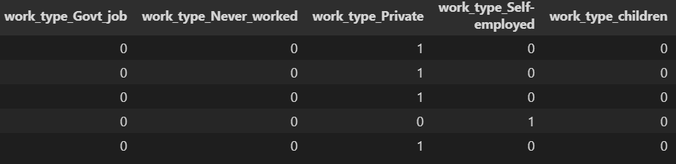
Data Transformation
Binning is used at columns that have true or false values (is_married).
Binning transforms one column (is_married) to a Boolean datatype.
True represents 1 while False represents 0.
Encoding is used to separate the categorical data types such as residence type, smoking status, occupation and gender.
Many machine Learning models and algorithms cannot read categorical data.

Slide 7
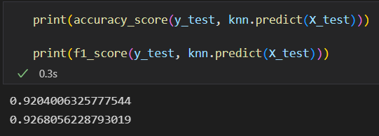
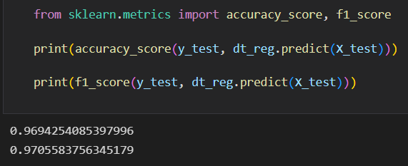
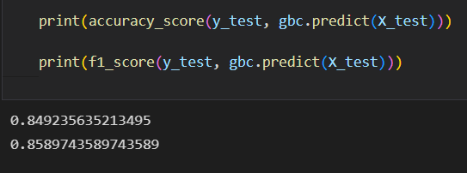
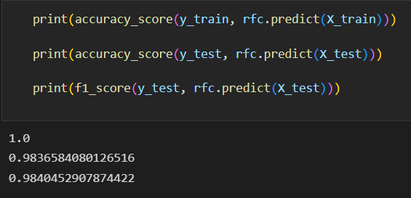
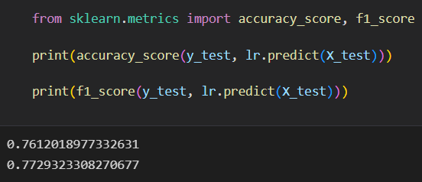
Modelling
K-Nearest
Decision Tree
Gradient Boosting
Dataset is split into X (other columns besides stroke) and y (stroke) datasets.
Train_test_split function was run where train size is 70% while test size is 30%.
Five machine learning models are tested.
Decision Trees
Logistic Regression
Random Forest Classifier
K-Nearest Neighbour Classifier
Gradient Boosting Classifier
Random Forest Classifier
Logistic Regression

Slide 8
Modelling (Cont.)
Random Forest Classifier turns out to be the best model compared to the other four models.
Accuracy score for testing: 0.984
Accuracy score for training: 1
F1 Score: 0.984
Random Forest Classifier is a very accurate model for predicting the stroke column.

Slide 9
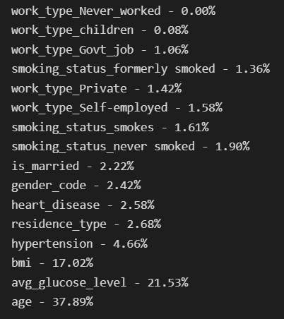
Feature Selection
Since encoding is done for work_type and smoking_status columns, it is unsure which columns will have a significant impact on the predicting column (stroke).
Feature selection is needed to find out if which column has a significant impact on the predicting column.
The columns that will be kept are the top 9 most impactful features.
age, avg_glucose_level, bmi, hypertension, residence_type, heart_disease, gender-code, is_married, smoking_status_never smoked.

Slide 10
Conclusion
Grid search was not necessary.
Accuracy score for the Random Forest Classifier model is near perfect.
Good in training and prediction.
The raw dataset was not perfect.
It is not well representative of some of the features.
E.g. 4% of participants who had stroke.
Over-sampling can duplicate rows to ensure that minority features are well represented.
Dataset will be well-balanced.
The model will be able to train and predict accurately.

