Slide 1
Dynamic peer-to-peer game networks using WebRTC
Jasper Abbink, Karens Grigorjancs, Joost Verdoorn
28 August 2013
Welcome● Assignment● WebRTC ● Peer-to-Peer ● Game ● Technology ● Quality & Testing ● Conclusion ● Questions?

Slide 2
Assignment
Welcome● Assignment● WebRTC ● Peer-to-Peer ● Game ● Technology ● Quality & Testing ● Conclusion ● Questions?

Slide 3
WebRTC
Welcome ● Assigment● WebRTC ● Peer-to-Peer ● Game ● Technology ● Quality & Testing ● Conclusion ● Questions?

Slide 4
Peer-to-Peer Introduction
What is it?
Decentralised distributed network architecture
No central server
Applications
File sharing (BitTorrent)
Instant messaging (Skype)
Media streaming (P2PTV)
Content distribution (CDN)
Infrastructure
Unstructured networks
Structured networks
Welcome ● Assignment ● WebRTC ● Peer-to-Peer ● Game ● Technology ● Quality & Testing ● Conclusion ● Questions?

Slide 5
Peer-to-Peer Network organisation
Node properties
Session duration, bandwidth, connectivity, latency…
Topology guidelines
Adaptations should use limited information
Adaptations should not break network if using incorrect information
A network should ensure connectivity to each node
…
Node positioning
Location based
Semantic based
Welcome ● Assignment ● WebRTC ● Peer-to-Peer ● Game ● Technology ● Quality & Testing ● Conclusion ● Questions?

Slide 6
Peer-to-Peer Vivaldi node positioning
Positions nodes in a n-dimensional space
Tries to equal Euclidean distance and latency between nodes
Implementation
A node starts at [-2, 2]
A node calculates its latency to nodes and asks their position
Adapts its own position
After a while, slows down to prevent oscillation
Welcome ● Assignment ● WebRTC ● Peer-to-Peer ● Game ● Technology ● Quality & Testing ● Conclusion ● Questions?

Slide 7
Peer-to-Peer PoPCorn supernode election
Relies on coordination based system like Vivaldi
Decentralised approach of electing a supernode
Implementation
A supernode generates a token and gives it to a random child
A node advertises its token and calculates the desired token position
A node calculates which node is the best candidate for the token
A node gives the token to the best candidate
If self, a node becomes a supernode
Welcome ● Assignment ● WebRTC ● Peer-to-Peer ● Game ● Technology ● Quality & Testing ● Conclusion ● Questions?

Slide 8
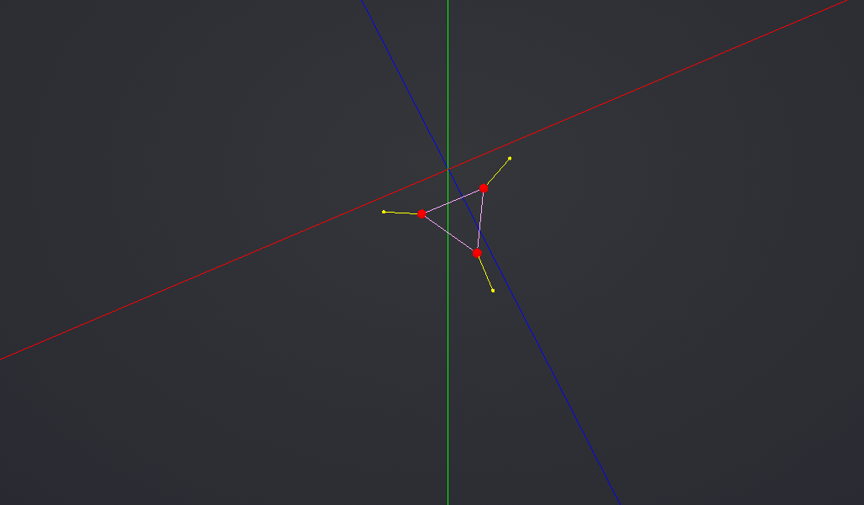
Peer-to-Peer Live demonstration
Welcome ● Assignment ● WebRTC ● Peer-to-Peer ● Game ● Technology ● Quality & Testing ● Conclusion ● Questions?

Slide 9
Game subtitle
Welcome ● Assignment ● WebRTC ● Peer-to-Peer ● Game ● Technology ● Quality & Testing ● Conclusion ● Questions?

Slide 10
Technology subtitle
Welcome ● Assignment ● WebRTC ● Peer-to-Peer ● Game ● Technology ● Quality & Testing ● Conclusion ● Questions?

Slide 11
Quality and Testing subtitle
Welcome ● Assignment ● WebRTC ● Peer-to-Peer ● Game ● Technology ● Quality & Testing ● Conclusion ● Questions?

Slide 12
Conclusion Reflection on research question
In what way can one create a dynamic peer-to-peer multiplayer-game-network-topology that scales with the amount of users participating by only using WebRTC?
How can one distribute essential network tasks over all peers?
How can the impact of unpredictable circumstances (peers suddenly leaving the network) be reduced?
How can all data reach all peers in a bandwidth-efficient way?
Welcome ● Assignment ● WebRTC ● Peer-to-Peer ● Game ● Technology ● Quality & Testing ● Conclusion ● Questions?

Slide 13
Conclusion WebRTC impact
Turbulent growth of knowledge on internet
Easy accessible with WebRTC libraries
Benefits from growth of JavaScript and HTML5 web applications
Browser dominance vs. Desktop applications
Browser compatibility still an issue
Expected a continuous growth in the next years
Welcome ● Assignment ● WebRTC ● Peer-to-Peer ● Game ● Technology ● Quality & Testing ● Conclusion ● Questions?

Slide 14
Questions?
Library repository Link
Game repository Link
Orbit Impossible http://webrtc.jstfy.com/
Play, Download and Contribute!
Welcome ● Assignment ● WebRTC ● Peer-to-Peer ● Game ● Technology ● Quality & Testing ● Conclusion ● Questions?

