Slide 1
Predicting Mental health disorders using Machine Learning for employees in technical and non-technical companies 2020 IEEE Belaynesh Mossie

Slide 2
Short description
Main aim
Predict mental health disorders among employees using machine learning techniques.
Using the OSMI 2019 survey data to predict whether an employee is likely to have a mental health disorder
Goal
Identifying the most effective algorithms for this prediction
Understanding the contributing factors to mental health disorders
Why:
The study addresses mental health challenges in workplaces.
The use of widely known ML models like Logistic Regression, SVM, Decision Trees, and Random Forest.
The dataset (OSMI 2019 Mental Health Survey) is publicly accessible

Slide 3
Methodology
Preprocessing
Handle data imbalance
Models from Original Study:
K-Nearest Neighbors (KNN)
Support Vector Machine (SVM)
Logistic regression
Decision Tree
Random Forest
Naive Bayes
Additional Model:
XGBoost
Evaluation metrics: Accuracy, Precision, Recall, F1-score
Method used: K-fold cross validation

Slide 4
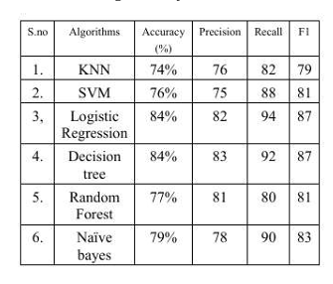
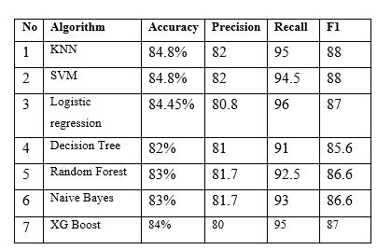
Result

Slide 5
