Slide 1
Multilabel Classification
Belaynesh Mossie
ID 1610803

Slide 2
Contents
Definition
How it works
Algorithms
Real world application
Demo

Slide 3
Definition
Type of classification task where each instance can belong to multiple classes simultaneously.
Involves training a model to predict a set of labels for each instance.
multi-label classification requires specialized machine learning algorithms that support predicting multiple mutually non-exclusive classes
A news article may belong to multiple categories like sport, politics, entertainment, technology, or economy.

Slide 4
How it works
In multilabel classification, each instance is represented by a set of binary labels (0s and 1s).
When given a new instance, the model predicts which labels are applicable.
The output is typically a binary vector where each element corresponds to a label
Evaluation metrics include precision, recall, F1-score, and subset accuracy, adjusted for multilabel scenarios.
Common approaches include:
Problem Transformation and Algorithm adaptaion

Slide 5
Algorithms
Problem Transformation Methods: Convert multilabel problems into multiple single-label problems. Examples include Binary Relevance, Classifier Chains, and Label Powerset.
Binary Relevance: Treat each label independently and train a separate binary classifier for each label.
Classifier Chains: Train a chain of classifiers where each classifier deals with one label and uses the predictions of previous classifiers as additional features.
Label Powerset: Treat each unique set of labels as a separate class and train a single multi-class classifier.
Algorithm Adaptation: Modify existing algorithms to handle multilabel data directly. Examples include multilabel k-nearest neighbors (kNN) and multilabel neural networks.

Slide 6
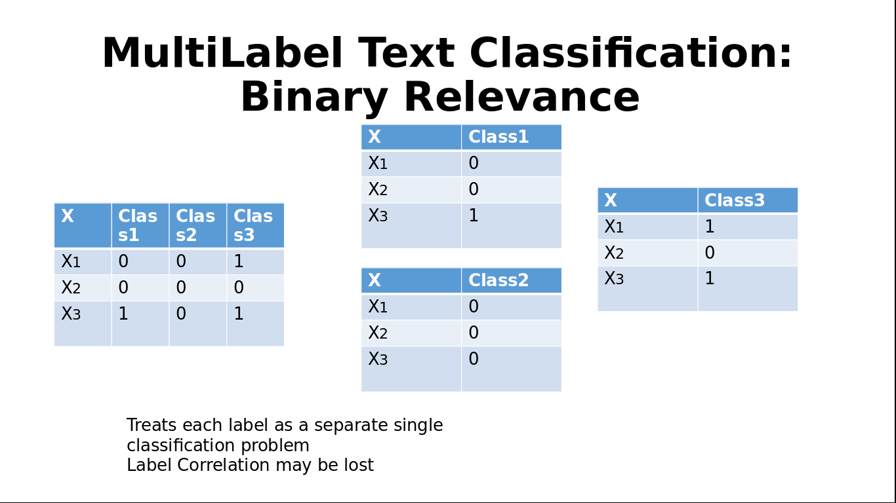

Slide 7
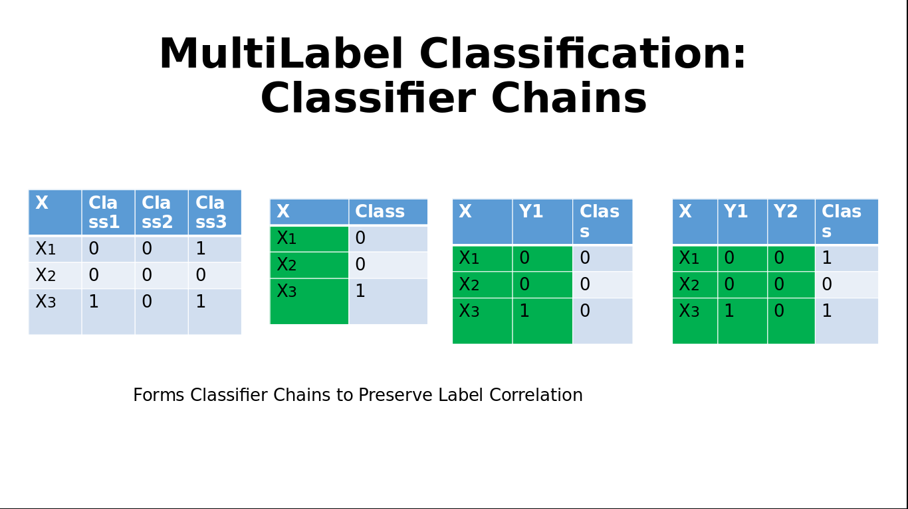

Slide 8
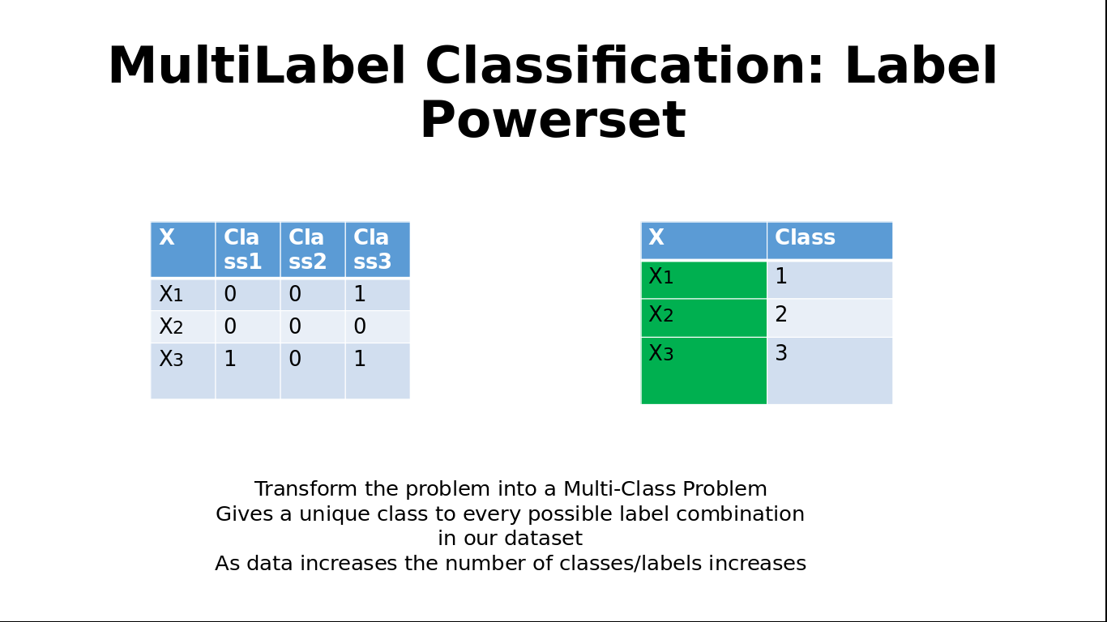

Slide 9
Real world applications
Text Classification:
A news article can be categorized into multiple topics such as "politics", "economy", and "technology".
Image Tagging:
An image can be labeled with multiple tags such as "cat", "indoor", and "cute".
Medical Diagnosis:
A patient’s symptoms can lead to multiple diagnoses or conditions, such as "diabetes", "hypertension", and "obesity".
Recommender Systems:
A movie recommendation system might suggest multiple genres or categories, such as "action", "comedy", and "thriller".

Slide 10
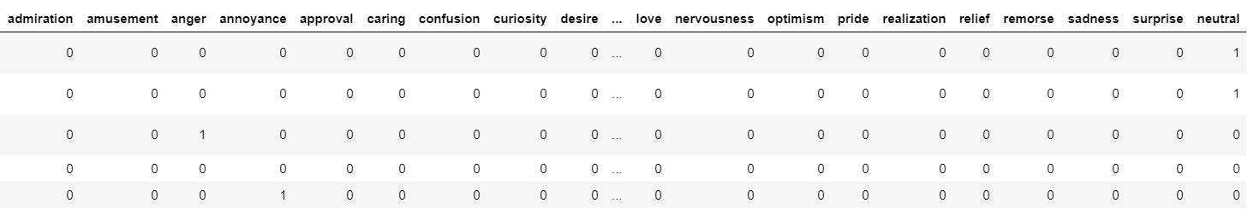
Demo

