Slide 1

Becky Matthews-Pease IST 719: Information Visualization
Tableau can “gather and extract data that are stored in various places. It drags data from any platform imaginable.”

Slide 2
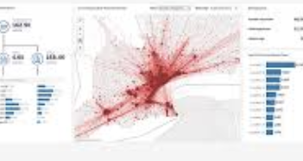

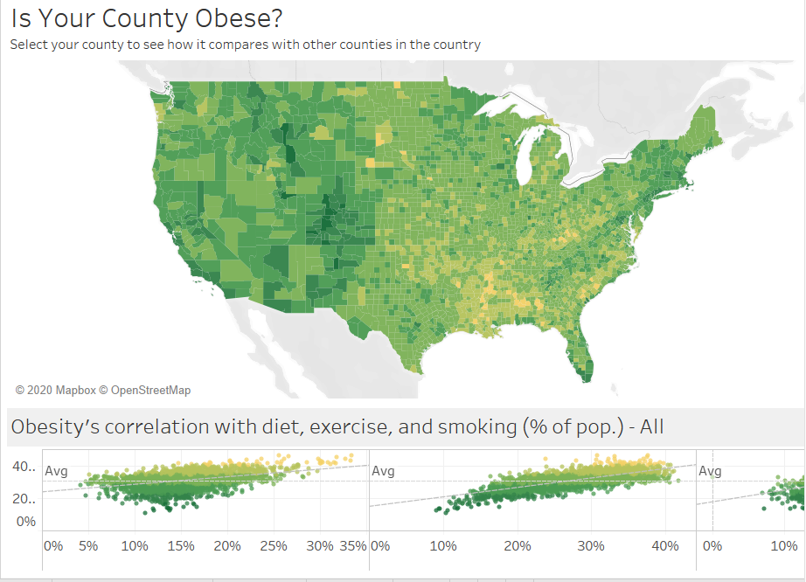
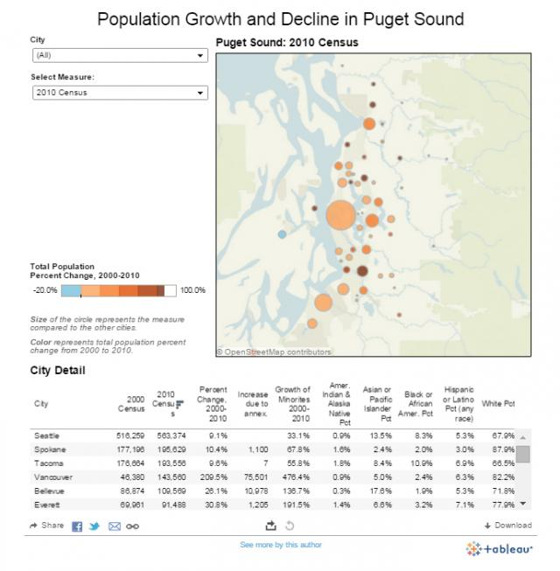
Tableau Public
A cost-effective option for individuals
Files are stored in the cloud and can’t be saved locally.
Files are also available publicly.
Tableau Desktop (Professional and Personal)
Intended for businesses/organizations
Full access to all data types
Work can be published in Tableau server
Workbooks are private and can’t be posted online.
More limited access than Desktop Pro
Tableau Online
Items are stored in the cloud
Enables users to share interactive Tableau work with anyone
Tableau Server
Allows sharing between organizations.
Works published on Tableau desktop can be made available to the licensed users who can view via browser
Tableau Reader
Lets a user view and/or share Tableau documents and dashboards
https://www.newgenapps.com/blog/what-is-tableau-its-uses-and-applications/

Slide 3

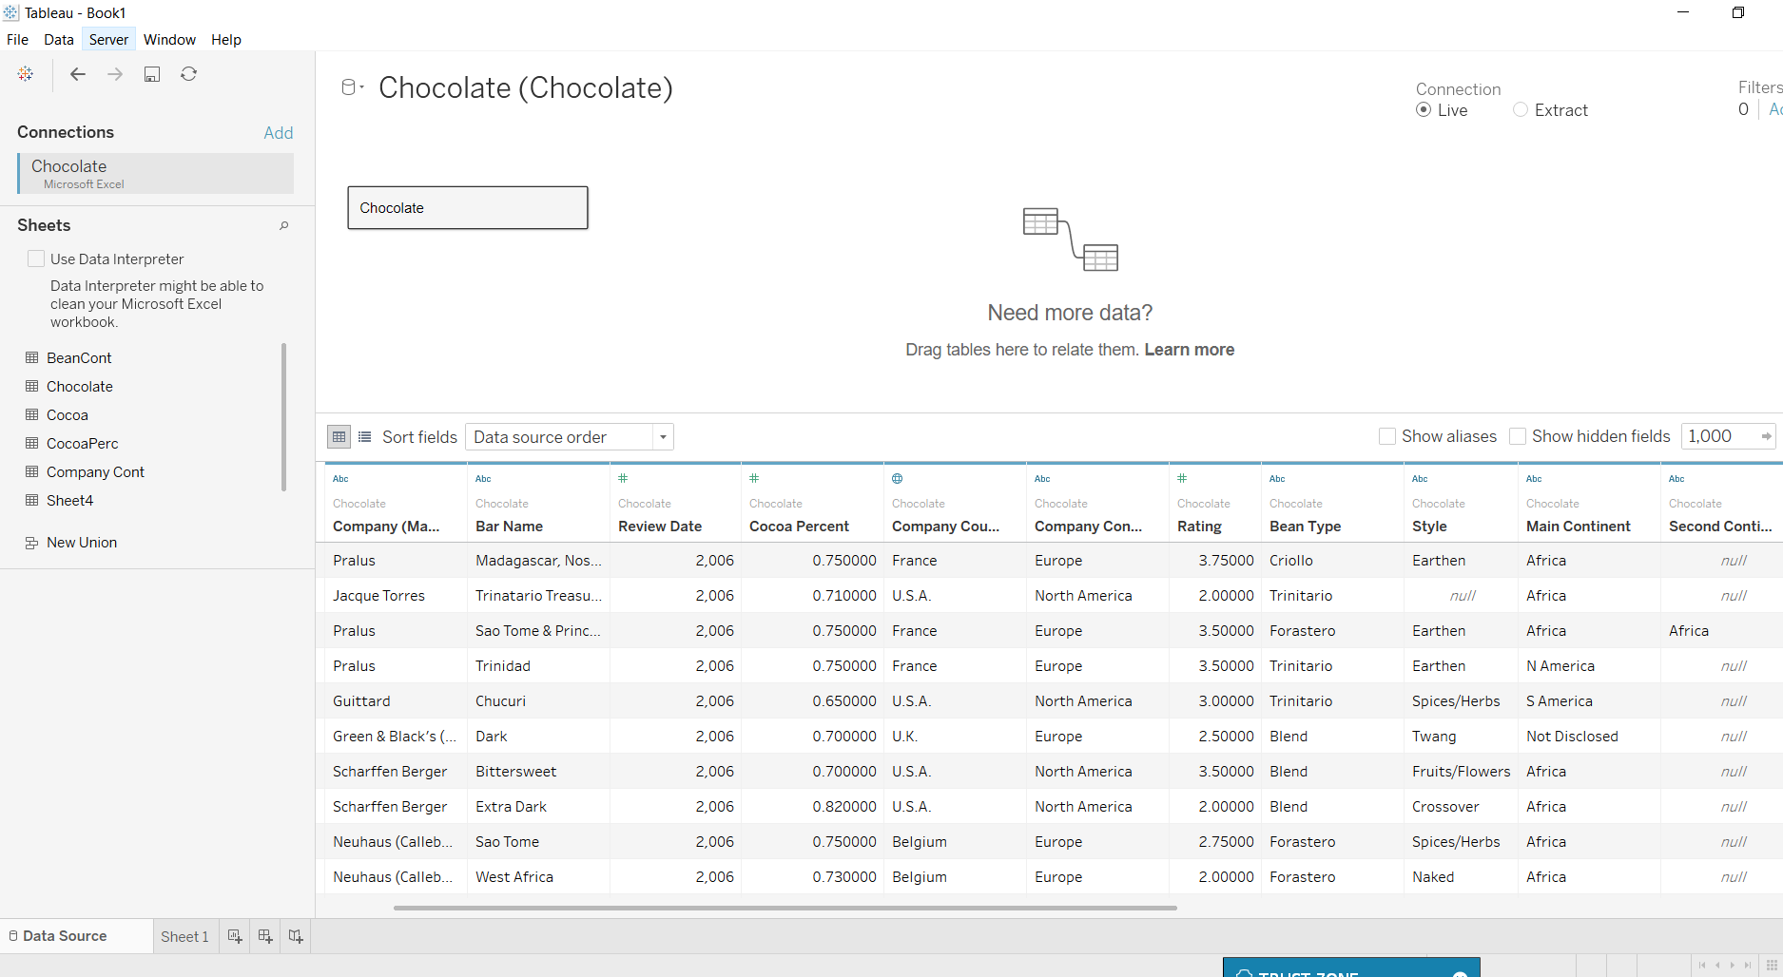
Features of Tableau
Toggle view and drag-and-drop
Dashboard commenting
Translate queries to visualizations
Import all ranges and sizes of data
Highlight and filter data
Security permissions at any level
Not well suited for data creation or clean up
Workbooks are similar to Excel spreadsheets, where a data set can be viewed, edited and filtered
Can combine public and proprietary data. For example, census data with company proprietary data
Create charts and interactive dashboards tracking and reflecting company KPIs in real time
Connects with 60+ data resources such as Microsoft SQL server, Amazon Redshift, Salesforce.
https://interworks.com/blog/dmurray/2014/12/29/what-tableau-and-not/

Slide 4

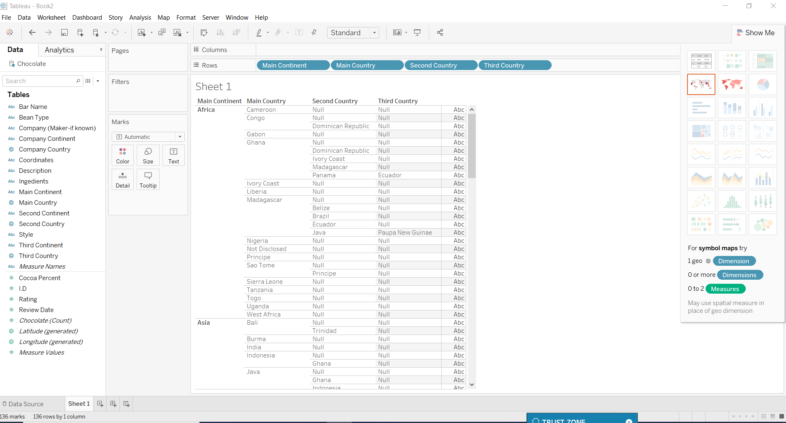
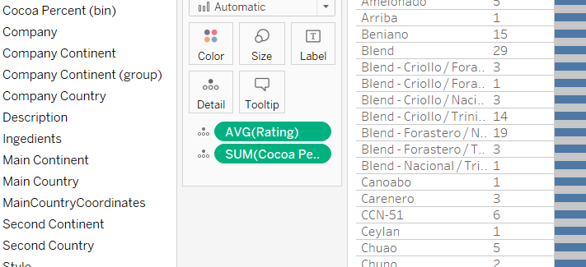
Variables can be arranged in a similar manner to Excel Pivot Tables:
Variables from the “Tables” column placed in the columns and row categories via
drag and drop. Values are dropped under “Marks” box
Clicking on a variable in the value field gives the option to change to sum, mean, median, and other various calculations

Slide 5
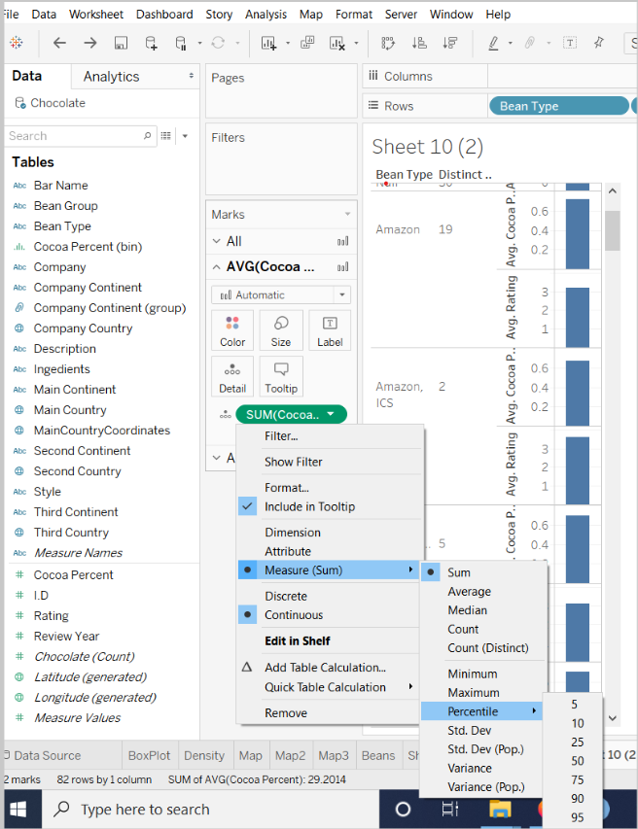
Different data sources can be pulled in, and data refreshed as needed
Variables are dragged and dropped into row, column, or value fields
Variables can easily be redefined as categorical, discrete and continuous
Different calculations ca be performed with data categories
Different workbooks can be viewed by clicking the tabs along the bottom

Slide 6
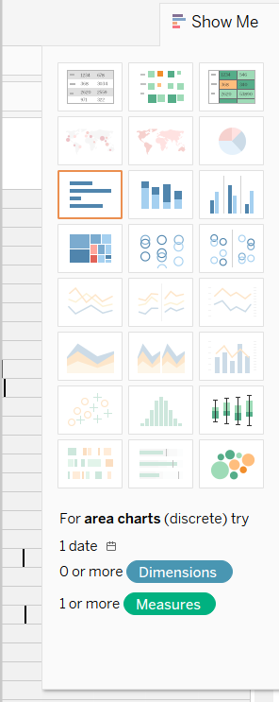
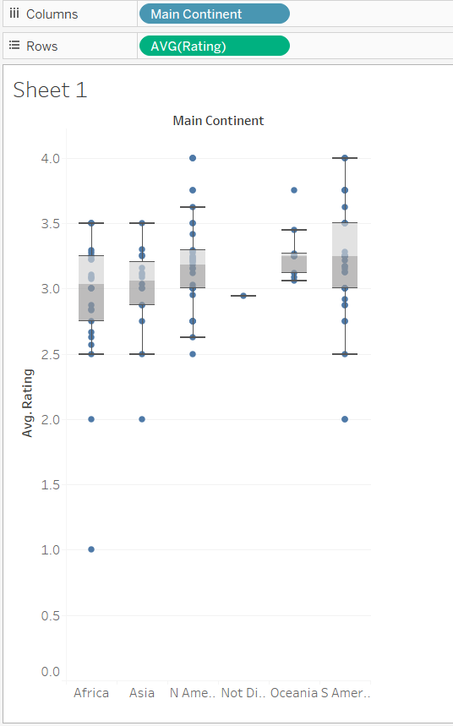
The left side of the application shows different graph options. Users can select any graph type not greyed out
Clicking each graph will tell users what type of information would be needed to use each graph type
Example Box Plot

Slide 7

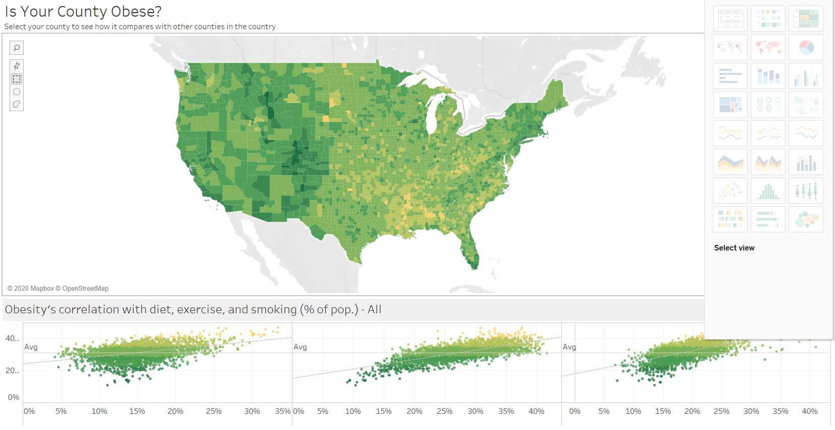
Publicly Available Interactive Dashboard:

Slide 8

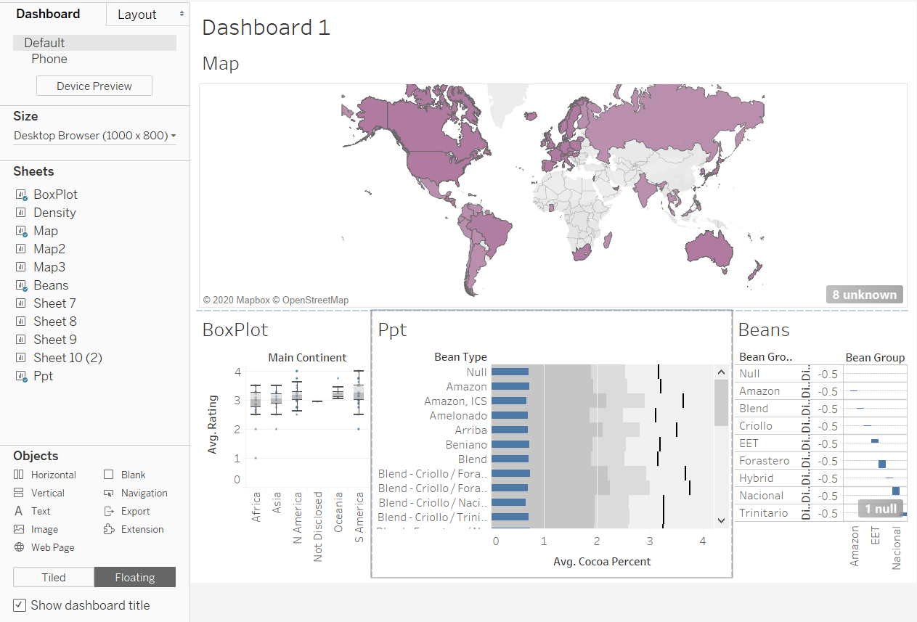
Combine graphs into dashboards:

Slide 9

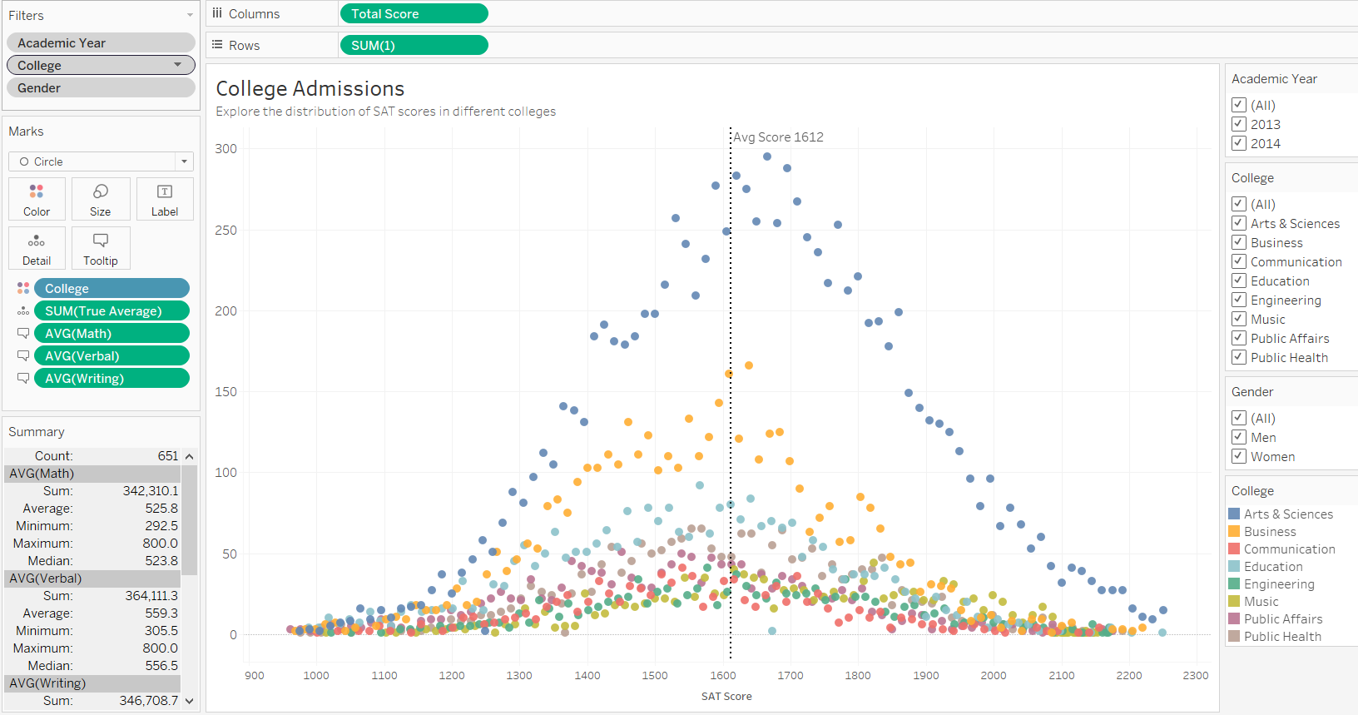
Publicly Available Interactive Graph: College Admissions

Slide 10

Thank you
Becky Matthews-Pease

