Slide 1


Customer Demographic Segmentation
Becky Matthews-Pease
With low interest rates, banks and credit unions are facing the need to grow deposits. Low interest rates have resulted in a decrease in deposits and an increase in loans, creating the need to increase deposits in order to continue to provide low interest loans. Customer segmentation by age and income can be utilized to produce targeted marketing that will result in increased deposits.

Slide 2

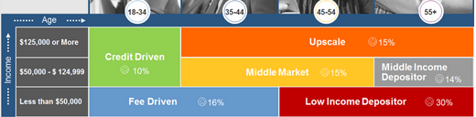
Proposed Segmentation by
Age and Income:
A 2019 study by Raddon divided the market based on age and income, defining each segment with descriptions such as “credit driven,” or “fee driven.” These divisions are added to a large data set of bank customers that is being used as the theoretical data set.
https://www.raddon.com/raddon-report/whom-target-deposits

Slide 3

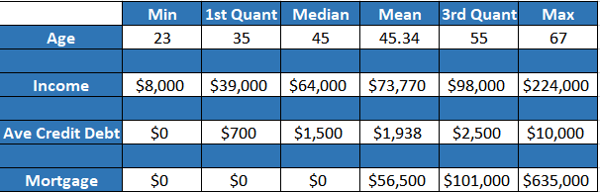
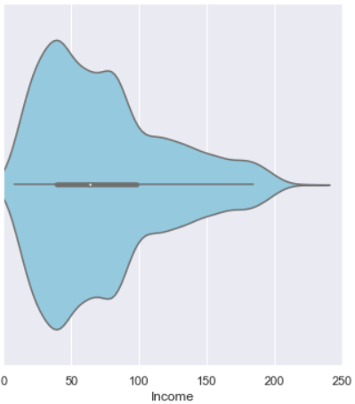
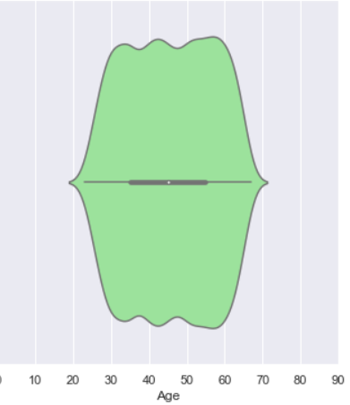
Proposed Segmentation by
Age and Income:
A data analysis of this dataset shows strong support for this proposed segmentation:
The Variables
Continuous:
Age
Years of Work Experience
Income
Average Credit Card Debt
Mortgage Amount
Discrete:
Education Level
Family Size
Binomial:
Personal Loan
Securities Account
Certificate of Deposit
Online User
Credit Card
Distribution of Income & Age

Slide 4
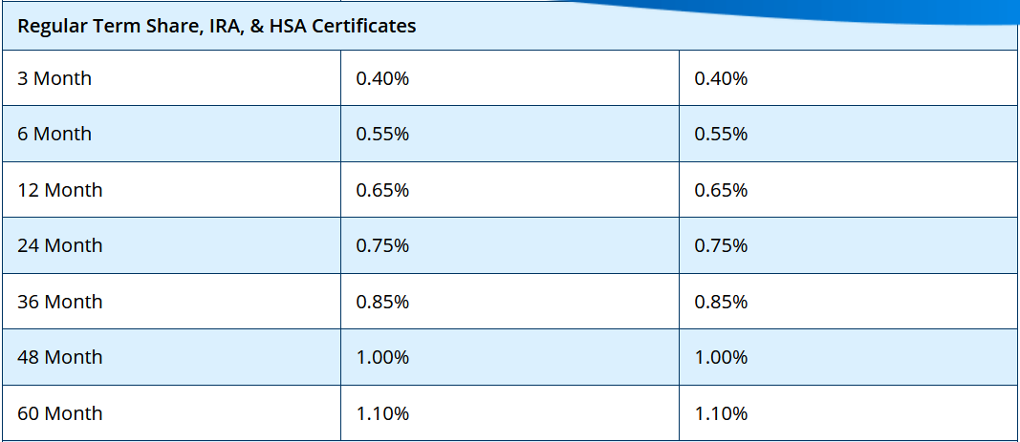
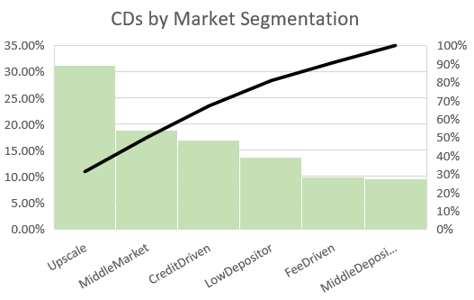
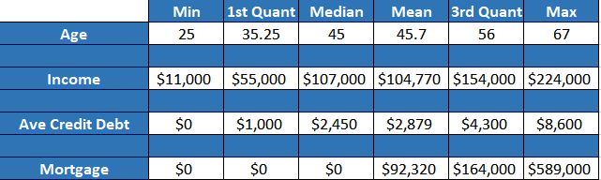
Certificates of Deposit
Traditionally research has shown that as individuals grow older, they become more risk-averse in their investments. Investing in CDs is an opportunity to invest without the risk of major loss. Looking at the dataset, Middle Market and Upscale segments make up over 40% of those who have investments in a certificate of deposit.
Drilling down further, we see that the median for CD investors is 45 years old with an income of $107,000, and the overall range of each variable skews towards higher numbers than the overall dataset.

Slide 5
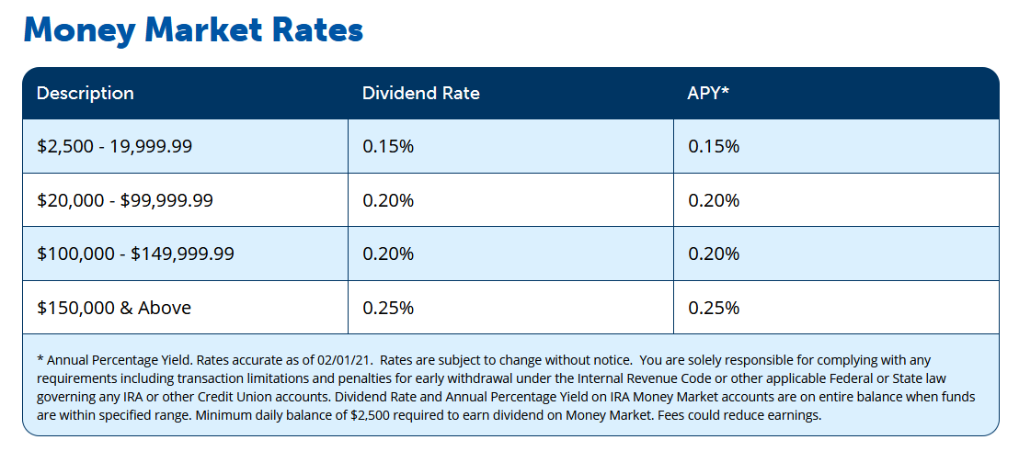

Money market accounts are another low-risk investment, but also one with the flexibility of withdrawal if necessary. The target market would be the credit and fee driven segments as well as the younger segments of the middle market and upscale segments – mainly those individuals at early adult life stages such as marriage and birth of children.

Slide 6
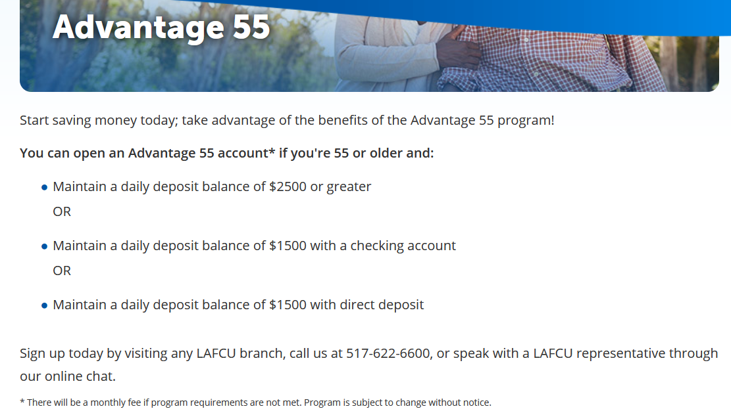

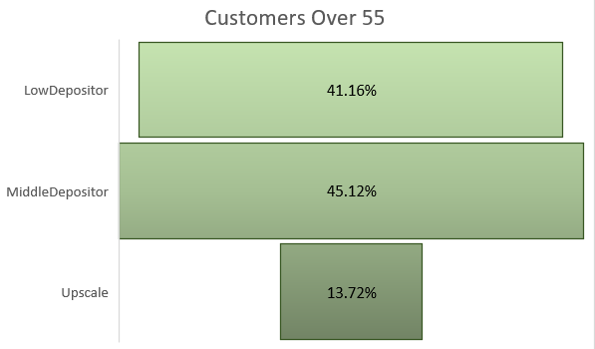

Customers Over Age 55
The Middle Depositor segment would be a good target for the Advantage 55 product. Of those customers in the data set, nearly half fall into this category. This segment would likely be able to maintain the minimum daily balances without inconvenience.
Low
Depositor
Medium
Depositor
Customers Over Age 55
Upscale

Slide 7
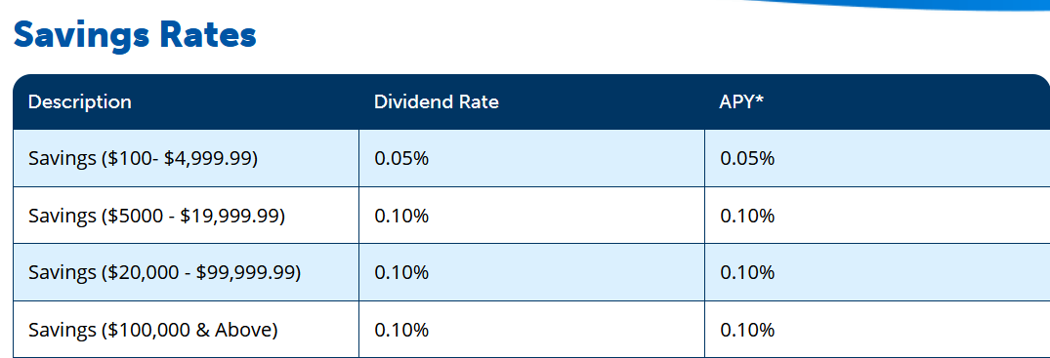
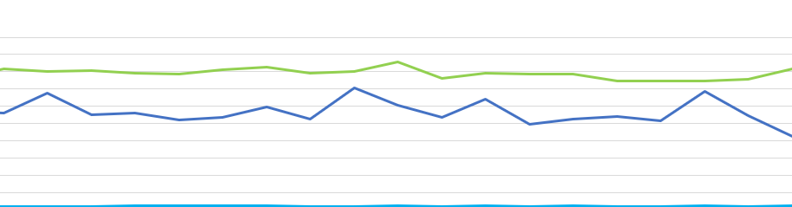

Individuals of the Middle Market and Middle Income Depositor segments start to stabilize in terms of income, mortgage debt and credit card debt. They are likely to have the ability to keep minimum balances in savings account, and will be saving for children’s college tuition and retirement.
Income
Customers Age 35+ with $50,000-$124,999 Income
Ave Mortgage
Ave Credit Card Debt
Average Income
Age

Slide 8

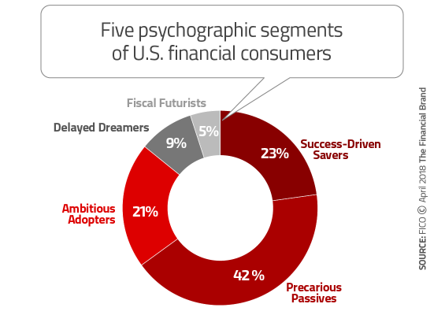
Beyond Demographic Segmentation
Segments can be refined using psychographic segmentation. By looking at customer deposit trends, purchasing habits, concerns, etc., more targeted campaigns can be sent to customers. When customers receive campaigns tailored to their interests and values, this results in a higher return on investment for campaigns.
Further data can be collected on current and potential customers based on social media. APIs can be used to review how users are responding to social media posts, how they interact with these posts, and what they have to say about a product or company
FICO cites the following segments based on surveyed
customers behaviors and attitudes towards financial products
https://www.fico.com/en/node/8140?file=12791

Slide 9

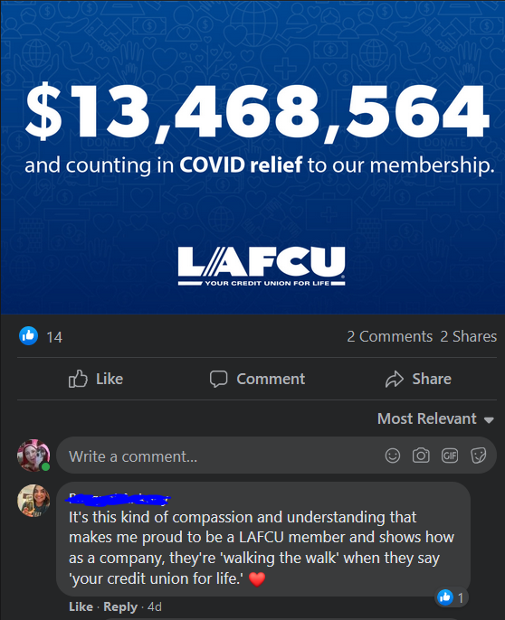


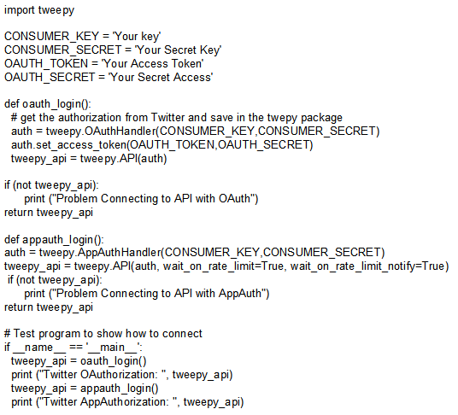
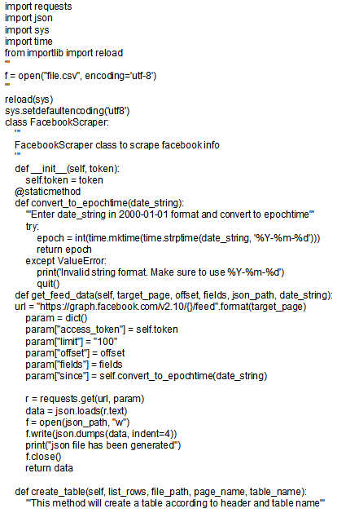
Social Media Scraping
With API code and developer accounts, analysis can go beyond number of likes, shares, levels of interaction and sentiment analysis.
Researchers can also discover the likes, needs, and habits of those who interact with social media posts, and using those trends attract more customers

Slide 10

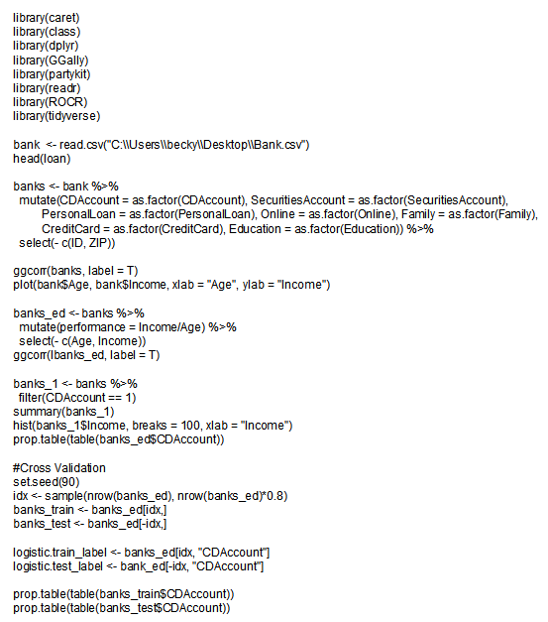
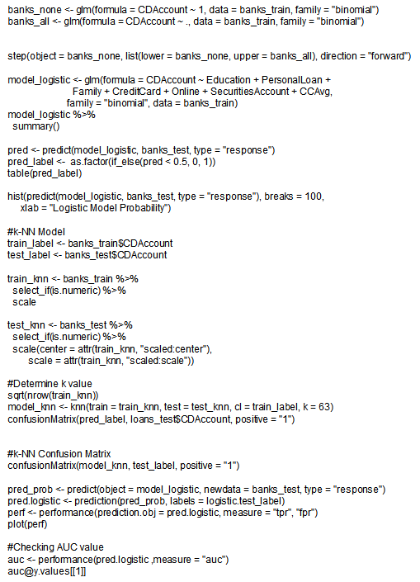
Exploring the Data with RStudio:
The Code Used

