Slide 1
Build.WithConfidence();
on API design, fluent interfaces and the builder pattern
GranitTreff #2 | 03.06.20 | @bemayr

Slide 2



Bernhard Mayr
studying psychology and philosophy @ university of innsbruck
studied software engineering @ fh hagenberg
working as a researcher @ innerspace gmbh
/
bemayr

Slide 3
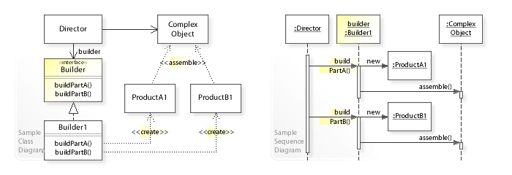
Let’s start with some UML…
http://w3sdesign.com/?gr=c02&ugr=struct

Slide 4
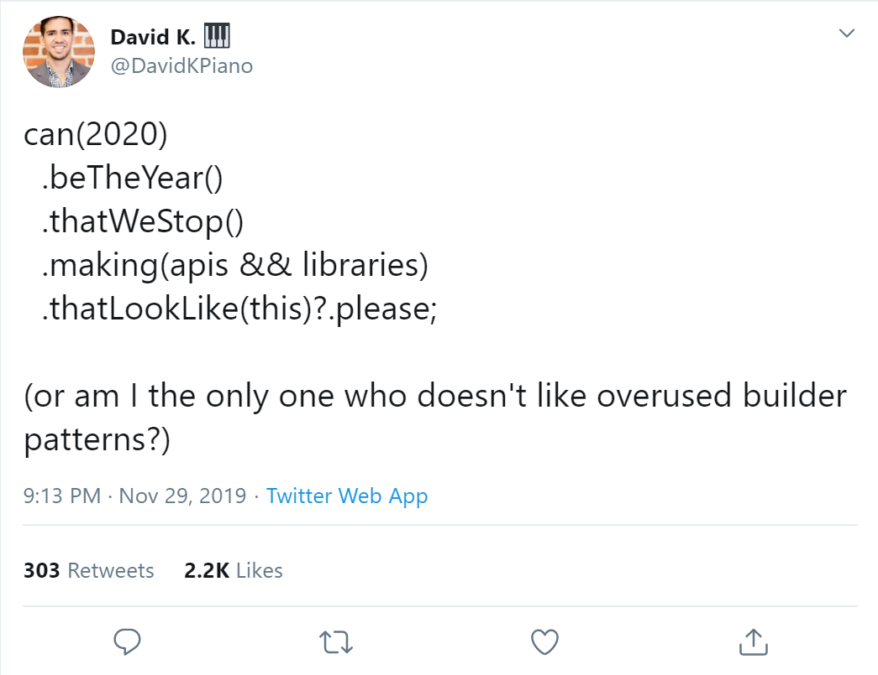
https://twitter.com/DavidKPiano/status/1200507988529860609

Slide 5



Slide 6
un-tree-shakeable
not needed (TypeScript + JSON)
high maintenance cost
finishing problem
👎
better: functional piping; composition; objects; await/yield

Slide 7
“
In software engineering, a fluent interface is an object-oriented API whose design relies extensively on method chaining. Its goal is to increase code legibility by creating an [internal] domain-specific language (DSL).

Slide 8
“
The builder pattern is a design pattern […]. It’s intent is to separate the construction of a complex object from its representation.

Slide 9
“
Fluent interfaces make sense in some APIs, like the QueryBuilder, or in general builder objects, especially when it comes to putting together nodes into a hierarchical structure.
https://ocramius.github.io/blog/fluent-interfaces-are-evil/

Slide 10
TOC
{}
autocompletion and static types as a navigation system (AaSTaaNS)
How to write a library with git in mind?
writing code vs. reading code
Why I am studying psychology...
"Oxford English Dictionary" - my new favorite dev tool

Slide 11
Findings (C#)
{}
Extension Methods
`using static …`
Composition
utilize Properties
.Build()
Indexed Builder
Skipping (inheritance)
DSL as Extension

Slide 12
Bernhard Mayr
studying psychology and philosophy @ university of innsbruck
studied software engineering @ fh hagenberg
working as a researcher @ innerspace gmbh
/
bemayr

Slide 13

https://github.com/innerspacetrainings/Statecharts.NET/

