Slide 2
hey there... 😉
I have to start with a small sorry upfront for showing you the following 🙈
... but I told myself I have to present this at every java…script-meetup I talk at 🙃
Notes:
[2 min]
- COMIC (alt-tab, make sure photos app is started!)

Slide 3
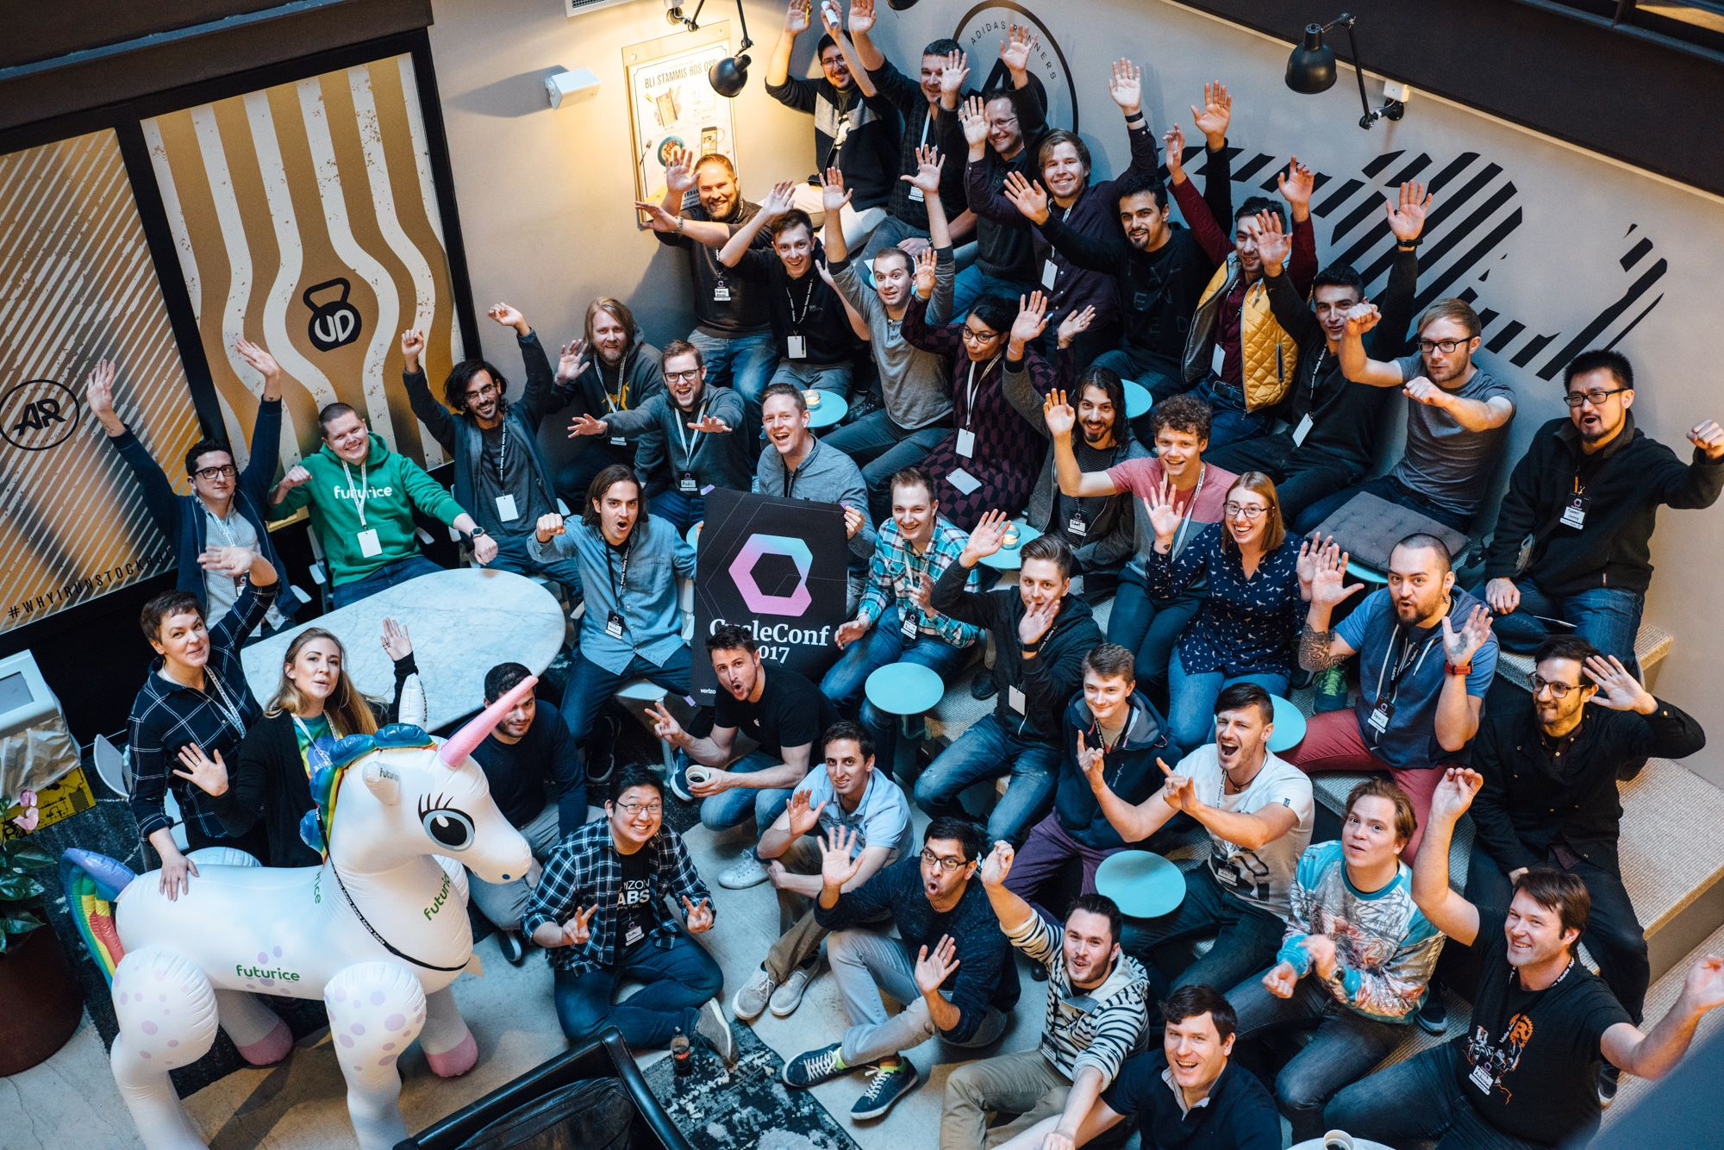

CycleConf 2017
Cycle.js
Notes:
[30 sec]
End of April in Stockholm organized by Futurice
~ 50 people
Liked the idea, no experience

Slide 4
Cycle.js

Slide 5
idea
concept
motivation
Notes:
[1 min]
- “The guy who created this, likes to think a lot – very philosophical questions”

Slide 6



studying psychology @ university of innsbruck
studied software engineering @ fh hagenberg
working @ softaware gmbh
Bernhard Mayr
#types #docker #typescript #ux #types #windows #continousintegration #dotnetcore #types #graphs #dx #types #xplatform #azure #angular #types #haskell #idris #purescript #statecharts #reactivity #typestyle #droneio #types #continuousdeployment
/
bemayr
Notes:
[30 sec]

Slide 7
professional overthinker with severe OCD
part time psychology student
full time “siach”
Bernhard Mayr
#types #docker #typescript #ux #types #windows #continousintegration #dotnetcore #types #graphs #dx #types #xplatform #azure #angular #types #haskell #idris #purescript #statecharts #reactivity #typestyle #droneio #types #continuousdeployment
/
bemayr
Notes:
[30 sec]

Slide 8
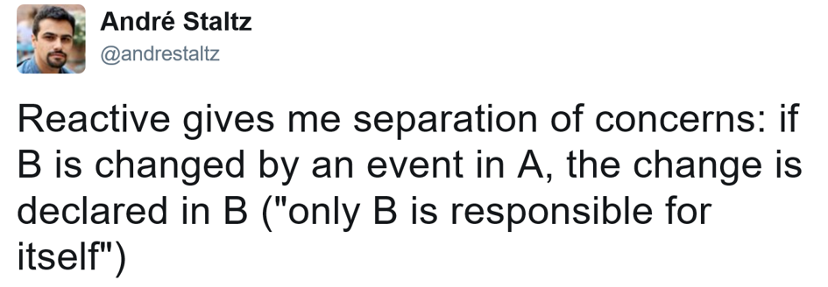
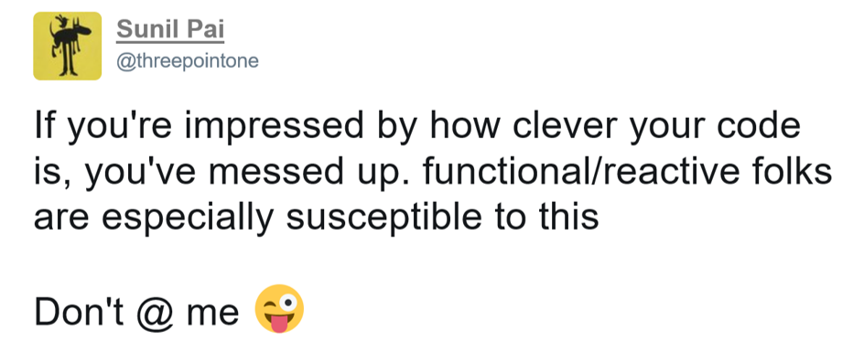

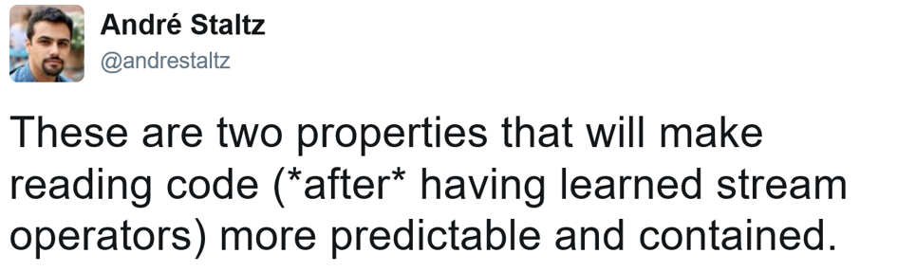
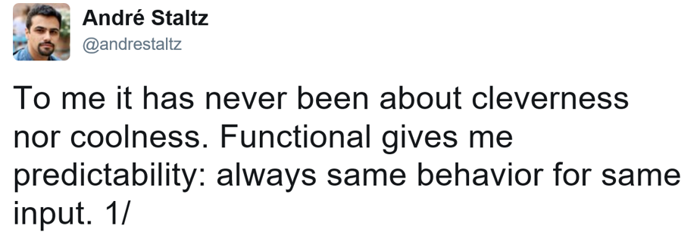

Slide 9
FUNCTIONAL
purity
Notes:
[1 min]
- “The guy who created this, likes to think a lot – very philosophical questions”

Slide 10
Pure Functions no side effects
// === PURE === //
Math.max(...values: number[]);
const double = x => x * 2;
// === IMPURE === //
Math.random()
function addToCart(item): void { cart.add(item); }
// - same input => same output
// - produce no side effects
// - does not rely on external mutable state

Slide 11
FUNCTIONAL
purity
declarative
Notes:
[1 min]
- “The guy who created this, likes to think a lot – very philosophical questions”

Slide 12
declarative “What” not “how”
const frameworks = ["React", "Cycle", "Covfefe"];
console.log(jsFrameworks); // ["React.js", "Cycle.js", "Covfefe.js"]
// not functional (imperative - you have to specify everything) let jsFrameworks = []; for (let i = 0; i < frameworks.length; i++) { jsFrameworks[i] = `${frameworks[i]}.js`; }
// functional (declarative - specify what, not how) const jsFrameworks = frameworks.map(framework => `${framework}.js`);

Slide 13


Slide 14
REACTIVE
Inversion of Control
Notes:
[1 min]
- “The guy who created this, likes to think a lot – very philosophical questions”

Slide 15
Inversion of Control
function onNetworkRequest() {
// ...
Bar.incrementCounter();
// ...
}
Foo.addOnNetworkRequestListener(() => {
self.incrementCounter(); // self is Bar
});
proactive
passive
listenable
reactive
POTUS
Twitter
POTUS
Twitter
POTUS
Twitter
preventBullshit();
POTUS.addOnGreatGreatMessageListener(() => {
self.
});
function onGreatGreatMessage() {
// ...
Twitter.tweet("covfefe");
// ...
}
POTUS.addOnGreatGreatMessageListener(() => {
self.tweet("covfefe"); // self is Twitter
});
Twitter gets reactive
tweet(…) can be private now
Logic is defined solely in Twitter
Notes:
no state management exposed

Slide 16
REACTIVE
Inversion of Control
Streams/Observables (DEMO)
Notes:
[1 min]
- “The guy who created this, likes to think a lot – very philosophical questions”

Slide 17
{ }

Slide 18






Slide 19
A functional and reactive JavaScript framework for predictable code
Notes:
[1 min]
- “The guy who created this, likes to think a lot – very philosophical questions”

Slide 20
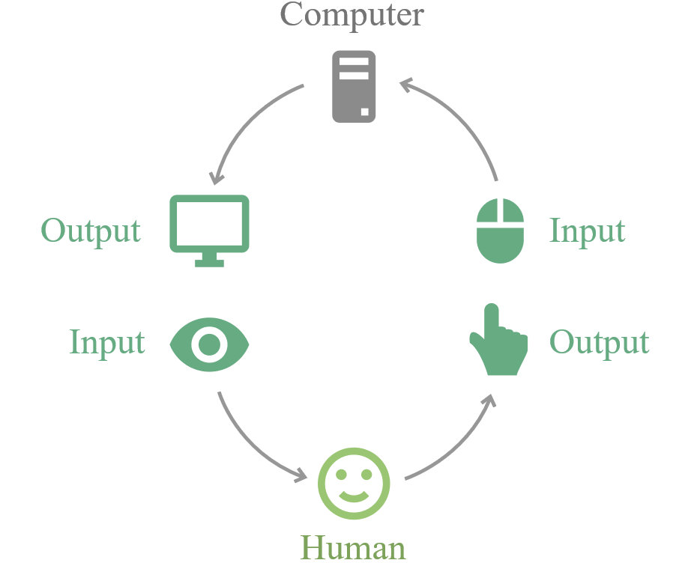
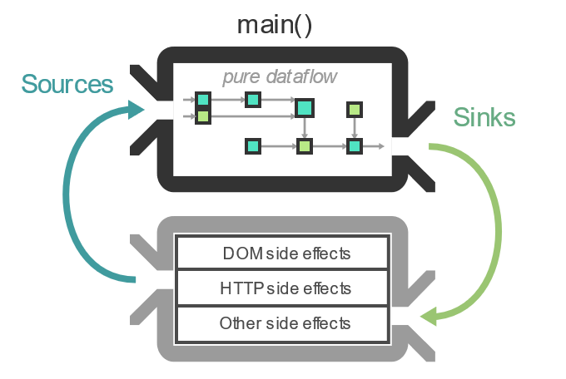
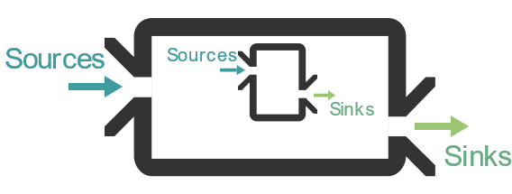
Name
architecture
components

Slide 21
In many frameworks the flow of data is implicit: you need to build a mental model of how data moves around in your app.
In Cycle.js, the flow of data is [more or less] clear by reading your code.

Slide 22
{ }

Slide 23
😍
https://github.com/sartaj/pipe-me
https://github.com/cyclejs/time
https://github.com/cyclejs-community/awesome-cyclejs

Slide 24
sources
The introduction to Reactive Programming you've been missing
Reactive MVC and the Virtual DOM
cycle.js.org
CycleConf [talks]
Learning how to ride: an introduction to Cycle.js
Save time avoiding common mistakes using RxJS [big recommendation]

