Slide 1
hey there... 😉
i’m so sorry, there is no zork today 😢
... but let’s start with a quick look at java…script 😀
(http://leftoversalad.tumblr.com/post/103503118002)

Slide 2
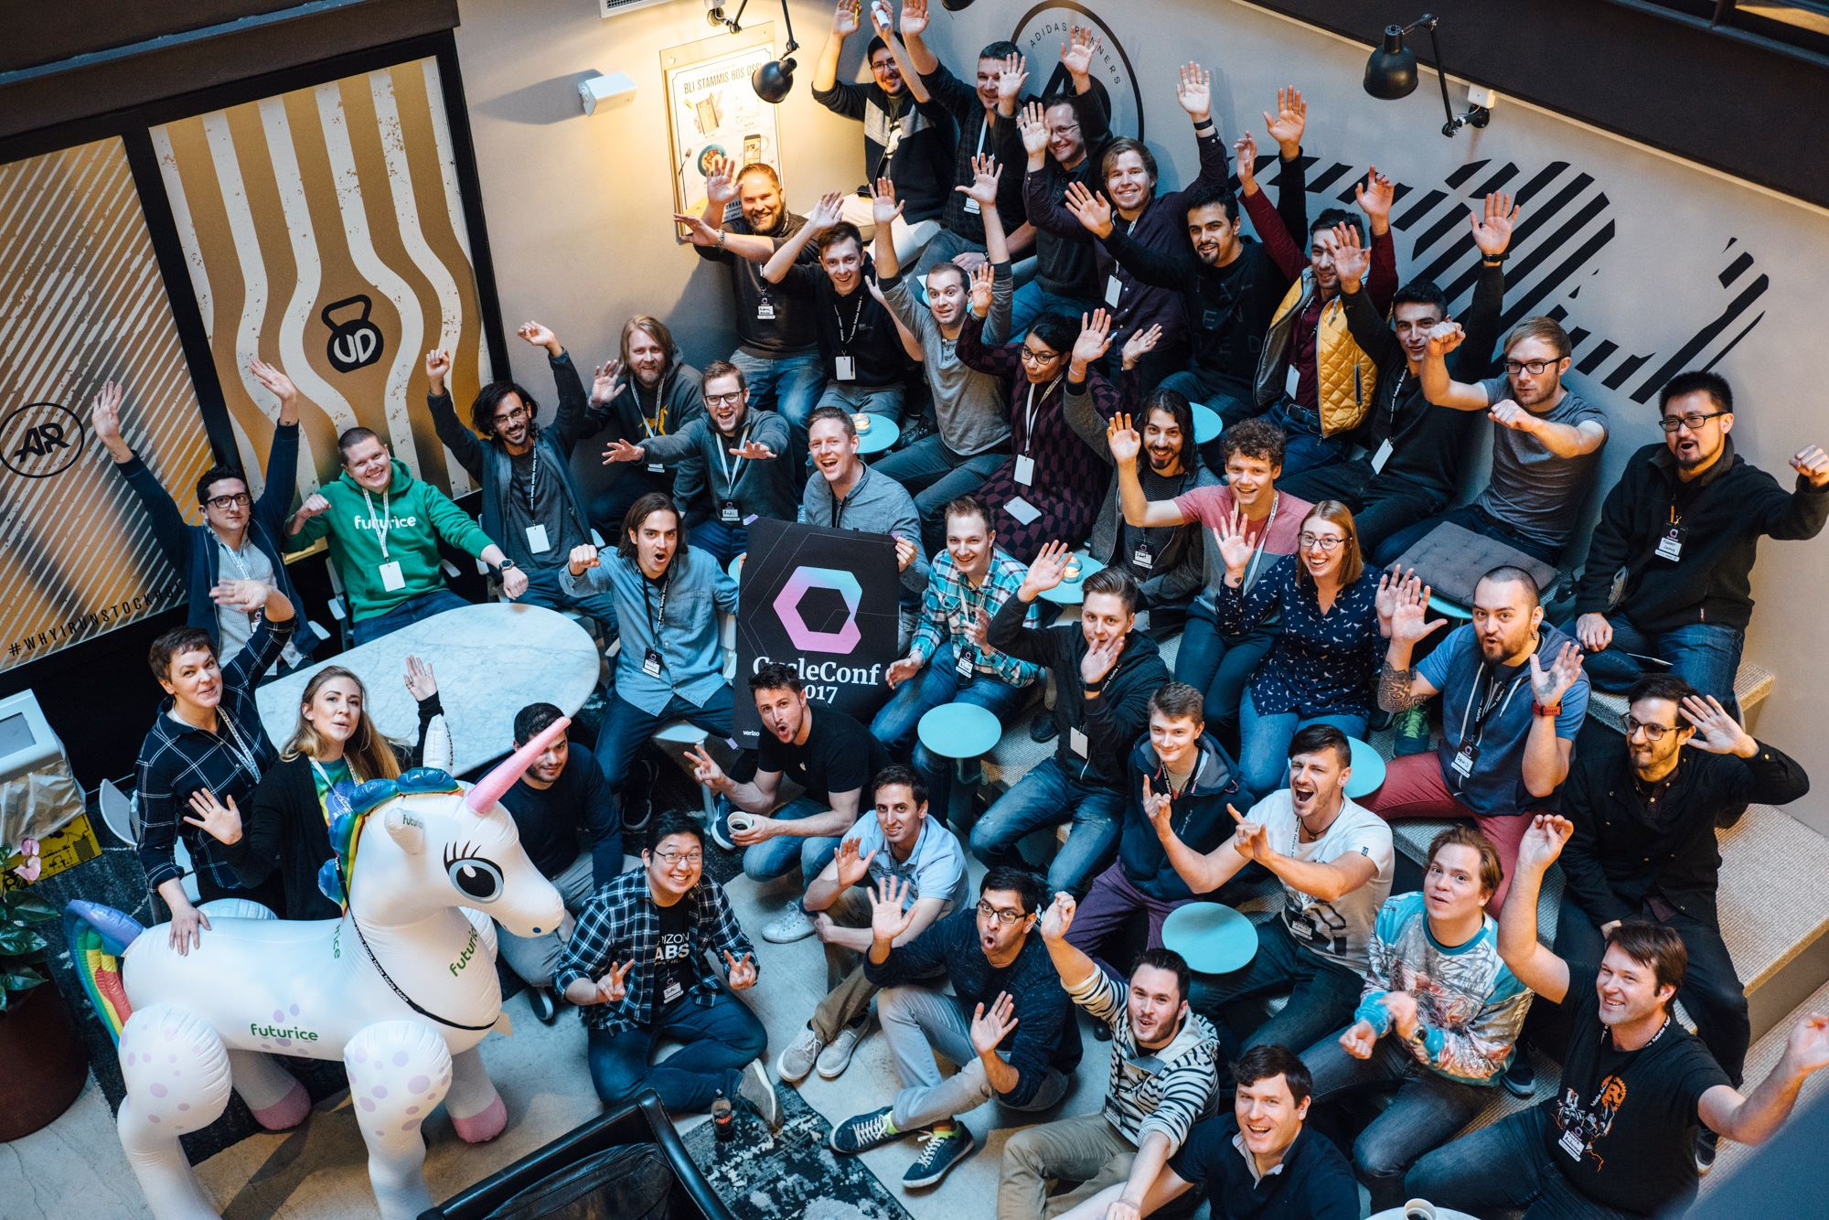

CycleConf 2017
Cycle.js

Slide 3
Cycle.js

Slide 4
idea
concept
motivation

Slide 5



studying @ fh hagenberg
working @ softaware gmbh
Bernhard Mayr
#types #docker #typescript #types #windows #continousintegration #dotnetcore #types #graphs #vuejs #types #xplatform #azure #angular #types #typestyle #droneio #types #continuousdeployment
/
bemayr

Slide 6
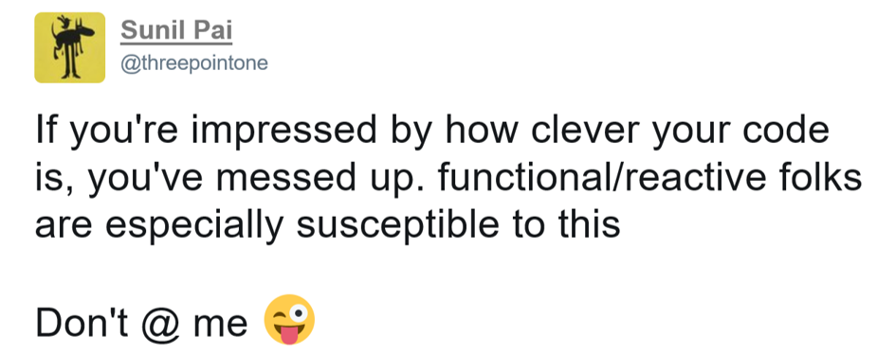

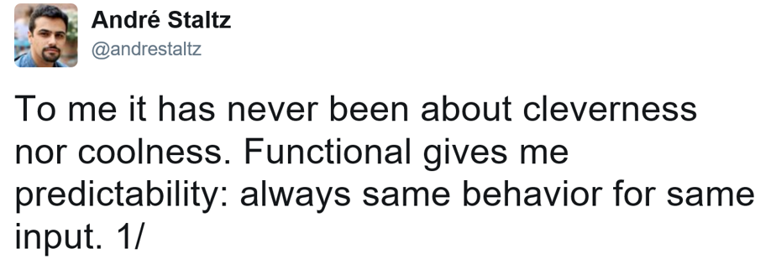

Slide 7
FUNCTIONAL
purity

Slide 8
Pure Functions no side effects
// === PURE === //
Math.max(...values: number[]);
const double = x => x * 2;
// === IMPURE === //
Math.random()
function addToCart(item): void { cart.add(item); }
// - same input => same output
// - produce no side effects
// - does not rely on external mutable state

Slide 9
FUNCTIONAL
purity
declarative

Slide 10
declarative “What” not “how”
const frameworks = ["Angular", "Vue", "Covfefe"];
console.log(jsFrameworks); // ["Angular.js", "Vue.js", "Covfefe.js"]
// not functional (imperative - you have to specify everything) let jsFrameworks = []; for (let i = 0; i < frameworks.length; i++) { jsFrameworks[i] = `${frameworks[i]}.js`; }
// functional (declarative - specify what, not how) const jsFrameworks = frameworks.map(framework => `${framework}.js`);

Slide 11
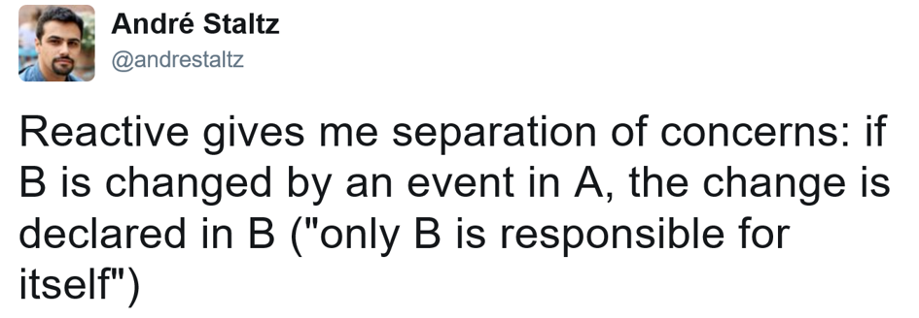


Slide 12
REACTIVE
Inversion of Control

Slide 13
Inversion of Control
proactive
passive
listenable
reactive
POTUS
Twitter
POTUS
Twitter
POTUS
Twitter
preventBullshit();
POTUS.addOnGreatGreatMessageListener(() => {
self.
});
function onGreatGreatMessage() {
// ...
Twitter.tweet("covfefe");
// ...
}
POTUS.addOnGreatGreatMessageListener(() => {
self.tweet("covfefe"); // self is Twitter
});
Twitter gets reactive
tweet(…) can be private now
Logic is defined solely in Twitter

Slide 14
REACTIVE
Inversion of Control
Streams/Observables (DEMO)

Slide 15
{ }

Slide 16
Streams/Observables
import * as Rx from "rxjs/Rx";
// --- from arrays to streams --- //
const items = [0, 1, 2, 3, 4, 5];
const items = Rx.Observable.from([0, 1, 2, 3, 4, 5]);
const items = Rx.Observable.interval(500).take(20);
items
.filter(x => x % 2 === 0)
.map(x => `${x * 10}%`)
.forEach(x => console.log(x));
/* ~~~~~~~ ASCII Marble Diagram ~~~~~~~ */
// interval: --0--1--2--3--4--5--6--...--|
// filter: --0-----2-----4-----6--...--|
// map: --0---20%---40%---60%--...--|
// => console.log (side-effect)
/* ~~~~~~~~~~~~~~~~~~~~~~~~~~~~~~~~~~~~ */
/* ~~~~~~~ http://rxmarbles.com/ ~~~~~~ */
/* ~~~~~~~~~~~~~~~~~~~~~~~~~~~~~~~~~~~~ */

Slide 17
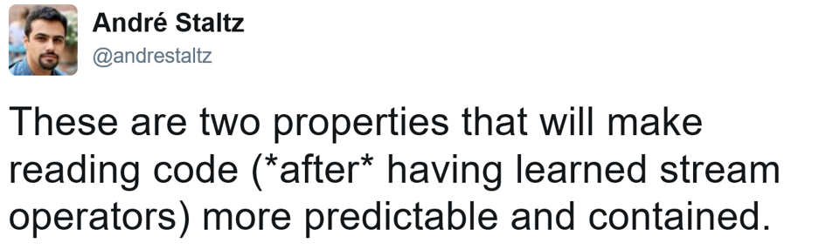






Slide 18
A functional and reactive JavaScript framework for predictable code

Slide 19
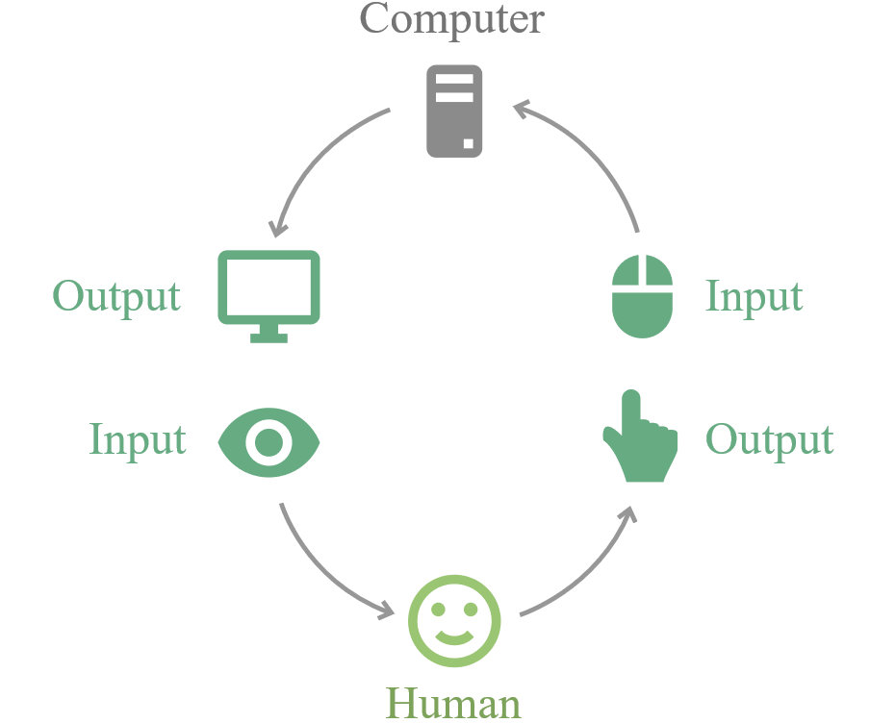
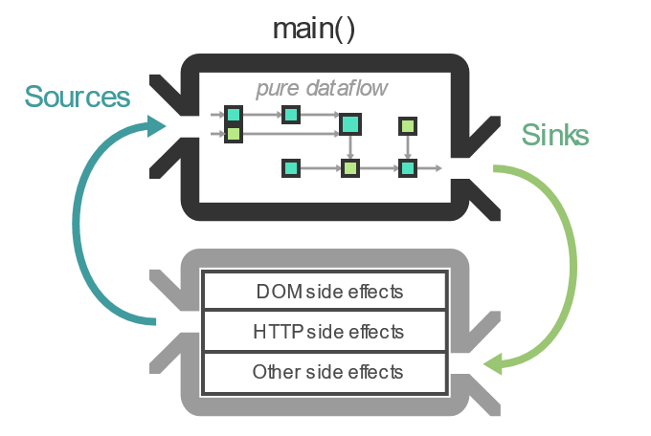
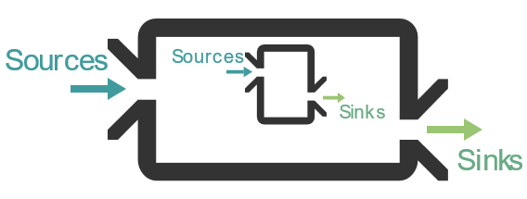
Name
architecture
components

Slide 20
{ }
(https://cycle.js.org/basic-examples.html#basic-examples-increment-a-counter)

Slide 21
😍
https://github.com/staltz/html-looks-like
https://github.com/cyclejs/time
https://github.com/cyclejs-community/awesome-cyclejs

Slide 22
sources
The introduction to Reactive Programming you've been missing
Reactive MVC and the Virtual DOM
cycle.js.org
CycleConf [talks]
Learning how to ride: an introduction to Cycle.js
Save time avoiding common mistakes using RxJS [big recommendation]

