Slide 1
What makes a song popular?
Spotify Exploratory Data Analysis

Slide 2
Question – What makes a song popular?
Spotify has a Python library that provides data on all its tracks – including audio features like tempo, key, ‘danceability’, etc.
We will use this data to attempt to determine what features have the largest impact on the overall popularity of a song

Slide 3
Variables used for analysis
“Danceability” – describes how suitable a track is for dancing
“Energy” – represents a perceptual measure of intensity and activity (high energy tracks are loud and noisy)
”Loudness” – overall loudness of track in decibels
“Valence” – describes musical positiveness (High valence tracks sound happy, low valence tracks sound sad)
“Instrumentalness” – predicts whether a track contains vocals
“Key” – musical key the track is in
“Mode” – whether the track is in a major or minor key
“Popularity” – overall popularity of track

Slide 4
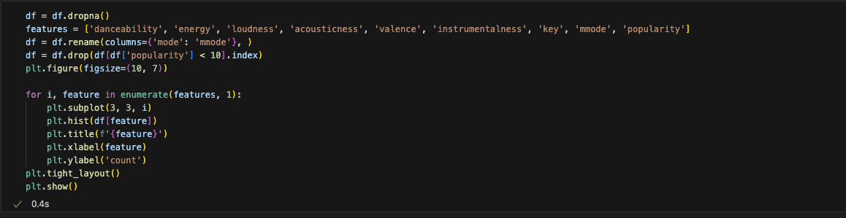
Histograms
Because there are so many tracks included, many of them are relatively unknown and have a popularity of 0, which was skewing the data. To get a more accurate model we dropped all tracks with a popularity less than 1, limiting the tracks to those with at least some exposure. There are not any other apparent outliers in the histograms. It is worth noting that the variables ”key” and “mode” are categorical variables, not continuous variables.

Slide 5
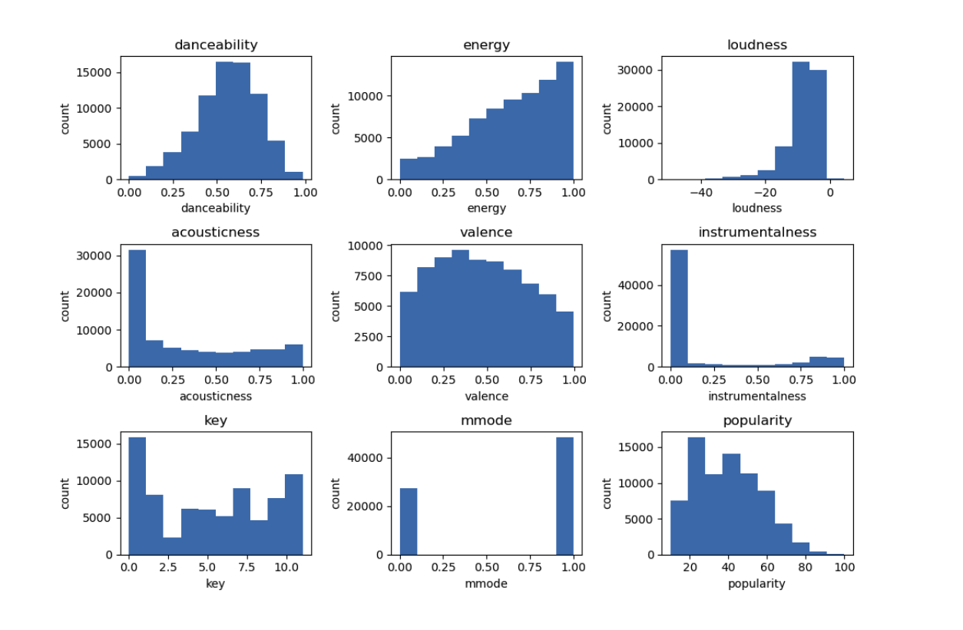
Histograms

Slide 6
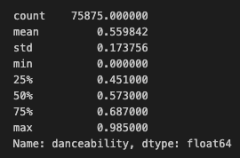
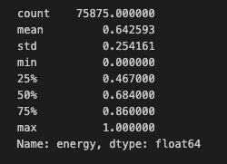
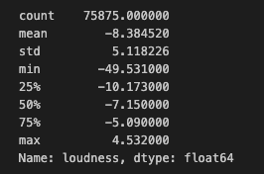
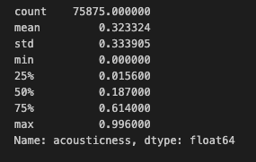
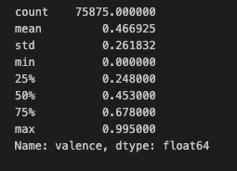
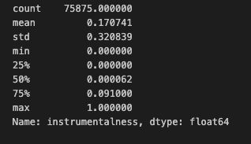
Descriptive characteristics

Slide 7
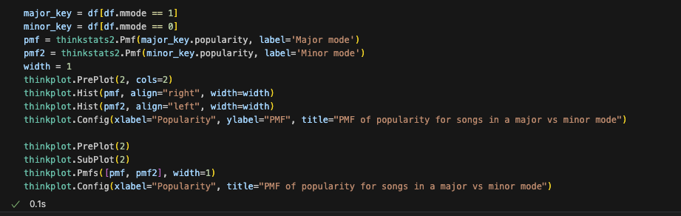
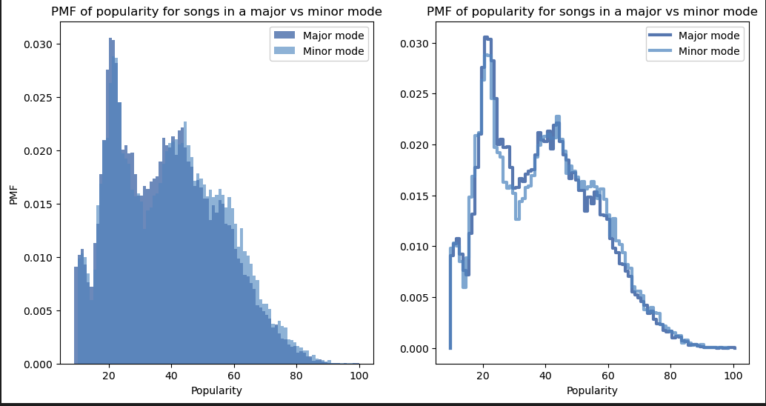
PMF comparison

Slide 8
PMF comparison
Looking at the charts for PMF of track popularity for songs in a major key vs minor key, it does not appear that there is a significant difference in probability for songs in a major or minor key to be more popular. We do see that the probability is higher for minor key songs at the right end of the graph, but not by much. This might suggest that songs in a minor key are slightly more likely to be popular.

Slide 9

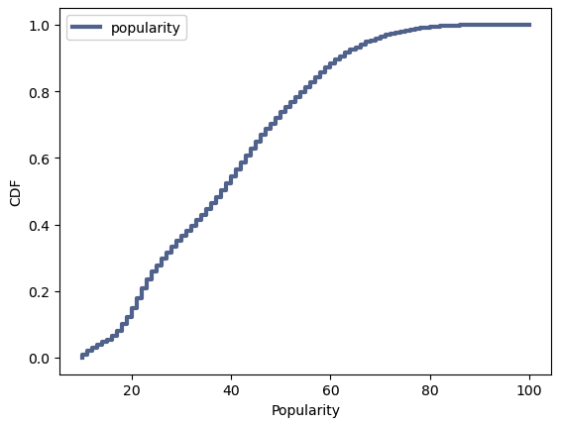
CDF

Slide 10
CDF
The CDF of track popularity shows us that over 90% of tracks have a popularity of less than around 70. This suggests that a popularity score of 70 might be a good cutoff to determine whether a song could be considered a ‘hit’.

Slide 11
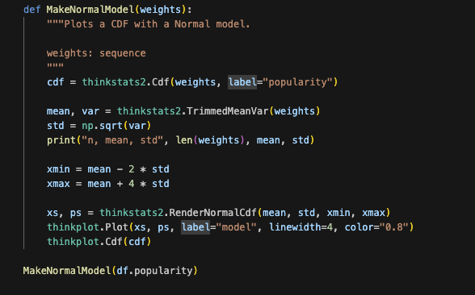
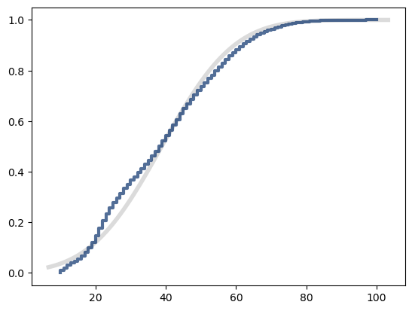
Popularity vs normal distribution
We can see in the chart that the normal distribution is not a very good fit for the distribution of track popularity, particularly in the left tail. The distribution matches better towards the right end of the curve.

Slide 12
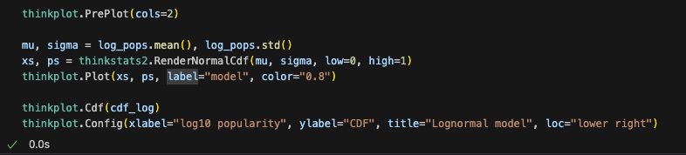
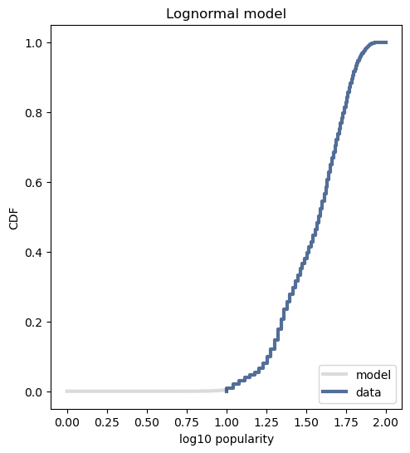
Track popularity vs lognormal distribution
We can see in this chart that the lognormal distribution is a better fit for the distribution of track popularity. This makes sense as the lognormal model is usually a better fit for a pareto distribution, which we might expect track popularity to fit better than a normal distribution.

Slide 13
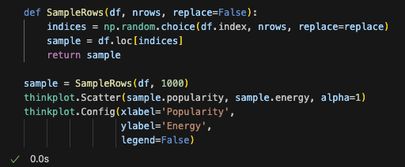
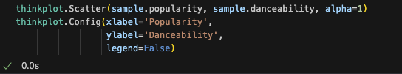
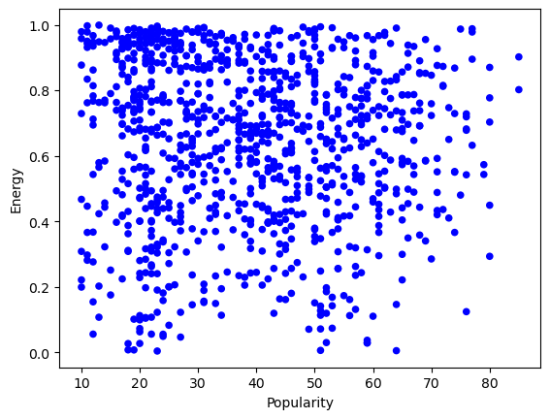
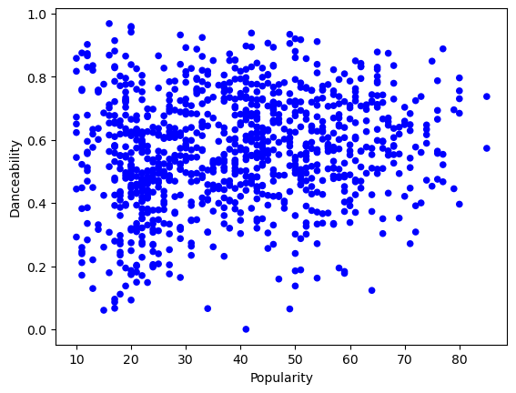
Scatterplots of Energy and Danceability vs Popularity

Slide 14
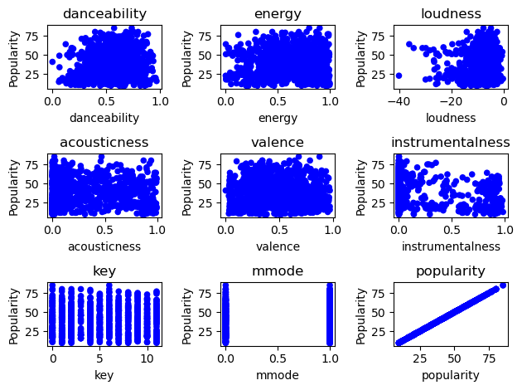
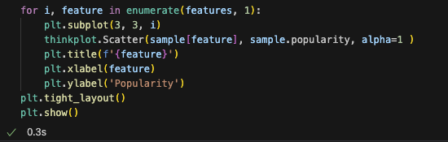
Scatterplots of other variables

Slide 15
Scatterplots analysis
Looking at the scatterplots does not reveal any obvious correlation between these variables and popularity. Perhaps the closest would be the scatterplot for danceability, which is confirmed by correlation analysis on the variables – The correlation between danceability and popularity is 0.12 which is low but still higher than many other variables.

Slide 16
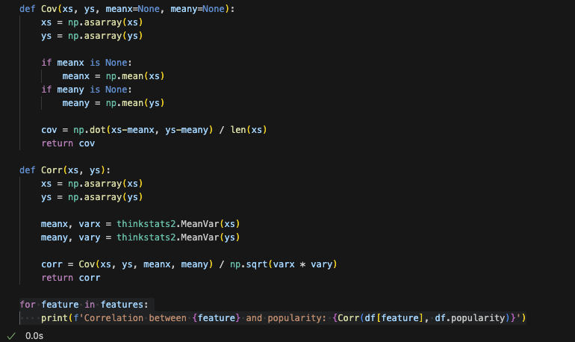
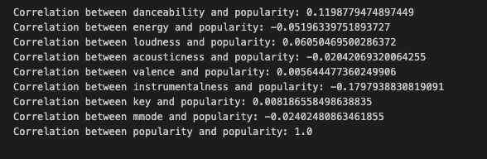
Correlations

Slide 17
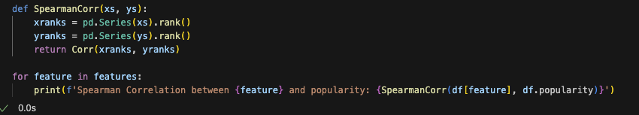
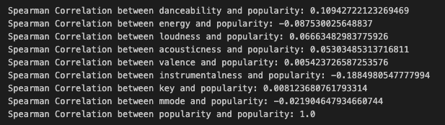
Spearman Correlations

Slide 18
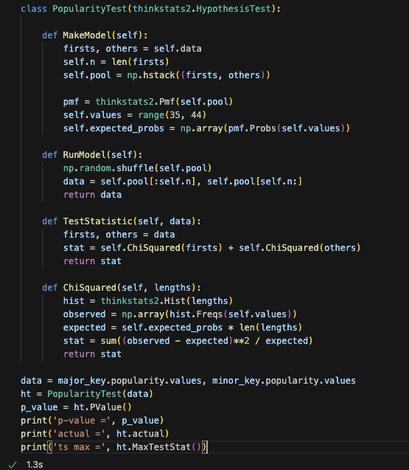

Chi squared test – Does musical mode influence popularity?

Slide 19
Chi squared test – Does musical mode influence popularity?
The chi squared test gives a p value of 0.715 for the relationship between popularity and musical mode which suggests that there is not a significant correlation between mode and popularity.

Slide 20

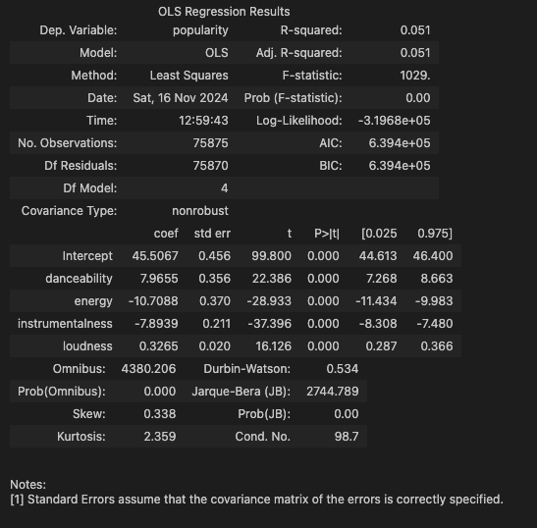
Regression analysis
We were able to achieve the best fit for a model by doing a regression between popularity and danceability, energy, instrumentalness, and loudness. These variables has the highest correlations with popularity individually, and creating a model using all of them results in a R-squared value of 0.051 – which is still low.
This suggests that these variables are not particularly effective in predicting track popularity.

Slide 21
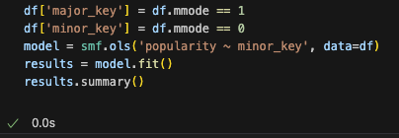
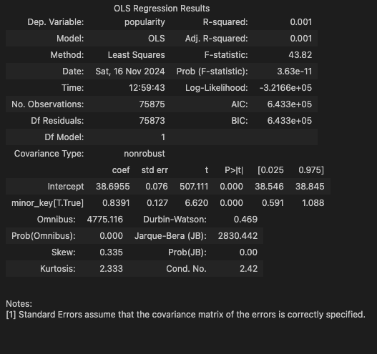
Regression analysis
We also ran a regression with a categorical variable, musical mode. Our regression resulted in a R-squared value of 0.001, suggesting that the model created using musical mode is a poor fit for track popularity.

