Slide 1


Predicting Employee Attrition
IBM HR Analytics Employee Attrition & Performance
August 7, 2025

Slide 2
Presentation Overview
Introduction
Data Overview
Methods
Results
Ethical Considerations
Conclusion

Slide 3
Introduction
Employee attrition disrupts teams, increases recruitment costs and diminishes institutional knowledge. Predictive analytics can identify at–risk employees and enable HR interventions.
[1]

Slide 4
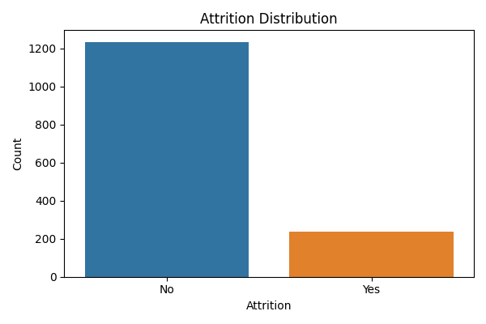
Dataset Overview
1,470 employees 35 original features; about 50 numeric predictors after one‑hot encoding Demographic, job role, satisfaction and compensation variables Attrition rate ≈16%
[1]

Slide 5
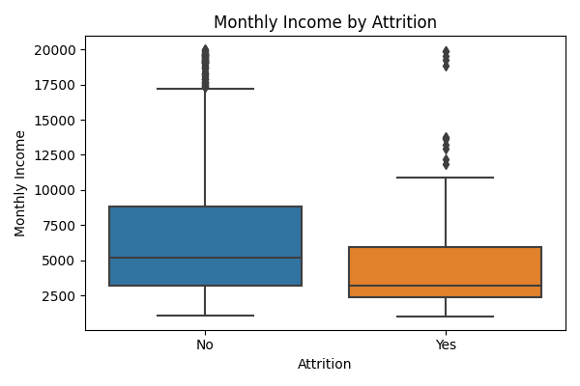
Exploratory Analysis
Employees who left tended to have lower monthly income. Boxplots reveal a right–skewed distribution for employees who stayed, indicating greater earning potential.

Slide 6
Methods
Preprocessing & Resampling
Models
Drop identifiers and constant columns
One‑hot encode categorical variables
Stratified 80/20 train–test split
SMOTE oversampling to balance the minority class
Logistic Regression: linear classifier with sigmoid activation
Decision Tree: interpretable rule‑based splits
Random Forest: ensemble of randomised trees
[2] [3]

Slide 7
Model Performance
Logistic regression achieves the best balance of precision and recall.
Random forest attains high accuracy but suffers from very low recall.
Decision tree underperforms and exhibits poor sensitivity.
[2] [3]

Slide 8
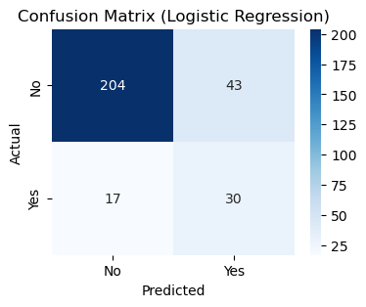
Confusion Matrix
Confusion matrix for logistic regression (test set)

Slide 9
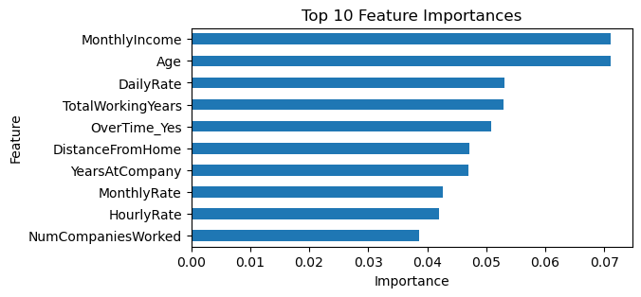
Important Predictors
Age and monthly income emerge as strong predictors of attrition.
Longer tenure and higher pay reduce the likelihood of leaving.
Working overtime still raises attrition risk.
[3]

Slide 10

Ethical Considerations
Assess fairness across demographic groups
Protect privacy and secure data storage
Communicate openly about model use
[6]

Slide 11
Conclusion & Next Steps
Logistic regression offers the best trade‑off between precision and recall.
Age and monthly income are among the strongest predictors, while overtime still elevates risk.
Random forest attains high overall accuracy but fails to identify many leavers; decision trees underperform.
Future work: test advanced resampling like SMOTE, incorporate behavioural metrics and run cross‑validation.
Use models to inform—not replace—HR judgement.
[4] [6]

Slide 12
References
[1] Employee attrition reduces profit margins and predictive models can identify at‑risk staff. (inseaddataanalytics.github.io) [2] Logistic regression uses a sigmoid function to predict binary outcomes. (www.geeksforgeeks.org) [3] Random forests are ensembles of decision trees grown on random subsets. (www.geeksforgeeks.org) [4] SMOTE creates synthetic minority samples by interpolating between neighbours. (pmc.ncbi.nlm.nih.gov) [5] Predictive HR analytics should avoid bias, protect privacy and be transparent. (www.hrcloud.com)

