Slide 1



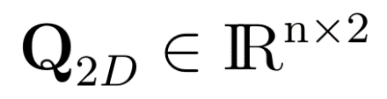
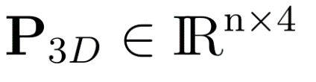
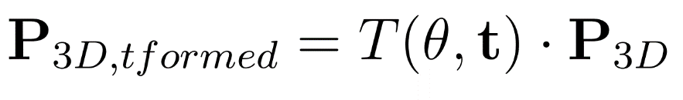
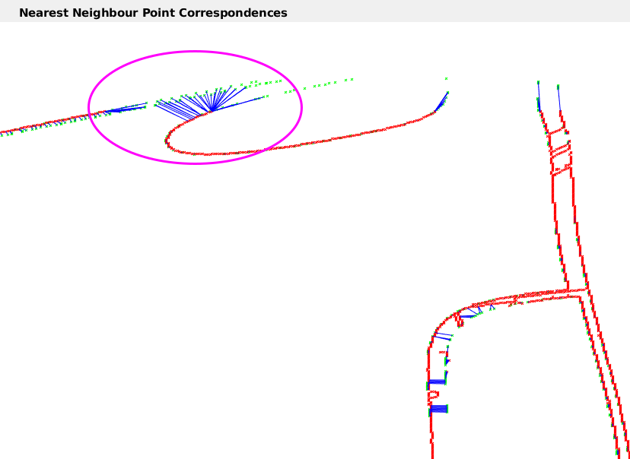
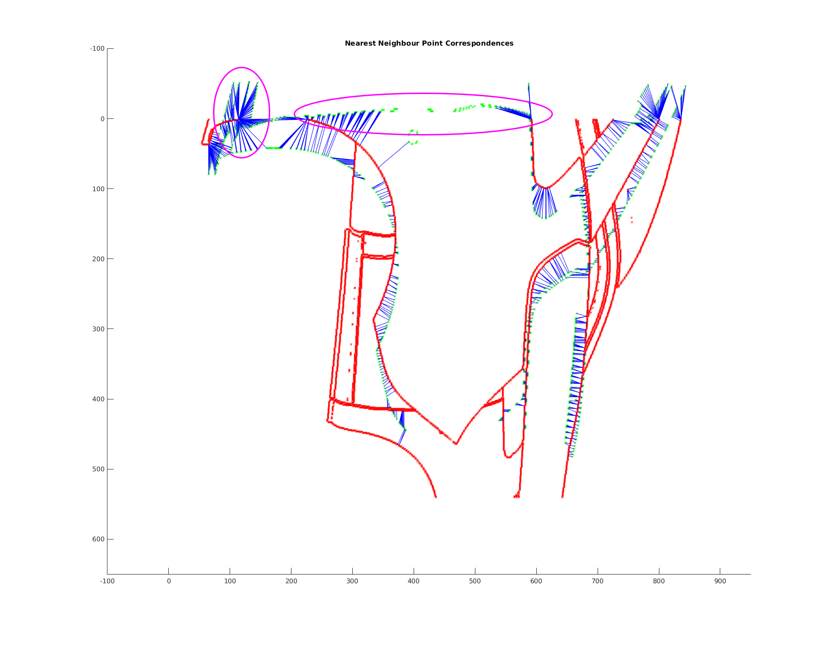
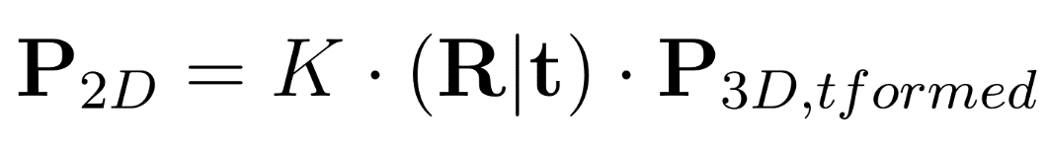
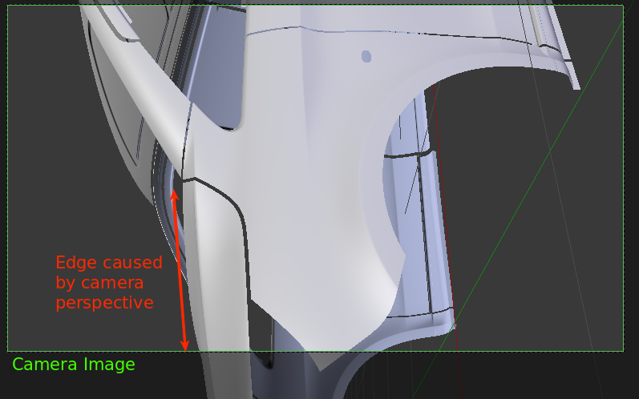
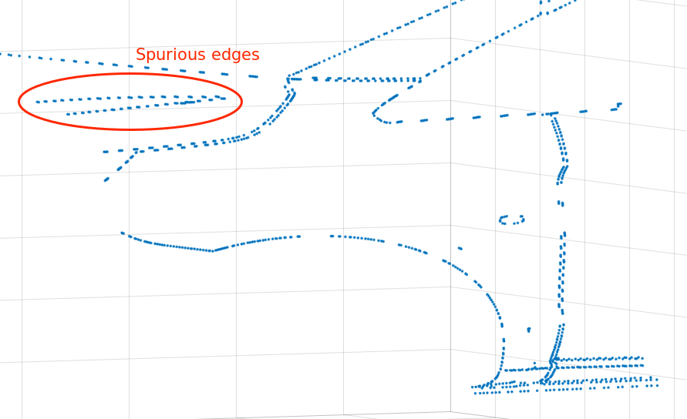
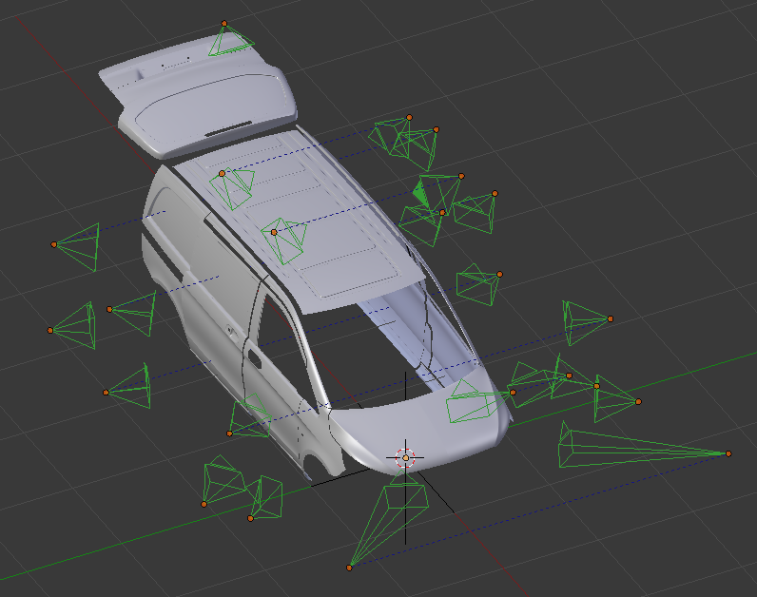
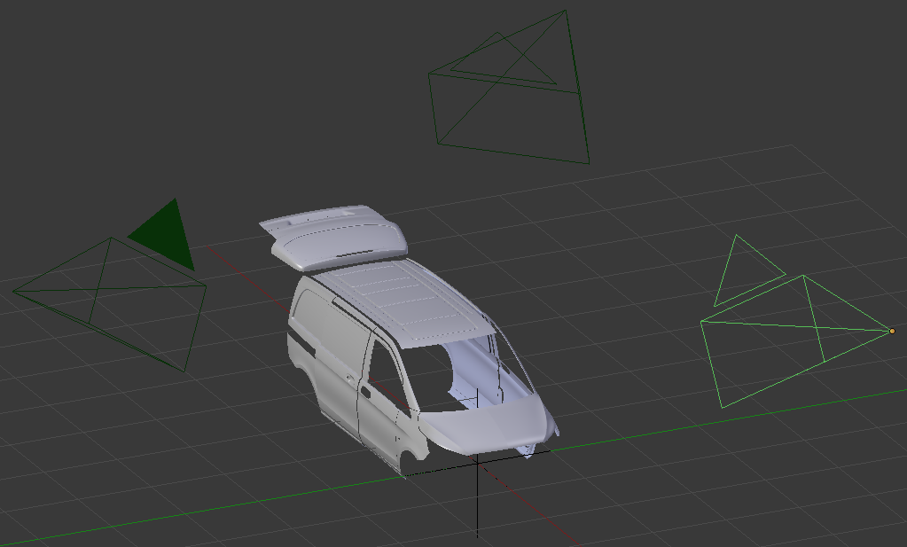
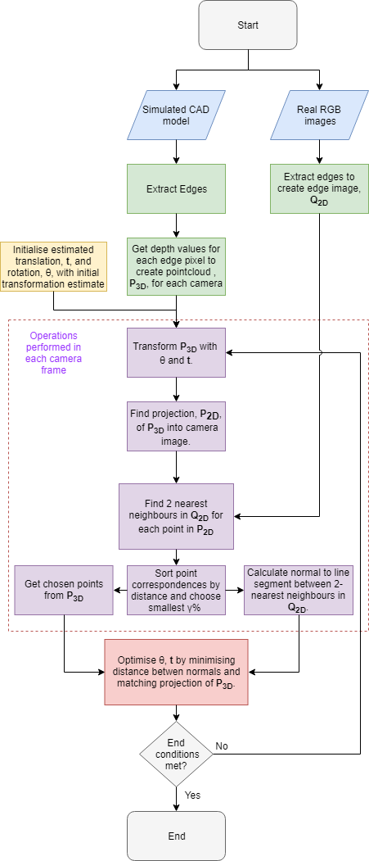
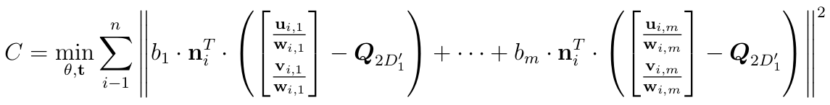


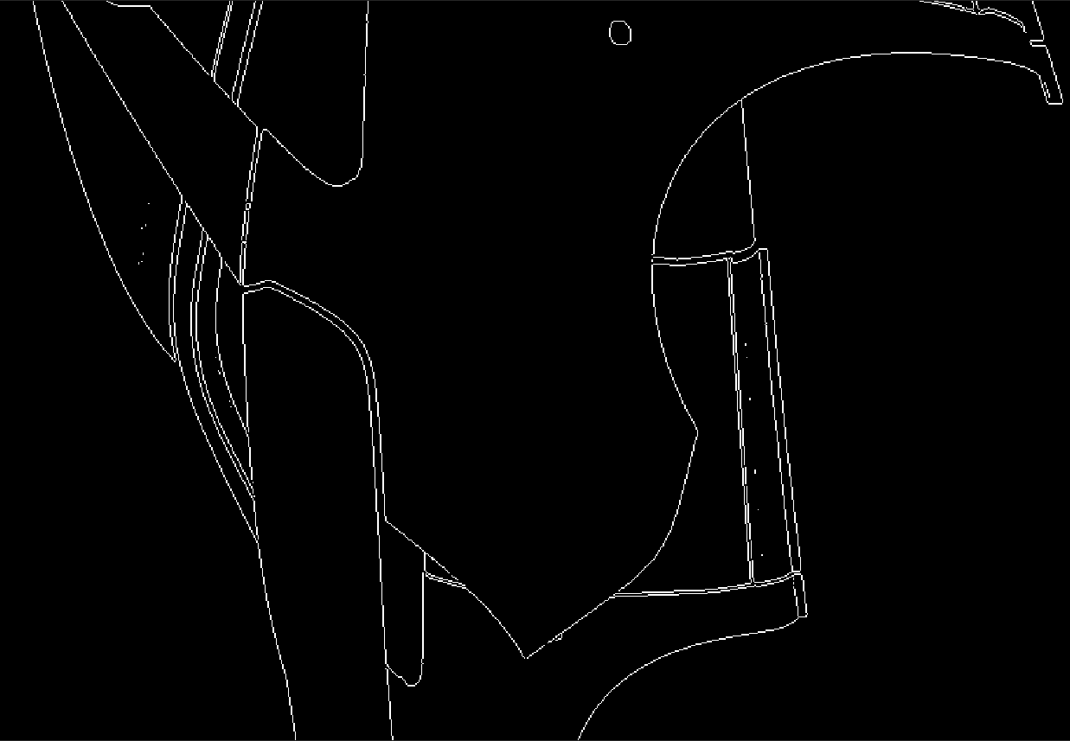
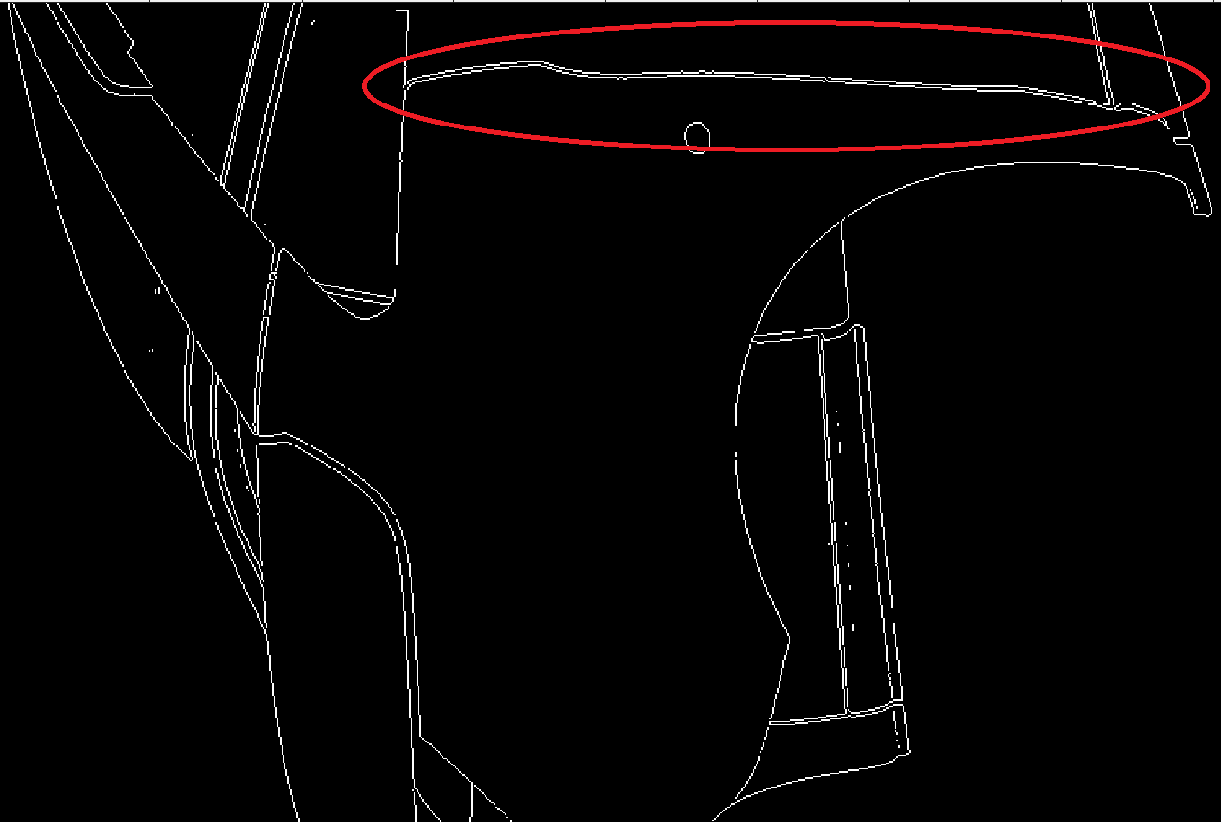
REPLACE THIS BOX WITH YOUR ORGANIZATION’S
HIGH RESOLUTION LOGO
3DoF Vehicle Localisation from Multi-View
Camera Geometry – A17-106
Student: Brendan Emery
Supervisor: Jaime Valls Miro
Abstract
Methodology
Discussion
Early detection of paint defects during vehicle manufacture leads to a reduction in costs, energy consumption and the number of vehicles that fail late-stage quality control tests. Automotive manufacturers including Ford, Volkswagen and BMW, have factories around the world currently using a system to autonomously detect defects in the paintwork of vehicles. These defects are identified in each camera image and projected onto a 3D model of the vehicle so that workers can locate and fix the defects. To project these defects accurately onto the model, an accurate estimate of the position and orientation of the vehicle with respect to the camera array needs to be known.
My work aims to provide an accurate, global estimate of the vehicle’s lateral rotation and translation on the conveyor belt using RGB images from the camera array and a CAD model of the vehicle.
Image Creation
Real edge images: Prominent edges are extracted from real camera images using Sobel edge detection algorithm to give, . .
CAD model edges: Images of the CAD model are rendered from each camera view within blender and edges are extracted using Blender’s Freestyle toolbox. Each edge pixel is associated with it’s depth value from blender to create a point cloud in homogeneous coordinates, , in each camera’s coordinate frame.
Transform Simulated Points
Simulated points, P_{3D}, are transformed in the global frame using the current translation and rotation estimate:
Project Simulated Points
Simulated points are projected into the image frame of each camera using the known camera calibration parameters, K, and the pose of cameras with respect to the global frame, R and t.
Find and Trim Nearest Neighbors
We find the 2 closest points in Q_{2D} for every point in P_{2D}. Matches are sorted by distance between corresponding points in ascending order and the γ smallest values are chosen. These point correspondences are used to find the chosen points in the simulated pointcloud, P_{3D’}, and their 2 matching real points, Q_{2D’_1} and Q_{2D’_2}.
Optimisation
The cost function is formulated to minimize the perpendicular distance between each point in the projection of P_{3D’} and the surface of Q_{2D’} given by the 2 nearest neighbors across all cameras.
The perpendicular distance is given by the dot product of the normal, n, to the line joining Q_{2D’_1} and Q_{2D’_2} and the vector from Q_{2D’_1} to the projection of P_{3D’}.
The cost function is formulated as a non linear least squares problem, given by:
Where, n is the number of points to be matched, m is the number of cameras and b_{m} is a boolean value that is 1 when the ith point is observed by the mth camera and 0 otherwise (important for calculating the jacobian). and are the x and y coordinates, respectively of the ith point of P_{3D’} projected into the mth camera frame.
There is a significant degradation in estimation performance when the cameras are positioned close to the vehicle with a limited field of view. This is due to a number of factors:
The primary reason is because there is not a 1:1 correspondence between real edge points and the projected CAD model edge points. Since the images capture slightly different, albeit overlapping, areas of the vehicle, there will be points that are seen in one image but not the other. This results in spurious point correspondences which causes errors in the optimization. We currently trim the nearest neighbors to mitigate the effect of this, however, the optimal choice of the parameter gamma changes with different vehicle locations.
Edges formed from depth discontinuities between a face and the background due to the perspective of the camera will not be the same between viewpoints.
When the edges of the CAD model are detected, there are inevitably pixels that are detected that are not exactly along that edge. When these spurious pixels are at a depth discontinuity, the depth values can be incorrect. We can deal with significant depth changes by clamping the maximum depth, however, smaller discontinuities are harder to deal with.
The quality of the estimation is dependent on the choice of cameras and direction of offset of the vehicle. E.g. the subset of cameras chosen in “Results for Setup 2” are more robust to negative translations in x. This is because there are significant edges that are occluded with positive translations in x.
Simulation Setup
We currently have 2 setups in our simulation (See Fig. 1).
3 cameras positioned further away from the vehicle to demonstrate the benefit of a larger viewing angle.
Actual arrangement of cameras used in manufacturing plants.
Figure 3. Shows how spurious point correspondences affect optimisation.
Figure 4. Example of spurious edge formed by depth discontinuity due to
camera perspective.
Figure 1. Left: Actual camera setup. Right: Setup with cameras
placed further away from vehicle.
Results
Since the calibration parameters for the cameras in the manufacturing plants have not been provided, we are using simulated data for the RGB images. Initial values of θ, x and y are set to 0. Results for Setup 2 were taken by selecting 4 cameras out of the available array.
Figure 4. Example of significant edge disappearing between cameras.
Next Steps for Project
Investigate methods to mitigate the effects of point 1. in “Discussion”.
The parameter gamma can be found automatically by minimizing the trimmed mean squared error while trying to use as many points as possible. This can be done at every iteration of the optimization so that a suitable value is found based on the current data rather than a predefined value.
Using the initial estimate from the existing system used in the vehicle manufacturing plants to initialise θ and t.
Test both setups with real image data.
θ (deg) | x (m) | y (m) | θ error (deg) | x error (m) | y error (m)
0 | 1 | 1 | -0.001009 | -0.000135 | -0.000212
10 | 0 | 0 | -0.00641 | 0.000362 | 0.000328
10 | 0.5 | 0.5 | -0.000778 | -0.000533 | 0.000128
15 | 0.5 | 0.5 | 0.013392 | 0.000124 | -0.000437
15 | 0.75 | 0.75 | 0.028792 | 0.000046 | -0.00086
20 | 0 | 0 | -0.016836 | 0.000712 | 0.000766
20 | 0.75 | 0.75 | 0.048009 | 0.00074 | -0.000873
Table 1. Results from Setup 1.
θ (deg) | x (m) | y (m) | θ error (deg) | x error (m) | y error (m)
0 | 0.15 | 0 | Did not converge
0 | -0.15 | 0 | 0.008954 | 0.012692 | 0.002299
0 | 0.1 | 0.1 | 0.124872 | 0.01042 | 0.016305
0 | -0.1 | -0.1 | 0.074743 | 0.002861 | 0.000625
1 | -0.1 | -0.1 | 0.195408 | 0.000611 | -0.00435
2 | -0.1 | -0.1 | Did not converge
Conclusion
At this stage of the project, it is apparent that having cameras with a wider field of view produces considerably better results compared with cameras that are positioned close to the vehicle. While the effectiveness of the system still needs to be evaluated on real data, our current recommendation is that installing a small number of cameras in carefully selected poses will produce the most robust and reliable pose estimation system.
Figure 2. Process flowchart.
Table 2. Results from Setup 2.

