Slide 1
Towards Trusted Machine Learning?
Learning Stochastic Systems with Global PAC Bounds
Hugo Bazille INRIA/IRISA,
Blaise Genest CNRS/IRISA,
Cyrille Jégourel SUTD, Singapore
Sun Jun SMU, Singapore

Slide 2
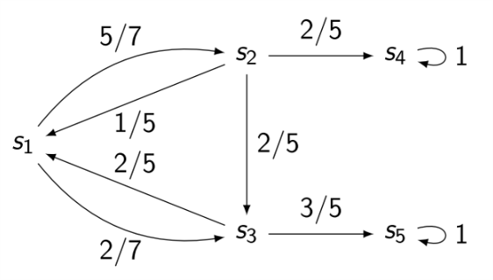
Formalism
Stochastic System
Learning Algorithm
from AI
(converges towards the
Markov System at ∞)
observations
reset
after finite time
Information on the system:
Set of states – known in this talk
Support of transitions – depends
Transition probabilities – never
Observation W:
Sequence of States observed
e.g.: s₁ s₂ s₃ s₁ s₃ s₅
Stochastic Model
(e.g. Markov Chain)
PAC bounds
(like for Statistical MC)
with probability 97%,
error < 3%
+

Slide 3
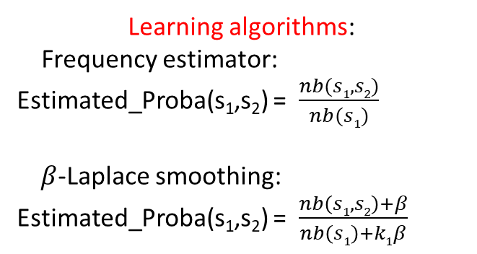
Formalism
Stochastic System
Learning Algorithm
from AI
observations
reset
Learning algorithms:
Frequency estimator:
Estimated_Proba(s₁,s₂) = $\frac{nb(s1,s2)}{nb(s1)}$
$β$-Laplace smoothing:
Estimated_Proba(s₁,s₂) = $\frac{nb\left(s1,s2\right)+β}{nb\left(s1\right)+k1β}$
Stochastic Model
(e.g. Markov Chain)
PAC bounds
(like for Statistical MC)
with probability 97%,
error < 3%
+

Slide 4
Formalism
Stochastic System
Learning Algorithm
from AI
observations
reset
Stochastic Model
(e.g. Markov Chain)
PAC bounds
(like for Statistical MC)
with probability 97%,
error < 3%
State of the art error analysis in AI:
bounds on transition probabilities:
P(Estimated_Proba(s,t)-Prob(s,t) < 3%) > 97%
using statistical « Chernov Bounds » with
enough observations of transitions.
+

Slide 5
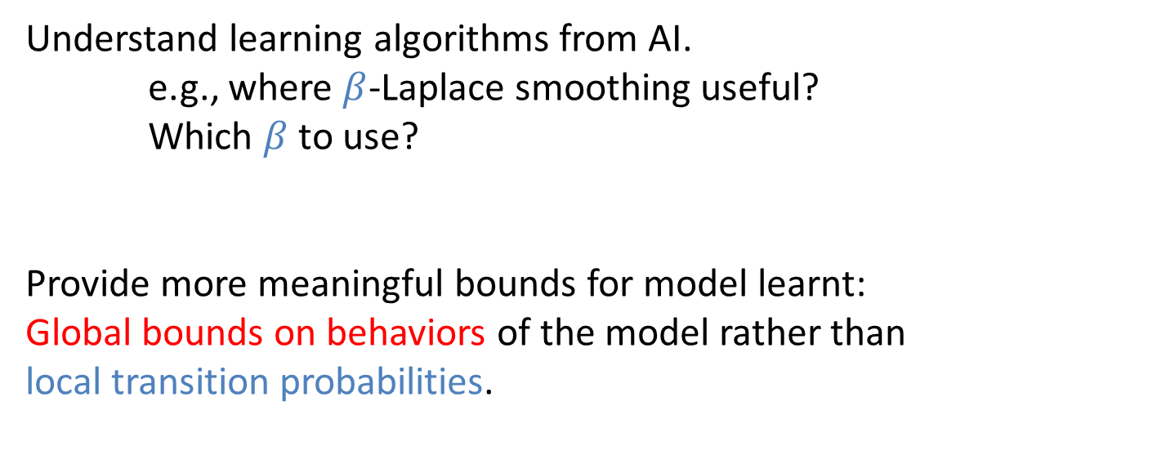
Goals
Understand learning algorithms from AI.
e.g., where $β$-Laplace smoothing useful?
Which $β$to use?
Provide more meaningful bounds for model learnt:
Global bounds on behaviors of the model rather than
local transition probabilities.
How? Use logics LTL, CTL… to specify global behavior.
We want that the probabilities to fulfil
logical formula in model and in system must be close.

Slide 6
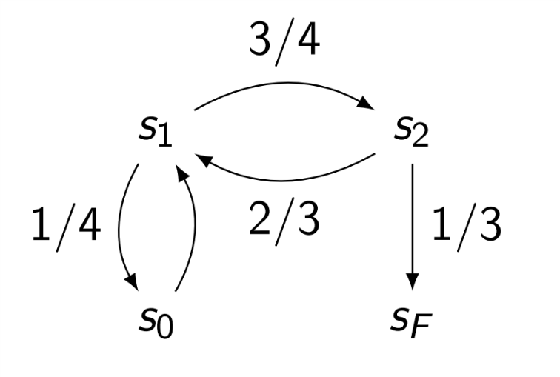
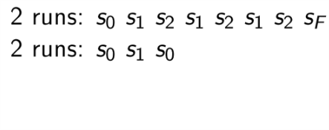
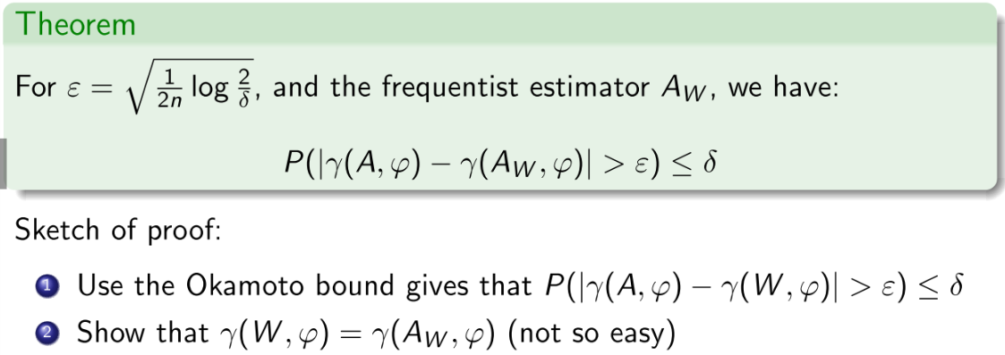
Result 1:
One fixed « Time Before failure » formula X(¬s₀Us_{F}):
Probability to see fault before seeing initial state again.
=> Frequency estimator, giving MC A_{W}
Reset strategy: reset when we reach s_{F} or s₀:
e.g.:

Slide 7
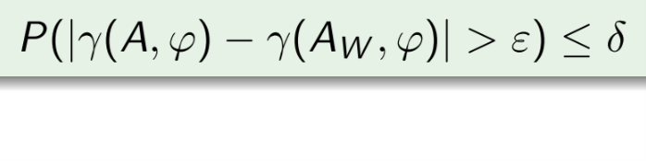
Result 2:
What about learning a Markov chain good for all properties?
=> find A_{W} , ε such that uniformely over all formula ϕ, we have:
- All properties of LTL?
- All properties of PCTL?
- All properties of CTL?
Not possible (ask arbitrarily high precision
for arbitrarily nested formula). [Daca et al.’16]
Possible for depth k formulas, but O(exp(k))
Not possible
(PCTL cannot handle any statistical error)
Possible, and not so costly!

Slide 8
Global PAC bounds for CTL
Error wrt Probability(Xϕ | ϕUψ | Gϕ), for all ϕ,ψ CTL formulae.
observations W={« u s v s »}: reset when same state seen twice
Need to know the support of transitions
(not the case for fixed timed before failure)
=> We use Laplace smoothing to ensure the probabilities are all >0.

Slide 9
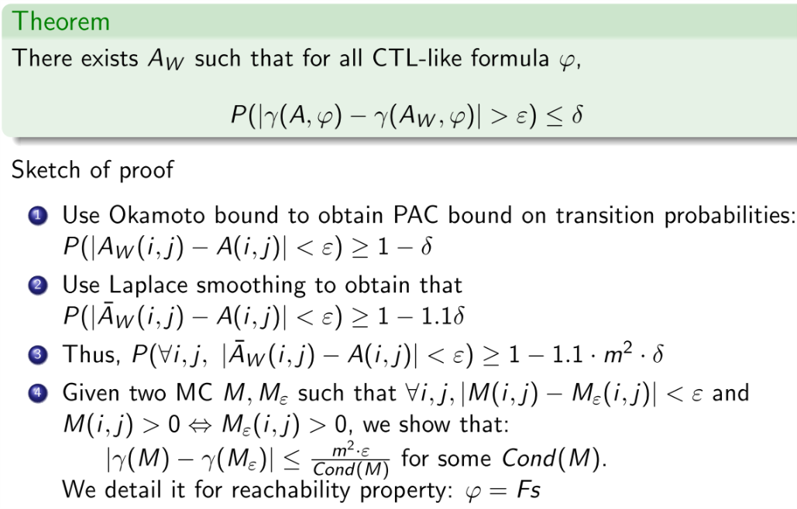
Global PAC bounds for CTL
Error wrt Probability(Xϕ | ϕUψ | Gϕ), for all ϕ,ψ CTL formulae.
observations W={« u s v s »}: reset when same state seen twice
… Next slide

Slide 10
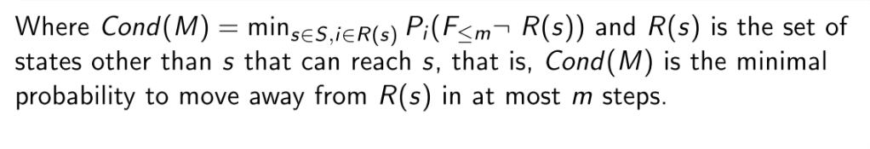
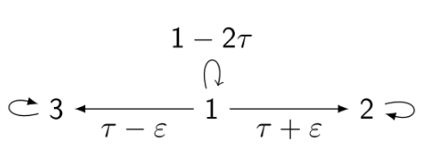
Conditioning of Markov Chain
R(2)=R(3)={1} and R(1)={}
P₁(Leave_{≤m} 1) = 1-(1-2τ)^{m} ≈ 2 m τ
=> Cond(M) ≈ 2 m τ

Slide 11
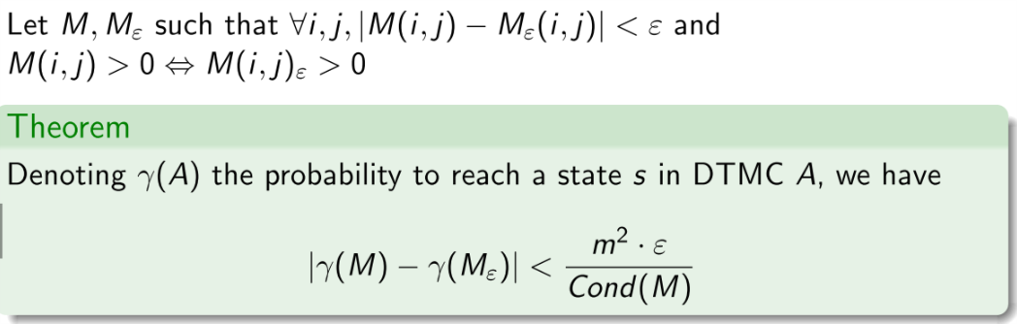
Error Bound
γ wrt Probability(Xϕ | ϕUψ | Gϕ), for all ϕ,ψ CTL formulae.
…true thanks to Laplace smoothing

Slide 12
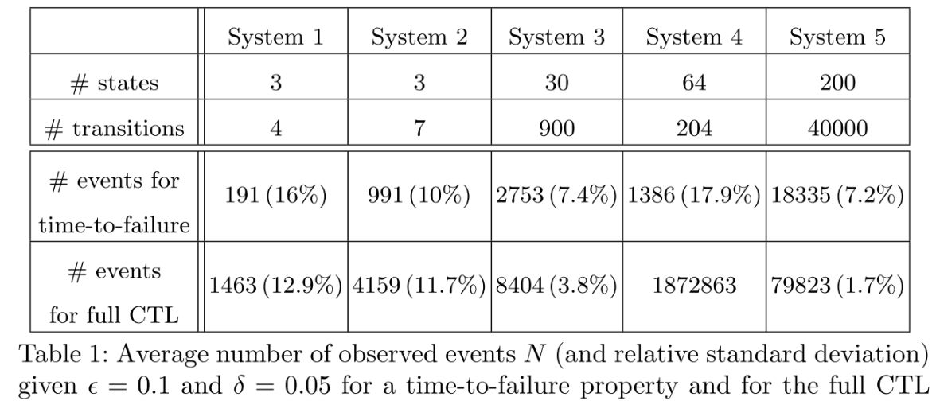
Experimental Results

Slide 13

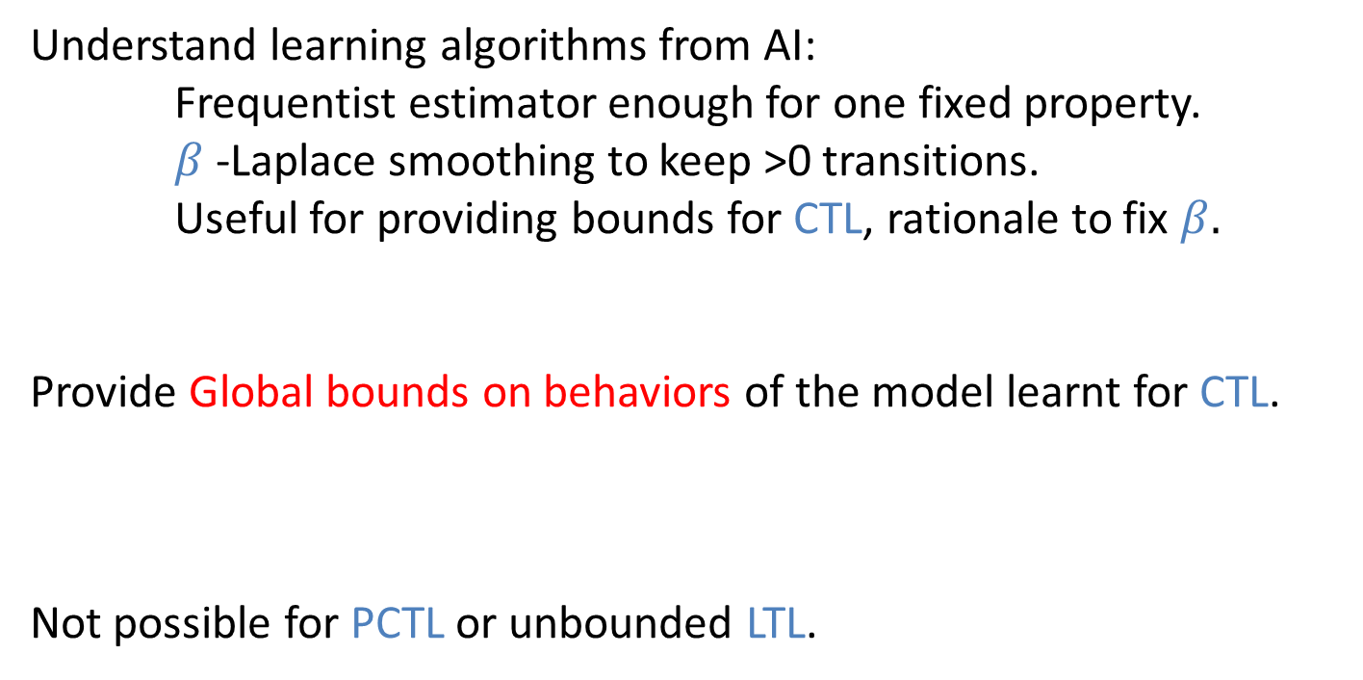
Conclusion
Understand learning algorithms from AI:
Frequentist estimator enough for one fixed property.
$β$-Laplace smoothing to keep >0 transitions.
Useful for providing bounds for CTL, rationale to fix $β.$
Provide Global bounds on behaviors of the model learnt for CTL.
Not possible for PCTL or unbounded LTL.

Slide 14
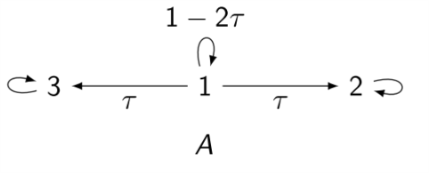
Local vs Global probabilities
Global Property ϕ: reach state 3.
From state 1: P^{A}(ϕ)= ½.
When learning A_{W}, small statistical errors possible
local error on proba: ε
From state 1: ϕ has probability (τ−ε)/2τ
Global error depends on conditioning τ of system
e.g.: τ = 2ε, P^{AW}(ϕ)=¼.

Slide 15
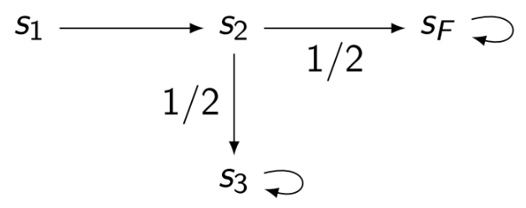
PCTL cannot handle statistical error
-ε
+ε
PCTL Property ϕ : (s₂ => Proba(X(s_{F})) ≥ ½)
P^{A}(ϕ)=1 in the original system A.
If we learn A_{W} from observations W, we can do a small statstical error ε and obtain
P^{AW}(ϕ)=0

Slide 16
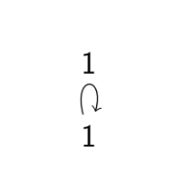
Global PAC bounds for CTL
Error wrt Probability(Xϕ | ϕUψ | Gϕ), for all ϕ,ψ CTL formulae.
observations W={« u s v s »}: reset when same state seen twice
Need to know the support of transitions
(not the case for fixed timed before failure)
Without it, learn: from system
with τ very small
=> We use Laplace smoothing to ensure the probabilities are all >0.

