Slide 1
Augmentation and the face
KineticAugment · Week 2 progress · 13 October 2026
Notes:
Progress since the V1.2 hand findings. Three threads: the round trip on unseen clips, an evidence base for meaning-preserving augmentation with a first trial, and the V1.3 face pipeline (head, jaw, hand-to-face geometry, face stream). Sources: docs/Week_2_Findings.md, docs/Augmentation_Grounding.md, and on feat/face-v1.3 docs/V1_3_Findings.md, V1_3_Training_Data_Audit.md, V1_3_Face_Integration_Results.md.

Slide 2
Four findings this week
1
2
3
4
Our 3-D copy matches the video
Smoothing stops the shaking
We know which changes are safe
The face works; hands float
We turn the tracker's dots on a signer into a 3-D body, turn it back into dots, and measure how far each dot moved. On 20 new videos the body was off by about 1 cm and the fingers by about half a centimetre.
The tracker makes hands wobble from frame to frame. Instead of smoothing the dots, we smooth the joint angles over a few frames, so the bones keep their length. Catch: fast motions get a little softer.
Sign-language research tells us which changes are safe, such as turning the camera or swapping hands. Our first test bent the arms too much: the hand moved far enough to land on a different spot.
Our 3-D head turns the same way as the real head, to within 1°. But when a signer touches their chin, our 3-D hand sits well in front of the face, so we can't yet detect touching.
≈ 1 cm
3.6–5.6×
≈ 10 cm
18 cm
body error (3% of shoulder width)
less hand shaking
hand moved in the first test (too far)
gap between hand and face
Notes:
Plain-language summary. Exact figures: body round-trip error 3.13% of shoulder width on 20 unseen WLASL clips (pilot 3.52%); shoulder width is about 31 cm, so about 1 cm. MANO hands 5.10 mm mean. Smoothing: Gaussian smoothing of the fitted SMPL-X/MANO parameters (sigma 1.5 frames) cut right-hand jitter 3.6–5.6x with bone-length variation 0.4–1.4%, against 2.7–12.3% when smoothing output points; peak wrist speed fell 35–56%. First trial: elbows +15° and shoulders +10° moved the wrists 94–115 mm, 3–4x SPOTER's ±4°. Face: head pose agrees with FaceLandmarker to 0.58° median; median hand-to-head depth gap on near-face frames 0.18 m, contact in 0 frames.

Slide 3
Round trip on unseen footage
Part 1
Does MediaPipe → SMPL-X/MANO → MediaPipe hold on clips it has never seen, and what is its remaining error made of?
Notes:
Week 2 findings, 2026-10-07. 20 clips drawn at random (seed 20261007) from 329 non-pilot WLASL clips, 1,236 frames.

Slide 4
The round trip transfers to unseen clips
MANO hands, random 20 (26 tracks)
5.10 mm
mean error · target ≤ 5 (pilot 7.38)
2.53 mm
fingertips · target ≤ 8 (pilot 3.28)
14.59 mm
p95 · target ≤ 15 (pilot 20.89)
Median difference −0.22 pp, clip-level 95% CI [−1.21, +1.16]. Upright on 1,234 of 1,234 frames.
Source: scripts/evaluate_round_trip.py → data/round_trip_eval/round_trip_report.json. Same WLASL pool; other datasets untested.
Notes:
Body medians match the pilot within noise. Hands do better than on the pilot: the pilot hands were the hard case. The hand mean misses its target by 0.1 mm. Limits: same WLASL pool, some clips share a signer (08917/08918), only 6 of 20 clips have a scored left hand, and hand detection covers 42% of side-frames. The per-clip spread is wider than the pilot (1.44–5.52%), ledger O8.

Slide 5
Body error is mostly systematic, not jitter
1
It depends on pose
On 63229 the arm error is 1–2% with the arm down and 9–10% with the hand at the chin. MediaPipe's arm proportions do not fit SMPL-X.
2
Hands are limited by the detector
Only 14–59% of hand error is constant; the rest is frame-to-frame detector change.
3
The conversion adds almost no jitter
0.00–0.25 pp over MediaPipe's own. Glitches in the output are the detector's.
Preliminary scratch analysis (data/round_trip_eval/week2_experiments/decomp.py). A clip that holds one pose reads as "constant".
Notes:
The top-ranked body clips by median error look fine on video: a steady offset of the elbow. So whether a clip is safe to augment should depend on the varying error and outliers, not the total. The agreed plan is to split error into systematic (shape-explained), varying (detector) and conversion-added parts, then set thresholds from what those show.

Slide 6
Smoothing parameters cuts jitter, keeps bones
3.6–5.6×
less right-hand jitter than the raw round trip, on all five clips
0.4–1.4%
bone-length variation when smoothing parameters, against 2.7–12.3% when smoothing output points
Cost: peak wrist speed falls 35–56%. Smoothing must be judged on jitter removed and motion kept, not on round-trip error, which rises by design.
Exploratory: week2_experiments/smooth_exp.py and smooth_results.txt; comparison videos for 01988, 28111, 69257.
Notes:
Variants compared: running average of outputs, centred Gaussian of outputs, centred Gaussian of fitted parameters at sigma 1, 1.5, 2.5. Smoothing outputs breaks bone lengths (CV up to 12%); smoothing parameters keeps them near the raw 1.1–1.5%. Body arms show the same pattern, e.g. 01988 jitter 1.28 → 0.47. The open risk is that brief sign motion is flattened, so the face audit recommends treating smoothing as an ablation with onset and peak timing checks.

Slide 7
Meaning-preserving augmentation
Part 2
Which changes to a signer's 3-D skeleton keep an isolated sign's meaning, and how strong can they be?
Notes:
docs/Augmentation_Grounding.md (2026-10-11), with source-level evidence in docs/augmentation-evidence/linguistics.md and slr_augmentation.md. Each claim there carries a URL and verification label.

Slide 8
What can vary without changing the sign
Contrastive: must be kept
Free to vary: within limits
Handshape: perceived categorically (CAR / WHICH)
Location: MOTHER (chin) vs FATHER (forehead)
Movement and palm orientation
Timing as morphology: repetitions, holds, end deceleration
Lexical mouth and face: NOT-YET needs the TH mouth
Left vs right hand: not lexically contrastive in ASL
Location shifts forward, back and sideways; forehead signs lowered
Signing rate: realised as sign duration
Movement size: whispered ↔ shouted
Dropping the weak hand, only for some two-handed signs
No source gives tolerances in millimetres or degrees. Bounds have to be set empirically and checked per clip.
Notes:
Sources tagged L1.3 (five parameters, minimal pairs), L5.1–5.3 (categorical perception for handshape but not place), L6.2–6.4 (rate vs aspect, telicity), L7.3 (lexical mouthing), L3.1 (handedness), L2.1–2.6 (location lowering, which acts on the higher member of a pair and avoids the eyes), L2.10 (register), L4.1–4.4 (weak drop conditions).

Slide 9
What sign-recognition studies measured
How to read this: a study trains a model to recognise signs, switches one change on or off, and compares how often the model names the right sign. "Points" is the gap between the two accuracy percentages.
Change | What happened to accuracy | Paper
Play the sign faster or slower | Dropped 15.65 points when turned off (81.47% → 65.82%, WLASL100), the biggest effect found | Laines et al., CVPR Workshops 2023
Turn the 3-D body up to 20° | Rose 1.46 points on WLASL (46.20% → 47.66%) and 1.29 on MSASL when added | Spoken2Sign (Zuo et al., ECCV 2024)
Rotate the picture up to 13° | Rose 2.27 points when added (58.97% → 61.24%, WLASL100) | SPOTER (Boháček & Hrúz, WACV Workshops 2022)
Nudge each arm joint up to 4° | Rose 2.27 points when added (58.97% → 61.24%, WLASL100) | SPOTER (Boháček & Hrúz, 2022)
Mirror left and right | Dropped only 0.69 points when turned off (81.47% → 80.78%); no study found it hurts | Laines et al., 2023
Resize the whole skeleton | Dropped only 0.22 points when turned off (81.47% → 81.25%) | Laines et al., 2023
Erase one direction (x, y or z) | Fell to 3.9% from 38.1% with no change, in general action recognition | AS-CAL (Rao et al., 2021)
Cut off part of the clip | Not tested: the authors refused it, since cutting a two-part sign can leave just one part | ASL Citizen (Desai et al., 2023)
Notes:
All accuracies are top-1. Laines, Gonzalez-Mendoza and Ochoa-Ruiz, CVPR-W (LatinX) 2023, arXiv 2304.05403: skeleton converted to a tree-structure skeleton image and classified with DenseNet, 5-fold cross-validation on WLASL100; speed resamples each clip to 48–74 frames, flip p = 0.5, scale 0.5–1.0. Spoken2Sign (Zuo, Wei, Chen, Mak, Yang, Tong; arXiv 2401.04730) rotates SMPL-X global orientation by U[−20°, 20°] then projects to 2-D; figures are dev-set results for NLA-SLR-Keypoint-64. SPOTER (Boháček & Hrúz, WACV Workshops 2022), Table 6: normalisation-only baseline 58.97%; each augmentation applied with probability 0.5; arm joints rotated with probability 0.3 by up to ±4°. AS-CAL (Rao et al., arXiv 2008.00188) is generic action recognition on NTU-60 (linear evaluation), not sign; STARS (Mehraban et al.) also found axis masking lowered accuracy. ASL Citizen (Desai et al., arXiv 2304.05934) gives the compound-sign rationale. Gap: no published work perturbs MANO hand pose under phonological constraints, so a constrained handshape augmentation would be new. Phonology as auxiliary targets (Kezar et al. 2023) gave +8.7 points on WLASL.

Slide 10
Which changes are safe to make
Safe for every sign
Safe only for some signs
Never safe
Turn the camera left or right, up to 20°
Flip it like a mirror, so the other hand signs
Play the whole sign a bit faster or slower
Nudge the shoulder, elbow and wrist a tiny bit (4°)
Make the person look a bit nearer or farther away
Move the person a little within the picture
Make the hand's path bigger or smaller, like shouting or whispering
Move where the sign happens, only in directions that keep its meaning
Bend the fingers slightly, keeping the same handshape
Change the body's build, then re-aim the arms so the hands land in the same spot
Leave out the second hand, only in two-handed signs that allow it
Hide a few points or frames, as if the tracker lost them
Move the hand to a different place: chin to forehead turns MOTHER into FATHER
Change the handshape, palm direction or path shape
Speed up only part of a sign, or add repeats or pauses
Play it backwards or cut part of it off
Mirror just one hand
Change a mouth shape that is part of the word
Notes:
Plain-language version of the three tiers in docs/Augmentation_Grounding.md §3. Technical ranges. Tier 1: yaw of SMPL-X global_orient ±20° plus a few degrees of pitch; mirror with SMPL-X joints, MANO hands and face swapped; uniform rate 0.8–1.25x with no crop; shoulder, elbow and wrist each p = 0.3, ±4°, then a location check; whole-scene scale 0.85–1.15 about the shoulder centre, applied last; uncentring with both hands kept in frame. Tier 2 needs an ASL-LEX gate or an invariant check: movement size 0.85–1.15; location shifts (neutral space any direction, body-anchored forward/back and sideways, forehead signs lowered only); within-category MANO handshape jitter; body shape with arm IK retargeting; weak-hand drop only for symmetrical, no-contact, non-alternating signs; detector-failure masking of joints or runs of 8 frames or fewer. Excluded: crossing a category, non-uniform time warps or added repetitions/holds, temporal reversal and aggressive crops, one-hand mirroring, changing lexical mouthing or facial expression, shear and whole-axis masking.

Slide 11
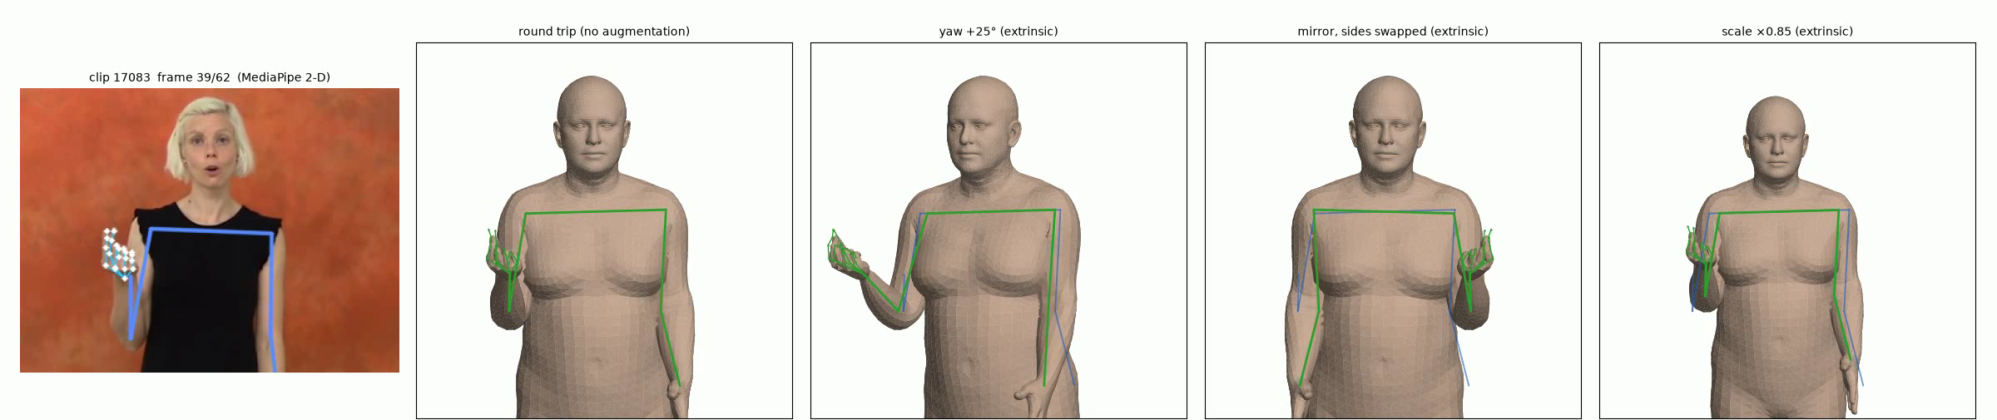
First trial: view, mirror and scale behave exactly
Source video
Round trip (no change)
Yaw +25°
Mirror, sides swapped
Scale ×0.85
Clip 17083 with the points MediaPipe tracked.
Points turned into a 3-D SMPL-X body and back. Every other panel starts here.
The whole figure turned 25° about a vertical line through the shoulder centre.
Left and right flipped across the shoulder centre and the hands swapped: a left-handed signer.
Everything shrunk 15% about the shoulder centre, as if the camera stepped back.
≤ 3×10⁻⁸ m
change at zero strength: each edit is exact
−15.00%
every bone at ×0.85; normalised pose unchanged
25° → 20°
keep yaw inside the tested ±20° next time
Green = augmented, blue = original. scripts/augment_trials.py, clips 17083 and 57641; video data/augment_trials/17083_augmentations.mp4.
Notes:
Each augmentation draws its parameters once per clip and applies them to every frame. Yaw, mirror and scale act on the round trip's outputs (landmarks and mesh vertices), which is equivalent to editing the SMPL-X global orientation for a rigid transform. Mirror also reverses the mesh's triangle winding so normals stay outward. Zero strength reproduces the round trip to at most 3e-8 m for every augmentation. Scale x0.85 shortened upper arm and forearm by exactly 15% while the shoulder-centred, shoulder-width-normalised pose changed by 0.00%, which is why classifiers that normalise this way cancel it. The trial's +25° yaw is slightly beyond Spoken2Sign's tested ±20°.

Slide 12
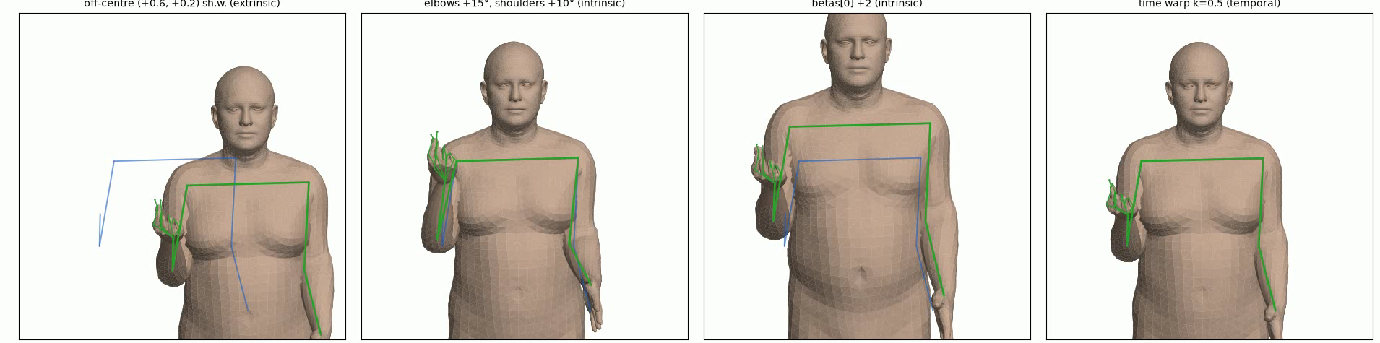
First trial: arm, shape and time changes overshoot
Off-centre
Arm pose
Body shape
Time warp
Whole figure slid 0.6 shoulder-widths right and 0.2 down (about 21 cm).
Both elbows bent 15° more and both shoulders raised 10°, in every frame.
First SMPL-X shape value (betas[0]) raised by 2: a bigger body making the same joint angles.
Clip re-timed unevenly (k = 0.5): start and end up to 1.5× faster, middle down to 0.5×; same length.
Pose unchanged once centred. Needs a check that both hands stay in the frame.
Wrists moved 94–115 mm, 3–4× the published ±4°. Use ±4°, then check location.
Arms 11–15% longer; wrists moved 68–83 mm. Re-aim the arms to keep the hands' spot.
Uneven timing can mimic a different grammar form. Use one constant speed instead.
Green = augmented, blue = original. Wrist displacements are medians over clips 17083 and 57641.
Notes:
Arm pose and body shape edit the SMPL-X parameters and rebuild landmarks and mesh from them; each MANO hand turns with its forearm. Off-centre adds one offset per clip to every landmark and vertex; MediaPipe's y axis points down, so +0.2 is downward. Elbow flex is applied in each frame's own bending plane. betas[0] +2 adds two standard deviations to the first shape coefficient. The time warp maps output time u to source time (T-1)(u + k sin(2 pi u)/(2 pi)), so source time advances at rate 1 + k cos(2 pi u), between 0.5 and 1.5, and never reverses. Body shape has no recognition-gain evidence, so it is lower priority than the Tier 1 set.

Slide 13
Every augmented clip is checked, then kept or rejected
Invariant | How it is measured
Location region at key frames | V1.3 hand-to-face distance with ASL-LEX regions; body regions for torso signs
Contact, incl. with the weak hand | V1.3 signed distance and contact flag; MANO hand-to-hand distance
Handshape category | Selected fingers, flexion, spread, thumb, classified from MANO pose
Palm orientation class | Palm normal relative to the torso frame
Repetitions and holds | Peaks and plateaus in wrist speed
End deceleration | Wrist speed over the last frames
Per-sign gating with ASL-LEX 2.0
≈ 48%
of WLASL videos carry ASL-LEX phonological labels
Labelled signs: all safe changes, including sign-specific ones gated by sign type, location, contact, handshape
Unlabelled signs: only changes safe for every sign
Licence unresolved (CC BY-NC vs CC BY); assume non-commercial
Notes:
Because the literature gives no numeric tolerances, rejection replaces bounds: an augmented clip whose phonological properties changed is dropped. The location and contact rows depend on the V1.3 face geometry, which is why the face depth gap (Part 3) matters for augmentation.

Slide 14
The face as a landmark for hand location
Part 3
Head, neck and jaw fitted to MediaPipe FaceLandmarker; signed hand-to-face distances with ASL-LEX regions; a face stream for training.
Notes:
Branch feat/face-v1.3. Design 2026-10-07, phase-A gate 2026-10-07, training-data audit and integration 2026-10-11. The face matters first as a solid landmark for hand location; expression is secondary.

Slide 15
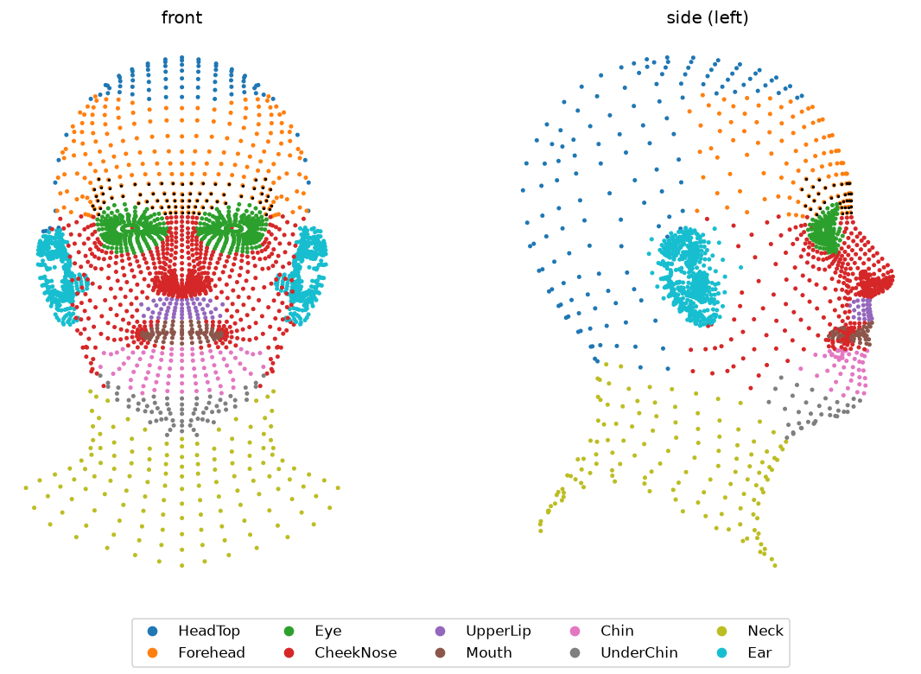
What the face pipeline measures
1
FaceLandmarker pass
478 points, 52 blendshapes and a head-pose matrix per frame
2
Head, neck and jaw fit
Occlusion-aware rotation from 17 rigid points; neck swung to the observed ears; jaw pitch from the lip gap
3
Hand-to-face geometry
Signed distance from 7 points per hand to the SMPL-X head, its ASL-LEX region, and a contact flag (< 2 cm)
4
Face stream
478 points stored head-local, plus blendshapes, as a separate classifier branch
SMPL-X head labelled with ASL-LEX regions
Notes:
MOTHER and FATHER differ only in location, so location relative to the face is a phonological parameter. The MediaPipe→SMPL-X correspondence comes from MPI's MediaPipe→FLAME embedding (105 points) transferred via the FLAME→SMPL-X vertex map. Expression fitting is out of scope; blendshapes stay a separate stream. Eye and Ear regions are generous (Ear radius 3.5 cm takes some temple).

Slide 16
Head and jaw fits pass their gate
0.58°
0.92
7.6 → 2.8%
1.3–1.5 mm
head-pose agreement with FaceLandmarker, median on near-face frames (target ≤ 5°; p95 2.66°)
jaw pitch vs jawOpen rank correlation, median; 6 of 8 scorable clips ≥ 0.7
ear-midpoint error (% shoulder width) once the neck swings, far frames
eye-corner error of the transferred MediaPipe → SMPL-X correspondence
What the gate cannot show
Both head rotations come from the same landmarks, and each is taken relative to its clip mean: a constant 45° error would still score about 0°. This is agreement, not absolute accuracy.
jawOpen is also computed from the landmarks, and 12 of 20 clips had too little jaw motion to score.
Notes:
Gate run on the 20 evaluation clips: 1,236 frames, 143 hand-near-face. Synthetic recovery: head 0.42°, jaw 0.32°, ear midpoint 0.58 mm with the swing vs 23 mm at rest. The axis-convention check is real: with the flip removed the reviewer's clips read 3.2–10.6°, with the rotation inverted 7.8–12.6°. Jaw failures: 69364 (0.50) and 63665 (0.69). No face was detected anywhere in clip 09849.

Slide 17
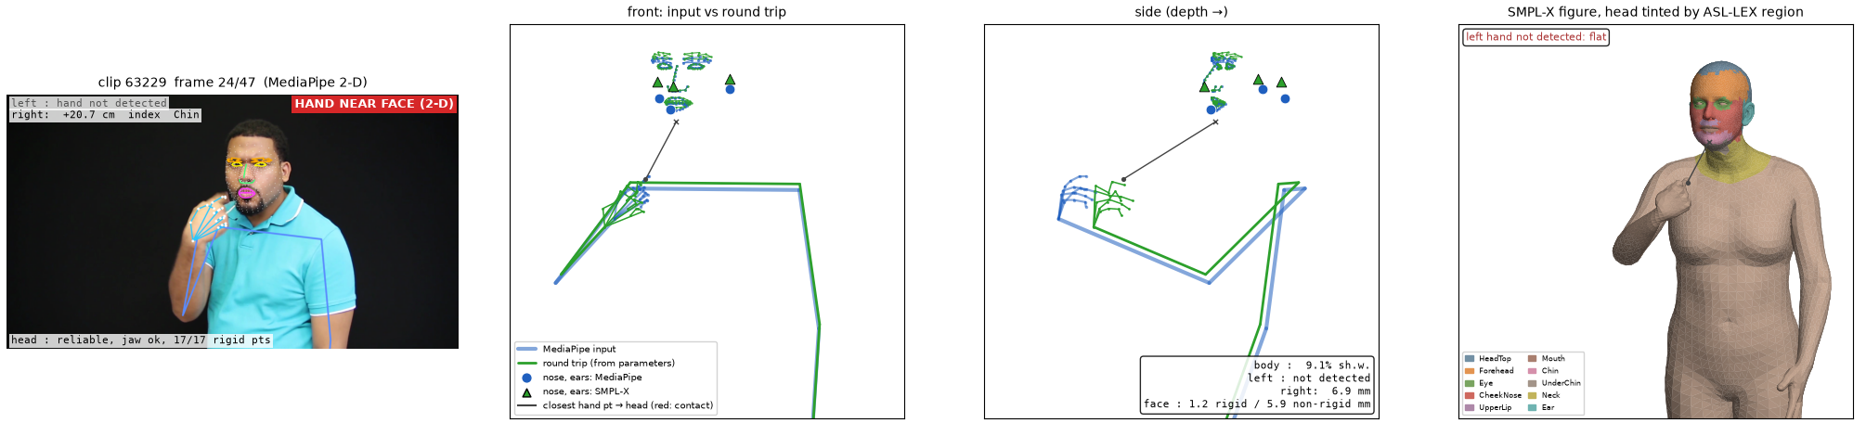
Hands hover about 18 cm in front of the face
18 cm
Why the hand hovers
median front-to-back gap between hand and head when the hand is at the face
One camera cannot see depth, so MediaPipe guesses how far each point is from the camera.
It guesses the body, each hand and the face separately. We join them by setting each hand's wrist on the body's wrist, so a wrong wrist depth moves the whole hand.
The gap is already in MediaPipe's own output before our fitting. Some of it may be real, with hands held in front of the face; we can't yet tell how much.
0 frames
where a hand touched the head, across all 20 clips
I'm looking for ways to bypass it: measuring hand-to-face distance in the 2-D image, correcting wrist depth from the image, and testing on clips where we know the hand touches.
Notes:
Clip 63229, frame 24: MediaPipe flags the hand as near the face in 2-D, but in 3-D the index fingertip is 20.7 cm from the chin. Across 143 near-face frames the median gap is 0.181 m along the camera axis against 0.111 m in the image plane, and no hand point came closer than 0.137 m to the head. The gap is already present in MediaPipe's pose-world output: fingertip-to-nose depth difference 0.217 m when hands are placed by the pipeline's wrist-to-wrist rule. MediaPipe face z is relative and scaled like x under weak perspective, and hand world landmarks use a hand-centred metric origin, so the combined scene is a modelling choice, not a calibrated one. Bypass routes already in progress on feat/face-v1.3: image-space proximity at head depth, and depth-corrected wrists from the image (next slide). Open question O16.

Slide 18
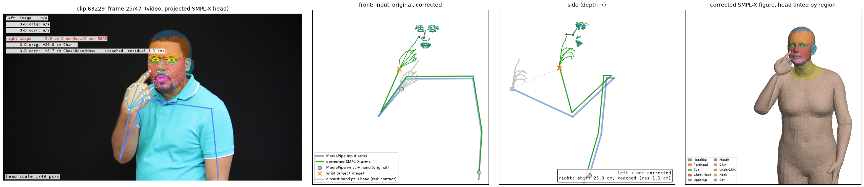
Depth correction is not yet trustworthy
25%
9 of 9
4.5 cm
of corrected pilot hand-frames reach their wrist target within 3 cm (131 of 524)
pilot contacts occur on wrists that never reached their target
depth shift from a 5% error in hand size, more than the 2 cm contact threshold
Decision: correction stays off for production. Contact is "unknown" unless validated, never "no contact".
Notes:
The correction re-aims the arm at a wrist depth inferred from the image and head scale. It re-fits joint directions with fixed bone lengths and a fixed first-pass translation, so the arm often cannot reach the target, yet the mesh's contact value is still exported. On the 6 evaluation clips 29 of 30 contacts had reached wrists, which is more encouraging, but there is no labelled contact reference. A 45° vs 63° field-of-view assumption shifts depth by 4.8 cm.

Slide 19
The face stream is wired in; its benefit is untested
Integration on real caches
Audit verdict
1,646
frames over 25 clips, every frame processed
Go
Observation-preserving face stream: 478 points, 52 blendshapes, head motion, with masks and provenance
99.94%
of observed face frames attached to the fitted head
Revise
Phase A as a source of contact labels: invalid heads still produced geometry (fixed with per-stream masks)
10⁻¹⁶ m
round-trip error of head-local face points (reversible)
Test
Whether faces help recognition: staged ablation on signer-disjoint splits
Classifier trains finitely with and without the face; no WLASL labels were available, so no accuracy was measured.
Notes:
Integration (2026-10-11): versioned per-clip archive (schema 1), adapter emitting body_hands, face, head and blendshape streams with same-shaped masks, and a masked multi-stream classifier. 19 focused tests pass. Missing values are filled only at the tensor boundary and stay false in their masks, so a missing face is distinguishable from a neutral face. Literature: CoSign's ablation cut WER from 27.8 to 22.8 by adding mouth keypoints, which motivates the test but does not predict a WLASL gain.

Slide 20
Open questions
1
Is the 18 cm hand-to-face depth gap real distance or pose-world depth error?
2
Accept clips with a large systematic offset, or flag them before augmenting?
Blocks contact measurement and the location/contact invariants.
08917, 08918, 57949 look plausible but sit up to 3.85 pp above the floor.
3
Does the round trip hold on another dataset, camera or signer pool?
4
Are the ASL-LEX head regions anatomically right?
All evidence so far is from WLASL.
Needs a visual check of the region map.
Notes:
Also carried over: O6, the elbow and shoulder joint-limit axes, which must be checked before any augmentation clamps poses to joint limits; and the ASL-LEX licence question.

Slide 21
Next steps
1
Rework the trial to the safe ranges
Yaw ±20°, mirror, uniform rate 0.8–1.25×, arm joints ±4° at p = 0.3, scale 0.85–1.15, uncentring with hands in frame.
2
Turn invariants into rejection checks
Location region and contact first; they depend on the face geometry and on the depth gap.
3
Get labels: WLASL annotations and ASL-LEX 2.0
Needed for per-sign gating and for any recognition result; settle the ASL-LEX licence.
4
Run the staged ablation
Observed vs fitted body+hands, then + face, then each augmentation alone, as SPOTER did, on signer-disjoint splits.
5
Build a small labelled contact set
Definite contact, near-but-not-touching and ordinary signing space, to calibrate depth correction.
Notes:
Order matters: the trial rework and invariants can proceed now; recognition results wait on labels. Temporal smoothing joins the ablation with onset and peak timing checks rather than being switched on by default. Treat the 20 inspected clips as a development set from now on; they are no longer an untouched test.

