Slide 1

DATA STRUCTURES
Department of Computer Science and Engineering The Chinese University of Hong Kong
CSCI2100B
CSCI2100S
Spring 2011
Sorting Algorithms
Last updated: 09/02/2011
Tang Wai Chung, Matthew
Notes:
31/01: typos fixed on page
01/02: p.2 updated, p.44 fixed, p.45 added

Slide 2
Contents
Important examples are marked with
Motivations & terminologies
Elementary sorting algorithms
Bubble sort
Insertion sort
Selection sort
Shell sort *
Merge sort
Quicksort
Lower bound of runtime complexity for general sorting algorithm *

Slide 3
Motivation
How items are stored in computer memory often has profound influence on speed and simplicity of algorithms.
Imagine how hard it would be to use a dictionary that is not alphabetized!
Sorting is clearly a practical problem.
But it also makes a valuable case study of how to attach programming problems in general.
Sorting techniques provide excellent illustrations of the general ideas in the analysis of algorithms.

Slide 4
Terminologies
We are going to study methods of sorting files of items containing keys.
Each item(record) contains a key, which is a small part of the item, and are used to control the sort.
The remainder of the item is called satellite data.
Sorting: rearrange the items such that their keys are ordered.
e.g. numerical order, alphabetical order, lexicographical order
Internal sort: sorting takes place entirely within the main memory of the computer.
External sort: handle massive amounts of data that cannot fit into the main memory. It requires a slower kind of memory (like hard-disk) for the sorting.

Slide 5
Stability
A sorting method is said to be stable if it preserves the relative order of items with duplicated keys in the file.
Adams 1
Black 2
Brown 4
Jackson 2
Jones 4
Smith 1
Thompson 4
Washington 2
White 3
Wilson 3
Adams 1 Smith 1
Washington 2 Jackson 2 Black 2
White 3 Wilson 3
Thompson 4 Brown 4 Jones 4
Adams 1 Smith 1
Black 2 Jackson 2 Washington 2
White 3 Wilson 3
Brown 4 Jones 4 Thompson 4
unstable
stable
Note: only some of the sorting algorithms in our discussion are stable.

Slide 6
Permutation and k-Permutation
A permutation of a finite set S is an ordered sequence of all the elements of S, with each element appearing exactly once.
For example, if S = {a, b, c}, there are 6 permutations of S:
abc, acb, bac, bca, cab, cba
There are N! permutations of a set of N elements.
A K-permutation of S is an ordered sequence of K elements of S, with no element appearing more than once in the sequence.
An ordinary permutation is just an N-permutation of an N-set.)
The twelve 2-permutations of the set a, b, c, d are
ab, ac, ad, ba, bc, bd, ca, cb, cd, da, db, dc

Slide 7
Inversion
An inversion in an array of numbers is any ordered pair (i, j) having the property that i < j but a[i] > a[j].
For example, the input list 34, 8, 64, 51, 32, 21 has nine inversions, namely (34,8), (34,32), (34,21), (64,51), (64,32), (64,21), (51,32), (51,21) and (32,21).
Intuition: We need to swap the element a[i] and a[j] so that the array is closer to be sorted. Thus more inversions imply more swaps are needed.
Notice that this is exactly the number of swaps that needed to be (implicitly) performed by insertion sort.

Slide 8
Assumptions
We assume the following in our discussion of the sorting algorithms:
Internal - Each algorithm will be passed an array containing the elements and an integer containing the number of elements stored entirely in the main memory.
Validity -- We will assume that n, the number of elements passed to our sorting routines, has already been checked and is legal.
Ordering -- We require the existence of the < and > operators, which can be used to place a consistent ordering on the input.

Slide 9
Elementary Sorting Algorithms
Easy to implement.
Take O(N²) time to sort N items in worse cases.
Yet suitable for:
occasions which the sort problem has to be solved only once.
small files where the number of items to be sorted is not too large. (< 500) Reasons: sophisticated algorithms generally incur overheads that makes them slower in small files.

Slide 10
Selection Sort
It is also called straight selection or push-down sort.
The algorithm works as follows:
Find the minimum value in the list (select)
Swap(exchange) it with the value in the first position
Repeat the steps above for the remainder of the list (to 2nd, 3rd, …., (n - 1)^{th} positions) until the entire array is sorted.

Slide 11
Selection Sort: Example
 |  | 34 | 8 | 64 | 51 | 32 | 21 |  | #ex | #cm
1 |  | 34 | 8 | 64 | 51 | 32 | 21 |  | 1 | 5
2 |  | 8 | 34 | 64 | 51 | 32 | 21 |  | 1 | 4
3 |  | 8 | 21 | 64 | 51 | 32 | 34 |  | 1 | 3
4 |  | 8 | 21 | 32 | 51 | 64 | 34 |  | 1 | 2
5 |  | 8 | 21 | 32 | 34 | 64 | 51 |  | 1 | 1
6 |  | 8 | 21 | 32 | 34 | 51 | 64
circled: selected shaded: sorted subarray
#ex: no. of exchanges #cm: no. of comparisons

Slide 12
Selection Sort: Code
void selectionsort(int n, int a[]){
int i, j, min, tmp;
for (i = 0; i < n - 1; i++){
min = i;
for (j = i + 1; j < n; j++){
if (a[j] < a[min])
min = j;
}
tmp = a[i];
a[i] = a[min];
a[min] = tmp;
}
}
N – 1 passes
select the min.
exch.

Slide 13
Selection Sort: Analysis
The algorithm consists of a selection phase in which the smallest of the remaining elements, min, is repeatedly placed in its proper position, i.
min is swapped with the element a[i].
The initial n-element priority queue is reduced by one element after each selection.
The first pass makes N - 1 comparisons, the second pass makes N - 2, and so on.
Therefore there is a total of (N - 1) + (N - 2) + … + 1 = N(N - 1)/2 = O(N²) comparisons.

Slide 14
Selection Sort: Analysis (2)
The number of swaps is always (N - 1).
unless a test is added to prevent the swap of an element with itself.
☑ little additional storage required - only a few temporary variables
The sort may be categorized as O(n²), although it is faster than the bubble sort.
☒ There is NO improvement if the input array is completely sorted or unsorted
The testing ignores the makeup of the array.

Slide 15
Selection Sort: Example 2
 |  | H | E | L | L | O | W | O | R | L | D |  | #e | #c
1 |  | H | E | L | L | O | W | O | R | L | D |  | 1 | 9
2 |  | D | E | L | L | O | W | O | R | L | H |  | 1 | 8
3 |  | D | E | L | L | O | W | O | R | L | H |  | 1 | 7
4 |  | D | E | H | L | O | W | O | R | L | L |  | 1 | 6
5 |  | D | E | H | L | O | W | O | R | L | L |  | 1 | 5
6 |  | D | E | H | L | L | W | O | R | O | L |  | 1 | 4
7 |  | D | E | H | L | L | L | O | R | O | W |  | 1 | 3
8 |  | D | E | H | L | L | L | O | R | O | W |  | 1 | 2
9 |  | D | E | H | L | L | L | O | O | R | W |  | 1 | 1
10 |  | D | E | H | L | L | L | O | O | R | W |  | 0 | 0

Slide 16
Insertion Sort
Bridge hand sorting
consider the items one at a time
insert each into its proper place among already considered(and sorted)
In computer, we need to make space for moving larger items one position to the right.
Clearly, insertion sort consists of N - 1 passes.
For pass p = 2 through N, insertion sort ensures that the elements in positions 1 through p are in sorted order.
Insertion sort makes use of the fact: Elements in positions 1 through p - 1 are already known to be in sorted order.

Slide 17
Insertion Sort: Example
 |  | 34 | 8 | 64 | 51 | 32 | 21 |  | #ex | #cm
1 |  | 8 | 34 | 64 | 51 | 32 | 21 |  | 1 | 1
2 |  | 8 | 34 | 64 | 51 | 32 | 21 |  | 0 | 1
3 |  | 8 | 34 | 51 | 64 | 32 | 21 |  | 1 | 2
4 |  | 8 | 32 | 34 | 51 | 64 | 21 |  | 3 | 4
5 |  | 8 | 21 | 32 | 34 | 51 | 64 |  | 4 | 5
circled: selected shaded: moved
#ex: no. of exchanges #cm: no. of comparisons

Slide 18
Insertion Sort: Code
Line 5-6: Shift down the elements until we find an element greater than a[i].
Line 7: insert the saved element at this point.
void insertionsort(int n, int a[]){
int i, j, tmp;
for (i = 1; i < n; i++){
tmp = a[i];
for (j = i; j > 0 && a[j - 1] > tmp; j--)
a[j] = a[j - 1]; // shift down
a[j] = tmp; // the insert
}
}
N – 1 passes
make space

Slide 19
Insertion Sort: Analysis (1)
Initially a[0] may be thought of as a sorted array of one element.
After k iterations, the elements a[0] through a[k] are in order.
Time complexity in various cases
If the initial array is sorted, only one comparison is made on each pass (line 5), so that the sort is O(N).
If the array is initially sorted in the reversed order, the sort is O(N²), since the total number of comparisons is
(N - 1) + (N - 2) + … + 2 + 1 = (N - 1)N/2 = O(N²)

Slide 20
Insertion Sort: Analysis (2)
☑ The closer the array is to the sorted order, the more efficient the insertion sort becomes. (i.e. less unnecessary comparisons)
The average number of comparisons in the simple insertion sort (by considering all possible permutations of the input array) is also O(N²).
The space requirements consists of only one temporary variable tmp.
In worse case, insertion sort makes O(N²) comparisons of keys and O(N²) movements of entries.

Slide 21
Insertion Sort: Analysis (3)
Improve searching: use a binary search.
This reduces the total number of comparisons from O(N²) to O(N log N).
The moving operation still requires O(N²) time. So the binary search does not significantly improves the overall time requirement.
Improve insertion: use the list insertion.
This reduces the time required for insertion but not the time required for searching for the proper position.
Also this requires time and memory to build the linked list copy of the original array.

Slide 22
A Lower Bound for Simple Sorting
The average number of inversions in an array of N distinct numbers is N(N - 1)/4.
Proof
For any list, L, of numbers, consider L_{r} , the list in reversed order.
Consider any pair of two numbers in the set of keys (x, y), with y > x.
In exactly one of L and L_{r} this ordered pair represents an inversion.
The total number of these pairs is
(N - 1) + (N - 2) + … + 1 = N(N - 1)/2
On average, it is half of the above.

Slide 23
A Lower Bound for Simple Sorting (2)
Any algorithm that sorts by swapping adjacent elements requires Ω(N²) time on average.
Proof
The average number of inversions is initially N(N - 1)/4 = Θ(N²)
Each swap removes only one inversion, so Θ(N²) swaps are required.
Average case complexity of insertion sort
j loop executes N(N - 1)/4 times.
i loop executes exactly n times.
Complexity = O(N) + N(N - 1)/4 = N²/4 + O(N)

Slide 24
Insertion Sort: Example 2
 |  | H | E | L | L | O | W | O | R | L | D |  | #e | #c
1 |  | E | H | L | L | O | W | O | R | L | D |  | 1 | 1
2 |  | E | H | L | L | O | W | O | R | L | D |  | 0 | 1
3 |  | E | H | L | L | O | W | O | R | L | D |  | 0 | 1
4 |  | E | H | L | L | O | W | O | R | L | D |  | 0 | 1
5 |  | E | H | L | L | O | W | O | R | L | D |  | 0 | 1
6 |  | E | H | L | L | O | O | W | R | L | D |  | 1 | 2
7 |  | E | H | L | L | O | O | R | W | L | D |  | 1 | 2
8 |  | E | H | L | L | L | O | O | R | W | D |  | 4 | 5
9 |  | D | E | H | L | L | L | O | O | R | W |  | 9 | 10

Slide 25
Bubble Sort
Scan the list from one end to the other, and whenever a pair of adjacent keys is found to be out of order, then those entries are swapped.
In this pass, the largest key in the list will have bubbled to the end, but the earlier keys may still be out of order. (assume that you begin from the left hand side)
The bubble sort is probably the easiest algorithm to implement but the most time consuming of all the algorithm.
The basic idea underlying the bubble sort is to pass through the array sequentially several times.

Slide 26
Bubble Sort: Example
 |  | 34 | 8 | 64 | 51 | 32 | 21 |  | #ex | #cm
1 |  | 8 | 34 | 51 | 32 | 21 | 64 |  | 4 | 5
2 |  | 8 | 34 | 32 | 21 | 51 | 64 |  | 2 | 4
3 |  | 8 | 32 | 21 | 34 | 51 | 64 |  | 2 | 3
4 |  | 8 | 21 | 32 | 34 | 51 | 64 |  | 1 | 2
5 |  | 8 | 21 | 32 | 34 | 51 | 64 |  | 0 | 1
(the bubbles)
circled: selected shaded: sorted subarray
#ex: no. of exchanges #cm: no. of comparisons

Slide 27
Bubble Sort: Code
Each pass consists of comparing each element in the array with its successor (a[i] with a[i + 1])
Swap the two elements if they are not in proper order.
After each pass, the largest element a[n - i - 1] is in its proper position within the sorted array.
void bubblesort(int n, int a[]) {
int i, j, tmp;
for (i = 0; i < n - 1; i++)
for (j = 0; j < n - 1 - i; j++)
// compare the two neighbors
if (a[j] > a[j + 1]) {
// swap a[j] and a[j+1]
tmp = a[j];
a[j] = a[j + 1];
a[j + 1] = tmp;
}
}

Slide 28
Bubble Sort: Improvement
Stops when we spot that there is no more exchanges in the last round.
void bubblesort_imprv(int n, int a[]) {
int i, j, tmp, swapped = 1;
for (i = 0; i < n - 1 && swapped; i++){
swapped = 0;
for (j = 0; j < n - i - 1; j++){
if (a[j] > a[j + 1]) {
swapped = 1;
tmp = a[j];
a[j] = a[j + 1];
a[j + 1] = tmp;
}
}
}
}

Slide 29
Bubble Sort: Analysis
Original version:
The number of comparisons made in: 1st pass: N - 1; 2nd pass: N - 2, and so on.
The total number of comparisons is (N - 1) + (N - 2) + … + 1 = N(N - 1)/2 = O(N²)$
With improvement:
When it is close to sorted, O(N)
When it is far from sorted, O(N²)
☑ Bubble sort requires little additional space.

Slide 30
Bubble Sort: Example 2
 |  | H | E | L | L | O | W | O | R | L | D |  | #e | #c
1 |  | E | H | L | L | O | O | R | L | D | W |  | 5 | 9
2 |  | E | H | L | L | O | O | L | D | R | W |  | 2 | 8
3 |  | E | H | L | L | O | L | D | O | R | W |  | 2 | 7
4 |  | E | H | L | L | L | D | O | O | R | W |  | 2 | 6
5 |  | E | H | L | L | D | L | O | O | R | W |  | 1 | 5
6 |  | E | H | L | D | L | L | O | O | R | W |  | 1 | 4
7 |  | E | H | D | L | L | L | O | O | R | W |  | 1 | 3
8 |  | E | D | H | L | L | L | O | O | R | W |  | 1 | 2
9 |  | D | E | H | L | L | L | O | O | R | W |  | 1 | 1

Slide 31
Comparing Elementary Sorting Algo.
Algorithm | # cm | # ex
Bubble Sort | N²/2 | N²/2
Insertion Sort | N²/4 (avg.) N²/2 (worse) | N²/4 (avg.) N²/2 (worse)
Selection Sort | N²/2 | N

Slide 32
Shell Sort
Selection sort moves the entries very efficiently but does many redundant comparisons.
Insertion sort uses the minimum number of comparisons, but is inefficient in moving element only one slot at a time.
Idea of Shell Sort
Modify the comparison method so that it first compares distant keys.
The distance between comparisons decreases as the algorithm runs through phases, with adjacent elements compared in the last phase.

Slide 33
Shell Sort
Increment Sequence: h_{t}, h_{t-1}, …, h₂, h₁ = 1,
After a phase using some increment h_{k}, we have a[i] ≤ a[i + h_{k}] for all i (i.e. all elements spaced h_{k} apart is sorted).
The array is said to be h_{k}-sorted.
Shell sort is also called diminishing increment sort
since the increment sequence goes smaller and smaller (i.e. h_{j+1} > h_{j})
 | 81 | 94 | 11 | 96 | 12 | 35 | 17 | 95 | 28 | 58 | 41 | 75 | 15
5-sorted | 35 | 17 | 11 | 28 | 12 | 41 | 75 | 15 | 96 | 58 | 81 | 94 | 95
3-sorted | 28 | 12 | 11 | 35 | 15 | 41 | 58 | 17 | 94 | 75 | 81 | 96 | 95
1-sorted | 11 | 12 | 15 | 17 | 28 | 35 | 41 | 58 | 75 | 81 | 94 | 95 | 96

Slide 34
Shell Sort: Strategy
For a h_{k}-sort, for each position i in h_{k}, h_{k+1}, …, n - 1, place the element in the correct spot among i, i - h_{k}, i - 2h_{k}, etc.
You can imagine this is like jumping over h_{k} elements on the array.
It is interesting that this is equivalent to perform an insertion sort on h_{k} independent subarrays.
Example: h_{k} = 3
 | 6 | 8 | 13 | 2 | 5 | 11 | 20 | 9
1 | 6 |  |  | 2 |  |  | 20
2 |  | 8 |  |  | 5 |  |  | 9
3 |  |  | 13 |  |  | 11

Slide 35


Shell Sort: Code
A popular choice for the increment sequence (as suggested by Shell):
void shellsort(int n, int a[]){
int i, j, inc, tmp;
for (inc = n / 2; inc > 0; inc /= 2)
for (i = inc; i < n; i++){
tmp = a[i];
for (j = i; j >= inc; j -= inc)
if (tmp < a[j - inc])
a[j] = a[j - inc];
else
break;
a[j] = tmp;
}
}
we may use better sequence
Notes:
Best Known Sequence: http://oeis.org/A102549 by Marcin Ciura, 2001.

Slide 36
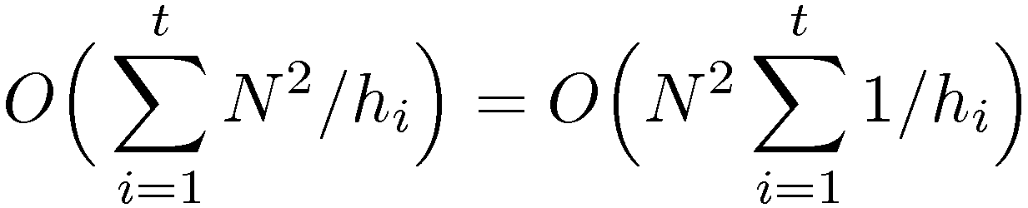
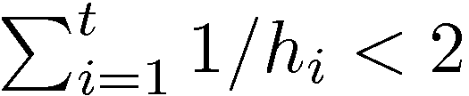
Shell Sort: Upper Bound Analysis
The worse-case running time of Shell sort, using Shell's increments, is Θ(N²).
Upper bound: a h_{k}-sort consists of h_{k} insertion sorts O(N²) of around N/h_{k} elements.
Total cost of a pass = O(h_{k}(N/h_{k})²) = O(N²/h_{k})
Summing over all passes,
Shell's sequence is a geometric sequence with ratio = 2,
Thus the worse case complexity of shell sort = O(N²)

Slide 37
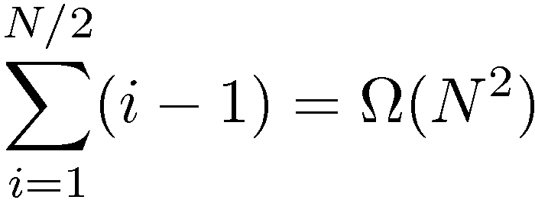
Shell Sort: Lower Bound Analysis
We pick N = 2^{x} for some x, so that all increments are even except the last one h₁ = 1.
We put N/2 largest numbers in the even positions and N/2 smallest numbers in the odd positions.
Therefore in before the last phase, the N/2 largest numbers remain in even positions, similar for smallest numbers.
The i-th smallest number is in 2i - 1, to restore it requires i - 1 moves in the array.
Total # moves =
After 4-sort | 1 | 5 | 2 | 6 | 3 | 7 | 4 | 8
After 2-sort | 1 | 5 | 2 | 6 | 3 | 7 | 4 | 8
After 1-sort | 1 | 2 | 3 | 4 | 5 | 6 | 7 | 8

Slide 38
Shell Sort: Analysis (3)
Although shell sort is easy to code, the analysis of its running time is difficult and the runtime depends on the choice of the increment sequence.
An important theorem about Shell sort:
An h_{k}-sorted array that is then h_{k-1}-sorted remains h_{k}-sorted.
Therefore it is clever to choose increments that are relatively prime, i.e. gcd(h_{i+1},h_{i}) = 1 for t > i ≥ 1
Hibbard's increments: 1, 3, 7, …, 2^{k} - 1 will give a worse-case running time Θ(n^{3/2}).
Sedgewick's increments: 9x4^{i} - 9x2^{i} + 1 or 4^{i} - 3x2^{i} + 1. Worst-case: O(n^{4/3}).

Slide 39
Part I: Summary
Study several fundamental sorting algorithms based on swapping elements in list.
Insertion sort: minimum no. of comparisons
Selection sort: minimum no. of element exchanges
Bubble sort: the slowest algorithm
Shell sort: performance depends on choice of increment sequence.
Understand the lower bound of O(N²) in sorting using swapping adjacent elements.

Slide 40
Merge sort
The classic example of divide and conquer strategy:
Divide: Split the array into two halves and solve the sorting problem independently
Conquer: Merge the sorted sub-array to get back a whole sorted array.
The fundamental operation is merging two sorted lists.
Since the lists (A and B) are sorted, the merging can be done by simply a linear scan through the input and put the output to an auxiliary list (C).
Thus we use three counters (a, b and c) to record the current position on the three lists respectively.

Slide 41
Merging: Example
1 | 13 | 24 | 26
2 | 15 | 27 | 38
1 | 13 | 24 | 26
2 | 15 | 27 | 38
1
1 | 13 | 24 | 26
2 | 15 | 27 | 38
1 | 2
1 | 13 | 24 | 26
2 | 15 | 27 | 38
1 | 2 | 13
Is this merging process stable?

Slide 42
Merging: Example (2)
1 | 13 | 24 | 26
2 | 15 | 27 | 38
1 | 2 | 13 | 15
1 | 13 | 24 | 26
2 | 15 | 27 | 38
1 | 2 | 13 | 15 | 24
1 | 13 | 24 | 26
2 | 15 | 27 | 38
1 | 2 | 13 | 15 | 24 | 26
1 | 13 | 24 | 26
2 | 15 | 27 | 38
1 | 2 | 13 | 15 | 24 | 26 | 27 | 38

Slide 43
Merge Sort: Algorithm
If N = 1, there is only one element to sort and we have the answer.
Otherwise, recursively merge sort the first half (A) and the second half (B).
The sorted two halves will be merged together using the procedure shown in the previous example.
Since the algorithm is recursive, we need a driver function to start the recursion. The function also allocates a temporary array.
30 void mergesort(int n, int a[]){ /* driver */
31 int *tmpa = (int *)malloc(n * sizeof(int));
32
33 msort(a, tmpa, 0, n - 1);
34 free(tmpa);
35 }

Slide 44
Merge Sort: Example (1)
Top-down merge sort: Divide-and-conquer approach Only merging steps in the recursion are shown.
 |  | H | E | L | L | O | W | O | R | L | D
1 |  | E | H
2 |  |  |  | L | L
3 |  |  |  | L | L | O
4 |  | E | H | L | L | O
5 |  |  |  |  |  |  | O | W
6 |  |  |  |  |  |  |  |  | L | R
7 |  |  |  |  |  |  |  |  | D | R | W
8 |  |  |  |  |  |  | D | L | O | R | W
9 |  | D | E | H | L | L | L | O | O | R | W
Notes:
09/02: fix mistakes in the divide stage.

Slide 45
Merge Sort: Example (2)
 |  | H | E | L | L | O | W | O | R | L | D
1 |  | E | H
2 |  |  |  | L | L
3 |  |  |  |  |  | O | W
4 |  |  |  |  |  |  |  | O | R
5 |  |  |  |  |  |  |  |  |  | D | L
6 |  | E | H | L | L
7 |  |  |  |  |  | O | O | R | W
8 |  | E | H | L | L | O | O | R | W
9 |  | D | E | H | L | L | L | O | O | R | W
Bottom-up merge sort: iterative, merge 1-1, then 2-2, 4-4, 8-8, etc.

Slide 46
Merge Sort: Code
Case (i): right = left → 1 element; do nothing and return
Case (ii): right = left + 1 → 2 elements;
center = left line 24 returns at once;
center + 1 = right line 25 returns at once.
Then merge two single-entry sub-arrays.
19 void msort(int a[], int tmpa[], int left, int right){
20 int center;
21
22 if (left < right){
23 center = (left + right) / 2;
24 msort(a, tmpa, left, center);
25 msort(a, tmpa, center + 1, right);
26 merge(a, tmpa, left, center + 1, right);
27 }
28 }

Slide 47
Merge Sort: Code (2)
1 void merge(int a[], int tmpa[], int l, int r, int rend){
2 int i;
3 int lend = r - 1;
4 int t = l;
5 int n = rend - l + 1;
6
7 while (l <= lend && r <= rend) // main loop
8 tmpa[t++] = a[l] <= a[r] ? a[l++] : a[r++];
9 while (l <= lend) // copy rest of first half
10 tmpa[t++] = a[l++];
11 while (r <= rend) // copy rest of second half
12 tmpa[t++] = a[r++];
13
14 // copy tmpa back
15 for (i = 0; i < n; i++, rend--)
16 a[rend] = tmpa[rend];
17 }
Determine when the scan on either half is done: calculate lend and rend.

Slide 48
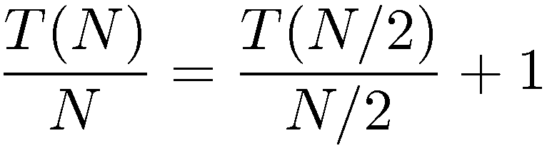
Merge Sort: Analysis
For simplicity, we assume N is a power of 2. (The result remains valid when this assumption is violated)
For N = 1, T(N) is constant and we let T(1) = 1,
otherwise, T(N) = 2T(N/2) + N,
we sort two halves and merge in linear time.
To prepare for telescoping, we divide the equation by N:

Slide 49
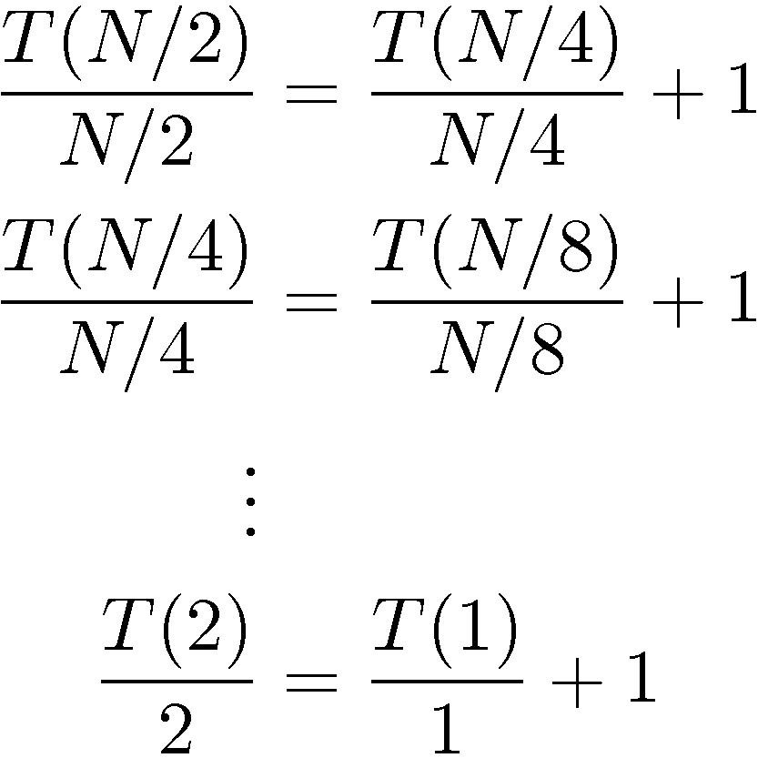
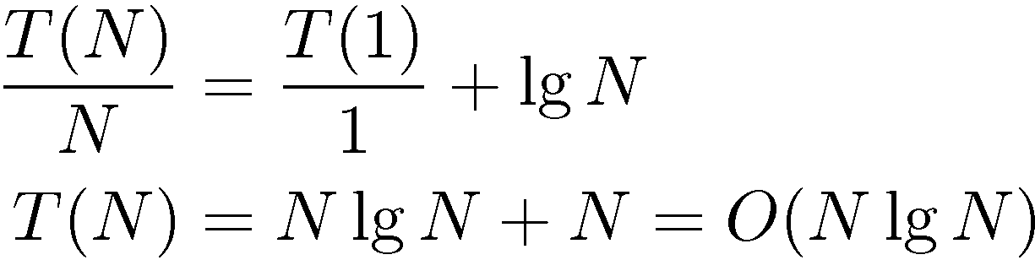
Merge Sort: Analysis (2)
This is valid for any N that is a power of 2, so:
Adding up all equations, we have

Slide 50
Properties of Merge Sort
☑ Guaranteed to sort a file of N items in O(N lg N) time
☒ use up O(N) extra space
need careful implementations for efficient sorting
Running time depends primarily on only the number of input keys
insensitive of their relative orders
stable

Slide 51
Stable Merging
A₁ | B₁ | B₂ | C₁ | A₂ | B₃ | C₂ | C₃
Merge the subarrays into the aux array
Pay attention to the relative orders of the alphabets
A₁ | B₁ | B₂ | C₁ | A₂ | B₃ | C₂ | C₃
We always merge from the left array first.
key₁(A₁) = key₁(A₂)
key₂(A₁) < key₂(A₂)
A₁ | A₂

Slide 52
Stable Merging (2)
A₁ | B₁ | B₂ | C₁ | A₂ | B₃ | C₂ | C₃
Continue with B₁, B₂, B₃
A₁ | A₂ | B₁ | B₂ | B₃
A₁ | B₁ | B₂ | C₁ | A₂ | B₃ | C₂ | C₃
Merge sort is stable only when the merging step is stable and preserve relative orders of the items.
A₁ | A₂ | B₁ | B₂ | B₃ | C₁ | C₂ | C₃

Slide 53
Quicksort
quicksort is one of the fastest known sorting algorithms in practice.
Its worse-case performance is O(N²) and its average runtime is O(N log N).
A divide-and-conquer recursive algorithm.
Quicksort Algorithm
If the number of elements in S is 0 or 1, then return
Pick any element v in S, named the pivot.
Partition S' = S – {v} into two disjoint groups:
Return {quicksort(S₁), v, quicksort(S₂)}

Slide 54
Quicksort: Pivot Selection
Ideally we want half the keys to go into S₁ and another half into S₂.
The choice of pivot can strongly affect the relative sizes of the partitions.
Why quicksort is faster than merge sort?
We can implement the partitioning to be performed in place and very efficiently. There is no need of an extra array in merge sort.
☹ The first element: bad choice. Keep making bad partitioning when the array is sorted or reversed.
😐 A random pivot: safe, but you take extra time to generate the random number.
☺ Median-of-Three Partitioning: pick the median of a[0], a[n - 1] and a[n / 2] to be the pivot.

Slide 55
Partitioning Strategy
Pick the pivot using median-of-three method
8 | 1 | 4 | 9 | 6 | 3 | 5 | 2 | 7 | 0
Swap the pivot with the last element (hiding)
Take two counters i and j at the first element and next-to-last element respectively.
8 | 1 | 4 | 9 | 0 | 3 | 5 | 2 | 7 | 6

Slide 56
Partitioning Strategy (2)
Goal: move all the small elements to the left part of the array while the large elements to the right part.
- move i until we find an element larger than the pivot - move j until we find a smaller element - exchange the two
8 | 1 | 4 | 9 | 0 | 3 | 5 | 2 | 7 | 6
And repeat …
2 | 1 | 4 | 9 | 0 | 3 | 5 | 8 | 7 | 6

Slide 57
Partitioning Strategy (3)
Until i and j cross.
2 | 1 | 4 | 5 | 0 | 3 | 9 | 8 | 7 | 6
Swap the pivot with the element pointed by i. Done!
2 | 1 | 4 | 5 | 0 | 3 | 6 | 8 | 7 | 9

Slide 58
Quicksort: Code
The median-of-three pivot selection:
9 int median3(int a[], int l, int r){
10 int c = (l + r) / 2;
11
12 if (a[l] > a[c]){
13 swap(&a[l], &a[c]);
14 if (a[l] > a[r])
15 swap(&a[l], &a[r]);
16 if (a[c] > a[r])
17 swap(&a[c], &a[r]);
18 // we are sure that:
19 // a[l] <= a[c] <= a[r]
20 swap(&a[c], &a[r]); // hide pivot
21 return a[r]; // return pivot
22 }

Slide 59
Quicksort: Code (2)
24 static void qsort_r(int *a, int left, int right){
25/6 int i, j, p; // handle simple cases
27 if (left >= right) return;
28 if (left + 1 == right){
29 if (a[left] > a[right])
30 swap(&a[left], &a[right]);
31 return;
32 }
33/4 p = median3(a, left, right); i = left; j = right;
35 while (1){
36 while (a[++i] < p);
37 while (a[--j] > p);
38 if (i < j)
39 swap(&a[i], &a[j]);
40 else
41 break;
42 } // restore pivot
43 swap(&a[i], &a[right]);
44/5 qsort_r(a, left, i - 1); qsort_r(a, i + 1, right);
46 }

Slide 60
Quicksort: Example
 |  | H | E | L | L | O | W | O | R | L | D
1 |  | D | E | H | L | O | W | O | R | L | L
2 |  | D | E
3 |  |  |  |  | L | L | W | O | R | L | O
4 |  |  |  |  |  |  | O | O | L | R | W
5 |  |  |  |  |  |  | L | O | O
6 |  | D | E | H | L | L | L | O | O | R | W
: median-of-three pivot

Slide 61
Quicksort: Analysis
When the array is small, it sorts in constant time: T(0) = T(1) = 1
If we choose the pivot in constant time, the runtime for N elements is just
the time spent on sorting the two partitions +
the linear time spent in the partitioning:
T(N) = T(i) + T(N - i - 1) + cN
for some constant c, i = |S₁| is the number of elements in S₁.

Slide 62
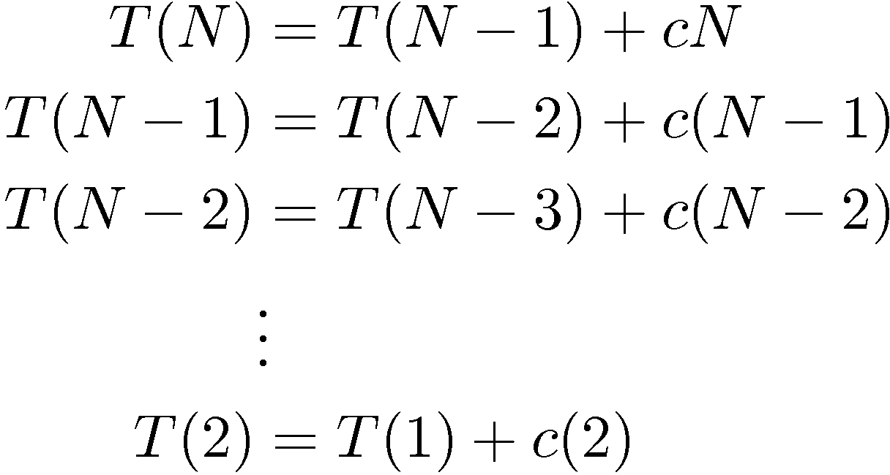
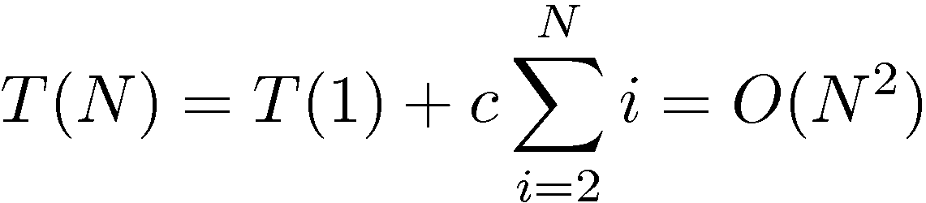
Quicksort: Worse-case Analysis
Worse case
We have pivot being the smallest elements throughout.
Then i = 0. For N > 1,
Adding up, we have

Slide 63
Quicksort: Best-case Analysis
Best case
The pivot is always in the middle. So the two subarrays are each close to half the size of the original.
T(N) = 2T(N/2) + cN
Repeat the same technique we used in analyzing merge sort, we conclude that
T(N) = cN lg N + N = O(N lg N)

Slide 64
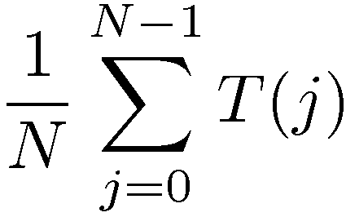
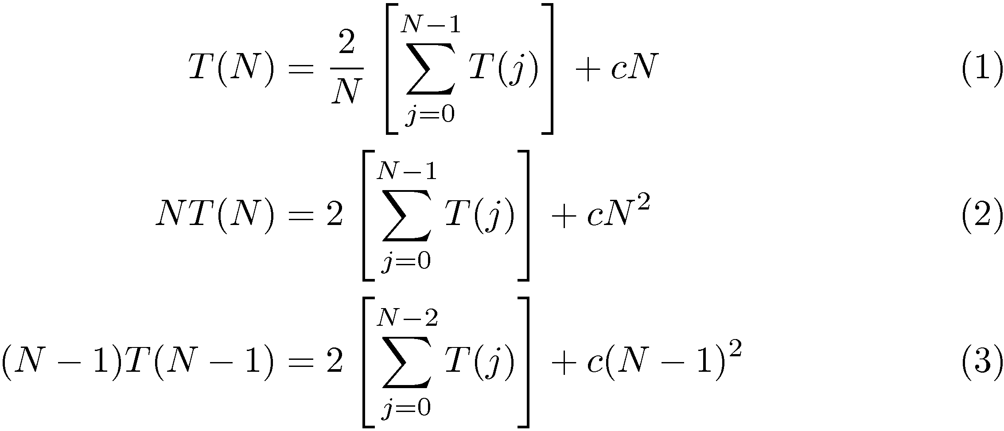
Quicksort: Avg-case Analysis
Average case
The average value of T(i), and T(n - i - 1), is
The runtime expression becomes:

Slide 65
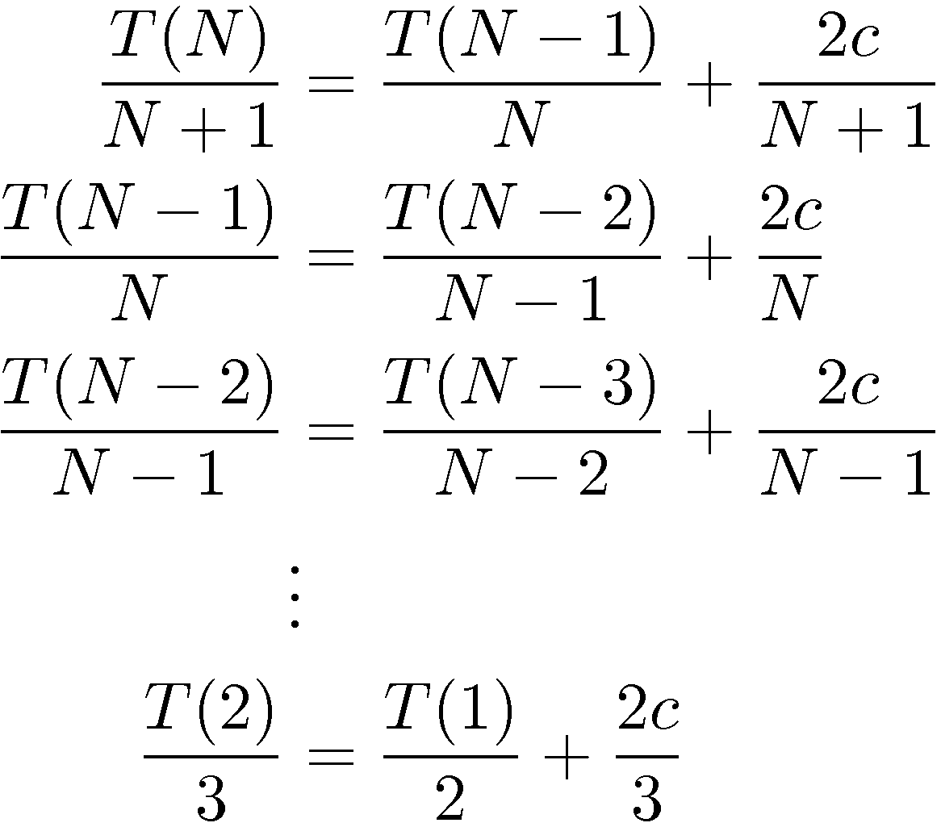
Quicksort: Avg-case Analysis (2)
Subtract (3) from (2)
NT(N) - (N - 1)T(N - 1) = 2T(N - 1) + 2cN – c ➔
NT(N) ≈ (N + 1)T(N - 1) + 2cN
(dropping constant c)
Telescoping:

Slide 66
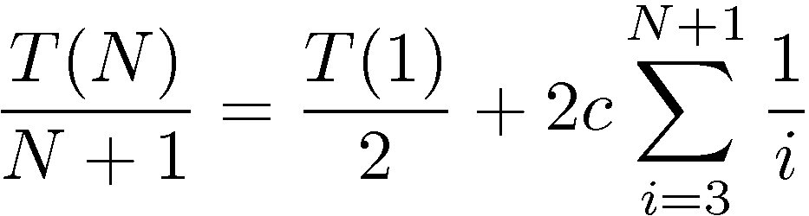
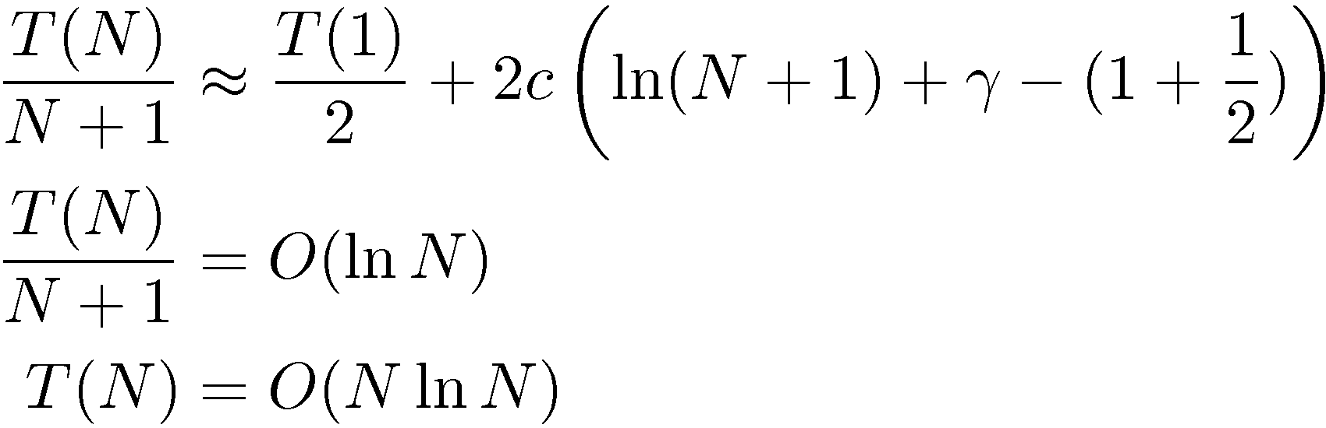
Quicksort: Avg-case Analysis (3)
The harmonic number H_{N} appears, take approximation:
Notes:
Or you can bound using integral \int_3^{n + 1} \frac{1}{x}dx

Slide 67
A General Lower Bound for Sorting
How fast can we sort?
Bubble sort, insertion sort and selection sort: O(N²)
Heapsort, merge sort and quicksort(avg.): O(N log N)
Comparison is the basic common technique that we have been using for sorting.
The number of comparisons made during the sort dominates the overall runtime of the algorithm.
We are going to show that Ω(N lg N) comparisons are always required ➔ a lower bound for general sorting algorithm using comparisons is Ω(N lg N).

Slide 68
Decision Trees
We answer YES or NO when we compare.
Suppose we record the decisions of YES and NO in a binary tree: if you answer YES, add a left child; if you answer NO, add a right child.
The resultant tree is called a decision tree.
No matter in what order you compare, you need to distinguish one permutation with another so that you can confirm on the sorted and correct answer.
Every algorithm that sorts by using only comparisons can be represented by a decision tree.

Slide 69
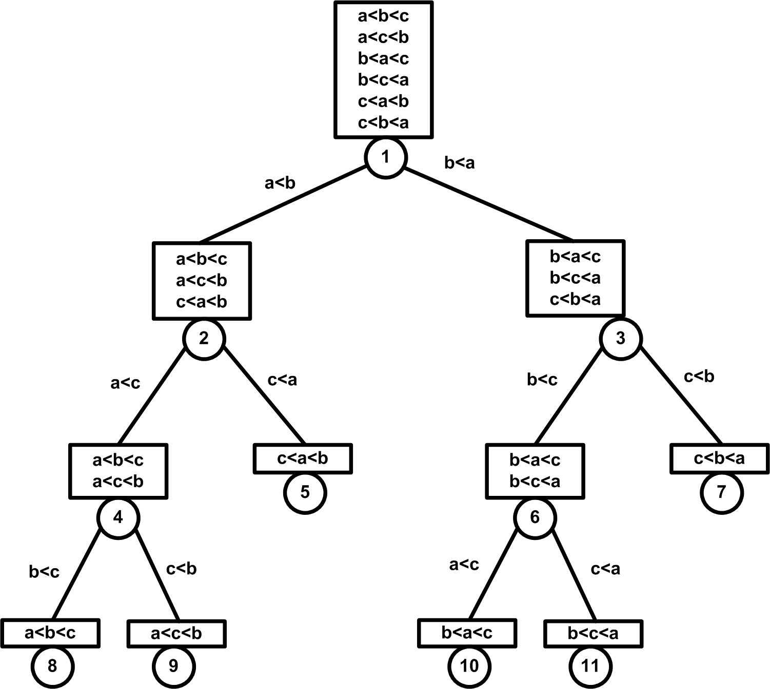
Decision Tree: Example
Insertion sort on an array of 3 elements a, b and c.

Slide 70
Lower Bound for Sorting
Recall that any binary tree T of height h has at most 2^{h} leaves.
So a binary tree with L leaves must have height at least ceil(lg L).
A decision tree to sort N elements has N! leaves (to distinguish every permutation), so the height of the tree is ceil(lg N!).
lg (N!) > lg (N/3)^{N} = N lg (N/3) = Ω(N lg N)
That means in the worse case we need at least (N lg N) comparisons to sort.
(N/3)^{n} < N! < (N/2)^{N}. For a tighter bound, use Stirling's approximation

Slide 71
Part II: Summary
Merge sort: solve the sorting by divide-and-conquer strategy. Fast and stable but requires O(N) memory.
Quicksort: fast, efficient and sort in-place. Constrained by pivot selection and can be O(N²) in worse case.
In general, we need O(N lg N) comparisons to distinguish every permutations of N elements.

