Slide 1

DATA STRUCTURES
Department of Computer Science and Engineering The Chinese University of Hong Kong
CSCI2100B
CSCI2100S
Spring 2011
Linked Lists
Last updated: 15/02/2011
Tang Wai Chung, Matthew

Slide 2
Contents
Linked lists
Basic list operations
Circular/empty list conventions
Memory allocation & implementation issues
The concept of abstract data type (ADT)
List ADT
Array implementation
Linked list implementation
Application: polynomial ADT
Legend:
Important examples
Advanced topics

Slide 3
Linked Lists
When our primary interest is to go through a collection of items sequentially, we can organize the items as linked list.
Linked list: a basic data structure where each item contains the information that we need to get to the next item (the link)
Advantage: the capability to rearrange the items efficiently.
A linked list is a set of items where each item is part of a node that also contains a link a node.

Slide 4
Linked List: Visualization
I am Ms. G! Let me call my buddy.
I would like to find Mr. K
G
B
A
K
Y
link
I am not Mr. K, but I can help you to call my buddy.
Oh yes! I am Mr. K.
Starting at a given node (the first in the sequence), we follow its link, which gives the second item, and so forth.

Slide 5
Linked Lists: Conventions
In principle, the list can be cyclic.
The sequence could seem infinite.
We often work with a simple sequential arrangement of a finite set, then we have 3 options to denote the end of the list:
null link that points to no node
refers to a dummy node that contains no item.
refers back to the first node, making the list circular.
Unless otherwise specified, we work with one-dimensional list.

Slide 6

Linked Lists: Declaration in C
We will declare each node as a structure in C
The list consists of a series of structures, which are not necessarily adjacent in memory, linked by pointers.
Each structure contains the element and a next pointer (link) to a structure of its successor
NULL link convention is used to denote the end.
Structure declaration
typedef struct node_s node;
struct node_s {
int e; /* the actual data */
node *next; /* self-referent link */
};
Notes:
Item changed to int e for simplicity

Slide 7
Linked Lists: Memory Allocation
We will create many instances of the same structure.
In general we do not know the number of nodes before our program executes.
Whenever we want to use a new node, we need to create an instance and reserve memory for it.
use malloc() in C.
When the node is no longer needed, we will return the allocated memory to the system.
use free() in C.
Structure allocation and freeing
node *x = malloc(sizeof(node));
node *y = malloc(sizeof *y);
...
free(x); free(y);

Slide 8
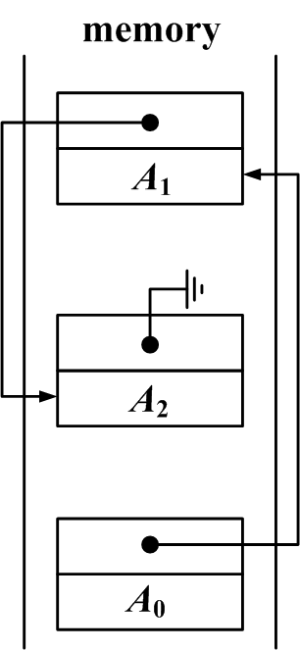
Linked List on Flat Memory
If we try to fit the above implementation onto the memory model ...
pointer as link
null link

Slide 9
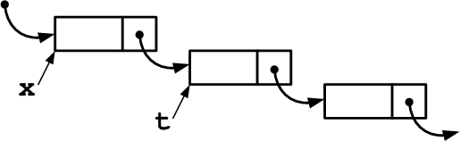
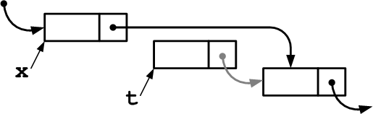
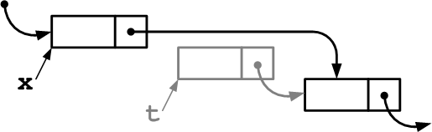
Linked List: Deletion
To delete the node following node x ...
x->next = x->next->next;
OR
t = x->next;
x->next = t->next;
free(t);

Slide 10
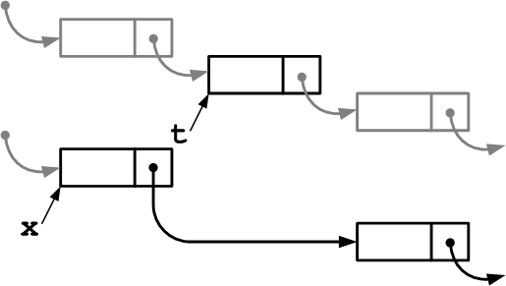
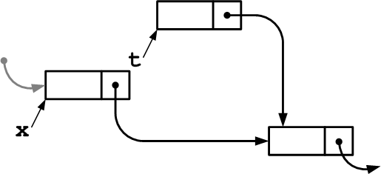
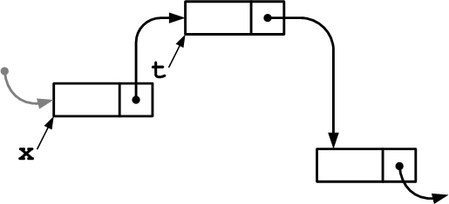
Linked List: Insertion
To insert node t into a list at a position following node x
t->next = x->next;
x->next = t;

Slide 11
Difficult Operations in Linked Lists
Insertions and deletions are efficient in linked lists.
By contrast, linked lists are not well suited for the "find the k-th item" that is efficient on arrays.
Another unnatural operation on singly linked lists is "find the item before a given item".
We shall see some modifications to make this operation easier.

Slide 12
The Josephus Problem
N people have to elect a leader by arranging themselves in a circle,
eliminating every Mth person around the circle
closing ranks as each person drops out.
In general, we may want to know the order in which the people are eliminated.
For example, N = 9, M = 5, the order would be
5 1 7 4 3 6 9 2 8

Slide 13
The Josephus Problem (2)
3
2
int main(int argc, char *argv[]){
int i, N = atoi(argv[1]), M = atoi(argv[2]);
node *t = malloc(sizeof(node)), *x = t;
t->e = 1;
t->next = t; /* cyclic */
for (i = 2; i <= N; i++){
x = (x->next = malloc(sizeof *x));
x->e = i;
x->next = t;
}
while (x != x->next){
for (i = 1; i < M; i++)
x = x->next;
printf("%d ", x->next->e);
x->next = x->next->next;
N--;
}
printf("%d\n", x->e);
return 0;
}
4
1
5
9
6
8
7
3
2
4
6
9
7
8

Slide 14
Elementary List Processing
Developing correct and efficient code for list-processing applications is an acquired programming skill that requires practice and patience to develop.
Let us provide a mental model in coding the linked list:
A linked list is either a null link or a link to a node that contains an item and a link to a linked list.
For example, we might write the following for-loop to scan through every item on the list (traversal):
for (t = x; t != NULL; t = t->next)
visit(t->e);

Slide 15
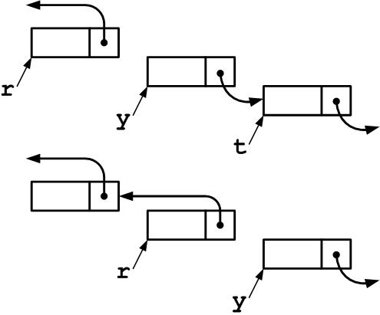
List Reversal
node *reverse(node *x){
node *t, *y = x, *r = NULL;
while (y != NULL){
t = y->next;
y->next = r;
r = y;
y = t;
}
return r;
}

Slide 16
List Insertion Sort
node heada, headb;
node *t, *u, *x, *a = &heada, *b;
for (i = 0, t = a; i < N; i++){
t->next = malloc(sizeof *t);
t = t->next;
t->next = NULL;
t->e = rand() % 1000;
}
b = &headb;
b->next = NULL;
for (t = a->next; t != NULL; t = u){
u = t->next;
for (x = b; x->next != NULL; x = x->next)
if (x->next->e > t->e)
break;
t->next = x->next;
x->next = t;
}
randomly generate a list of integers
initialize list B
locate point of insertion (list A traversal)
insertion
Notes:
15/2: incorrect indentation fixed

Slide 17
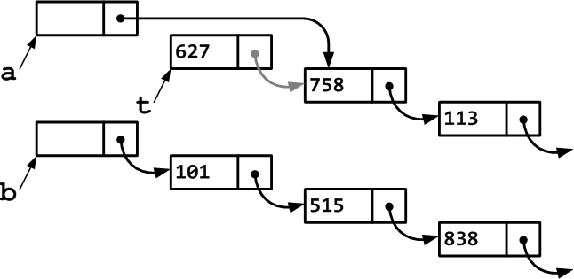
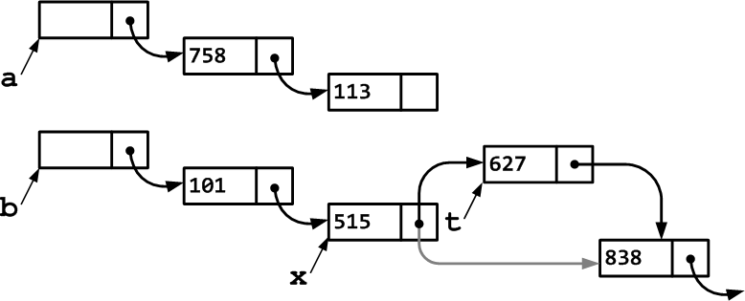
List Insertion Sort: Illustration

Slide 18
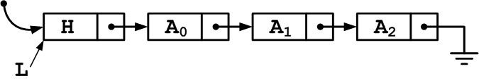
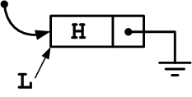
Header Node in Linked List
The previous example illustrates an important convention: keep a header(dummy) node to specify the beginning of the list.
This simplifies our coding since we do not have to distinguish between empty list & real list.
It also allows the list to be passed to functions more easily.
Then an empty list is represented as:
No data is stored in the dummy node.

Slide 19
Interface for Linked List Operations
When we do not want to repeat the basic list operations inline, we can choose to make a set of black-box functions.
This usually works better with the header node convention so that the functions can easily return an empty or non-empty list through a single interface.
node *new_node(int);
void free_node(node *);
void insert_next(node *, node *);
node *delete_next(node *);
node *next(node *);
int item(node *);

Slide 20
Revisiting Josephus Problem
We may rewrite our solution to Josephus problem using the newly created interface.
Contrast with the previous inline version of the solution.
int main(int argc, char *argv[]){
int i, N = atoi(argv[1]), M = atoi(argv[2]);
node *t, *x;
for (i = 2, x = new_node(1); i <= N; i++){
t = new_node(i);
insert_next(x, t);
x = t;
}
while (x != next(x)){
for (i = 1; i < M; i++) x = next(x);
t = delete_next(x);
printf("%d ", item(t));
free_node(t);
}
printf("%d\n", item(x));

Slide 21

Doubly Linked Lists
Traverse linked lists in a backward direction is not convenient.
To facilitate to and fro movement on a linked list, we add an extra pointer to the predecessor.
But we have to take care of more pointers when you insert or delete.
Deletion is simplified and is O(1) in doubly linked lists.

Slide 22
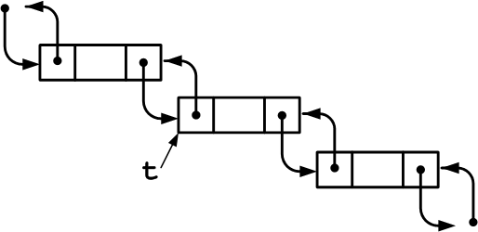
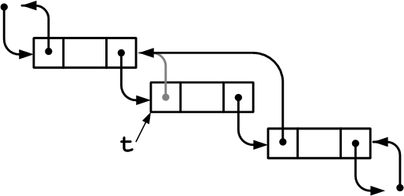
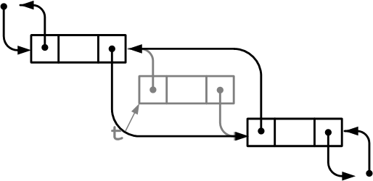
Doubly Linked Lists: Deletion
t->next->prev = x->prev;
t->prev->next = t->next;

Slide 23

Doubly Circular List
Another popular convention is to have the last cell keep a pointer back to the first (with or without header).
Code snippets
struct node_s {
int e;
node *next;
node *prev;
};
void delete(node *t){
t->prev->next = t->next;
t->next->prev = t->prev;
free(t);
}

Slide 24
List Abstract data type (ADT)

Slide 25
ADT: Definition
Abstract Data Type
An abstract data type (ADT) a data type (a set of values and a collection of operations on those values) that is accessed only through an interface.
We refer to a program that uses an ADT as a client, a program that specifies the data type as an implementation.

Slide 26
Abstract Data Type (ADT)
Integers, floating point numbers, characters are data type. They have associated operations (addition, multiplications, etc.)
Abstract data type consists of a sets of operations, yet how the operations are implemented is hidden.
For example, given a set ADT, we want operations like union, intersection, size and complement.
ADTs may be implemented in different ways, but the programs that use them can safely ignore which implementation was used.

Slide 27
The List ADT
A general list of the form A₀, A₁, A₂, ..., A_{N-1}.
The size of the list is N.
The special list with size 0 is called empty list.
A_{i+1} follows A_{i} and A_{i-1} precedes A_{i}.
The position of A_{i} is i.
The elements in the list may be simplified to integers for simplicity. Although complex elements can be used.
A₀
A₁
...
A_{i}
...
A_{N-1}
We use 0-based counting scheme.

Slide 28
List Operations
Utility: print_list and make_empty
Searching: find returns the position of the first occurrence of a key
insert and delete: insert a new element in some position and delete a key from the list.
find_kth: return the element in some position k.
Examples: Given L: 34, 12, 52, 16, 12
[find(52)] returns 2
[insert(X, 3)] L: 34, 12, 52, X ,16, 12
[delete(52)] L: 34, 12, X, 16, 12
next and previous are other possible operations

Slide 29
The List ADT (Coding)
The client programs do not have to understand the actual implementation of the ADT.
Instead, an interface is well-defined to allow easy manipulations of the lists
List ADT interface declaration
int list_is_empty(list_t list);
list_t list_create(void); /* create a new empty list */
void list_free(list_t list); /* free(destroy) the list */
void list_insert(list_t list, pos_t p, int x); /* normal insert */
void list_insert_end(list_t list, int x); /* insert at the end */
void list_insert_begin(list_t list, int x); /* insert at the front */
void list_delete(list_t list, int x); /* delete a specific item */
pos_t list_find(list_t list, int x); /* searching */
pos_t list_find_kth(list_t list, int k); /* searching by index */
pos_t list_begin(list_t list); /* iterator */
pos_t list_next(list_t list, pos_t p); /* iterator */
int list_is_end(list_t list, pos_t p); /* iterator */
int list_get(list_t list, pos_t p); /* accessor */
void list_set(list_t list, pos_t p, int x); /* accessor */
void list_print(list_t list); /* utility */

Slide 30
Simple Array Implementation of List ADT
An estimate of the maximum size of the list is required.
A dynamically-growing array is accepted but the insertion would be slow if the initial size is not well estimated.
An array implementation allows:
print_list and find in O(N)
find_kth in O(1)
insert: inserting at pos. 0 requires pushing the entire array down. O(N)
delete: deleting the first element requires shifting all elements 1 position up. O(N)
Array implementation is slow when insert and delete are frequent.

Slide 31
Array Implementation of List ADT
typedef struct list_s *list_t;
typedef int pos_t;
#define NPOS -1
struct list_s {
int *e;
int n;
};
The list is actually an array with its size accounted.
pos_t list_find(list_t list, int x){
int i;
for (i = 0; i < list->n; i++)
if (list->e[i] == x)
return i;
return NPOS;
}
The classic sequential search on the items stored.

Slide 32
Array Implm. of List ADT (2)
void list_insert(list_t list, pos_t p, int x){
int i;
assert(list->n + 1 <= MAX_SIZE);
for (i = list->n; i > p; i--)
list->e[i] = list->e[i - 1];
list->e[p] = x;
list->n++;
}
Be careful with the size limitation
Then shift the stored data and make room
void list_delete(list_t list, int x){
int i, p;
if ((p = list_find(list, x)) == -1)
return;
for (i = p; i < list->n - 1; i++)
list->e[i] = list->e[i + 1];
list->n--;
}
Safe: Just report error if the key is not found
Then shift down the stored data

Slide 33
List ADT: Linked List Implm.
Instances of the node structure are created on demand (with malloc()).
The beginning of the list is marked by the dummy header node.
Insertion at a specific position is fast.
struct node_s;
typedef struct node_s *list_t;
typedef struct node_s *pos_t;
#define NPOS NULL
typedef struct node_s node;
struct node_s {
int e;
node *next;
};

Slide 34
List ADT w/ LL: Basic Operations
is_empty: check whether the given list is an empty list
int list_is_empty(list_t list){
return (list->next == NULL);
}
is_last: check whether the given position in the list is the last element.
int list_is_end(list_t p, pos_t p){
return (p == NULL);
}
create: generate an empty list. Remember to free the list when it is not used anymore.
list_t list_create(void){
node *t = malloc(sizeof *t);
t->e = INT_MIN;
t->next = NULL;
return t;
}

Slide 35
List ADT w/ LL: Insertion & Deletion
void list_insert(list_t list, pos_t p, int x){
node *t = malloc(sizeof *t);
t->e = x;
t->next = p->next;
p->next = t;
}
Insert in a given position. O(1)
Deletion based on key requires a searching. O(N)
void list_delete(list_t list, int x){
pos_t t, u;
for (t = list; t->next != NULL && t->next->e != x; t = t->next);
if (t->next == NULL) return; /* 'x' does not exist */
u = t->next;
t->next = u->next;
free(u);
}
When we are given an element to be deleted in the list, we first have to check whether the element exists in the list.
If it exists, we need to find it predecessor so that we can remove the node containing the element.

Slide 36
List ADT w/ LL: find & free
Similar to delete, we use a for-loop to traverse the list.
pos_t list_find(list_t list, int x){
pos_t t;
for (t = list->next; t != NULL && t->e != x; t = t->next);
return (t == NULL ? NPOS : t);
}
CAREFUL: Always copy the next pointer before you free the node, or you lose the link. Traverse each node. Copy the link then free the node.
void list_free(list_t list){
node *t, *u;
for (t = list->next; t != NULL; t = u){
u = t->next;
free(t);
}
free(t); /* the header */
}

Slide 37
List ADT: Comparison
Operation | Array Implm. | Linked List Implm.
create | O(1) | O(1)
insert | O(N) | O(1)
delete | O(N) | O(N)
find | O(N) | O(N)
find_kth | O(1) | O(N)
free | O(1) | O(N)

Slide 38

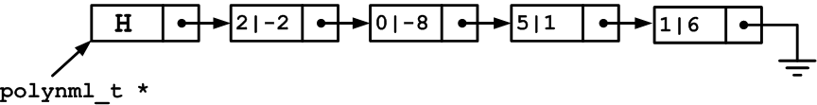
Example: The Polynomial ADT
Array implementation: inefficient for sparse polynomials; waste time in adding and multiplying zeros.
Singly linked list implementation: good for both sparse and dense polynomials.
A very good application of linked lists.
typedef struct node_s node;
typedef node polynml_t;
struct node_s {
int coeff;
int degree;
node *next;
};
Example:

Slide 39
The Polynomial ADT (Cont’)
Addition: Find like terms and add up coefficients. Add all unlike terms.
Multiplication: nested list traversal (nested for-loops)
polynml_t *add(polynml_t *p1, polynml_t *p2){
polynml_t *psum = list_copy(p1);
node *p, *t;
for (p = p2->next; p != NULL; p = p->next)
if ((t = list_find(psum, p->degree)) != NULL)
t->coeff += p->coeff; /* add up like terms */
else /* unlike terms just add to list */
list_insert(psum, psum, *p);
return psum;
}
Complexity: O(|p₁||p₂|) |p| denotes the no. of terms in the polynomial p.

Slide 40
Summary
Concept and definition of linked lists
Basic operation of linked lists: insertion, deletion, traversal
Linked list implementation details in C
Different conventions in realizing linked lists and extension to doubly linked lists.
Introduce the concept of abstract data type.
The list ADT with
Array implementation
Linked list implementation
Application of linked list in abstracting polynomials.

