Slide 1
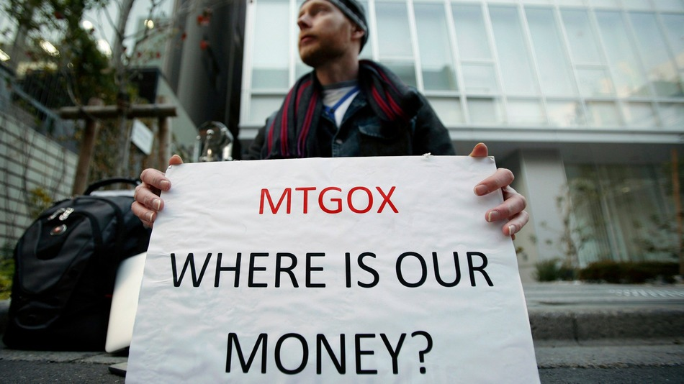
Facebook
Mt.Gox, Bitcoin’s $460M Disaster

Slide 2
N
W
E
S
The Background
Mt.Gox, Bitcoin’s $460M Disaster

Slide 3
The Background
1
Bitcoin exchange company lauched in July 2010 in Tokyo
2
One of the biggest Bitcoin exchange in the world
3
Handle 70% of all bitcoin transactions in 2013

Slide 4
N
W
E
S
The Incident
Mt.Gox, Bitcoin’s $460M Disaster

Slide 5
The Incident
1
In Feb 2014, its computer system was hacked and 850000 bitcoins were missing
2
Represent 7% of the world's bitcoin supply and worth $460 million
3
Mt.Gox filed for bankruptcy protection in Tokyo

Slide 6
The Incident
4
Mt.Gox faces lawsuit filed by customers for mismanagement
5
Collapse of Mt.Gox had hurt people's confidence in digital currency
6
People started to question bitcoin's reliability because of the lack of government regulation

Slide 7
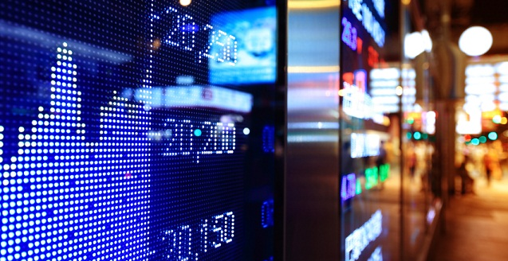
Facebook
Bitcoin Exchange Rate Reached $1000

Slide 8
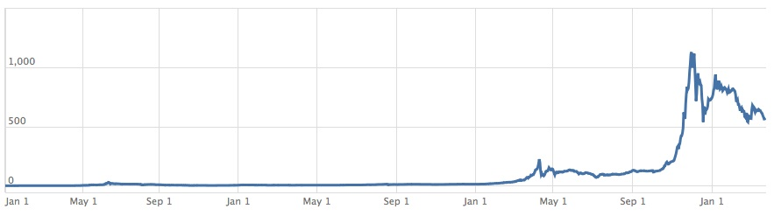
Bitcoin Price

Slide 9
Year 2011
1
Public's interest in Bitcoin was growing
2
Bitcoin price increased from $0.30 to $32
3
Wikileaks and Electronic Frontier Foundation accepted bitcoin donations

Slide 10
Year 2012
1
Over 1,000 merchants are accepting Bitcoin
2
Bitcoin price began to rise, reaching to a peak of $266
3
5.2 million of Bitcoins have been generated

Slide 11
Year 2013
1
Baidu had allowed clients to pay with bitcoins
2
BTC China overtook Mt. Gox to become the largest bitcoin trading exchange
3
Bitcoin price reached to $1100 in China

Slide 12
Goverments' Concerns
1
Sucess of bitcoin has caused the concern of the government
2
The People's Bank of China had prohibited Chinese financial institutions from using bitcoins
3
Other countries start to question regulation is needed

