Slide 1

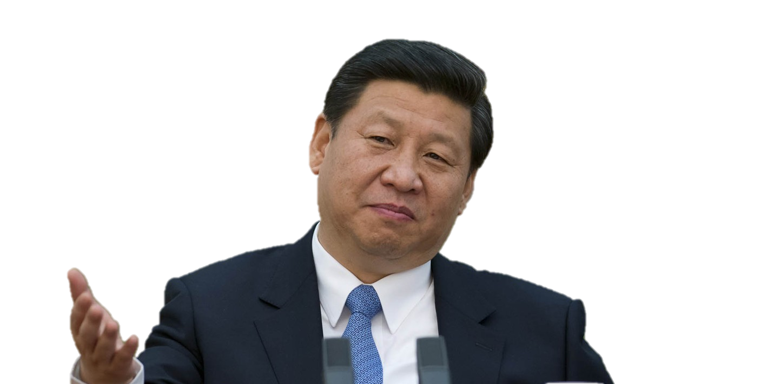
“
Bitcoin is not a currency and should not be circulated and used in the market as a currency.
”
President of the People's Republic of China
Notes:
First of all, see how our motherland reacts to Bitcoin. In Dec 2013, China declared that Bitcoin is not a currency and should not be circulated and used in the market as a currency. Financial institutes warned people to get away from Bitcoin. This was interpreted as China was going to ban Bitcoin. In fact, people are free to buy and sell Bitcoin, only financial institutes are prohibited from processing transactions using Bitcoin, that means you can not pay off your credit card using Bitcoin. In this case, Bitcoin is not being treated as a real currency in China. Therefore, China is not in favor of Bitcoin.
Let’s move on and take a look on another largest economy in the world reacts to Bitcoin.

Slide 2
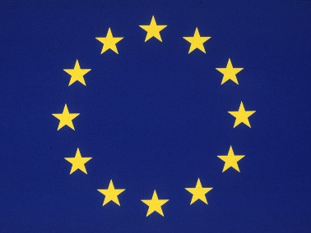

“
Currently, no specific protection exists in the E.U. that would protect consumers from financial losses if a platform that exchanges or holds virtual currencies fails or goes out of business
”
Chairman of the European Banking Authority
Notes:
After a week China bans Bitcoin transactions in financial institutes, the European Banking Authority said “Currently no specific protection exists in the EU that would protect consumers from financial losses if a platform that exchanges or holds virtual currencies fails or goes out of business”. And European regulator said that the digital currency is vulnerable to hackers, might lose its value and any misuse could prompt law enforcement agencies to close Bitcoin exchange platforms and keep consumers from accessing their investment. It seems that EU also not welcoming Bitcoin too. How about the US?

Slide 3

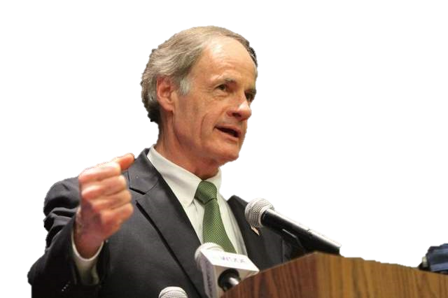
“
Let's see what good can come from Bitcoin
”
U.S. Senator for Delaware
Notes:
In January, the head of an influential Senate committee on virtual currencies warned against “killing the baby in the cradle” by over-regulating Bitcoin. Senator Tom Carper said that there were “good things” in the virtual currency, and likened the current situation to the early days of the Internet. Tom Carper also asked his committee surveyed over 40 countries on their official stances on Bitcoin. Let’s take a look.

Slide 4








































NEGATIVE
POSITIVE
NEUTRAL
Notes:
As you can see, most countries are neutral to Bitcoin at this moment, they don’t officially ban the use of Bitcoin while warning the people about the dark side of it. Like Australia, it is aware of an Australian Bitcoin bank being hacked in Oct 2013, resulting US$1 million lost. For Hong Kong, there is nothing official about Bitcoin, though the treasury secretary said existing laws forbid its use for fraud or money laundering. Most countries that are against Bitcoin due to there is no law or regulation can be applied on Bitcoin right now. However, we don’t agree on this as the Germany government said, Bitcoin can be treated as foreign currency and regulated by corresponding law. Other criticisms are based on the uncertainties of Bitcoin. Some countries like Turkey and Estonia warned that Bitcoin is suspicious, it looks similar to a Ponzi Scheme or Tulip mania in Holland. As a responsible government, they should find out the truth instead of making decision based on rumors or guesses. Bitcoin is still young, we believe there will be many possibility in the future. However, if we ban Bitcoin simply because we don’t get familiar with it, because someone uses it to launder money, then we will never see the good side of it. Therefore, the government should not ban Bitcoin while keep an eye on the development of Bitcoin. As Tom Carper said “Let’s see what good can come from Bitcoin”.
Thank you.
Positive:
Alderney is trying to take the lead and become the central hub for the bitcoin, by minting and issuing physical bitcoins and creating an international center with a bitcoin storage vault service that complies with anti-money laundering rules
Brazil passed a law in October 2013 specifically for electronic currencies
Canada welcomed the first Bitcoin ATM last year.
Germany treats Bitcoin as foreign currency
United States: financial institutes claimed no need to be worry about Bitcoin. law enforcement agency claimed that they won’t hunt down Bitcoin like a monster. This leaded to a rise in Bitcoin price from 200 to 1200 USD.
Neutral: Australia was aware of an Australian Bitcoin bank being hacked in Oct 2013, resulting US$1 million lost.
Estonia has no official stance, but warned that Bitcoin might be a Ponzi scheme
Hong Kong: Nothing official, though the treasury secretary there said existing laws forbid its use for fraud or money laundering.
Indonesia: Bitcoin is a potential payment method, but it’s different than ordinary currency. It is not regulated by the central bank so there are risks.
Spain government has a Bitcoin wallet.
Negative:
Denmark’s Finanstilsynet (Financial Supervisory Authority) has issued a statement rejecting the bitcoin as a currency and stating that it will not regulate bitcoin use.
The central bank of France has criticized it as speculative and warned about its use for nefarious dealings
Netherlands doesn’t see virtual currency as being an electronic money
Russian law firm thinks that using it to buy things there could be illegal given that the Russian ruble is the exclusive means of payment in the Russian Federation per the law.
Turkey thinks Bitcoin is similar to Tulip mania in Holland, the Mississippi balloon in France, or the Enron or mortgage balloons in the United States, because the Bitcoin has no use value, but only exchange value.

Slide 5
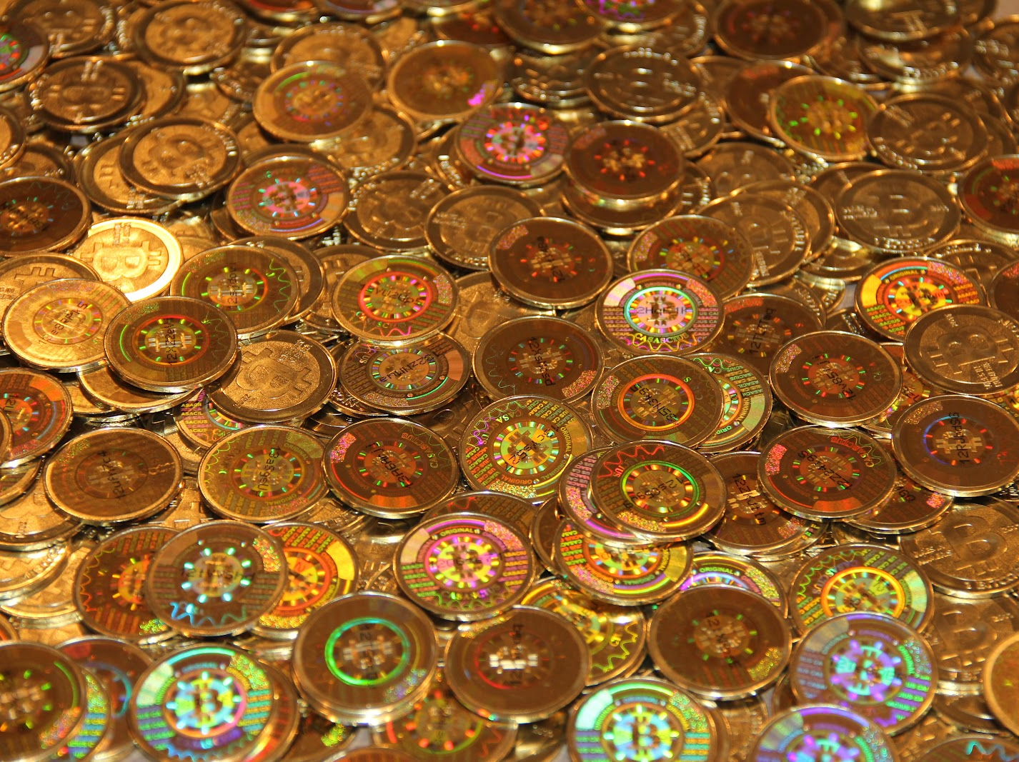
The End

