Slide 1
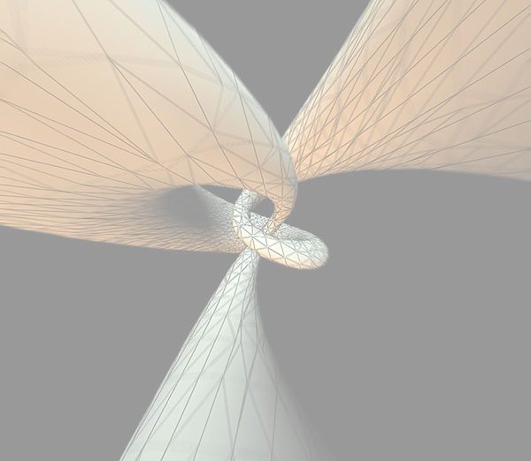
CSCI 3280
Introduction to Multimedia
(2014 Spring)
Computer Science & Engineering
The Chinese University of Hong Kong

Slide 2
Teaching Staff
Lecturer:
Prof. Wong, Tien-Tsin (ttwong@cse.cuhk.edu.hk)
Office: SHB 1015
Office hour: Tue 2:30-4:30pm
Tutors:
Shen Wuyao (wyshen@cse.cuhk.edu.hk)
Mao Xiangyu (xymao@cse.cuhk.edu.hk)
Office: SHB 1026

Slide 3
Lectures, Tutorials, ...
Lectures
  LHC 103 H5
  LSB LT2 F2-3
Tutorials
  No tutorial for the first 2 weeks.
  To be rescheduled next Thursday!!
Homepage: http://www.cse.cuhk.edu.hk/csci3280/
    Username: csci3280 Password: multimedia2014
Newsgroup: eLearning
Language: Cantonese with English technical terminologies

Slide 4

Textbook & References
Semi-Textbook:
  “Fundamentals of Multimedia”
  by Ze-Nian Li and Mark S. Drew, Prentice Hall, 2004
References: (In order of importance)
  “Multimedia Communication: Applications, Networks, Protocols and Standards”
  by Fred Halsall, Addison Wesley
  “Digital Compression for Multimedia”,
  by Jerry D. Gibson, Tony Berger, David Lindbergh and Richard L. Baker, Morgan Kaufmann, 1998
  Technical papers, online document, ...

Slide 5
Course Contents
1. Overview
  Introduction
  Multimedia applications
  Media types
  Challenges and research issues
  Tools

Slide 6
2. Media Data Representations
  Digital audio
  Computer music, MIDI, mp3
  Digital image, video (2D or 3D)
3. Computer Graphics
  Will not be covered in this course.
  I recommend you to take
  CSCI3260
4. Data Compression
  Lossless compression, Huffman, Arithmetic, LZW
  Lossy compression, JPEG, JPEG2000
  Video coding, Motion JPEG, H.261, MPEG/2/4/7

Slide 7
5. Storage Media (optional)
  Magnetic media
  RAID
  Optical disks
  Block placement and admission control
6. Network Communications
  Recommend you to take a network course
  CSCI4430
  Techniques for transferring huge data volume
  Streaming

Slide 8
7. Project
  will be announced later
  P2P, streaming
  C, C++ or Java + some libraries

Slide 9
Evaluation
15%+15% Two programming assignments
20% Mini-project (group of 3)
50% Final exam
(11 April 2013, 9:30am)
If you cannot attend, please drop this course

Slide 10
Important Issues
Switch off all your phones before lectures & tutorials
If you want to receive the phone call, please move outside of the classroom
To respect the right of your classmates, refrain from talking during the lectures & tutorials
No copy (or similar program copies) or cheating is allowed. Otherwise, ….

Slide 11
Important Issues (2)
You need to have sufficient programming background (C, C++ or Java) in order to finish the assignments and projects
Please refer the document of Student/Faculty Expectation on Teaching and Learning.

