Slide 1

Chapter 1
Introduction

Slide 2
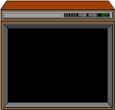



What is a Medium?
A means of conveying and distributing information.
(e.g., print and broadcast media.)
A material and form of artistic expression. (e.g, paper, stone, inks, musical instruments.)
natural media

Slide 3
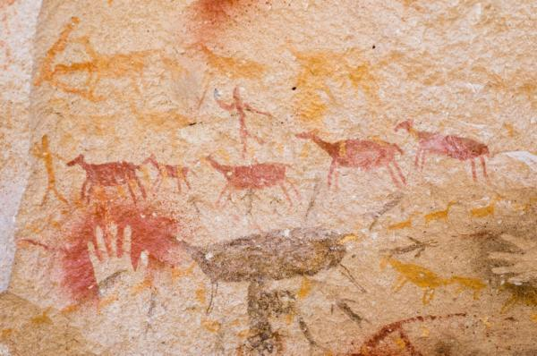
A kind of natural medium

Slide 4
Natural and Digital Media
Natural Media rely on physical elements -- paper, stone, inks and paints, and musical instruments.
Digital Media rely on the computer and “bits”.
In this course. Media refer to the types of digital information carriers, such as textual data, images, audio, and video.
Why digital?
  Easy integration & sharing of resources (storage, transmission network).
  Allows encryption, compression etc.
  More reliable
  Can be used and copied many times without losing quality.

Slide 5
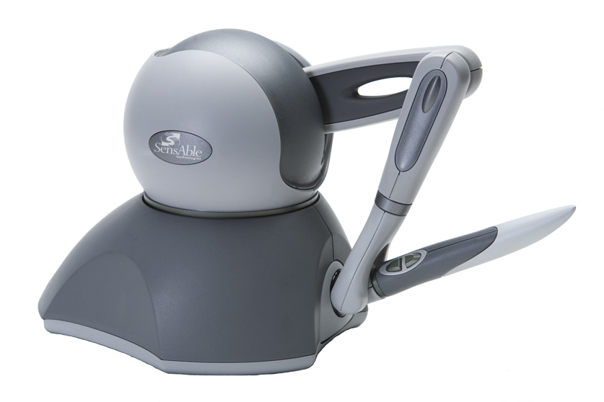
What is Multimedia?
Multimedia combines audio and visual material to provide computerized interaction of text, sound, graphics, images, animation & video to enhance communication and to enrich its presentation.
Explores the use of various sensory channels and modes of expression.
Five senses: sound, sight, touch, taste & smell.
Current technology allows us to handle sound and sight and partially touch (Phantom in our SGI lab).
Taste and smell are not tangible currently.

Slide 6
What is Multimedia? (2)
Multimedia systems handle at least one type of “continuous media” as well as “discrete media”.
We used the following definition of Multimedia:
“A multimedia system is characterized by computer-controlled, integrated production, manipulation, presentation, storage and communication of independent information, which is encoded at least through a continuous (time-dependent) and a discrete (time-independent) medium.”

Slide 7
Why Multimedia?
Picture, sound or even touch, taste and smell are sometimes more effective to convey information than boring text.
One extreme example: Virtual Reality
People are demanding such “TV features” as sound, image, and video from their computers.
They also want such “computer features” such as interactivity and content-on-demand for the television.
Merging of computer and TV industries
e.g. Microsoft (computer company) partnered with MSNBC (TV broadcast company)
e.g. Apple launched Apple TV

Slide 8
Why Multimedia? (2)
Many MM applications are used to emulate human communications and to assist the human being in organizing & managing vast amounts of information in various media types (e.g., a photo database for fashion models).

Slide 9
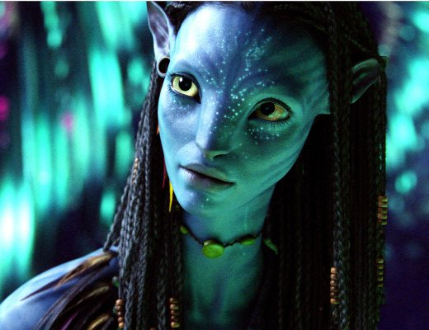
The Implications
TV: analog to digital, e.g. HDTV
Digital TV: 2-way interaction + digital A / V => merging of 3 industries: computer, communication, and broadcasting
To provide for creation, editing, transport, and distribution of digital A/V.
(e.g., NowTV Video-on-demand service)
Internet-based TV and radio station
Digital cinema with stereo vision (e.g. Avatar)

Slide 10
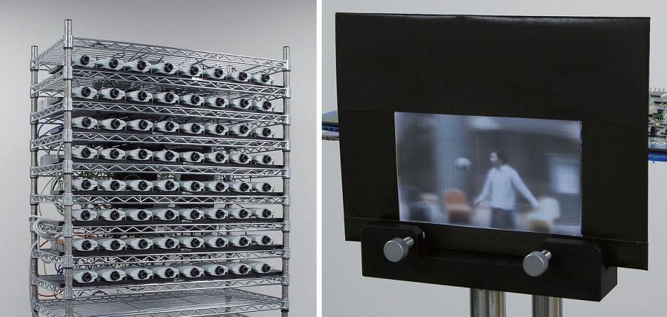
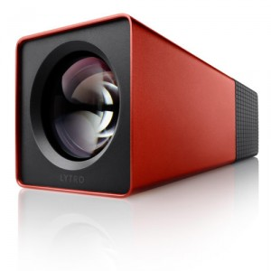
Current 3D TV is only stereo TV
Real 3D is like this
Play Lytro camera (not video yet)

Slide 11
Computer Multimedia Applications
Some are used to embellish the human-computer interface by adding sounds, animation, and other forms of multimedia.
(More importantly) some are used to manipulate multimedia data, and these data is central to the applications.
Some common functions: to capture, generate, store, retrieve, process, transmit, and present multimedia information.

Slide 12
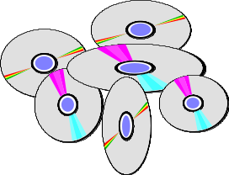
Multimedia Application
Home theater
  A blu-ray disc can hold 25GB per layer. There can be up to 4 layers for BD-XL.
  Provide high-quality video and audio
Electronic Games
  Each game is a highly interactive multimedia application that presents layered 2D/3D animation with synchronized sound effects and music.
  New generation of computer games usually use DVD or even Blu-ray to store the game data.

Slide 13
Hypermedia Browsers
  A hyperdocument is a document composed of multiple media types. On the world-wide-web, hyperdocuments are organized by linkings. We can traverse and retrieve the hyperdocuments through these links.
Multimedia Presentation Systems
  An “engine” that displays, synchronizes, provides interaction with, and generally manipulates multimedia material. (e.g., Authorware, Macromedia Director, Powerpoint, Flash)
Multimedia Mail and Instant Messengers
  Handles electronic messages containing audio, graphics, and other media, e.g. MIME mails, whatsapp, MSN

Slide 14
Teleconferencing
  Computers equipped with microphone, speakers, and video cameras, and placed on a multimedia network, can establish audio and video connections between each other.
  Multi-user tools, such as group editors. A group editor allows conference participants to share documents, and to edit the documents simultaneously, e.g. Skype video chat, iphone FaceTime
Multimedia Services
  Interactive Shopping
  Tele-banking
  Education
  Medical Services (telemedicine)
  Video-on-demand
  Information-on-demand, wikipedia

Slide 15
Media Types
Non-temporal (Discrete) -- do not have a time dimension, and their contents & meanings do not depend on the presentation time.
  Text
  Image (2D samples, e.g. GIF, JPEG)
  Graphics (2D/3D geometry, e.g. CorelDraw, VRML)
Temporal (Continuous, Isochronous) -- have a time dimension. They convey meanings only if “displayed” at a specific rate.
  Video, Animation
  Digital Audio (sampled sound, like image)
  Music (e.g. MIDI, symbolic represented sound, like graphics)

Slide 16
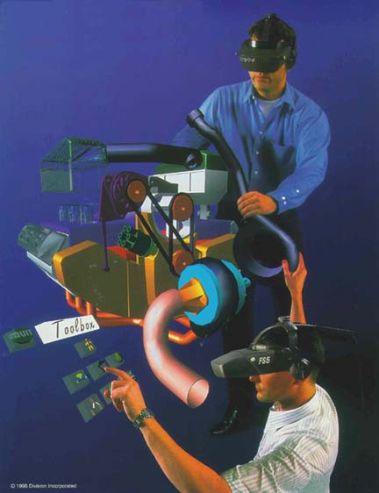
Text
Not visually exciting.
Conveys essential and precise information.
Text representation:
e.g. ASCII - English (1 byte)
e.g. BIG5, GB - Chinese (2 bytes)
e.g. Shift-JIS - Japanese (2 bytes)
e.g. UTF-16 - Unicode multi-language (4 bytes)
Storage “friendly” (compact)
Sometimes, certain information
is too clumsy to be captured by
words. e.g. try to write an essay to
describe the right figure.

Slide 17
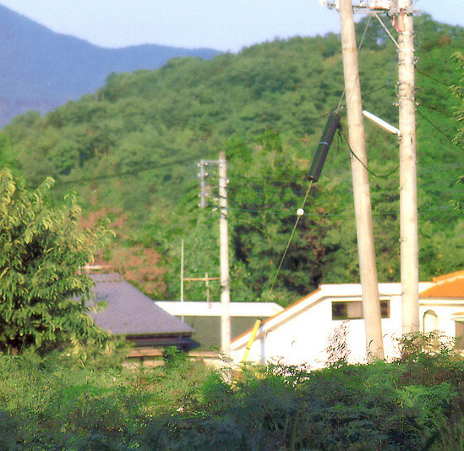

Digital Images
Two-dimensional arrays of pixels of
varying color.
Color model: how to specify the color of a pixel?
  RGB: Colors are represented by a numeric triple specifying red (R), green (G), and blue (B) intensities.
  YUV, YIQ, HSV
  CYMK for publishing
  24 bit really sufficient?

Slide 18
Digital Images (2)
Compression
  A page-sized 24-bit color image with 300 pixels per inch takes up about 20Mbytes.
  Lossless and lossy.
  Many different standards: JPEG, GIF, TIFF,....
Image processing:
blurring, sharpening, edge detection, filtering.
Image transformation:
e.g., morphing (transform one image into another).

Slide 19

Graphics
Graphics data are represented by a geometric model and a rendering process.
2D graphics is sometimes called vector graphics.
2D geometric primitives: circle, rectangle, line ...
Rendering process: rasterization of these primitives
e.g. CorelDraw, MacDraw.

Slide 20

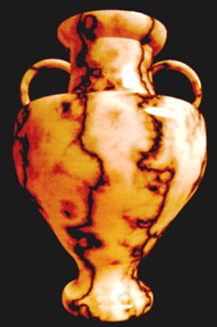
Graphics (2)
3D graphics consists of 3D geometric primitives like triangles, circle, plane, surface patches, …
The rendering process is actually a physical simulation of light propagation.
Difference between image and graphics:
  Image is actually a 2D array of color samples.
  Once recorded, cannot be changed.
  Usually large storage needed
  e.g. JPEG, GIF
  Graphics consists of 2D/3D geometric primitives and rendering process.
  Can be easily modified.
  Usually more compact, but not always.
  e.g. VRML, OpenGL, CorelDraw

Slide 21
Video
A sequence of images called frames. “persistence of vision”.
Attributes: Frame rate, Resolution, Aspect Ratio, Interlacing.
Formats. e.g. NTSC (National Television Systems Committee) PAL (Phase Alternation Line).
Current video broadcast is in both analog and digital
format frame rate scan lines aspect ratio
NTSC 30 525 4:3
PAL 25 625 4:3
HDTV(US) 30 1125 16:9
HDTV(EURO) 25 1250 16:9

Slide 22
Video (2)
Theoretically, almost any color can be produced by mixing 3 primary colors (red, green, blue). An analog video camera produces 3 distinct continuous signals, one for each color component.
Luminance/chrominance principle: the three primary colors can be converted into 2 parts:
  Luminance: information on the brightness of the image.
  Chrominance: information on the color of the image.
Because the human eye is not very sensitive to color information, the bandwidth of these 2 color components can be independently reduced before transmission.

Slide 23
Digital Video
A video can also be represented by a sequence of digital images.
broadcast quality video: 1 sec = 10MB.
For lesser quality, and a good compression technique, it is possible to achieve: 1 sec = 1M bits => transfer rate of CD-ROM => VCD.
Compression: Lossless and lossy.
For lossy compression, can achieve 50:1 or higher.
MPEG: The Moving Pictures Expert Group MPEG-1:1.2-1.5Mbps VHS quality video. MPEG-2: 4-10 Mbps. Used in DVD.

Slide 24
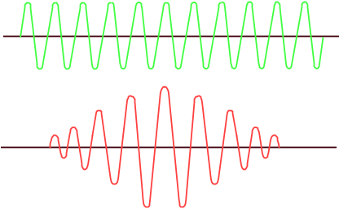
Digital Audio
Digital audio representation
  Produced by sampling a continuous signal generated by a sound source.
  A process called analog-to-digital conversion (A/D).
Sampling frequency
  Human ear is sensitive to frequencies of up to about 20kHz.
  Sampling frequency > 40kHz (for CD => 44.1kHz, 16 bits per sample).
Number of channels
  2 for stereo
  Some audio editing equipment may have 16 or 32 channels.
  5 for AC3 (surround sound)

Slide 25
Digital Audio
Storage
  An hour of high quality stereo digital audio requires > 500MBytes of storage.
  A CD-ROM can store about 650MBytes of data.
Digital audio effects
  Echoing
  Equalization
  Noise reduction
  Pitch shifting
  Acoustic environment

Slide 26



Music
MIDI -- Musical Instrument Digital Interface
  Digital musical instruments send MIDI messages to a sequencer.
    Notes, temp, velocity, beat, bars, multiple instruments
  The sequencer composes the music according to the messages received.
  The sequencer/ synthesizer has a “palette” of sounds for each type of instrument
MIDI sequencer

Slide 27
Music (2)
Why distinguish digital audio and music?
In fact any sound or music can be sampled, recorded and finally represented as digital audio.
Analogous to image and graphics.
What “music” mentioned here consists of musical primitives and synthesis process.
Therefore it is more compact than digital audio.

Slide 28
Challenges
Multimedia stresses all components of a computer system (volume & time constraints).
CPU processing power
  Fast speed for data capturing, codec, data enhancement. (Large amounts of data being processed in real-time).
Storage and Memory
  High capacity, fast access time, high transfer rates.
System architecture
  High bus bandwidth, efficient I/O.
Software
  Tools for retrieval and data management of continuous media data.
Notes:
6

Slide 29
Challenges (2)
Operating systems
  Support for new data types, real-time scheduling, multimedia file systems, time-critical synchronization.
Networks
  High bandwidth, low latency, low jitter.
Application latency
  e.g., video playback requires end-to-end jitter control within a couple of milliseconds.
Synchronization
  what is the tolerance?
  how do we achieve?

Slide 30
Research Areas
1. fast processors
2. high-speed networks
3. large capacity storage devices
4. video & audio compression algorithms
5. graphics systems
6. human-computer interface
7. real-time operating
systems
8. information storage and
retrieval
9. hypertext & hypermedia
10. languages for scripting
11. parallel processing
methods

Slide 31
Compression
Throughput and storage
  “If a picture is worth a thousand words, then a video is worth 414 million (4-byte) words per minute,” (or 25GBytes/hr !!!!)
  What are the requirements on network data transfer rate? On disk I/O?
Compression makes it possible.
  50:1 yields 0.5 GBytes/hr.
  200:1 for HDTV.
  How expensive is the processing?
  Hardware solution?
  Software solution?

Slide 32
Compression (2)
MM systems require data compression for 3 reasons:
  the large storage requirements of MM data (30 MB/s).
  relatively slow storage devices that cannot play MM data in real time.
  Network bandwidth that does not allow real-time video data transmission.

Slide 33
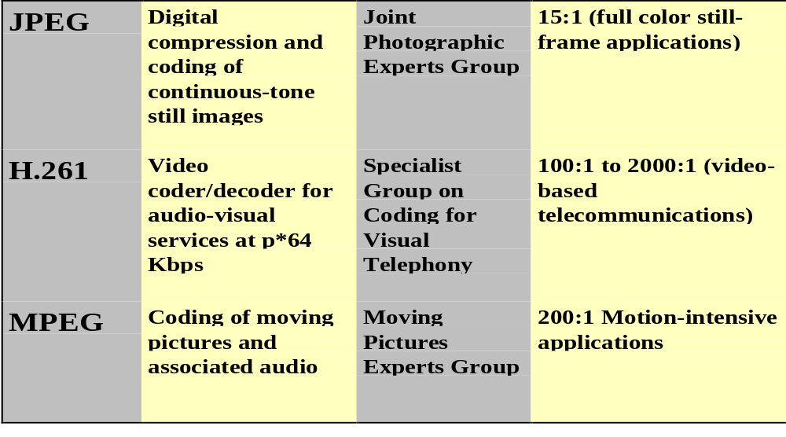
Some Compression Standards

Slide 34
Multimedia Networking
Many multimedia applications, such as video mail, video conferencing, and video-on-demand, require the support of a high performance network system.
In these applications, the multimedia objects are stored at a server and played back at the clients’ sites.
Remote retrieval of multimedia objects has stringent time constraints.
Delay: the amount of time it takes to transmit a data unit (e.g., a video frame) from a sender to a receiver.
Jitter: delay variation.

Slide 35
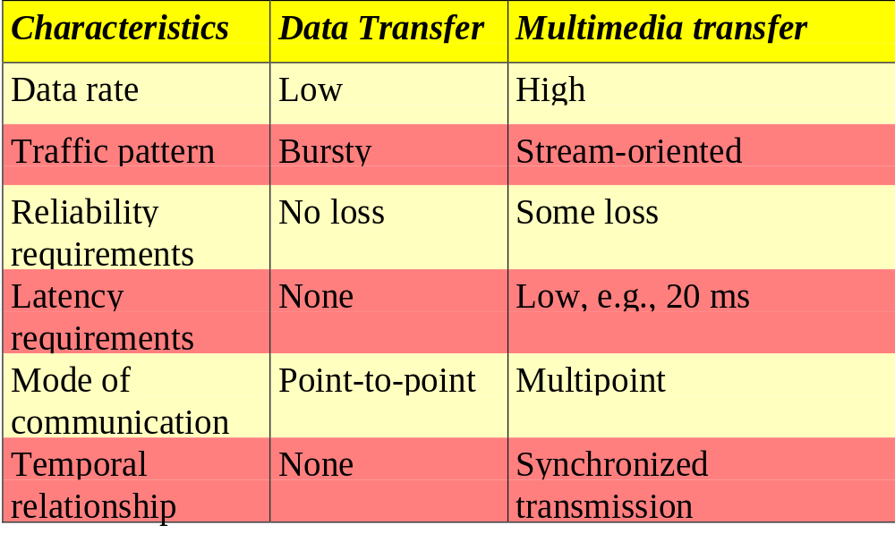
Multimedia Networking (2)

Slide 36
Synchronization
Continuous synchronization
  requires constant synchronization of lengthy events.
  e.g., video-phone
Point synchronization
  a single point of one media block coincides with a single point of another media block.
  e.g., slide show with blocks of audio allotted to each slide.

Slide 37
Synchronization Example
Asynchrony in a video telephone system
video
source
video
dest.
video
encoder
video
decoder
Network
B-ISDN
transmission coder
transmission decoder
audio
source
audio
dest.
audio
encoder
audio
decoder
start-up delay due to decompression pipeline can cause video to trail audio where decompression delay is generally smaller.
different encoding
times for video
and audio
variations in packet arrival times (jitter) introduced by:
-independent routing paths,
-packet loss,
-packet buffering

Slide 38
I/O Scheduling
In a disk-based database system, disk I/O occupies a major portion of transaction execution time.
Disk seek time, which accounts for a very significant fraction of disk access latency, depends on the disk head movement. The order in which I/O requests are serviced, therefore, has an immense impact on the response time and throughput of the I/O subsystem.
Example. HPF, Elevator, FD-Scan, HPGF.

Slide 39
requests
A
C
D
B
track #
0
1
2
3
4
5
6
7
8
head moving this way
Highest Priority First (HPF) -- serve the request that has the highest priority (earliest deadline for example).
Elevator -- scan the disk and pick up requests “on-the-way”.
FD-SCAN -- always “target” the disk head towards the track with the highest priority request, but also service whatever requests are on its way.
Highest Priority Group First (HPGF). Disk requests are grouped into a small number of priority levels. The disk is scheduled to service the highest priority group first. The Elevator Algorithm is used for the intra-group scheduling.

Slide 40
Multimedia Information Retrieval
To retrieve a text document from the Web, we use keyword search via “Google”, for example.
To retrieve a record from a relational database, such as Oracle, we use a SQL statement.
To retrieve a picture, how shall we formulate a query?
What about audio? How do we describe a sound?
To be honest, this is still a hard research problem which is not yet been solved.

Slide 41
Summary
Large data volume
  How to store?
  How to transfer?
  Do we need careful scheduling?
Multiple media channels
  How to capture?
  How to display/play/present?
  How to synchronize them?

