Slide 1
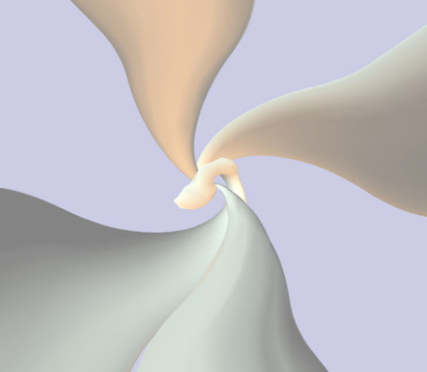
Chapter 2
Media Representations:
Audio Media

Slide 2
Media Hierarchy
Video
Temporal Media
Audio
Animation
Image
Discrete Media
Graphics
Text

Slide 3
Temporal Media
Contents and meanings depend on presentation time.
End-to-end fixed time relationship, from data capture to playback - isochronous media.
There are lower and upper delay time bound (requirement) for data delivering.

Slide 4

Measuring Audio
Audio sensation is caused by vibration in air pressure that reaches the human ear-drum.
Audible frequency of vibration ranges from 20Hz to 20KHz.
How come audio CD is 44.1 KHz sampled?
Pressure fluctuation causes sound heard as soft or hard, measured by amplitude.
frequency
amplitude
pressure
time

Slide 5
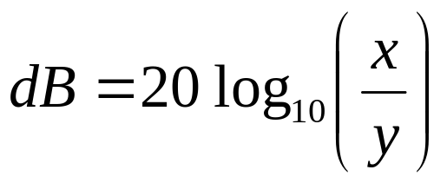
Measuring Audio (2)
Dynamic range of human hearing is very large.
  Lower limit is threshold of audibility.
  Upper limit is threshold of pain.
  The two can differ by 1,000,000 times (1 Million).
To work with large range, audio amplitude is often measured in dB (decibels).
If y is the amplitude of audibility threshold and x is the upper limit, then
the threshold of pain = 20 * log1000000 = 120 dB.
Also as signal-to-noise ratio (SNR)

Slide 6
Representation of Audio Data
Continuous audio waveform → electrical voltage in a microphone (analog signal) (red curve)
Analog → digital for computer processing (ADC conversion).
Digital → analog in soundcard/speaker during playback (DAC).
3 stages:
  Sampling
  Quantization
  Coding

Slide 7
Sampling (in time domain)
Continuous time → fixed intervals at which the analog signal is read.
Frequency is called sampling rate.
Higher sampling rate ⇒ better approximation to original curve.
Samples

Slide 8
Quantization (in value domain)
Continuous signal levels → fixed intervals
→ discrete values
Size of interval is called quantization step.
Smaller quantization step ⇒ better approximation to original curve.
Quantization error
Values that can
be represented
in computer

Slide 9
Coding
Representing quantized values digitally is called coding.
6 levels, hence 3 bits are enough:
  000 011 100 001 000 001 010 000 001 000 000 001

Slide 10
Sampling Rate
Nyquist theorem: Signal contains frequency components up to f Hz, then effective sampling requires
sampling rate ≥ 2f Hz (critical sampling)
Audible frequency range is 20KHz ⇒ CD sampling is 44.1KHz
Human voice range < 3.1KHz ⇒ digital telephone is 8kHz.
Aliasing : problem of sampling at < critical sampling rate.

Slide 11
Sampling Rate (2)
For example, actual frequency = f
Let sample at a sampling rate of 1.33 f
We reconstruct a wrong waveform with 1/3 f
This phenomena is called aliasing in sampling theory

Slide 12
Quantization Levels
Discrepancy between sampled values and original analog signal values gives rise to
Quantization error (noise)
Quantization levels affects choice of number of coding bits.
Quantization levels is manifested in Signal-to-Noise Ratio (SNR).
Usually quantization levels are linear
Logarithmic scale is more uniform in perceptual domain

Slide 13
How good is the signal?
In analog system, there is voltage (signal) you want to measure, and there is always some random fluctuations (noise).
Ratio of the power of signal and noise is called the Signal-to-Noise Ratio (SNR).
The large the ratio is, the better is the signal quality.
Measuring unit: decibels (dB).

Slide 14

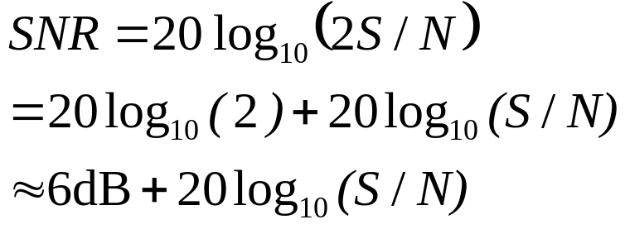
How good is the Quantization?
“How are bits related to SNR?”
N is quant’n noise,
S is signal level
1 more bit used in coding, max signal increase by 2 and hence increases SNR by 6 dB.
In practice, 8-bit audio gives 48 dB.
16-bit CD-audio gives 98 dB.
  Good because it is close to the audibility limit of 100~120 dB.
  When SNR is close to 120 dB, quantization noise is subdued to audibility threshold.

Slide 15
Limitations of Human Hearing
Before we go on, let’s study the limitation of human hearing perception
Just like visual media (discussed in next chapter), human hearing has much limitation
Have you experience that some tones are not audible when they are not loud enough?
We cannot hear every tone that physically exists
It is pointless to store the “sound” that we cannot hear
These limitations are the foundation of modern compression of digital audio
In this chapter, we only study the limitations, the compression method/standard (such as MPEG Layer 3 or MP3) that utilizes these limitations will be discussed later. (Because we need more knowledge to understand the MP3)

Slide 16
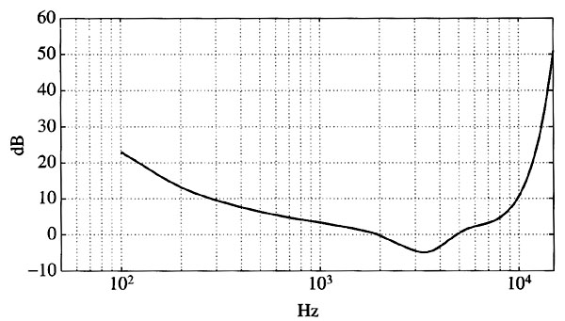
Threshold of Hearing
A frequency is not audible if its loudness (measured in dB) is below the threshold of hearing
The threshold is frequency dependent
A psychological experiment is done to obtain the plot
Generate that frequency and turn up its volume (loudness) until it is barely audible. That loudness is the threshold.
Loudness (dB)
Frequency (Hz)

Slide 17
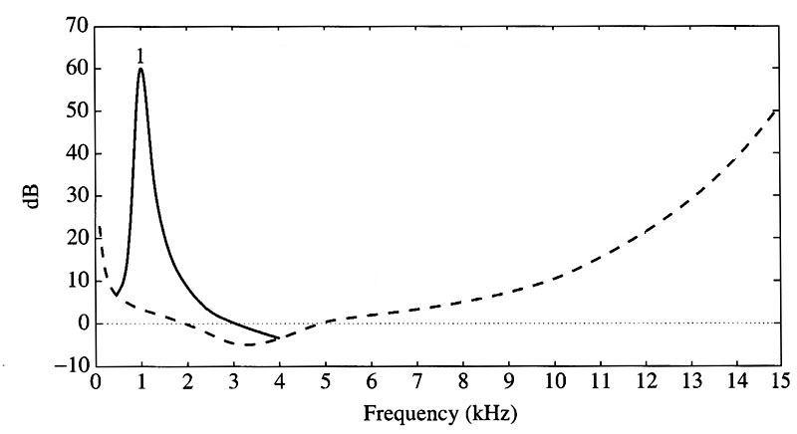
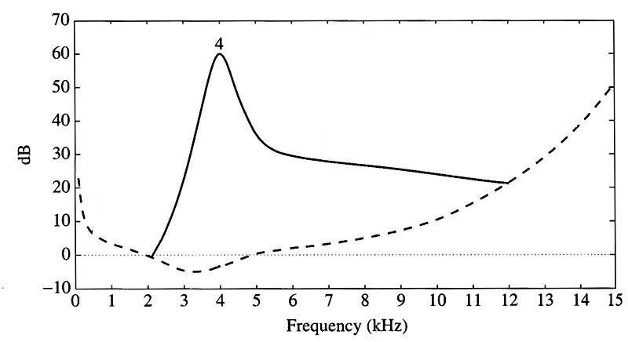
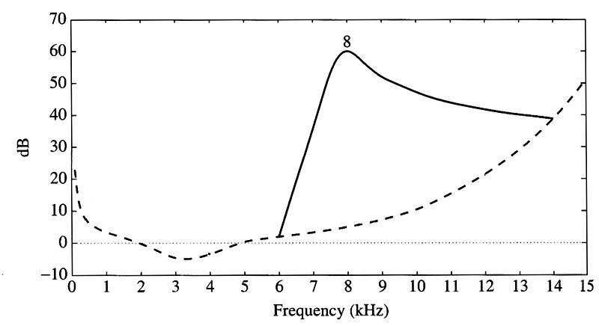
Frequency Masking
When a particular frequency (masking tone) is played at a loud volume, it may mask the nearby frequency
i.e. we cannot hear that nearby frequency
This is known as frequency masking
As the masking tone changes, frequency masking curve changes
The following plots show three “add-on” frequency masking curves for 8kHz played with 60dB loudness
Frequency masking curve when 1kHz is played with 60dB
Frequency masking curve when 4kHz is played with 60dB
Frequency masking curve when 8kHz is played with 60dB

Slide 18
Critical Bands (1)
Human hearing range naturally divides into critical bands
Our ears operate like a set of band-pass filters (a limited range of frequencies is passed while others are blocked
Within a critical band, we human are not very well in resolving frequencies in the same band
The width of critical band (critical bandwidth) is not constant
Lower critical bands have smaller bandwidths while high critical bands have larger bandwidths
For bands above 500Hz, their bandwidths increases roughly linearly
There are 24 critical bands

Slide 19
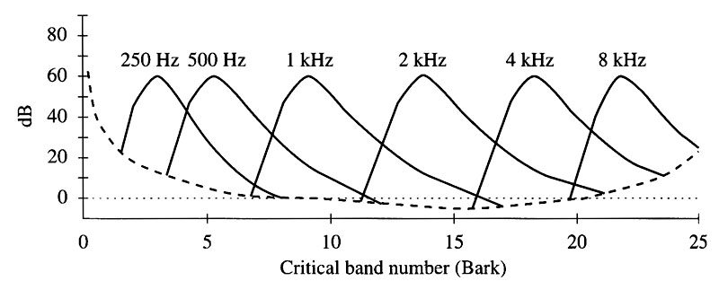
Critical Bands (2)
We can “normalize” the band to form a new unit called “Bark”
The following diagram shows the frequency masking curves in this Bark domain

Slide 20
Temporal Masking (1)
The frequency masking mentioned before assumes the masking takes effect when all frequencies are played simultaneously
Nearby frequencies may be temporarily masked even the masking tone is turned off. This is known as temporal masking
Under loud tone, hearing receptors in our inner ears become saturated and require time to recover

Slide 21
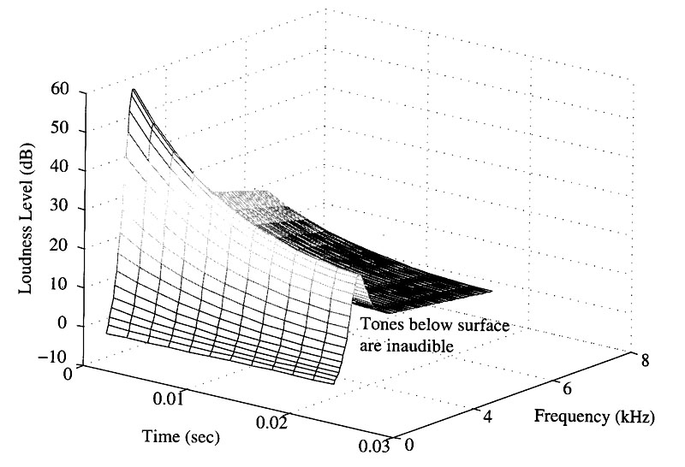
Temporal Masking (2)
Therefore, we actually have masking surfaces rather than masking curves
Again, the masking surface changes as the masking tone changes

Slide 22
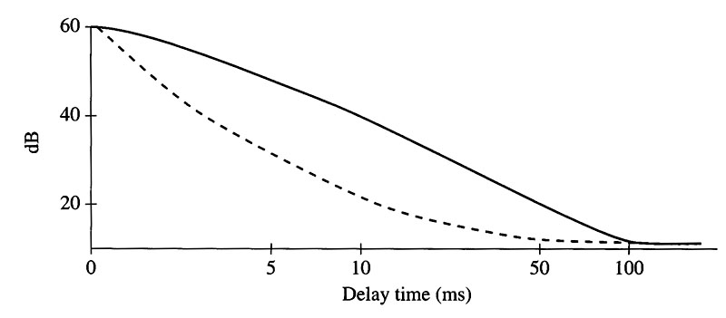
Temporal Masking (3)
Besides post-masking, there exists pre-masking
Pre-masking means that frequencies may also be masked out just before the stronger masking tone is played
If the masking tone is played longer, it takes longer time to recover
The curves show the time needed to recover versus the loudness of test tone
masking tone played 200ms
masking tone
played 100ms

Slide 23
Audio Compression
Modern audio compression method such as MP3, Dolby AC-3, and Sony ATRAC (MDLP) utilize these limitations to achieve high compression ratio
However, we shall defer the discussion of the compression method/standard to later chapter, because we need more compression tools to ease our discussion

Slide 24
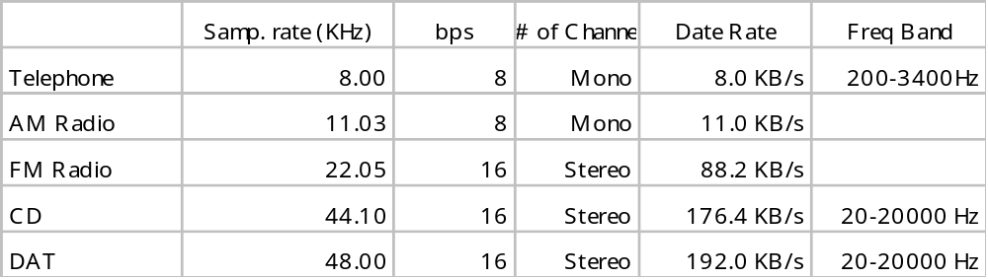
Audio Encoding Standards
Telephone-quality audio uses 8-bit logarithmic quantization at 8000Hz sampling rate.
CD-quality music/audio is sampled at 44.1 KHz with 16-bit PCM quantization. (PCM to be discussed later).
Popular audio file formats: .au (SUN), .aiff (MAC, SGI), .wav (PC), .mp3 (internet), .ra (RealAudio)

Slide 25
MIDI
Is there any better (more compact) way to represent the audio?
For music, why not store the notes in the song, instead of sampling the sound wave.
During playback, synthesize the music in real time.
MIDI (Musical Instrument Digital Interface)
Industrial standard defines the interface between computer and electronic musical instruments.
Allows record, playback, synchronization and communication of sound-producing devices.

Slide 26
MIDI (2)
MIDI defines the
  Hardware
  Data format (format of messages between computer and musical instrument). No audio sample is included. It encodes the notes (128 notes or 10 octaves).
When a musician presses a piano key, a MIDI message. The message indicates the beginning of note and encodes the stroke intensity.
Device communicates with other devices through channels. There are altogether 16 musical channels, one for each instrument.
It identifies 128 instruments, e.g. flute, violin, …

Slide 27
MIDI (3)
Two main MIDI devices
Synthesizer
  sound generator, e.g. electronic guitar
  includes microprocessor, keyboard, control panel, memory, etc
  Some sound cards store the wave table of different instruments. In other words, the MIDI synthesizers are built into the sound card.
Sequencer
  Storage server for MIDI data.
  Stand-alone unit or a software program
  Nowadays, it is usually a software on computer
For further information, you can find a MIDI FAQ course homepage.

