Slide 1
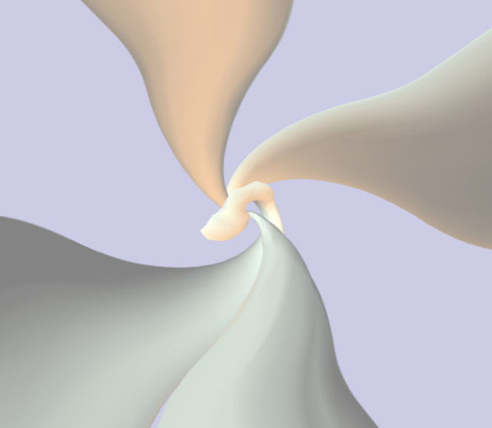
Chapter 4
Media Representations:
Visual Media (Continuous)

Slide 2
Motion Video
Persistence of vision
  An image transmitted to the brain persists for a short time before fading out, or being replaced by another image.
  Duration of persistence varies from person to person.
  Usually longer than 30 msec.
Discrete image perceived as continuous motion sequence when presented at a rate > 30 fps.
  Jerkiness often resulted when video is played at 24 fps.
  Low-cost video phones give 2 fps. Motion becomes discrete sequence.
  Much smoother motion can be achieved with 60 fps technologies.
  TV broadcasting standards: NTSC is 30 fps and PAL is 25 fps.

Slide 3
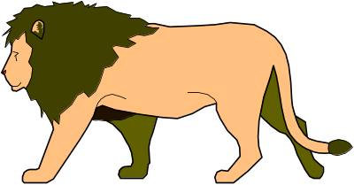
Image Capture
Image formation process:
  Light irradiated on the camera due to objects in the scene
  ⇒ electrical voltage on the CCD sensor array
  ⇒ 2D image
Camera
lens
CCD
sensor
Scanning
sensing
elements
Electrical
voltage
(analog)

Slide 4
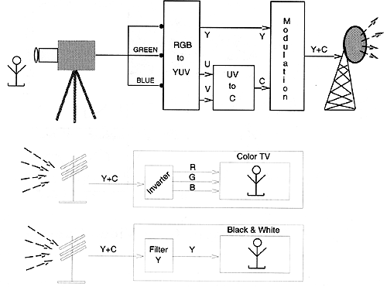
Analog TV
Last generationTV signal is not represented as digital bits, but analog signal.
Instead of transmitting bits through the channels, the analog signal is transmitted. (Because the technology is very old, more than 50 years)
RGB signals output from the video camera and usually converted to YUV or YIQ for transmission. Why?

Slide 5
Analog TV (2)
Human are more sensitive to intensity level than color signal.
YUV or YIQ effectively separates luminance (intensity) from chrominances (color) components
Compatible with old B/W TV
By reducing the bandwidth of the two chrominances components, we can reduce the bandwidth needed.
Transmitted signal is analog!!
How to compress analog signal? Not very effective

Slide 6
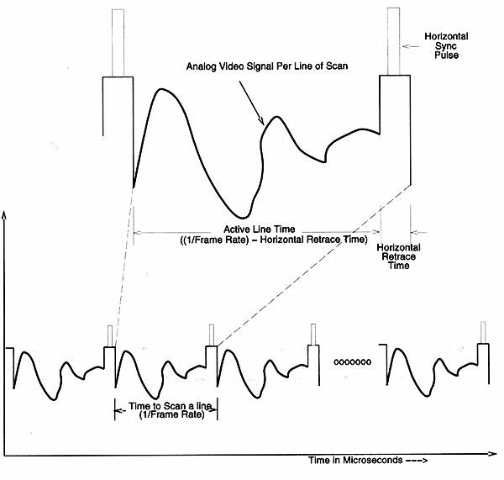
Analog Video Signal
To represent the information on the 2D screen, the video signal is sampled vertically.
That is, a 2D continuous function (2D view) is composed of discrete number of scanlines.
But horizontally (within each scanline), the video signal is analog.

Slide 7
Analog Video Signal (2)
Spatial-temporal information is ordered as function of time according to a predefined scanning convention.
A synchronization signal is introduced to synchronize horizontal and vertical retreats. Actual video signal occupies lesser time.

Slide 8
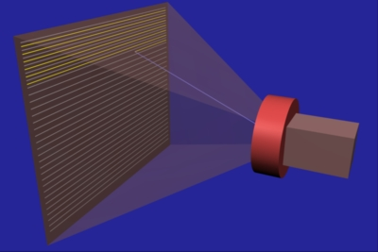
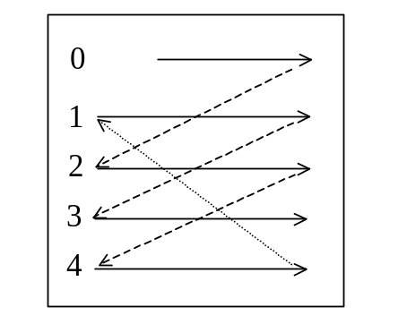
Interlacing
Progressive scanning traces a complete picture (frame) from top to bottom and left to right.
Interlaced scanning is used in TV industry. It traces odd and even numbered lines separately.
Allow us to see the whole screen in half of the time
Design for CRT with slow refresh rate (cheaper), so that 30Hz looks like 60Hz.
May look flicking for some users with sensitive vision
Similar techniques used in image format e.g GIF89, progressive JPEG

Slide 9
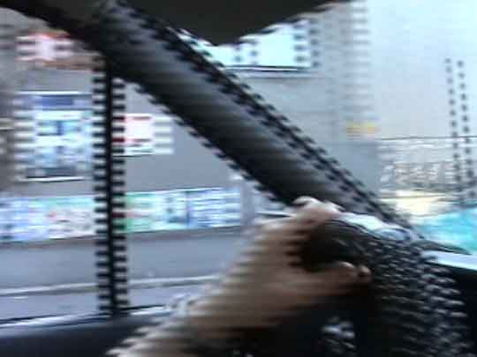
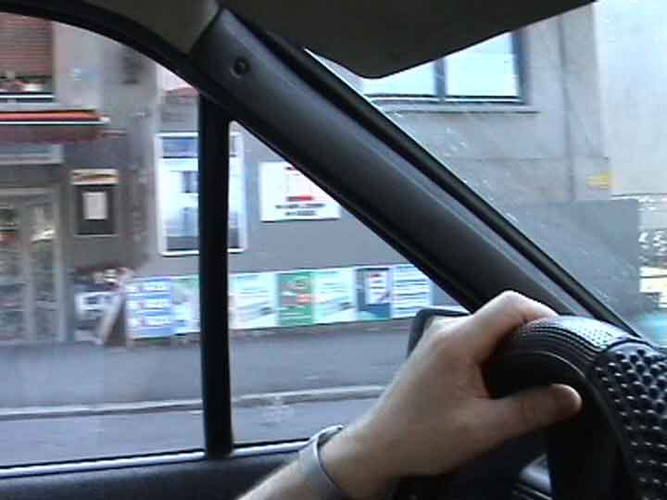
Interlacing During Capture
High-speed video capture is more expensive
Interlacing is also used in DV
Original frame from DV
Postprocessed digitally

Slide 10
Common TV Standards
NTSC (National Television Systems Committee)
525 scan lines, 30 frames per second, interlaced
Aspect ratio 4:3
First 20 lines are reserved for control information
Color model for transmission: YIQ
Bandwidth allocated, Y:4.2MHz, I: 1.0MHz, Q:0.6MHz.
Used in USA, Japan & Latin America.
PAL (Phase Alternating Line)
625 scan lines, 25 fps, aspect ratio 4:3, interlaced
Color model used YUV
Y: 5.5MHz, U: 1.8MHz, V: 1.8MHz
U and V are lowpass filtered to half bandwidth of Y.
Used in Western Europe & Hong Kong.

Slide 11
Common TV Standards (2)
SECAM (SEquential Couleur Avec Memoire)
625 scan lines, 25 fps, interlaced
Aspect ratio 4:3
Color model for transmission: YIQ
Bandwidth allocated, Y: 6.0MHz, I: 2.0MHz, Q: 2.0MHz.
Used in Eastern Europe & France.

Slide 12
Digital Video
Analog video are difficult to manipulate.
Instead of representing each frame as a discrete number of scan line of analog signal, each frame can be digitized to a 2D digital image.
Movie industry and TV broadcast are already using digital video due to power of non-linear video editing
Non-linear video editing includes image processing techniques, fade-in and fade-out, insertion of synthetic objects, ….

Slide 13
Digital Video (2)
Difficulties of analog video:
  nonlinear editing is not possible e.g live action+synthetic monster
  hard to compress, all you can do is to manipulate the waveforms,
  no semantic information you can make use
  may degrade if repeated record
  interference between luminance and chrominance.
  Noisy, ghosting, ...
Advantages of digital video:
  nonlinear video editing, all studio use digital video for special effect
  most universal digital compression techniques can apply
  no degradation if repeated record
  allow separate coding of luminance & chrominance.
  Either sharp or receive nothing.
  Moreover, error detection and error recovery are possible

Slide 14
High Definition TV (HDTV)
A fully digital video technology for TV broadcast.
Two line structures: 720-line and 1080-line
Several frame rates. Aspect ratio 16:9
e.g. 720 scan lines for TV, 60 fps, progressive scanning.
Coding format is decoupled from transmission format
Highly dependent on digital compression techniques
  Video compression:
  motion compensation
  discrete cosine transform
  i.e. MPEG-2
  Audio compression
  digtial audio compression technique AC-3
  significant audio features are encoded with more bits
  spectral components that are less audible are not encoded.

Slide 15
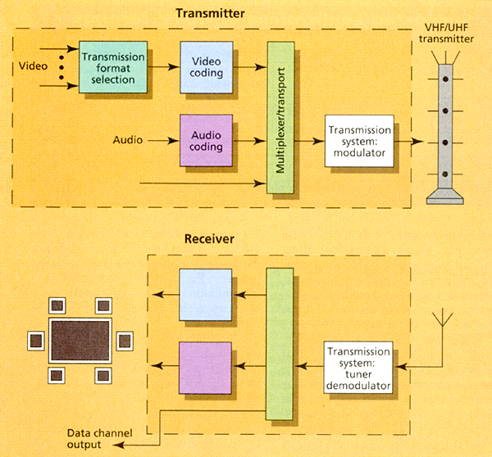
HDTV (2)
HDTV encoding, transmission and decoding:
It can be transferred through various networks, such as terrestrial simulcast, cable satellite, fiber.

Slide 16
HDTV (3)
The physical channel does not matter as the bit-stream can still be modulated, transmitted and demodulated.
Currently, there are 3 major HDTV standards
Previously mentioned HDTV is USA standard.
European HDTV is similar to American HDTV
Japanese HDTV is the first HDTV standards proposed by NHK in 1968. It is pretty old and not fully digital. Also known as MUSE
In 2008, Hong Kong launched HDTV. Two standards are adopted: MPEG2 (for simulcast such as TVB Pearl) and H.264 (for pure digital TV)

Slide 17
Motion Video
Most critical issue is size of data.
  An appreciable display contains 640x480 pixels in a frame ≈ 300 KB.
  A video of 30 fps requires transmission of 10 MB per sec!
  24-bit full color display demands 30 MB per sec.
Transmission and storage of uncompressed video is impractical.
  Compression ratio of 100:1 reduces it to 0.3 MB per sec.
  Video compression techniques: H.261, MPEG.

Slide 18
Computer Animation
Video and computer animation is analogous to image and graphics.
Computer animation generates the motion sequence of a still figure.
Key frame approach involves
  Input step
  Interpolation step
Input step
  Specifying key frames in which the figures are at characteristic positions.

Slide 19
Computer Animation(2)
Interpolation step
  Generate intermediate positions of figures in between the key frames.
  Easiest approach is linear interpolation, but has lots of shortcomings.
  Cubic spline is better approach to yield smooth trajectory of motion.
Motion capture
  Instead of entering keyframes by mouse and keyboard
  They are entered by natural postures.
  Tracking the markers (magnetic or optical)
  Latest advancement: vision based tracking, e.g. Kinect
  http://www.youtube.com/watch?v=1NZa1oafiZU&feature=related

Slide 20
Computer Animation(3)
The final movie sequence is synthesized by rendering the objects with the predetermined position and orientation.
e.g. flash

