Slide 1
CSCI 3280 Tutorial 4 Mini Project Specification Karaoke System（C++）

Slide 2
Main topic:
1, Low Level API
2, Wave File Format
3, Audio Play Procedure

Slide 3



Low Level API
Kalaoke System
Music Player
Please do NOT leave your questions to the final day

Slide 4
Low Level API
Windows APIs
High-level: calling one function ?
PlaySound(“c:\\abc.wav“,0,SND_ASYNC|SND_FILENAME)
Low-level: manipulating the sound data manually
DirectX APIs
Third-party codes

Slide 5
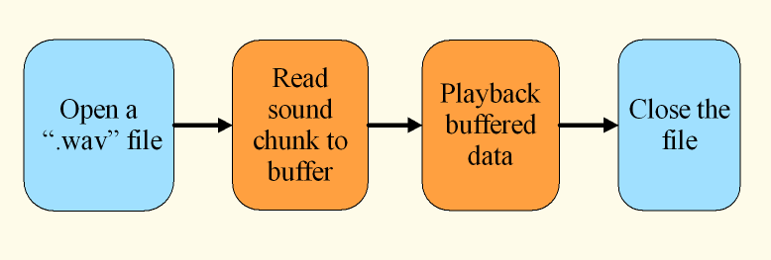
Low Level API
Full control by your code!

Slide 6
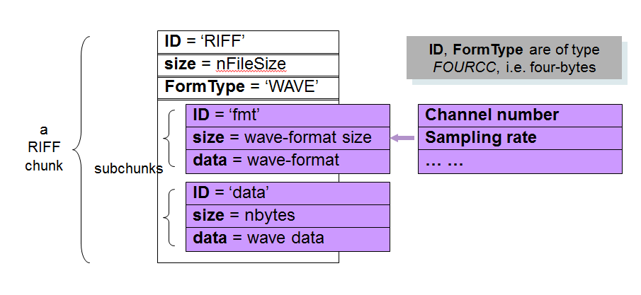
WAV File format
RIFF (Resource Interchange File Format)

Slide 7
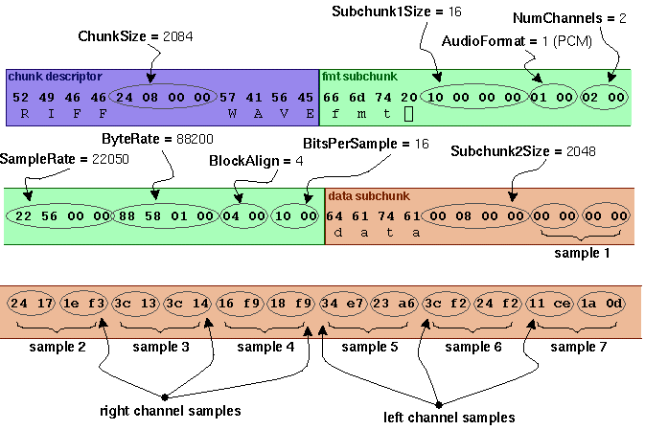
WAV File format

Slide 8
Windows API
windows.h
mmsystem.h
Function:
mmioXXXX()
waveOutXXXX( )
You can read the sample program.
Hints:
Google is your friend!

Slide 9

Audio Play Procedure
Open a wav File
Go into RIFF chunk
Go into fmt chunk
Go into data chunk
Escape from Sub chunk
Read Sub chunk Info
Open audio device
Prepare buffers
Read data chunk data
Close audio device
Close the wav file
Play back buffer data
HMMIO mmioOpen (LPSTR filename, LPMMIOINFO info, DWORD flags);
Opens a file for unbuffered or buffered I/O

Slide 10
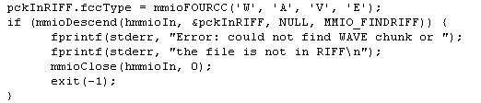
Audio Play Procedure
Open a wav File
Go into RIFF chunk
Go into fmt chunk
Go into data chunk
Escape from Sub chunk
Read Sub chunk Info
Open audio device
Prepare buffers
Read data chunk data
Close audio device
Close the wav file
Play back buffer data
mmioDescend (HMMIO h, LPMMCKINO lpck, LPMMCKINFO lpckParent, UNIT flags);
Descends into a chunk of a RIFF file

Slide 11

Audio Play Procedure
Open a wav File
Go into RIFF chunk
Go into fmt chunk
Go into data chunk
Escape from Sub chunk
Read Sub chunk Info
Open audio device
Prepare buffers
Read data chunk data
Close audio device
Close the wav file
Play back buffer data
LONG mmioRead (HMMIO h, HPSTR pch, LONG cch);
reads a specified number of bytes from a file

Slide 12

Audio Play Procedure
Open a wav File
Go into RIFF chunk
Go into fmt chunk
Go into data chunk
Escape from Sub chunk
Read Sub chunk Info
Open audio device
Prepare buffers
Read data chunk data
Close audio device
Close the wav file
Play back buffer data
mmioAscend(HMMIO h, LPMMCKINFO lpck, UINT flags);
Ascends out of a chunk in a RIFF file

Slide 13
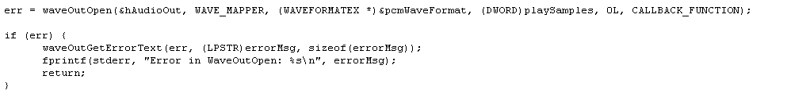
Audio Play Procedure
Open a wav File
Go into RIFF chunk
Go into fmt chunk
Go into data chunk
Escape from Sub chunk
Read Sub chunk Info
Open audio device
Prepare buffers
Read data chunk data
Close audio device
Close the wav file
Play back buffer data
waveOutOpen(LPHWAVEOUT phwo, UINT uDeviceID, LPWAVEFORMATEX pwfx, DWORD dwCallback, DWORD Instance, DWORD fdwOpen );

Slide 14

Audio Play Procedure
Open a wav File
Go into RIFF chunk
Go into fmt chunk
Go into data chunk
Escape from Sub chunk
Read Sub chunk Info
Open audio device
Prepare buffers
Read data chunk data
Close audio device
Close the wav file
Play back buffer data
waveOutPrepareHeader(HWAVEOUT hwo, LPWAVEHDR pwh, UINT cbwh );

Slide 15
Audio Play Procedure
Open a wav File
Go into RIFF chunk
Go into fmt chunk
Go into data chunk
Escape from Sub chunk
Read Sub chunk Info
Open audio device
Prepare buffers
Read data chunk data
Close audio device
Close the wav file
Play back buffer data
waveOutWrite (HWAVEOUT hwo, LPWAVEHDR pwh, UINT cbwh );

Slide 16
Audio Play Procedure
Open a wav File
Go into RIFF chunk
Go into fmt chunk
Go into data chunk
Escape from Sub chunk
Read Sub chunk Info
Open audio device
Prepare buffers
Read data chunk data
Close audio device
Close the wav file
Play back buffer data
mmioClose (HMMIO h, UINT wflags);
mmioClose (hmmioIn, 0);

Slide 17
Audio Play Procedure
Open a wav File
Go into RIFF chunk
Go into fmt chunk
Go into data chunk
Escape from Sub chunk
Read Sub chunk Info
Open audio device
Prepare buffers
Read data chunk data
Close audio device
Close the wav file
Play back buffer data
waveOutClose (HWAVEOUT hwo);
waveOutClose (hAudioOut);

Slide 18
Tutorial Next week
Some useful functions
Lyrics display

Slide 19
Thank you.

