Slide 1
Project using Java

Slide 2
Outline
Play wav in Java
GUI in Java

Slide 3
About the requirement
How low level function should I call?
Basically you should decode the header part of wav file by yourself.
You should read by byte or bytes and then convert them to meaningful variables or play them.
We should find some variables representing sample rate, bits per sample… and see that you really use them to play the music.

Slide 4
Let’s take Java as example!
We need to do the following steps:
1. Read the wav file
2. Decode the header
3. Create the format instance
4. Play the music

Slide 5
Read the wav file
I use the FileInputStream class to do this:
File file = new File(“X:\xxx\xxx\xxx.wav”);
FileInputStream fis = new FileInputStream(file);
Ps: you may need import java.io.*;

Slide 6
Decode the header
First read the word RIFF: String ChunkDescriptor = "" + (char) fis.read() + (char) fis.read() + (char) fis.read() + (char) fis.read();
Then the chunk size: byte[] tmp_4_byte = new byte[4]; fis.read(tmp_4_byte); long ChunkSize = byteArrayToLong(tmp_4_byte);

Slide 7
Create the format instance
Create the class instance using constructor fun: AudioFormat af = new AudioFormat(float SampleRate, int SampleSizeInBits, int Channels, boolean Signed, boolean BigEndian);
Notice that: AudioSystem.getAudioInputStream(input).getFormat() is not allowed !
Ps: you may need import javax.sound.sampled.*;

Slide 8
Play the music
DataLine.Info info = new DataLine.Info(SourceDataLine.class, af);
SourceDataLine line = (SourceDataLine) AudioSystem.getLine(info);
line.open(af);
line.start();
All above are preprocessing, what you need to control is in the following.
Line is basically a buffer buffering the raw music data to be played

Slide 9
Play the music
line.available() how many bytes the line is available for play you can use it in this way: count=inputStream.read(buffer,0,line.available());
line.write(buffer, 0, count); read count bytes raw data from buffer to line, and written data will be played
line.drain(); drains queued data from the line by continuing data I/O until the line's internal buffer has been emptied.
line.close();

Slide 10
Java example
With above code you can play the music now!
Hints:
1. For volume control, you can search for FloatControl class and line.getControl() function.
2. For synchronization of multiple threads, search for synchronized method or lock in Java.

Slide 11
GUI in Java
GUI---- Graphic User Interface
You should have learnt MFC then.
We will talk about GUI of Java

Slide 12
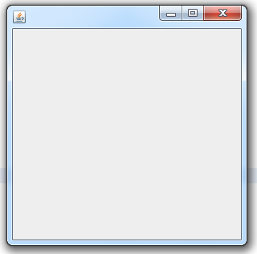
GUI in Java
How to create a window? window is named JFrame in Java
JFrame a=new JFrame(); a.setSize(300, 300); a.setLocation(100, 100); a.setVisible(true); a.setDefaultCloseOperation(JFrame.EXIT_ON_CLOSE);
Ps: import javax.swing.JFrame;

Slide 13
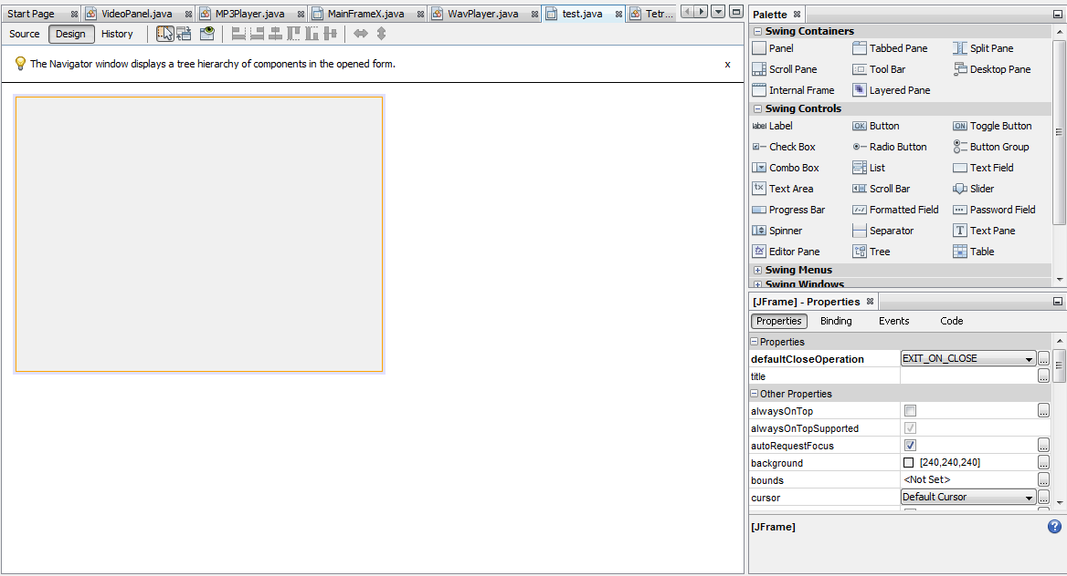
Customize JFrame
How to create a window as you like?
1. One way is to use some editor tools. For example, in Netbeans new a JFrame Form. You can drag and drop to create buttons, labels……

Slide 14
Customize JFrame
How to create a window as you like?
2. Another way is to write a class extends JFrame and you can have full control of all the things.
The 1st way is quite simple, you just create what you need and then click source and add code in corresponding position.
I’ll introduce more about the 2nd way.

Slide 15
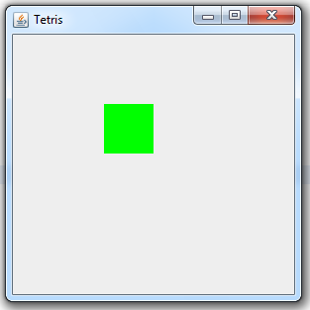
Basic drawing
How to draw things in a window? use the Graphics class
public void drawRect() {
Graphics g=this.getGraphics().create();
g.setColor(new Color(0, 255, 0));
g.fillRect(100, 100, 50, 50);
}
Ps: import java.awt.*;

Slide 16
Basic drawing
All drawing methods should be put in a method named paintComponent. This is a method you need to override.
public void paintComponent(g) { super.paintComponent(g); drawRect(); }
Ps: you can also pass the g here to your methods, actually this is a more formal way to write the code.

Slide 17
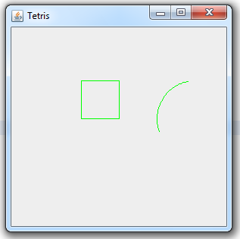
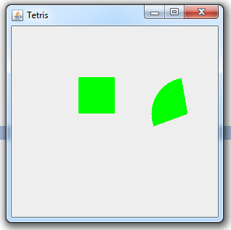
Some more drawings…
Some drawing examples:
g.drawRect, g.drawLine, g.drawOval, ……
g.drawRect(100, 100, 50, 50);
g.drawArc(200, 100, 100, 100, 100, 100);
g.fillRect, g.fillOval, g.fillPolygon,……
g.fillRect(100, 100, 50, 50);
g.fillArc(200, 100, 100, 100, 100, 100);

Slide 18
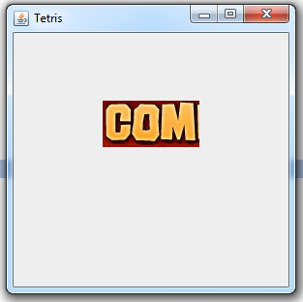
Draw an image
How to draw a image into your window? Use the Image class
Image i = Toolkit.getDefaultToolkit().getImage("combo.jpg"); g.drawImage(i,100,100,200,150,0,0,100,50,null);
First 4 number: coordinate of top left corner and bottom right corner of target rectangle region
Last 4 number: coordinate of top left corner and bottom right corner of source rectangle region
This means it will dynamically resize the image
Put the image under the project folder

Slide 19
Buffer your image
You can buffer and modify you image in this way:
Image B_Image = createImage(300, 300);
Graphics B_g = B_Image .getGraphics();
……
//use B_g to draw on the buffered image
……
g.drawImage(B_Image , 0, 0, null);
//draw buffered image to the g of the JFrame

Slide 20



Double buffering
We can use this to try the idea of double buffering to avoid the screen flicker.
Screen
Buffer
Back
Buffer
Screen
Buffer
Back
Buffer
Screen
Buffer
Back
Buffer

Slide 21
More…
1. To create buttons try searching JButton. You can customize the button with images.
2. To handle mouse and keyboard event try searching addMouseListener and addKeyListener.

