Slide 1
LZW Compression

Slide 2
Outline
Theory part of LZW compression/decompression
About assignment 2 and some details

Slide 3
Introduction
What is LZW?
Lossless compression method
Lempel-Ziv-Welch
Based on LZ78

Slide 4
Basic idea
Assume repetition of phase usually occurs
Use a code to represent one phase
Build a dictionary of phases that we met
If a phase is found in dictionary, use the code
If not found, add it to dictionary and give it a code
Very high compression ratio if lots of repetition
Skip

Slide 5
Algorithm
But how to handle byte steam?
The algorithm is similar to lecture note!
However, each node have maximum number of 256 child nodes.
R
R
0
1
<0>
<255>
<1>
…..
0
1
0
1
255

Slide 6
Tree Structure Example
ENCODER SIDE:
R
R
a
b
c
d
0
….
97
98
99
100
….
255
a b a b c d

Slide 7
Tree Structure Example
ENCODER SIDE:
R
R
a
b
c
d
0
….
97
98
99
100
….
255
b
256
a b a b c d
output: 97,

Slide 8
Tree Structure Example
ENCODER SIDE:
R
R
a
b
c
d
0
….
97
98
99
100
….
255
b
a
256
257
a b a b c d
output: 97,98

Slide 9
Tree Structure Example
ENCODER SIDE:
R
R
a
b
c
d
0
….
97
98
99
100
….
255
b
a
256
257
c
258
a b a b c d
output: 97,98,256

Slide 10
Tree Structure Example
ENCODER SIDE:
R
R
a
b
c
d
0
….
97
98
99
100
….
255
b
a
d
256
257
259
c
258
a b a b c d
output: 97,98,256,99

Slide 11
Tree Structure Example
ENCODER SIDE:
R
R
a
b
c
d
0
….
97
98
99
100
….
255
b
a
d
256
257
259
c
258
a b a b c d
output: 97,98,256,99,100 Encode complete!

Slide 12
Tree Structure Example
DECODE SIDE:
R
R
a
b
c
d
0
….
97
98
99
100
….
255
input: 97,98,256,99,100
output:

Slide 13
Tree Structure Example
DECODE SIDE:
R
R
a
b
c
d
0
….
97
98
99
100
….
255
input: 97,98,256,99,100
output: a

Slide 14
Tree Structure Example
DECODE SIDE:
R
R
a
b
c
d
0
….
97
98
99
100
….
255
b
256
Last string
input: 97,98,256,99,100
output: a b
Last string = a

Slide 15
Tree Structure Example
DECODE SIDE:
R
R
a
b
c
d
0
….
97
98
99
100
….
255
b
a
256
257
Last string
input: 97,98,256,99,100
output: a b a b
Last string = b

Slide 16
Tree Structure Example
DECODE SIDE:
R
R
a
b
c
d
0
….
97
98
99
100
….
255
b
a
256
257
c
258
Last string
input: 97,98,256,99,100
output: a b a b c
Last string = a b

Slide 17
Tree Structure Example
DECODE SIDE:
R
R
a
b
c
d
0
….
97
98
99
100
….
255
b
a
d
256
257
259
Last string
c
258
input: 97,98,256,99,100
output: a b a b c d
Last string = c

Slide 18
Algorithm
Now let’s see a table structure example

Slide 19
Compression
CODE | Entry
0 | NUL
:
97 | a
98 | b
99 | c
100 | d
: | :
255 | ASCII-255
: | :
IN: a b c c c d c c d
Prefix
Char.
Search
Code Saved
NULL
OUT:

Slide 20
Compression
CODE | Entry
0 | NUL
:
97 | a
98 | b
99 | c
100 | d
: | :
255 | ASCII-255
IN: a b c c c d c c d
Prefix
Char.
Search
Code Saved
NULL
‘a’
“a”
97
“a”
‘b’
“ab”
256
“ab”
OUT:
97

Slide 21
Compression
CODE | Entry
0 | NUL
:
97 | a
98 | b
99 | c
100 | d
: | :
255 | ASCII-255
256 | “ab”
IN: a b c c c d c c d
Prefix
Char.
Search
Code Saved
NULL
‘b’
“b”
98
‘b’
‘c’
“bc”
257
“bc”
OUT: 97,
98

Slide 22
Compression
CODE | Entry
0 | NUL
:
97 | a
98 | b
99 | c
100 | d
: | :
255 | ASCII-255
256 | “ab”
257 | “bc”
IN: a b c c c d c c d
Prefix
Char.
Search
Code Saved
NULL
‘c’
“c”
99
‘c’
‘c’
“cc”
258
“cc”
OUT: 97, 98,
99

Slide 23
Compression
CODE | Entry
0 | NUL
:
97 | a
98 | b
99 | c
100 | d
: | :
255 | ASCII-255
256 | “ab”
257 | “bc”
258 | “cc”
IN: a b c c c d c c d
Prefix
Char.
Search
Code Saved
NULL
‘c’
“c”
99
‘c’
‘c’
“cc”
258
‘cc’
‘d’
“ccd”
OUT: 97, 98, 99,
259
“ccd”
258

Slide 24
Compression
CODE | Entry
0 | NUL
:
97 | a
98 | b
99 | c
100 | d
: | :
255 | ASCII-255
256 | “ab”
257 | “bc”
258 | “cc”
259 | “ccd”
IN: a b c c c d c c d
Prefix
Char.
Search
Code Saved
NULL
‘d’
“d”
100
‘d’
‘c’
“dc”
OUT: 97, 98, 99, 258,
100
260
“dc”

Slide 25
Compression
CODE | Entry
0 | NUL
:
97 | a
98 | b
99 | c
100 | d
: | :
255 | ASCII-255
256 | “ab”
257 | “bc”
258 | “cc”
259 | “ccd”
260 | “dc”
IN: a b c c c d c c d
Prefix
Char.
Search
Code Saved
NULL
‘c’
“c”
99
‘c’
‘c’
“cc”
258
‘cc’
‘d’
“ccd”
259
OUT: 97, 98, 99, 258, 100,
259

Slide 26
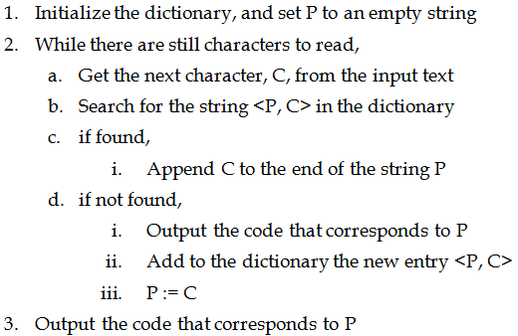
Reminder

Slide 27
Reminder
N-bit code → 2^N-1 phases
First 0-255 entries are all the single characters
Last phase 2^N-1 is reserved
Denote “End-Of-File”
Must be written as the last code of one file

Slide 28
Decompression
Reverse of the compression process
Look up the phase according to the code that we read
Update the dictionary on-the-fly

Slide 29
Decompression
CODE | Entry
0 | NUL
:
97 | a
98 | b
99 | c
100 | d
: | :
255 | ASCII-255
IN: 97, 98, 99, 258, 100, 259
cW
pW
C
dict(pW)+C
97
a
OUT:

Slide 30
Decompression
CODE | Entry
0 | NUL
:
97 | a
98 | b
99 | c
100 | d
: | :
255 | ASCII-255
IN: 97, 98, 99, 258, 100, 259
cW
pW
C
dict(pW)+C
98
97
‘b’
“ab”
256
“ab”
OUT: a
b

Slide 31
Decompression
CODE | Entry
0 | NUL
:
97 | a
98 | b
99 | c
100 | d
: | :
255 | ASCII-255
256 | “ab”
IN: 97, 98, 99, 258, 100, 259
cW
pW
C
dict(pW)+C
99
98
‘c’
“bc”
257
“bc”
OUT: a b
c

Slide 32
Decompression
CODE | Entry
0 | NUL
:
97 | a
98 | b
99 | c
100 | d
: | :
255 | ASCII-255
256 | “ab”
257 | “bc”
IN: 97, 98, 99, 258, 100, 259
cW
pW
C
dict(pW)+C
258
99
‘c’
“cc”
exception
258
“cc”
OUT: a b c
c c

Slide 33
Decompression
CODE | Entry
0 | NUL
:
97 | a
98 | b
99 | c
100 | d
: | :
255 | ASCII-255
256 | “ab”
257 | “bc”
258 | “cc”
IN: 97, 98, 99, 258, 100, 259
cW
pW
C
dict(pW)+C
100
258
‘d’
“ccd”
OUT: a b c c c
259
“ccd”
d

Slide 34
Decompression
CODE | Entry
0 | NUL
:
97 | a
98 | b
99 | c
100 | d
: | :
255 | ASCII-255
256 | “ab”
257 | “bc”
258 | “cc”
259 | “ccd”
IN: 97, 98, 99, 258, 100, 259
cW
pW
C
dict(pW)+C
259
100
‘c’
“dc”
OUT: a b c c c d
c c d
260
“dc”

Slide 35
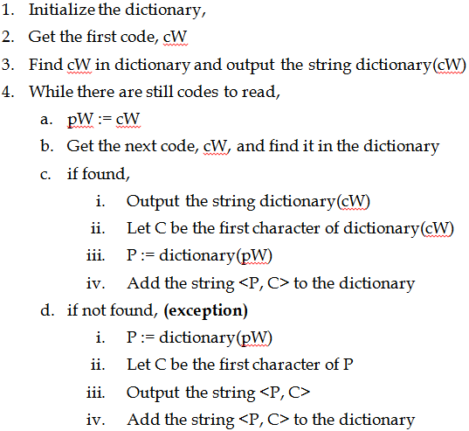
Reminder

Slide 36
Reminder
Exception that a code from the lzw file refers to an entry not present yet
Decompression “lags” behind compression
in compression, after producing the first code, the dictionary now contains the 256-th entry
in decompression, the 256-th entry is added after reading the second code

Slide 37
What have to do in Ass2 ?
Compress and Decompress a list of files to a single archive
In command line:
For compression :
>lzw –c <lzw filename> < list of file names>
For decompression:
>lzw –d <lzw filename>

Slide 38

What have to do in Ass2 ?
Compression

Slide 39
File format
LZW file format
<filename1>\n
<filename2>\n
<filename3>\n
….
\n
<Compressed file1><end-of-file>
<Compressed file2><end-of-file>
<Compressed file3><end-of-file>
….
Header

Slide 40

What have to do in Ass2 ?
Decompression

Slide 41
Details of Implementation
Full dictionary
Code size = 12 in this assignment
At most 4096 entries
Create a new dictionary in compression
Similar steps in decompression

Slide 42
Discussion
File end
Denote 2^N-1 as EOF code of one file
Output this EOF defined by us when finishing the compression of one file
Stop or open another file when detects the EOF in decompression

Slide 43
Discussion
File end
Please do not make yourselves confused with “2^N-1 as EOF code” and EOF returned from reading file.
“2^N-1 as EOF code” is for separating the files from one to one. EOF, means that there is no any character to be read.

Slide 44
Discussion
You are provided with sketch file. And six functions should be paid attention to.
write_code(lzw_file, code, code_size)
This function is for writing the code to file. It is not necessary to modify this function.

Slide 45
Discussion
Be careful on using the write_code() routine, since the write_code() routine stores things in a buffer before actual writing
Remember to flush the buffer at last!
write_code(lzw_file, 0, 12);

Slide 46
Discussion
read_code(lzw_file, code_size)
This function is for reading the code from file. It is not necessary to modify this function as well.

Slide 47
Discussion
readfileheader(lzw_file, outputfile, numberoffile)
This function is for reading the information of header from file. It is not necessary to modify this function.

Slide 48
Discussion
writefileheader(lzw_file, outputfile, numberoffile)
This function is for writing the information of header to file. It is not necessary to modify this function as well.

Slide 49
Discussion
compress(inputfile, lzw_file)
This function is for compression. You are required to implement this function.

Slide 50
Discussion
decompress(lzw_file, ouputfile)
This function is for decompression. You are required to implement this function.

Slide 51
Reminder
You are provided with a sample program
Your output should be the same as the ones from sample program.
“fc /w /c file1 file2” for file comparison in Windows Command Line.

Slide 52
Reminder
Try to speed up look-up process
Tree structure
Hashing function
There are bonus for advanced data structure accelerating the speed of compression and decompression.
Reference page: http://en.wikipedia.org/wiki/LZW

