Slide 1


Causal Inference and its Applications in Neuroimaging
Behrad Moniri
Augmented Intelligence Research Lab
Sharif University of Technology

Slide 2
Contents
Causal Inference Framework
Causal Learning Algorithms and Applications in Neuroimaging
PC Algorithm
GES and IMaGES
LiNGAM
Additive Noise Models
Fast Causal Inference
Granger Causality
TiMINo Causality
Dynamic Causal Modeling
Stimulus-based Causal Inference
Implementations

Slide 3
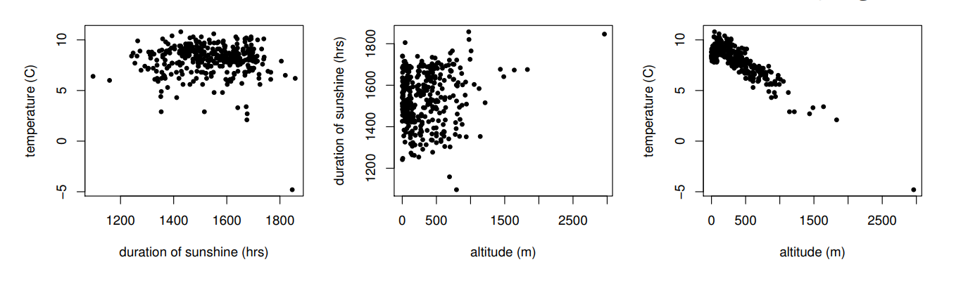
Causal Inference Framework

Slide 4
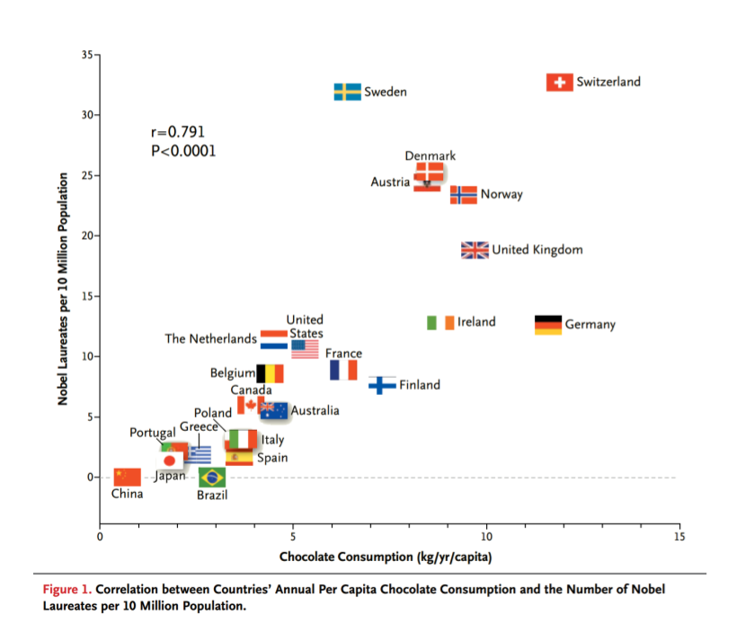
FH Messerli, Chocolate Consumption, Cognitive Function, and Nobel Laureates. New England Journal of Medicine, 2012

Slide 5
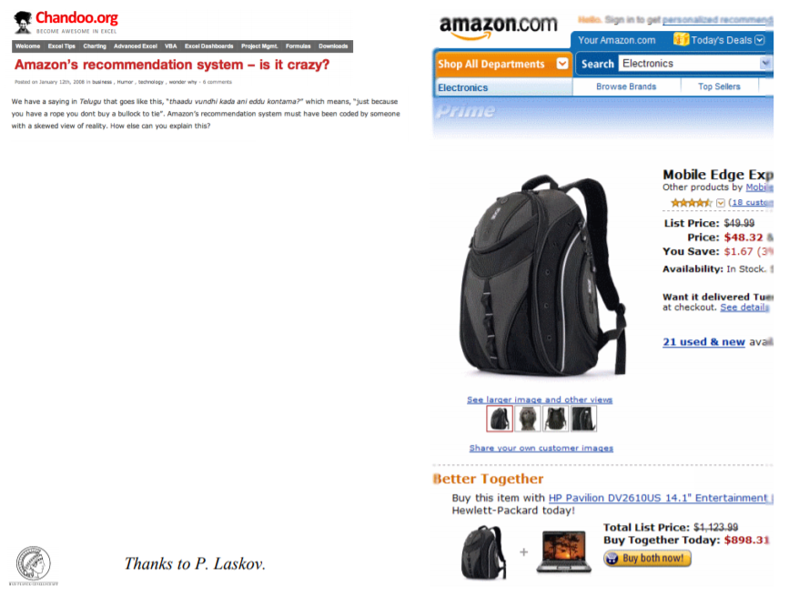

Slide 6
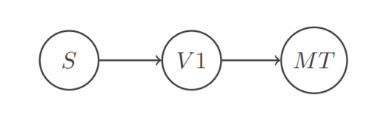

Goal of Causal Inference
Causation predicts the impact of intervention
$$P\left(V1 | do\left(S=cat\right)\right)≠P(V1|do\left(S=dog\right))$$

Slide 7
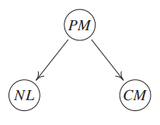


Intervention and Observation
Parent Myopia, Child Myopia and Night light
(Effects of Confounding)
Randomized Experiments
NL $⫫$ CM | PM
NL $⫫$ CM
G. E. Quinn, C. H. Shin, M. G. Maguire, and R. A. Stone. Myopia and ambient lighting at night. Nature, 399:113–114, 1999
K. Zadnik, L. A. Jones, B. C. Irvin, R. N. Kleinstein, R. E. Manny, J. A. Shin, and D. O. Mutti. Vision: Myopia and ambient night-time lighting. Nature, 404: 143–144, 2000

Slide 8
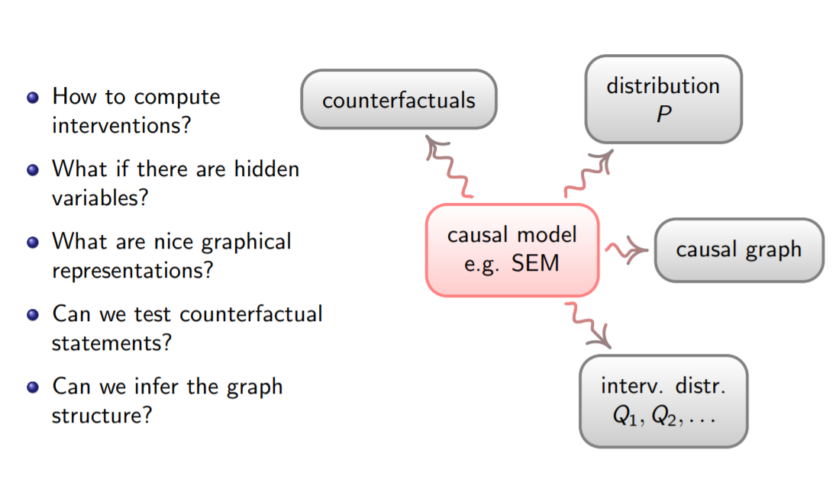

Slide 9
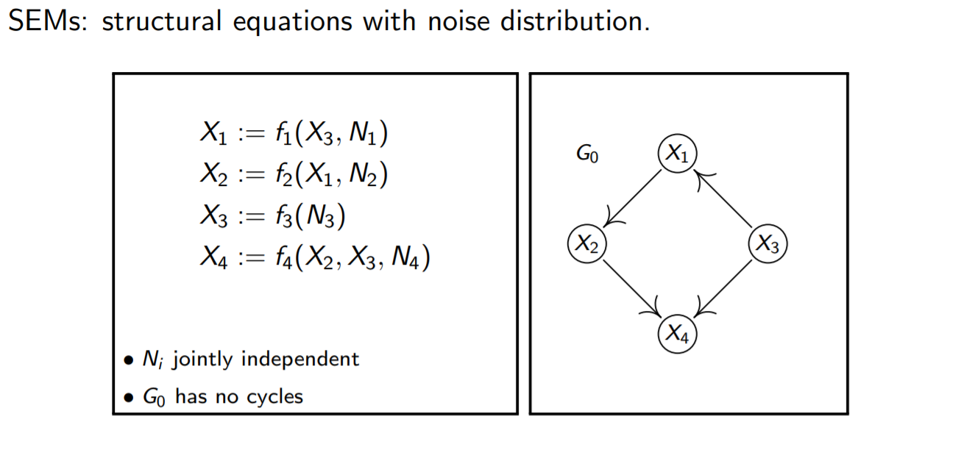
Structural Equation Models

Slide 10
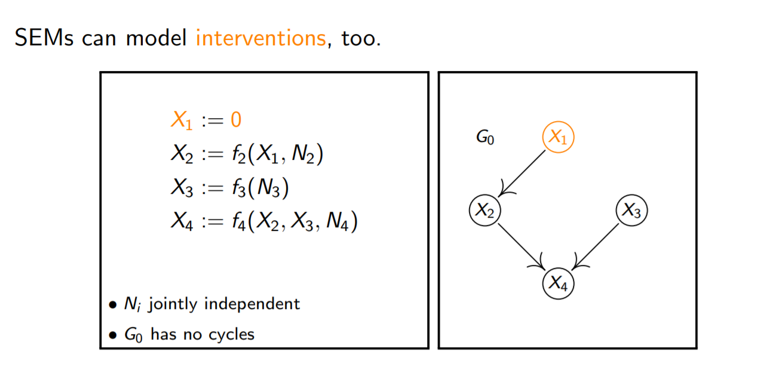
Structural Equation Models

Slide 11
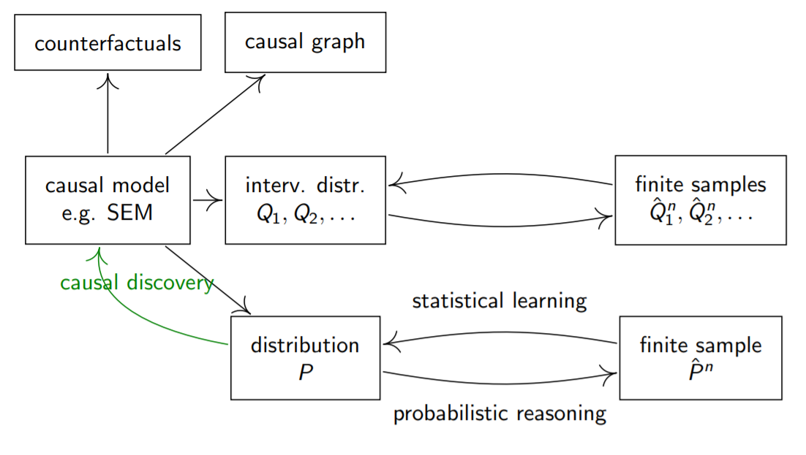
Cardiz et al. / MLSS 2017

Slide 12
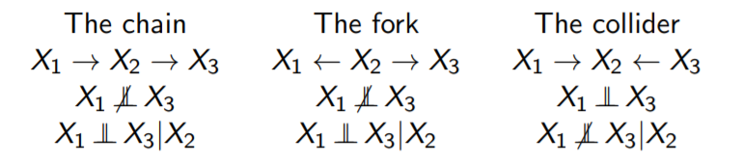

d-separation
$X_{i}$ and $X_{j}$ are d-separated by the set $S$ if all paths between $X_{i}$ and $X_{j}$ are blocked by $S$.
Cardiz et al. / MLSS 2017

Slide 13
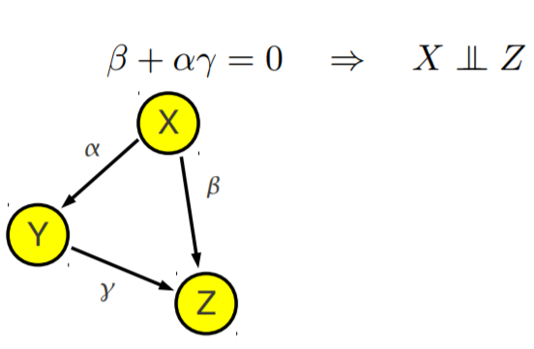
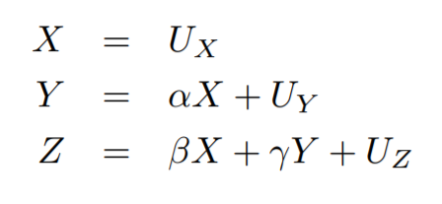
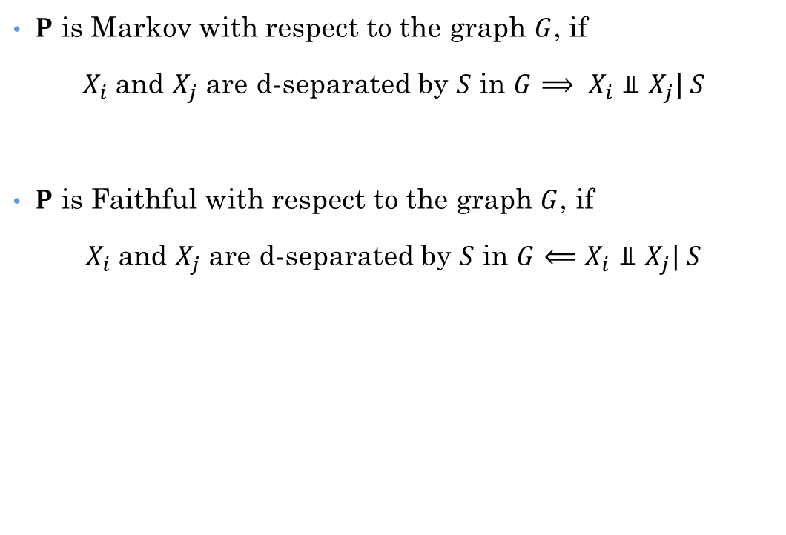
Markov Property and Faithfulness
$P$ is Markov with respect to the graph $G$, if
$X_{i}$and $X_{j}$ are d-separated by $S$ in $G$ $⟹ X_{i}⫫X_{j}| S$
$P$ is Faithful with respect to the graph $G$, if
$X_{i}$and $X_{j}$ are d-separated by $S$ in $G$ $⟸X_{i}⫫X_{j}| S$
Cardiz et al. / MLSS 2017

Slide 14
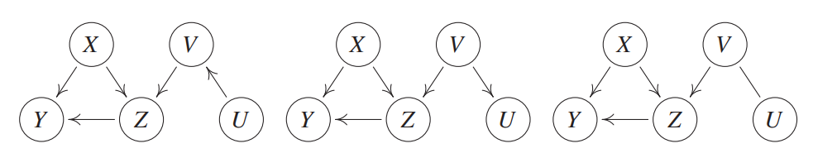
Markov Equivalent Classes
Definition. Markov Equivalence Class
Theorem (Verma and Pearl, 1990). two DAGs are Markov equivalent if they have the same skeleton and the same v-structures.
CPDAG

Slide 15
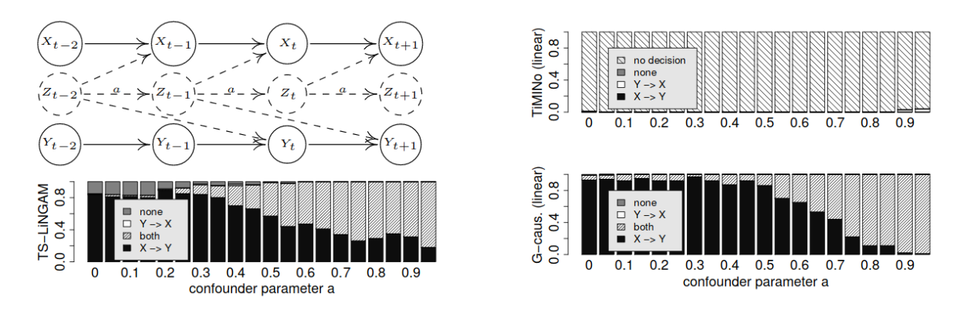
Causal Learning Algorithms and Neuroimaging!

Slide 16
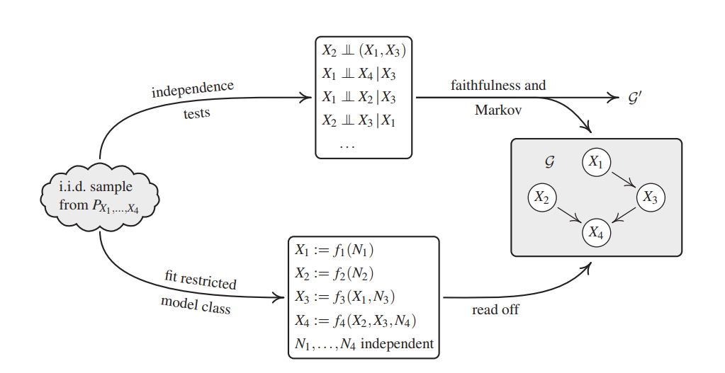
Two families of learning algorithms

Slide 17
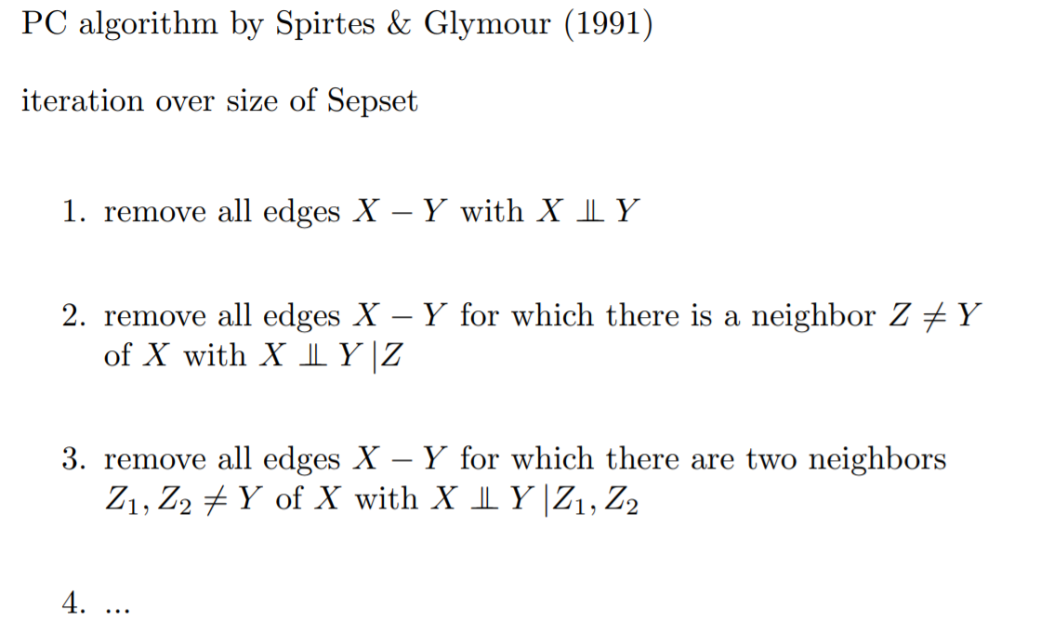
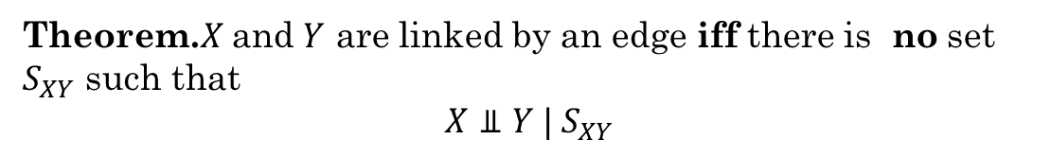
PC Algorithm
Theorem.$X$ and $Y$ are linked by an edge iff there is no set $S_{XY}$ such that
$$X⫫Y | S_{XY}$$

Slide 18
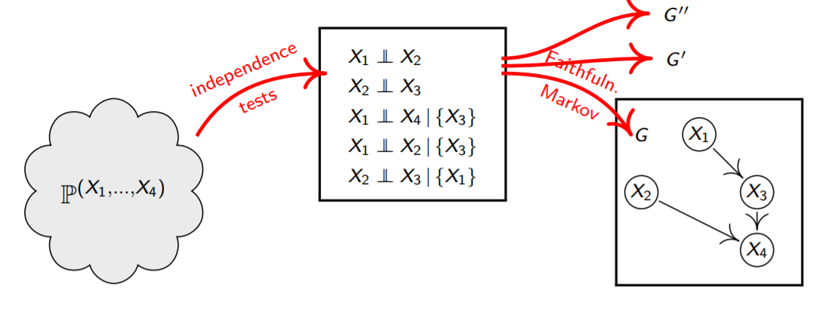
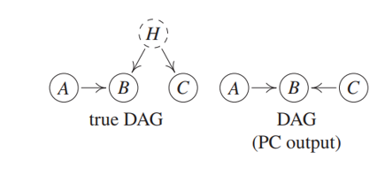
The Problem!
MEC
1) What about confounders?!
2) Conditional Independence Tests are very Hard.

Slide 19
PC and Neuroimaging
Does not include temporal dependencies
Diffusion Tensor Imaging (DTI)
Consistency between subjects in patterns of edges obtained from GES and PC (Sun et al. 2012).
The use of PC for fMRI data to determine the presence of edges has been promising.

Slide 20

Greedy Search
For each graph we may consider the maximum likelihood estimator $\hat{θ}$ for $θ$ and then define a score function by the BIC
$$S\left(Data, G\right)=\log{p\left(Data | \hat{θ}, G\right)−\frac{\#params}{2}\log{(n)}}$$

Slide 21
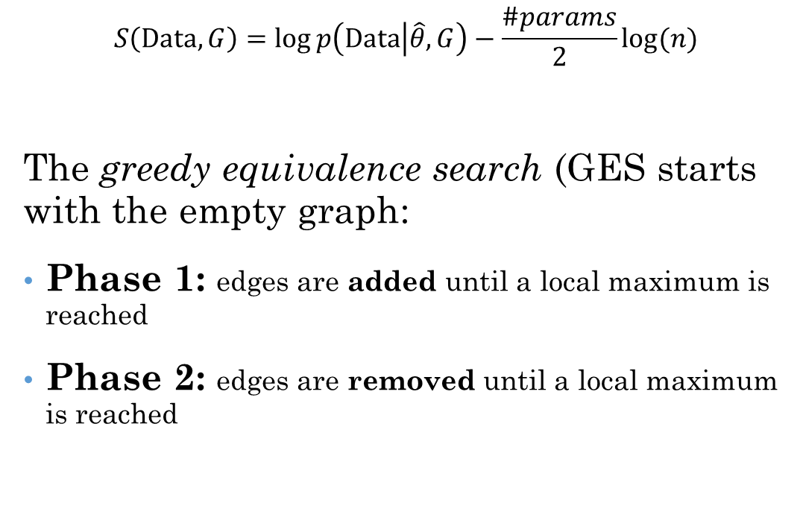
Greedy Search
$$S\left(Data, G\right)=\log{p\left(Data | \hat{θ}, G\right)−\frac{\#params}{2}\log{(n)}}$$
The greedy equivalence search (GES starts with the empty graph:
Phase 1: edges are added until a local maximum is reached
Phase 2: edges are removed until a local maximum is reached
Extention: IMaGES!
Chickering DM (2002) Optimal structure identification with greedy search. JMLR.

Slide 22
GES in Neuroimaging
GES does not include temporal information.
However, to date, the GES algorithm has only been applied on fMRI data! A lot!
Differences in brain processes among individuals diagnosed with Autism spectrum disorder (Hanson et al. 2013).
Hanson C, Hanson SJ, Ramsey J, Glymour C (2013)
Atypical effective connectivity of social brain networks in individuals with autism. Brain Connect.

Slide 23
GES in Neuroimaging
Results for lengths of time series typically seen in fMRI might be unreliable (Mumford and Ramsey 2014).
BIC typically assumes a linear Gaussian likelihood. The consistency of selection methods using BIC is not guaranteed when the data are non-normally distributed.
Mumford JA, Ramsey JD (2014) Bayesian networks for fMRI: a primer. NeuroImage.

Slide 24
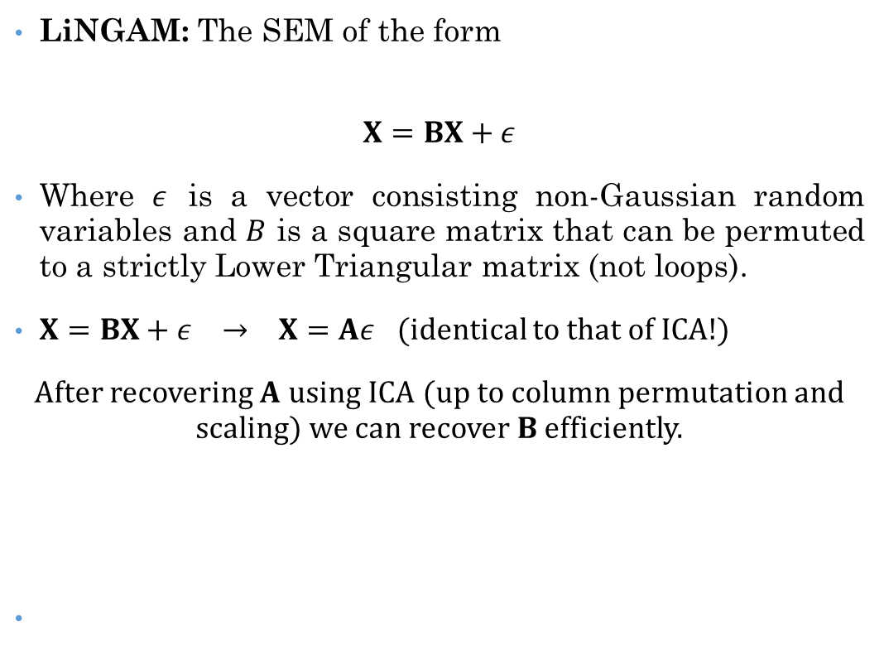
LiNGAM (Linear Non-Gaussian Acyclic Models)
LiNGAM: The SEM of the form
$$X=BX+ε$$
Where $ε$ is a vector consisting non-Gaussian random variables and $B$ is a square matrix that can be permuted to a strictly Lower Triangular matrix (not loops).
$X=BX+ε → X=Aε$ (identical to that of ICA!)
After recovering $A$ using ICA (up to column permutation and scaling) we can recover $B$ efficiently.

Slide 25
LiNGAM in Neuroimaging
A considerable amount of literature discussing the use of LiNGAM.
Considerably less literature using LiNGAM!
Liu et al. (2015) uses LiNGAM to identify connectivity differences with bipolar disorder and major depressive disorder and showed differences.
fMRI is non-Gaussian (Rice Distribution).
Preprocessing and filtering is an issue.
Liu et al. (2015) Altered effective connectivity between bipolar and unipolar depression based on resting-state fMRI. J Affect Disorder.

Slide 26

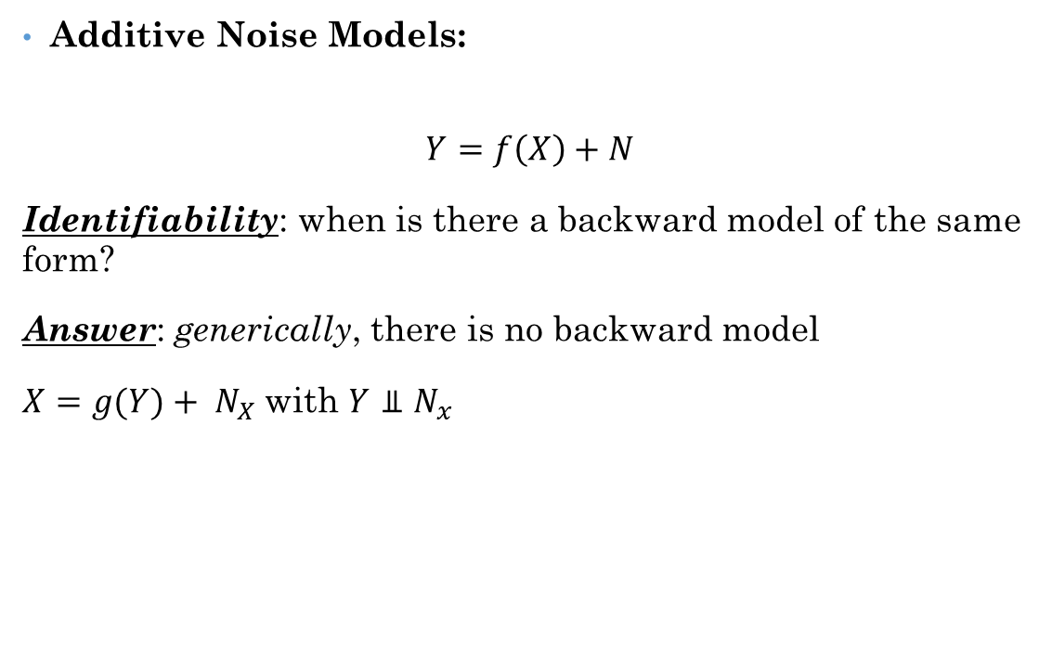
Additive Noise Models
Additive Noise Models:
$$Y=f\left(X\right)+N$$
Identifiability: when is there a backward model of the same form?
Answer: generically, there is no backward model
$X=g(Y)+ N_{X}$with $Y⫫N_{x}$
Hoyer et al.: Nonlinear causal discovery with additive noise models. NIPS 21, 2009
Peters et al: Causal Discovery with Continuous Additive Noise Models, JMLR 2014
Peters et al.: Detecting the Direction of Causal Time Series. ICML 2009

Slide 27
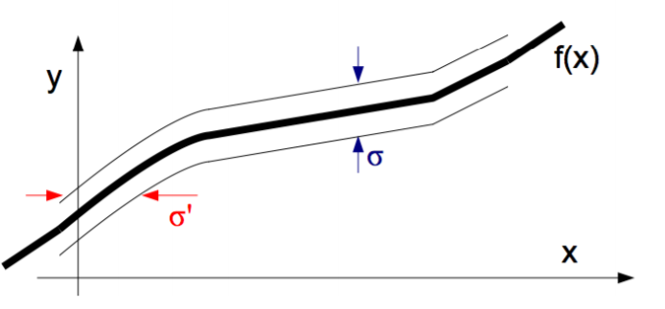

Intuition
• Assume noise of bounded range
• Additive noise model implies range of Y around $f$ is constant
• For nonlinear $f$, range of $X$ around backward function non-constant

Slide 28
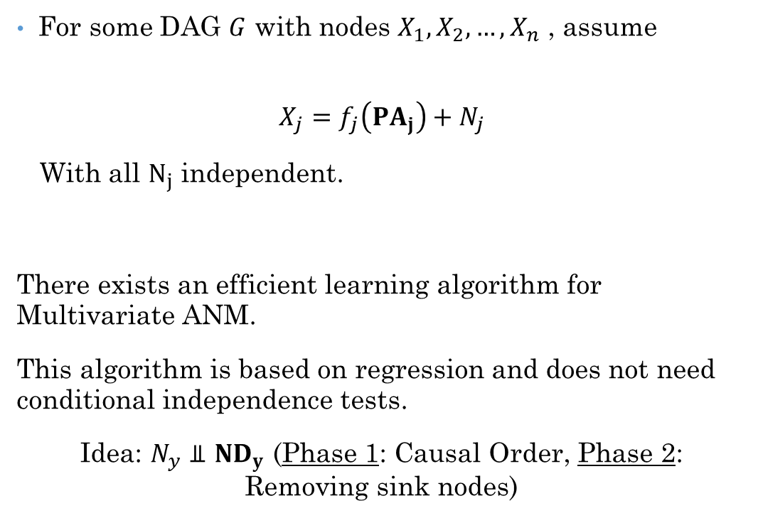
Multivariate ANM
For some DAG $G$ with nodes $X_{1}, X_{2},…, X_{n}$ , assume
$$X_{j}=f_{j}\left(PA_{j}\right)+N_{j}$$
With all $N_{j}$ independent.
There exists an efficient learning algorithm for Multivariate ANM.
This algorithm is based on regression and does not need conditional independence tests.
Idea: $N_{y}⫫ND_{y}$ (Phase 1: Causal Order, Phase 2: Removing sink nodes)
Peters, J., Mooij, J. M., Janzing, D., and Schölkopf, B. Causal discovery with continuous additive noise models. JMLR (2014).

Slide 29
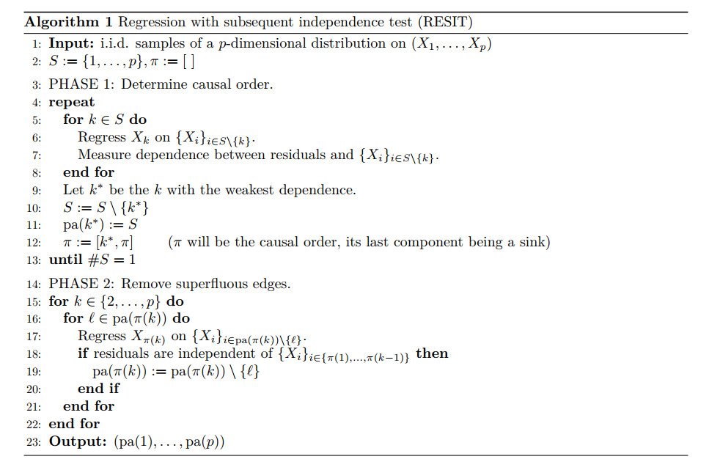
RESIT Algorithm

Slide 30

Multivariate ANM
One can identify the DAG $G$ (except for some rare cases).
Distinguishes even between Markov equivalent DAGs.
Avoids conditional independence testing: if all residuals
$X_{j}−f_{j}(PA_{j})$ are independent,${ P}_{X_{1}, X_{2}, …,{ X}_{n}}$ satisfies the Markov condition w.r.t. $G$.
Peters, J., Mooij, J. M., Janzing, D., and Schölkopf, B. Causal discovery with continuous additive noise models. JMLR (2014).

Slide 31
ANM and Neuroimaging
Never used in neuroimaging studies!
(As far as I know. Searched a lot!)

Slide 32
Fast Causal Inference!
FCI is a search procedure that accounts the effect of unobserved, or latent, confounders.
Recovers Partial Ancestral Graph
Directed edges
Bidirectional edges
Induced edges (not enough information to uniquely determine the direction of the connection.)
Finds the class of DAGs (possibly with latent confounders) that have the same set of independence assertions.

Slide 33
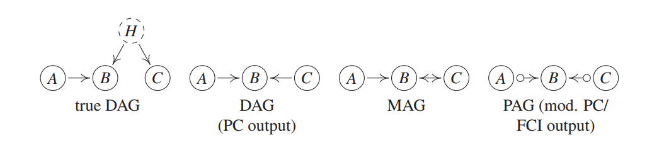
Partial Ancestral Graphs

Slide 34
FCI in Neuroimaging
To my knowledge, FCI has ever been applied to fMRI data.
Advantage: accounting for of latent confounders
Disadvantage: the need for iid random variables.
fMRI signal is almost by definition neither independent between timepoints, nor identically distributed.
It’s output is not even a CPDAG!

Slide 35
FCI in Neuroimaging
An extremely fruitful line of research, as the ability to account for latent confounders would be extremely useful in the fMRI context.

Slide 36
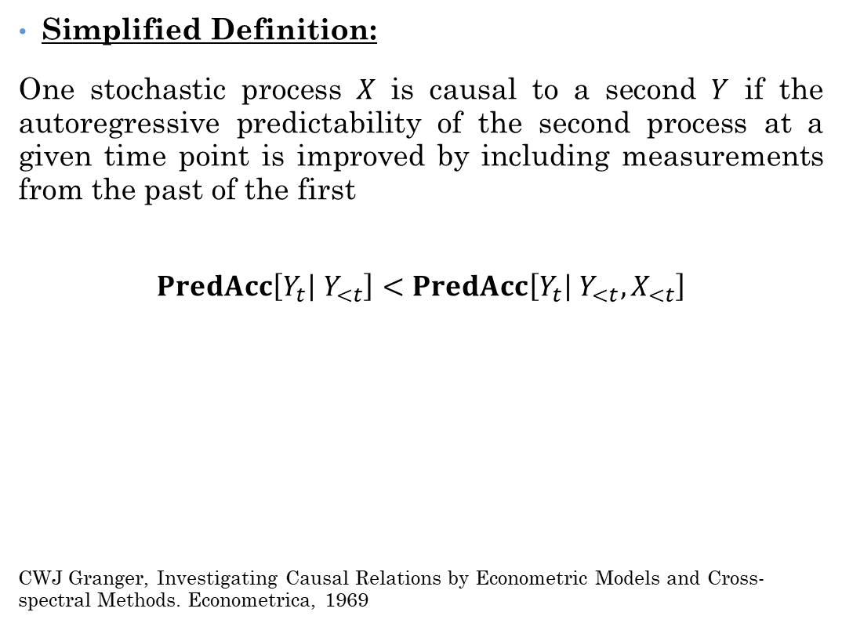
Granger Causality
Simplified Definition:
One stochastic process $X$ is causal to a second $Y$ if the autoregressive predictability of the second process at a given time point is improved by including measurements from the past of the first
$$PredAcc\left[Y_{t} | Y_{<t}\right]<PredAcc\left[Y_{t} | Y_{<t}, X_{<t}\right]$$
CWJ Granger, Investigating Causal Relations by Econometric Models and Cross-spectral Methods. Econometrica, 1969

Slide 37
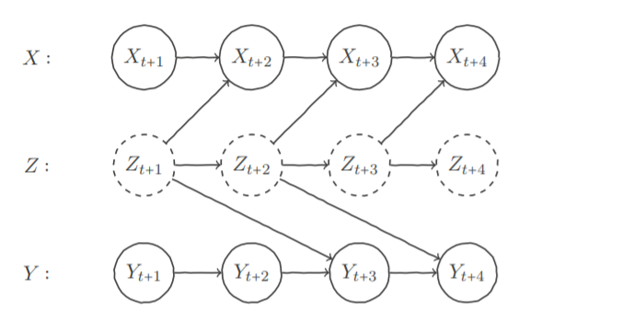

Granger Causality
$$PredAcc\left[Y_{t} | Y_{<t}\right]<PredAcc\left[Y_{t} | Y_{<t}, X_{<t}\right]$$
J Peters et al. Causal discovery on time series using restricted structural equation models. NIPS, 2013

Slide 38

Granger Causality
Granger’s Definition: One stochastic process $X$is causal to a second $Y$ if the predictability of the second process at a given time point is worsened by removing past measurements of the First from the universe’s past.
$$PredAcc\left[Y_{t} | U_{<t}\right]>PredAcc\left[Y_{t} | U_{<t}, X_{<t}\right]$$
Granger, Investigating Causal Relations by Econometric Models and Cross-spectral Methods. Econometrica, 1969

Slide 39
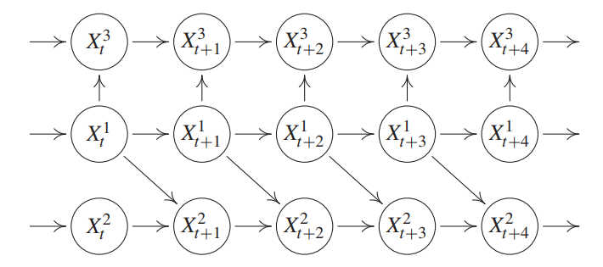
Instantaneous Effect
Granger Causality fails when there are instantaneous effects.
When the temporal resolution of data collection is low relative to the process being studied, edges may appear contemporaneously.
Granger, Investigating Causal Relations by Econometric Models and Cross-spectral Methods. Econometrica, 1969

Slide 40
Granger Causality in Neuroimaging
It is one of the more highly used approaches for arriving at directed connectivity models.
Using Granger Causality for fMRI connectivity analysis has been under much debate in recent literature (e.g., Wen et al. 2013; Deshpande and Hu 2012, … ).

Slide 41

TiMINo Causality
TiMINo is a natural extension of additive noise models to time series.
A very similar Learning Algorithm to RESIT for ANMs, based on regression.

Slide 42
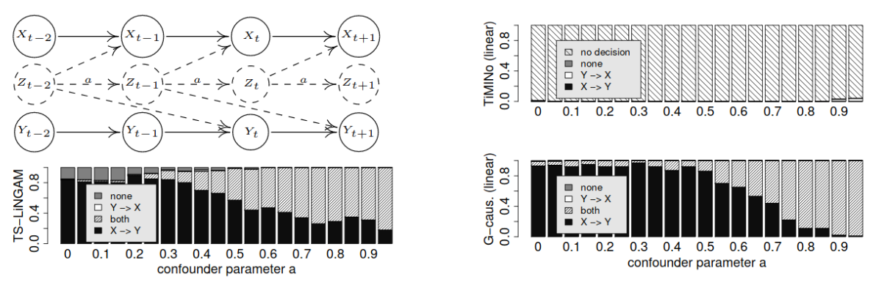
TiMINo in Neuroimaging
No work has been done!
It is a time series model!
TiMINo can handle instant effects.
TiMINo seems to be more robust to hidden confounding than Granger Causality (No proof for that!)

Slide 43
Dynamic Causal Modeling
Causality in DCM is used in a control theory sense and means that, under the model, activity in one brain area causes dynamics in another, and that these dynamics cause the observations.
(Friston, PLOS Biology, 2009)

Slide 44
Dynamic Causal Models
V5
a₂₂
z₂
“How does brain activity, z, change over time?”
b₂₁
For m inputs:
a₂₁
$$\dot{z}=(A+\sum_{j=1}^{m}{u_{j}}B^{j})z+Cu$$
Attention u₂
V1
z₁
a₁₁
c₁₁
A: Structure
B: Modulatory
Input
C: Driving
Input
Driving input u₁
$$\left[\begin{matrix}{\dot{z}}_{1} \\ {\dot{z}}_{2}\end{matrix}\right]=\left(\left[\begin{matrix}a_{11} & 0 \\ a_{21} & a_{22}\end{matrix}\right]+u_{2}\left[\begin{matrix}0 & 0 \\ b_{21} & 0\end{matrix}\right]\right)\left[\begin{matrix}z_{1} \\ z_{2}\end{matrix}\right]+\left[\begin{matrix}c_{11} & 0 \\ 0 & 0\end{matrix}\right]\left[\begin{matrix}u_{1} \\ u_{2}\end{matrix}\right]$$
Change in
activity per
region
Current
activity
per region
External input 2
(attention)
All
external input
(KJ Friston et al., Dynamic Causal Modelling. NeuroImage, 2003)

Slide 45
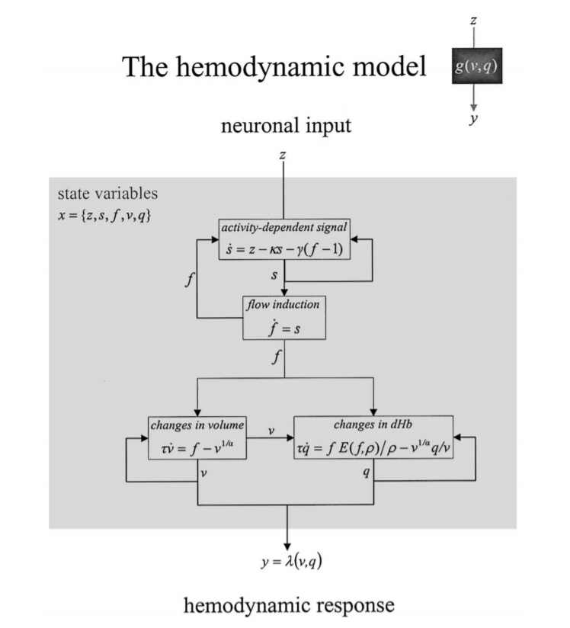
(KJ Friston et al., Dynamic Causal Modelling. NeuroImage, 2003)

Slide 46

Dynamic Causal Modelling
Inference procedure:
Define $M=\{M_{1}, M_{2},…, M_{n}\}$
Fit models to observed data
Best fitting $\hat{M}$ wins
(KJ Friston et al., Dynamic Causal Modelling. NeuroImage, 2003)

Slide 47
Criticism of DCM
Lohmann et al. 2012: Large number of Model Parameter
Number of parameters explode by increasing m and n!
Identification is impossible from experimental data
Their experiment:
Simulated brain connections.
Large fraction of wrong models obtained higher evidence by DCM compared to the true “best” model.
Similar model fit does not translate into similar connectivities!
Lohmann et al., 2012

Slide 48
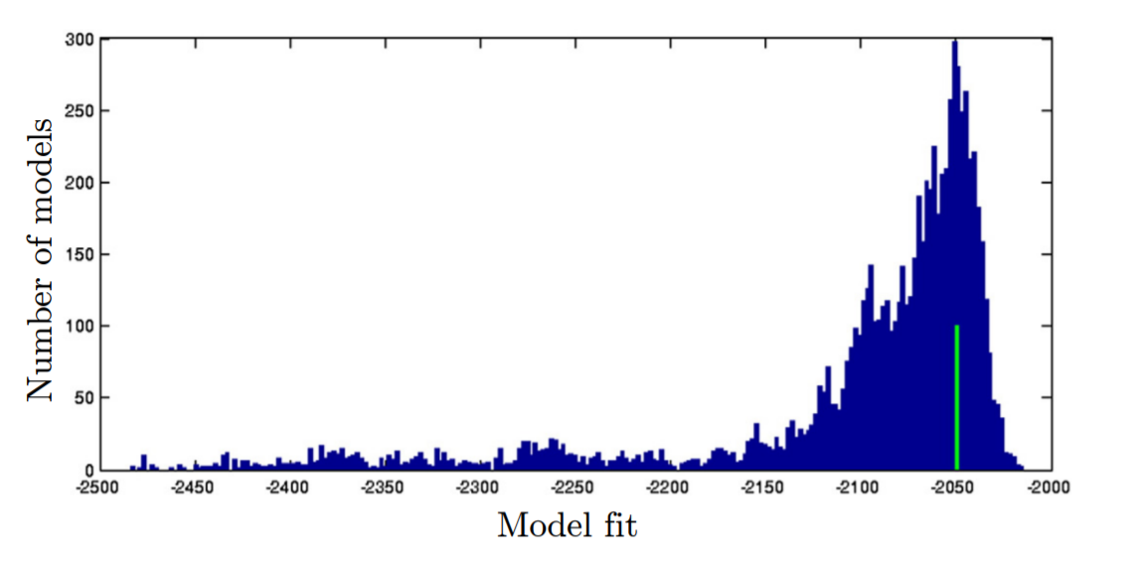
Criticism of DCM
Similar models does not translate into similar connectivities!

Slide 49
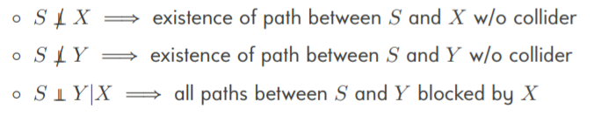
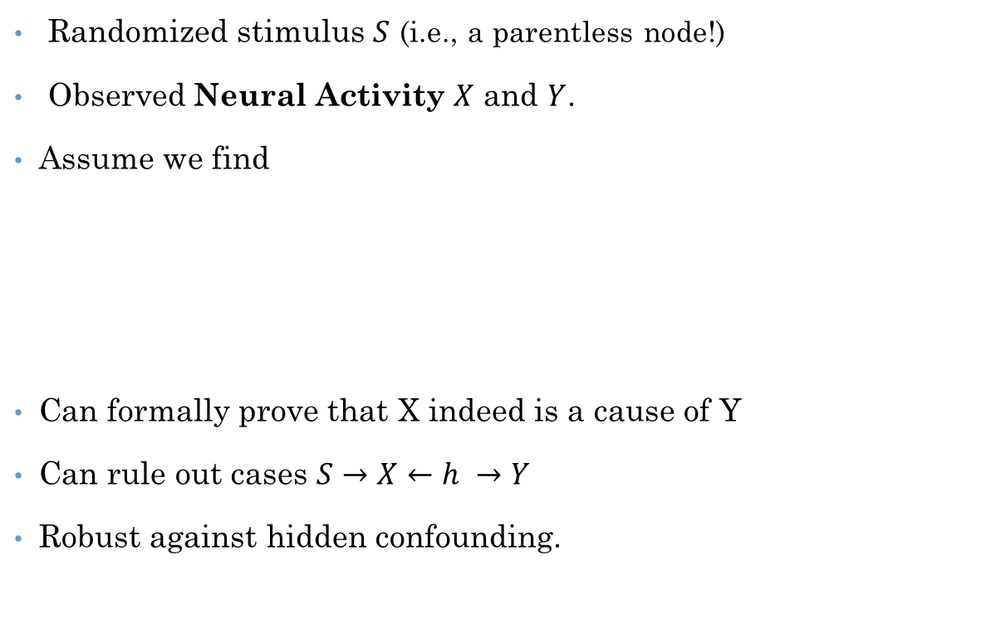
Stimulus Based Causal Inference
Randomized stimulus $S$ (i.e., a parentless node!)
Observed Neural Activity $X$ and $Y$.
Assume we find
Can formally prove that X indeed is a cause of Y
Can rule out cases $S→X←h →Y$
Robust against hidden confounding.
M Grosse-Wentrup et al., NeuroImage, 2015
S Weichwald et al., IEEE Journal of Selected Topics in Signal Processing, 2016

Slide 50
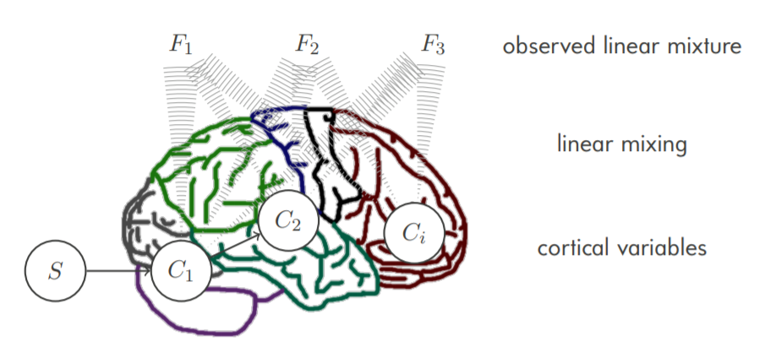
MERLiN Mixture Effect Recovery in Linear Networks

Slide 51
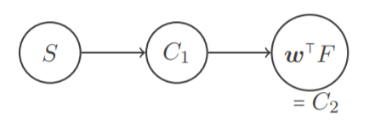

MERLiN Mixture Effect Recovery in Linear Networks
Given samples of $S$, $C_{1}$ and $F$
Find linear combination w such that
Find $w$ such that:
$dep\left(S, w^{T}F\right)=high$
$dep\left(S, w^{T}F | C_{1}\right)=Low$
S Weichwald et al., MERLiN: Mixture Effect Recovery in Linear Networks.
IEEE Journal of Selected Topics in Signal Processing, 2016

Slide 52
Implementations
Language | University | Main Contributors | Project Name
Java | CMU | Sprites and Glymour | Tetrad
R | ETH, MPI, … | Many! | PCalg
Python | Purdue | Bareinboim | Auto-Angrist
 |  |  | …

Slide 53
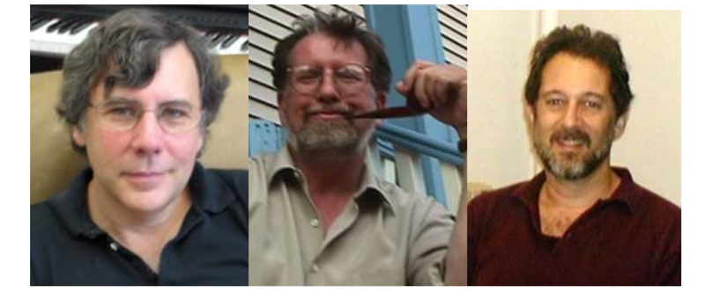
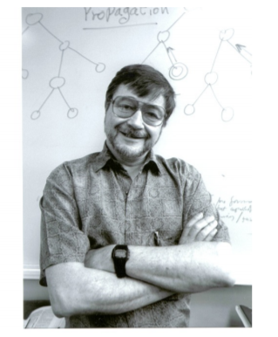
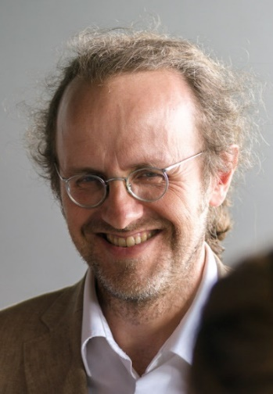
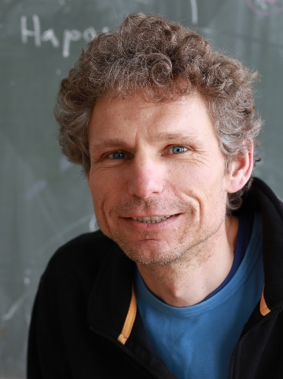
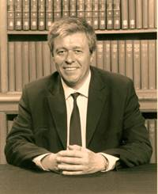
Questions?
http://ee.sharif.edu/~bemoniri
bemoniri@live.com

