Slide 1
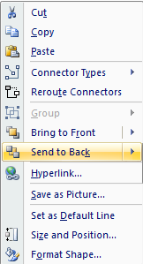
Customer
As you draw these edges with the line tool, be sure to attach them on the center of the nodes and “send to back” to ensure proper display
Right-Aligned
Choose left or right-aligned nodes as appropriate
Left-Aligned
These nodes can be moved around rather easily, as the lines remain attached to the node center.
Power
See also:
An Introduction to Wardley (Value Chain) Mapping
Doctrine, Climate and Context Specific Gameplay

Slide 2
Customer
visible
Right-Aligned
Left-Aligned
Value Chain
invisible
Power
Genesis
Custom Built
Product
(+ rental)
Commodity
(+ utility)
Evolution

