Slide 1
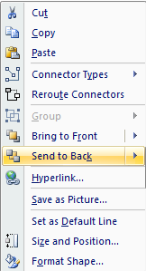
User
As you draw these edges with the line tool, be sure to attach them on the center of the nodes and “send to back” to ensure proper display
Right-Aligned
Choose left or right-aligned nodes as appropriate
Left-Aligned
These nodes can be moved around rather easily, as the lines remain attached to the node center.
Power
See also:
An Introduction to Wardley (Value Chain) Mapping
Doctrine, Climate and Context Specific Gameplay

Slide 2
User
visible
Right-Aligned
Value Chain
Left-Aligned
Power
invisible

Slide 3
User
visible
Right-Aligned
Value Chain
Left-Aligned
invisible
Power
Activities
Practices
Data
Knowledge
Genesis
Novel
Unmodeled
Concept
Custom
Emerging
Divergent
Hypothesis
Product (+ rental)
Good
Convergent
Theory
Commodity (+ utility)
Best
Modeled
Accepted
Evolution

