Slide 1
TURING MACHINES
0
0
0
0
0
1
1
1
0
0
0

Slide 2
“COMPUTER” USED TO BE A JOB
Before electronic computers, a computer was a person.
Computers did long calculations by hand, following written instructions step by step.
They didn’t need to understand why the steps worked. They just needed to follow them carefully.
Instructions
written steps to follow
Paper and pencil
to write things down
Their memory
of which step they’re on
What a human computer worked with

Slide 3
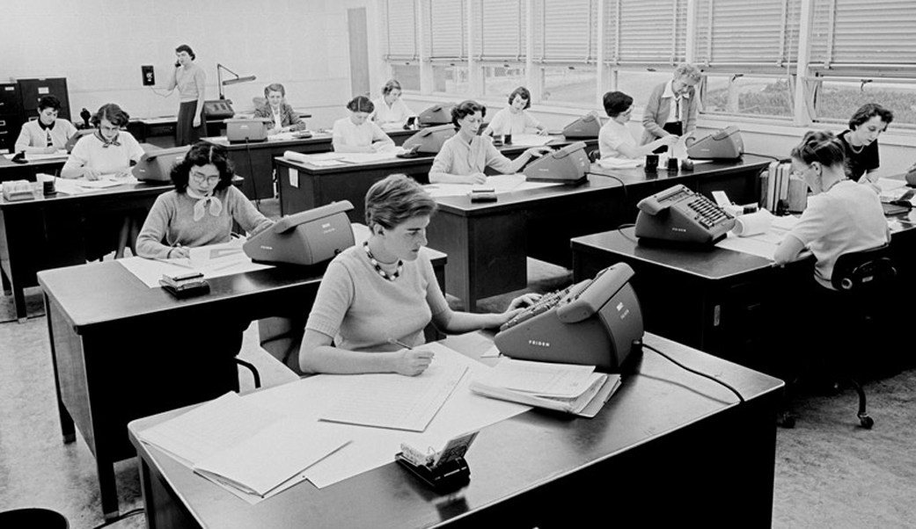
NASA computers, mid-1950s
Instructions
written steps to follow
Paper and pencil
to write things down
Their memory
of which step they’re on
Human computers at work at JPL, mid-1950s
(photo credit: NASA/JPL-Caltech)
What a human computer worked with

Slide 4
A QUESTION FROM 1928
In 1928 the mathematician David Hilbert asked a question about math itself.
To answer “no,” someone first had to say exactly what “following steps mechanically” means.
Is there a step-by-step procedure that can take any math statement and decide whether it can be proved?
Hilbert’s question, in plain words. Its German name is the Entscheidungsproblem (“decision problem”).

Slide 5
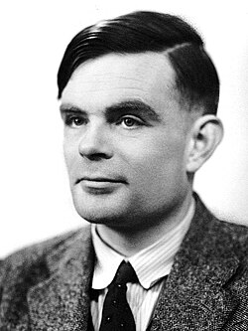
ALAN TURING
A British mathematician. In 1936 he answered Hilbert’s question.
His idea: picture a human computer, then strip the job down to the simplest possible steps.
The result is a precise description of “following steps.” Today we call it a Turing machine.
Alan Turing in 1951
(photo: Elliott & Fry. © National Portrait Gallery, London)
1912
1936
1939–45
1954
born in London
publishes the Turing machine
breaks German codes at Bletchley Park
dies, age 41
Computer science’s biggest prize, the Turing Award, is named after him.

Slide 6
WHAT A HUMAN COMPUTER DOES
Turing noticed that every step of hand calculation comes down to a few things:
Looks at one symbol
You only ever look at a small part of the paper at a time.
Maybe changes it
Write a symbol, or erase one and write another.
Moves a little
Look at the next symbol over.
Remembers where they are
“I’m on step 4 of the instructions.” Turing called this the state.
Anything more complicated can be built out of these.

Slide 7
THE PARTS OF A TURING MACHINE
…
0
0
0
1
1
0
1
0
0
0
0
…
Tape
A row of squares. Each square holds 0 or 1. The tape goes on as far as we need, in both directions.
Head
It reads the one square it’s on, can write 0 or 1 there, then moves one square left or right.
State and rules
The state is a number: which step the machine is on. A table of rules says what to do in each state.
That’s the whole machine.

Slide 8
READING ONE RULE
1
R
2
write 1
move right
go to state 2
Every rule says three things, always in this order: what to write, which way to move, and which state to go to next.
L means move left. R means move right.
Going to state 0 means stop. The machine has halted.

Slide 9
THE RULE TABLE
One row for each state. One column for each symbol the head might read.
To take a step, the machine finds the row for its state and the column for the symbol under the head. That cell is the rule to use.
Here the machine is in state 1 and the head reads 0, so it uses 1R2.
state 1
0
0
0
0
0
state
reads 0
reads 1
1
1R2
1L2
2
1L1
1L0

Slide 10
THE FIRST STEP
Start: a blank tape (all 0s), the machine in state 1.
state
reads 0
reads 1
1
1R2
1L2
state 1
2
1L1
1L0
0
0
0
0
0
0
0
Predict: which rule does the machine use? What do the tape and state look like after one step?

Slide 11
THE FIRST STEP: ANSWER
Start: a blank tape (all 0s), the machine in state 1.
state
reads 0
reads 1
1
1R2
1L2
state 1
2
1L1
1L0
0
0
0
0
0
0
0
After one step:
State 1, reading 0: the rule is 1R2.
It writes 1, moves one square right, and switches to state 2.
state 2
0
0
0
1
0
0
0

Slide 12
THE WHOLE RUN
step
state
reads
rule
tape after the step
start
1
0
0
0
0
0
0
Halted
Step 6 goes to state 0, so the machine stops. It left four 1s, with the head on the first one.
1
1
0
1R2
0
0
0
1
0
0
2
2
0
1L1
0
0
0
1
1
0
3
1
1
1L2
0
0
0
1
1
0
4
2
0
1L1
0
0
1
1
1
0
5
1
0
1R2
0
1
1
1
1
0
6
2
1
1L0
0
1
1
1
1
0
“state” is the state the machine is in when it takes that step.

Slide 13
THE MACHINE, MORE PRECISELY
States: 1, 2, …, n. The machine starts in state 1. State 0 means halt.
Symbols: 0 and 1. Every square holds 0 unless the input put a 1 there.
Rules: for each state and each symbol, at most one rule. A rule is three things: a symbol to write, a direction, and a next state.
Mathematicians call the rule table the transition function and often write it as δ (delta).
δ(1, 0) = (1, R, 2)
In state 1, reading 0: write 1, move right, go to state 2. In our table, that’s the cell 1R2.

Slide 14
A SNAPSHOT OF THE MACHINE
At any moment, three things describe the whole machine: what’s on the tape, which square the head is on, and the current state.
The rules never change while the machine runs.
Square numbers can be negative. The head can walk left of where it started.
A snapshot like this is called a configuration. Each row of the whole run was one.
state 2
0
1
1
1
0
0
0
−3
−2
−1
0
1
2
3
tape: 1s on squares −2 to 0. Head: square −1. State: 2.

Slide 15
ONE STEP, PRECISELY
If the state is 0, the machine has halted. Stop.
Read the symbol under the head.
Find the rule for this state and this symbol. If that cell is blank, stop with an error.
Write the rule’s symbol on the square under the head.
Move the head one square left or right.
Switch to the rule’s next state. Go back to 1.
The order matters. 1L0 writes 1, moves left, and then halts, so the head finishes one square to the left of where it wrote.

Slide 16
WHY SUCH A SIMPLE MACHINE MATTERS
A Turing machine
A C++ program
Your phone
=
=
can compute the same things, given enough time and tape
As far as anyone knows, anything any computer can calculate, a Turing machine can calculate too.
A real computer is much faster and much easier to program. But it can’t compute anything a Turing machine can’t.
This idea is called the Church–Turing thesis. Alonzo Church reached the same conclusion in 1936 in a different way.

Slide 17
A MACHINE THAT RUNS MACHINES
Turing’s paper also described a universal machine. Give it another machine’s rule table and that machine’s input, and it does whatever that machine would do.
Every computer you’ve used works this way: a program is data that another program reads and follows.
Our simulator is a program that runs Turing machines. It’s written in JavaScript. Later in this unit, you’ll write one in C++.
a rule table + an input
a program that runs machines
what that machine would do

Slide 18
SOMETHING NO MACHINE CAN DO
Some machines halt. Others run forever.
Turing proved that no machine can take any machine plus its starting tape and always say correctly whether it will halt.
Today this is called the halting problem. It’s how Turing answered Hilbert: no, there is no such general procedure.
a machine + its tape
Will it halt?
No machine can always answer this correctly.
Next: Turing’s argument, written as C++.

Slide 19
SUPPOSE WE COULD CHECK FOR HALTING
// Returns true if program, run on input,
// eventually stops. Always returns an answer.
bool halts(string program, string input) {
// ... suppose someone figured this out ...
}
Suppose someone wrote this function, and it always gives the right answer.
A program is just text, so it can be passed in as a string.
We’ll show this leads to a contradiction, so the function can’t exist.

Slide 20
A PROGRAM THAT DOES THE OPPOSITE
void contrary(string program) {
if (halts(program, program)) {
while (true) {
}
}
}
contrary asks: would this program halt if its own text were its input?
If yes, it loops forever.
If no, it returns right away.

Slide 21
FEEDING contrary ITSELF
// me holds the source code of contrary
contrary(me);
Predict: does this call halt or run forever? Try both answers.

Slide 22
FEEDING contrary ITSELF: ANSWER
// me holds the source code of contrary
contrary(me);
If halts(me, me) says it halts…
…then contrary loops forever. So halts was wrong.
If halts(me, me) says it runs forever…
…then contrary returns right away. So halts was wrong.
Either way, halts gives a wrong answer. So a halts that’s always right can’t exist. Turing’s 1936 proof uses the same trick, with machines in place of functions.

Slide 23
OUR TURING MACHINE
ben-allen.github.io/CIS-001/tools/turing-machine.html

Slide 24
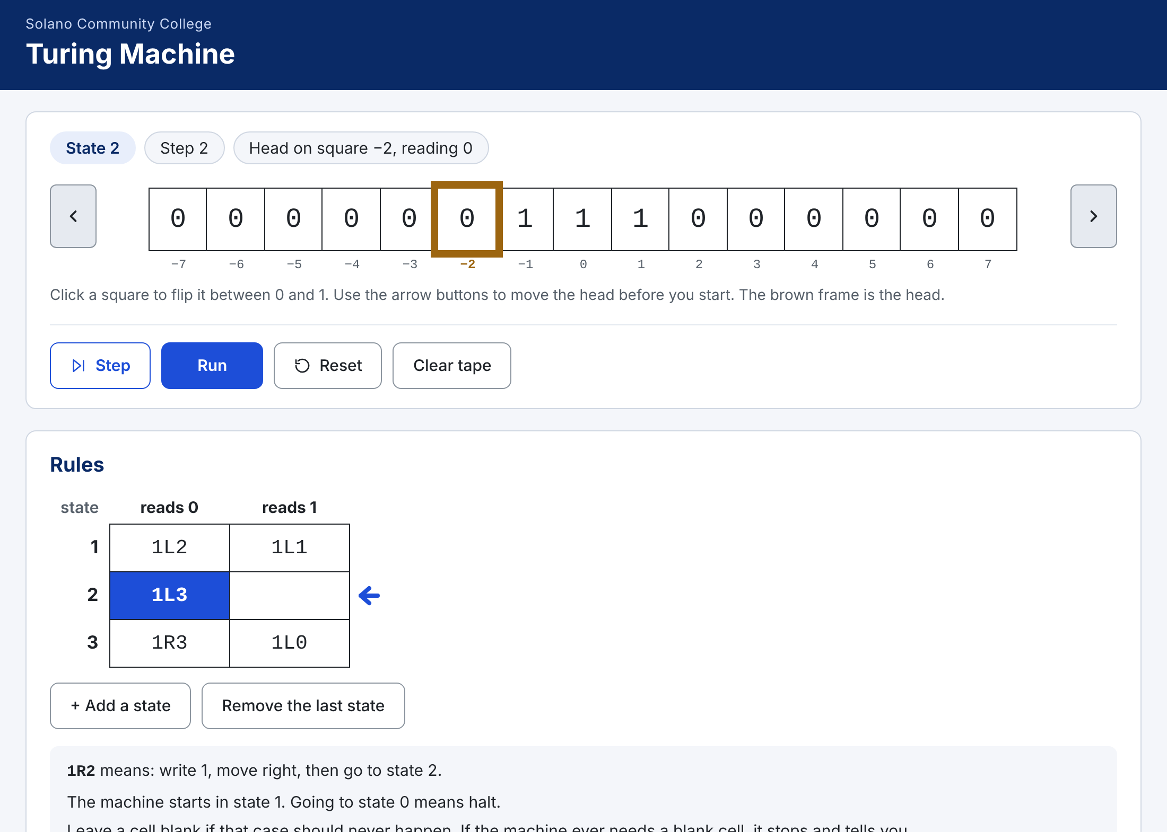
THE SCREEN
1 Status
the state, the step count, and what the head is reading
1
2
2 Tape
the brown frame is the head; square numbers are underneath
3
3 Buttons
Step, Run, Reset, Clear tape
4
4 Rules
the table you type your machine into

Slide 25
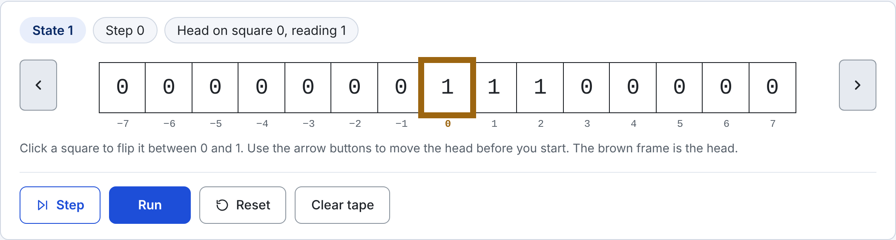
SETTING UP THE TAPE
Click a square to flip it between 0 and 1.
The arrow buttons at each end move the head one square.
Clear tape sets every square back to 0.
Above: the number 3, ready to go. Three 1s in a row, head on the leftmost 1.

Slide 26
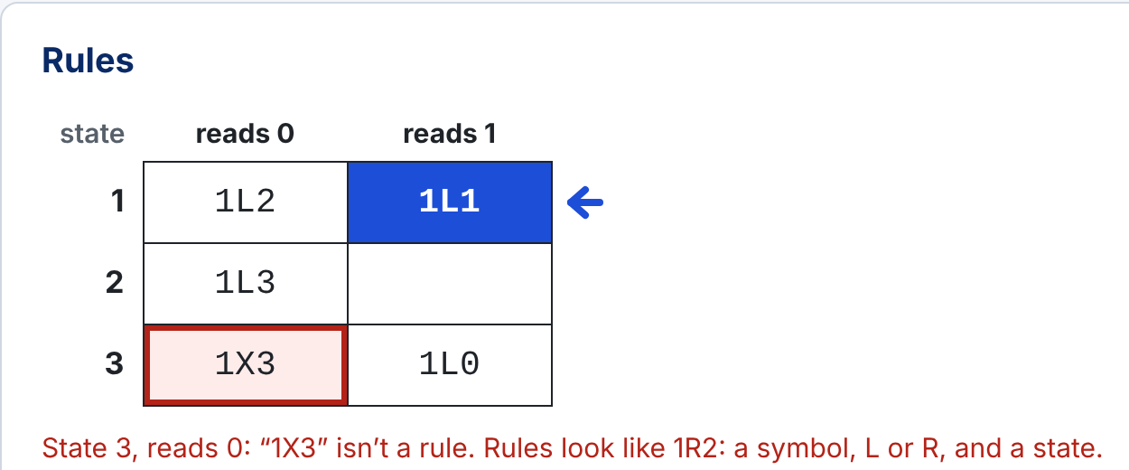
TYPING IN RULES
Type a rule like 1R2 into a cell. Lowercase is fine.
Leave a cell blank if that case should never happen.
+ Add a state adds a row.
A red outline means the simulator can’t read that rule. The message under the table says why.
Here someone typed X where L or R should be.

Slide 27
WRITING A MACHINE DOWN
# today’s first machine
1: 1R2 1L2
2: 1L1 1L0
One line per state: the state number, a colon, the rule for reading 0, then the rule for reading 1.
A dash (-) means a blank cell.
Lines that start with # are comments.
You’ll turn in your machines this way, and it’s the format your own C++ Turing machine will read.

Slide 28

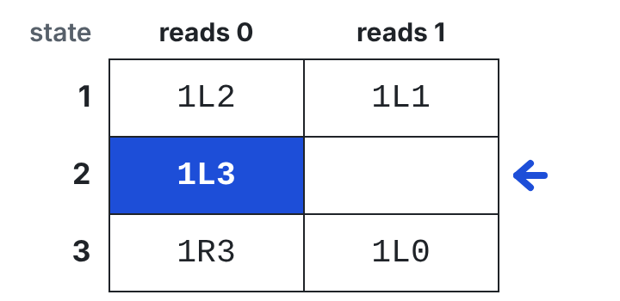
RUNNING YOUR MACHINE
Step uses one rule, then waits.
Run keeps stepping until the machine stops. While it runs, the button says Pause.
Reset puts back the tape you started with, in state 1.
The blue cell is the rule the machine will use next. The arrow marks the current state.
Stepping is the best way to find out what your machine is really doing.

Slide 29
WHEN IT STOPS
Halted after 5 steps. The tape holds 6, a well-formed number.
The machine reached state 0. The tape holds a number, written the way we write numbers here (next section).
Halted after 4 steps. The tape is blank.
It halted with nothing on the tape.
Stopped after 4 steps. There is no rule for state 3 reading 1. Fix the rule, then press Step or Run to carry on.
It needed a rule from a blank cell. That cell gets a red outline. Fill it in, then press Step or Run to carry on.
If Run keeps going and going, your machine may never halt. Press Pause, then Step to see what it repeats.

Slide 30
WRITING NUMBERS WITH 1s
We write a number as that many 1s in a row. 3 is 1 1 1.
0s on both sides show where the number starts and stops. A blank tape is 0.
Machines start and finish with the head on the leftmost 1. We call that well-formed.
0
1
1
0
0
0
0
0
2
3
0
1
1
1
0
0
0
0
5
0
1
1
1
1
1
0
0
Why not binary? Machines that count in 1s are much shorter to write. If we represented numbers in binary, how would we determine where numbers start and end?

Slide 31
PUZZLE 1: SUBTRACT 1
Start
Write a machine that takes away one 1.
It should work for any number that’s 1 or more.
0
1
1
1
0
0
0
0
Finish
0
1
1
0
0
0
0
0
Hint: you need only one rule.
Check: put 3 on the tape and press Run. The message should end with:
The tape holds 2, a well-formed number.

Slide 32
PUZZLE 2: ERASE A NUMBER
Start
Write a machine that erases the whole number, leaving a blank tape.
It should work for any number, including 0.
0
1
1
1
0
0
0
0
Finish
0
0
0
0
0
0
0
0
Hint: a rule can send the machine back to the state it’s already in. That’s how a machine repeats.
(blank tape: the head can be anywhere)
Check: put 3 on the tape and press Run. The message should end with:
The tape is blank.

Slide 33
PUZZLE 3: ADD 1
Start
Write a machine that adds one more 1.
Finish with the head on the leftmost 1.
0
1
1
1
0
0
0
0
Finish
0
1
1
1
1
0
0
0
Hint: every rule moves the head. Think about where the head is after the last rule.
Check: put 3 on the tape and press Run. The message should end with:
The tape holds 4, a well-formed number.

Slide 34
PUZZLE 4: ADD 2
Start
Write a machine that adds two 1s.
Try changing your answer to puzzle 3.
0
1
1
1
0
0
0
0
Finish
0
1
1
1
1
1
0
0
Hint: test it with 0 too. Does it still finish on the leftmost 1?
Check: put 3 on the tape and press Run. The message should end with:
The tape holds 5, a well-formed number.

Slide 35
WHAT DOES THIS MACHINE DO?
state
reads 0
reads 1
Predict: type this machine in. Put 2 on the tape and run it. Then try 4. What does it do?
1
1L2
1L1
2
1L3
3
1R3
1L0
Before you run it: which state does the machine stay in while it reads 1s?

Slide 36
WHAT DOES THIS MACHINE DO? ANSWER
state
reads 0
reads 1
It adds 3. 2 becomes 5, and 4 becomes 7.
State 1 moves left past the 1s (1L1), then writes the first new 1.
States 2 and 3 write two more 1s. Then 1L0 steps back onto the leftmost 1 and halts.
The blank cell never gets used.
1
1L2
1L1
2
1L3
3
1R3
1L0
With 2 on the tape:
Halted after 5 steps. The tape holds 5, a well-formed number.

Slide 37
CHALLENGE: A LONGER MACHINE
state
reads 0
reads 1
Type in this machine and run it with 1, 2 and 3 on the tape.
What does it do?
Then step through it slowly. What is each state’s job?
1
0R0
0R2
2
0R3
1R2
3
1R4
1R3
4
1L5
5
0L6
1L5
It takes a while: with 3 on the tape, it runs for 40 steps.
6
0R1
1L6

Slide 38
CHALLENGE: THE MOST 1s
Start with a blank tape.
Use only states 1 and 2 (plus state 0 to halt). Fill all four cells.
Your machine must halt. How many 1s can it leave on the tape?
Our very first machine left four. Can you beat it?
state
reads 0
reads 1
1
?
?
2
?
?
This is called the busy beaver problem. Tibor Radó posed it in 1962.

Slide 39
LOOKING AHEAD: YOU’LL BUILD ONE
Later in this unit you’ll write a Turing machine in C++: a program that reads a machine written down as text and runs it. Some questions to start thinking about:
How do you store one rule? A whole rule table?
The tape has no end in either direction. How do you store that?
The head can be on square −5. What happens if you use that as a vector index?
How do you read 1: 1R2 1L2 from a file?
What should your program do with a rule like 1X2, or a blank cell?
How do you show the tape after each step?

Slide 40
QUESTIONS YOU MIGHT BE ASKING
Is this a real machine?
It’s an idea on paper. People have built working ones for fun, even out of Lego, but nobody uses them to compute.
Why only 0 and 1?
Two symbols are enough. More symbols wouldn’t let the machine compute anything new, just do it with fewer rules or steps.
Why does every rule have to move?
That’s how this machine is defined. To stay on a square, move away and come back.
My machine runs forever. Is the simulator broken?
Probably not. Press Pause, then Step, and watch which rules repeat.
Why write numbers with 1s and not binary?
Adding 1 is just one more 1. Machines that count in binary need a lot more rules.
Is C++ more powerful than a Turing machine?
No. Anything a C++ program can compute, a Turing machine can too, given enough time and tape. C++ is just much easier to write.

