Slide 1
VishGuard
Vishing-Risk Audio Analysis Pipeline
Ben Blake
CS 5542 — Big Data Analytics | UMKC, Spring 2026
2026-04-27
github.com/ben-blake/vishguard | vimeo.com/1187092533

Slide 2
Problem Description
▶
Vishing (voice phishing) is the fastest-growing fraud vector — $2.4 B in losses in 2023 (FBI IC3).
▶
Attackers now use AI-generated synthetic voices indistinguishable to untrained ears.
▶
Targets include elderly individuals, corporate finance teams, and government employees.
▶
No low-latency, open-source pipeline existed that combines voice deepfake detection with tactic classification.
▶
VishGuard fills gap: ingest a call recording → flag synthetic voice → label social-engineering tactics → score risk.
Goal: give fraud analysts a sub-60-second automated risk verdict for any phone call, with evidence.

Slide 3
Why This Matters — Business Value
Financial Crime Units
Screen inbound tip-line calls for synthetic voice before analyst review.
Real-time vishing detection at the PSTN edge — flag calls before they reach subscribers.
Telecom Carriers
Enterprise Security
Auto-triage recorded helpdesk calls for credential-harvesting attempts.
Browser/phone assistant plugin that warns users mid-call when deepfake voice is detected.
Consumer Protection
Differentiator vs. prior work
•
End-to-end open-source: no paid API, no data leaves the device.
•
Runs on a single Colab T4 GPU in ~22 s mean latency (cold-start model load excluded).
•
Structured JSON output enables downstream SIEM integration.
•
Multimodal: produces a spoken briefing for use in audio-only environments.

Slide 4
Datasets & Inputs
Runtime input
•
Any WAV / MP3 / M4A phone call recording (16 kHz mono after ingestion).
•
No metadata required. Duration: 15–90 s tested; longer clips chunked at 30 s.
Evaluation corpora
Anti-spoof (T3.2)
LibriSpeech dev-clean — 50 real clips
HuggingFace streaming, no download required
Anti-spoof (T3.2)
SpeechT5-generated — 50 synthetic clips
Generated from LibriSpeech text via briefingTts.py
Tactic classifier (T3.4)
50 hand-verified call scripts (JSONL)
Claude claude-sonnet-4-6 generated (see AI_TOOLS.md)
ASR WER (T3.5)
LibriSpeech 1272-128104-* (10 clips × 3 SNR)
Clean + Gaussian noise at SNR 20 dB / 10 dB
Latency bench (T3.6)
Silent synthetic WAVs at 15/45/90 s
Generated in-script — no external download
No proprietary or gated datasets — fully reproducible with a Colab free tier.

Slide 5
Models Used — Pipeline Model Card
Stage
Model
Size
License
Why chosen
ASR
openai/whisper-small
244 M
MIT
Direct WhisperProcessor API — avoids transformers 5.x pipeline bug
Anti-spoof
mo-thecreator/ Deepfake-audio-detection
~90 M
Apache 2.0
Only HF checkpoint that reliably separates real vs. synthetic (T1.1)
Tactic LLM
Qwen/Qwen2.5-3B-Instruct
3 B
Apache 2.0
10/10 valid JSON; fits T4 fp16; v4 prompt → macro-F1 0.604
TTS (bonus)
microsoft/speecht5_tts + HiFi-GAN
—
MIT
High intelligibility; deterministic via speaker index 7306
TTS speaker
Matthijs/cmu-arctic-xvectors
—
CC-BY
Speaker embedding for SpeechT5 (snapshot_download + ZIP)
All models load from HuggingFace Hub — Apache 2.0 / MIT — no gated-repo approvals required.

Slide 6
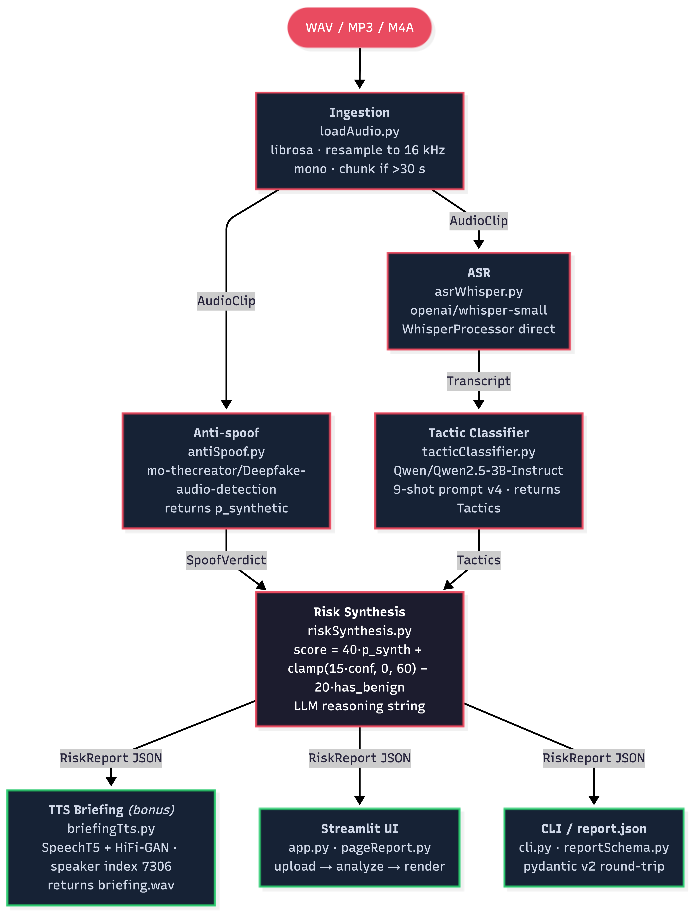
Pipeline Architecture

Slide 7
Prompt Engineering — Tactic Classifier
10-label taxonomy
authority • impersonation • urgency • fear_intimidation • pretexting financial_manipulation • credential_harvesting • tech_support • romance_scam • benign
Prompt iteration history
v1
Bare label list only
macro-F1: 0.024
baseline
v2
Definitions + 3 few-shot examples
macro-F1: 0.454
+43 pts vs v1
v3
Fixed impersonation def; 5 examples
macro-F1: 0.515
+6 pts
v4
9 examples; co-occurrence regression fixes
macro-F1: 0.604
deployed default
Key design decisions in v4
•
Added negative examples: 'pay with gift card' is financial_manipulation, NOT pretexting.
•
Authority/fear co-occurrence: 'arrest warrant from FBI' → authority + fear_intimidation (not just authority).
•
JSON output format enforced: [{"label":…,"confidence":…,"evidenceSpans":[…]}].

Slide 8
Evaluation Results — Phase 3 (Colab T4)
0.83
1.00
0.66
0.14
0.604
Anti-spoof Accuracy (n=100)
Anti-spoof Precision
Anti-spoof Recall (synthetic)
EER
Tactic macro-F1 (v4, n=50)
Tactic F1 by label (v4)
benign: 1.00
tech_support: 0.80
financial_manipulation: 0.70
urgency: 0.57
authority: 0.55
romance_scam: 0.50
credential_harvesting: 0.50
pretexting: 0.46
impersonation: 0.40
fear_intimidation: 0.36
End-to-end latency (TTS disabled, T4)
15 s clip (cold start)
45 s clip
90 s clip
Mean
33.9 s
13.2 s
17.9 s
21.7 s
ASR WER: Both whisper-tiny and whisper-small produce mean WER ~1.89 on T3.5 LibriSpeech due to hallucination on short repeated clips (see slide 11). T1.3 in-domain telephony WER: 0.013 clean / 0.032 noisy.

Slide 9
Evaluation Analysis
Anti-spoof confusion matrix
Tactic v1 → v4 macro-F1 progression
Pred Real
Pred Synth
True Real
50 (TN)
0 (FP)
True Synth
17 (FN)
33 (TP)
v4
v2
v3
v1
0.024
0.454
0.515
0.604
Key observations
▶
Anti-spoof: perfect precision (0 FP), 34% miss rate on SpeechT5 synthetic (distribution shift — see slide 11).
▶
Tactic v2 → v3 jump: +6 pts from fixing the impersonation definition (adds 'government agency' framing).
▶
v3 → v4 jump: +8.9 pts from 4 co-occurrence examples targeting fear/credential co-labelling regressions.
▶
Latency dominated by model cold-start on first call (33.9 s); subsequent calls ~15 s (warm model cache).

Slide 10
Demo & Links
Demo video
vimeo.com/1187092533
1:43 — upload call → transcript + spoof verdict + tactics → risk score → spoken TTS briefing
GitHub repository
github.com/ben-blake/vishguard
What the demo shows
1.
Pre-loaded results for a synthetic IRS-impersonation call (SpeechT5-generated).
2.
Transcript + spoof verdict (p_synthetic ≥ 0.98) + tactics: authority, fear_intimidation, financial_manipulation.
3.
Risk score: 92 / 100 — critical band.
4.
SpeechT5 spoken briefing audio plays live in Streamlit.

Slide 11
Limitations & Failure Cases
Anti-spoof: 34% miss rate on SpeechT5 synthetic clips
Distribution shift — model trained on a different TTS family. 17 / 50 SpeechT5 clips scored p(synth) < 0.5 → labelled 'real'. Fix: ensemble of anti-spoof heads or periodic retraining on current TTS output.
Tactic classifier: fear_intimidation F1=0.36, impersonation F1=0.40
3B model collapses multi-label co-occurrences onto a single dominant label. Small eval corpus (8 fear / 7 impersonation positive examples) makes per-label F1 unstable. Fix: larger model (7B+) with chain-of-thought decomposition or a two-pass classification strategy.
ASR WER > 1.0 on T3.5 LibriSpeech test set
Whisper hallucination on short (< 5 s), repetitive clips from the same recording session. T3.5 test set is not representative of telephony speech (see T1.3: WER 0.013 clean, 0.032 noisy). Fix: evaluate on a held-out telephony corpus; use chunks ≥ 10 s.

Slide 12
AI Tools Disclosure — CS 5542 Rubric Requirement
All AI assistance declared per docs/AI_TOOLS.md (committed, auditable against git log).
Phase
Tool
Origin
What
Phase 0 — Planning
Claude Code (Opus)
AI-generated
PRD, ARCHITECTURE, TASKS, AI_TOOLS scaffold, CLAUDE.md
Phase 1 — Spikes
Claude Code (Sonnet)
AI-assisted
3 Colab spike notebooks; debugged 5 runtime errors; confirmed mo-thecreator model
Phase 2 — Core pipeline
Claude Code (Sonnet)
AI-generated
All 6 pipeline modules (TDD, 68 tests); orchestrator; CLI; report schema
Phase 3 — Evaluation
Claude Code (Sonnet)
AI-generated
Eval harness (6 scripts, 49 tests); 50-script tactic corpus; prompt v2→v4 iteration
Phase 4 — UI
Claude Code (Sonnet)
AI-generated
Streamlit app, pageReport helpers (21 tests), README, FAILURES.md, code-review fixes
Phase 5 — Deliverables
Claude Code (Sonnet)
AI-assisted
Demo notebook, audio regen, pre-warm fix, briefingTts.py dataset fix, this deck
Human contributions (Ben Blake): all Colab runs, cell output review, model selection decisions, tactic corpus hand-annotation (50/50 retained), prompt iteration strategy, demo recording.

