Slide 1
GeophyzViz
Machine Learning

Slide 2
Data exploration
Keyword matrix
Keyword frequency
Principle Component Analysis
K-means clustering
Top-N relevant articles

Slide 3
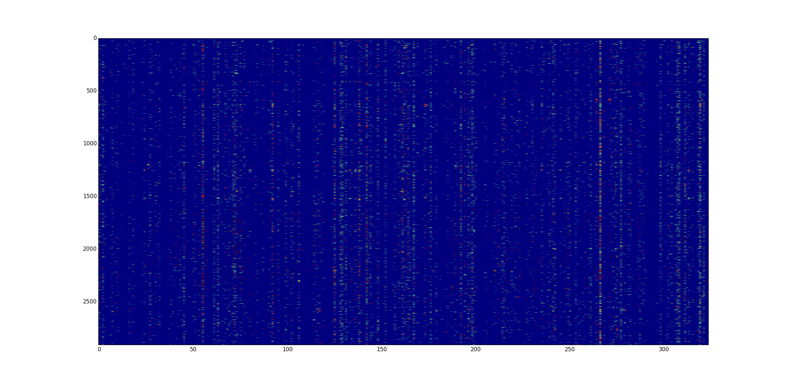
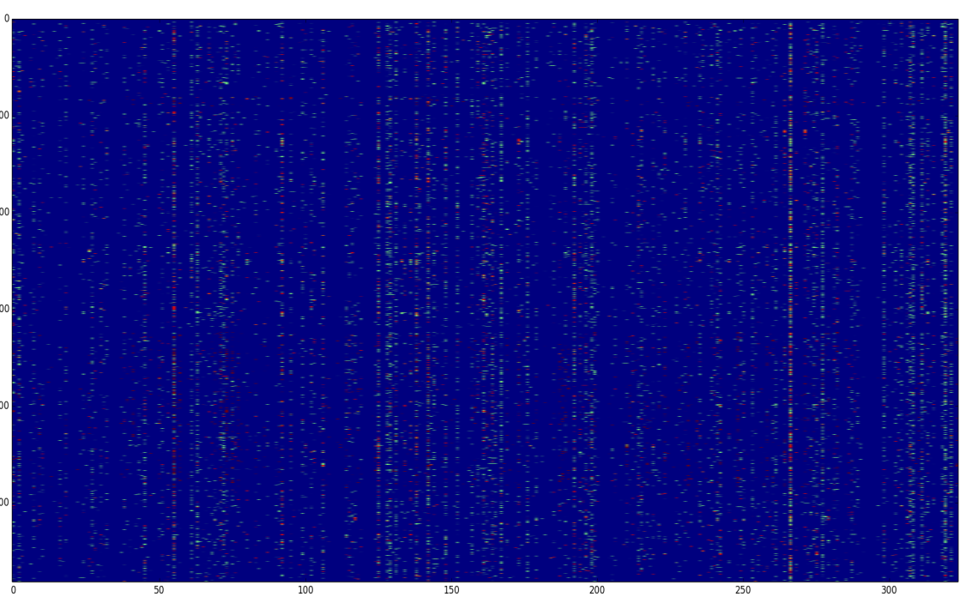
Keyword Matrix

Slide 4
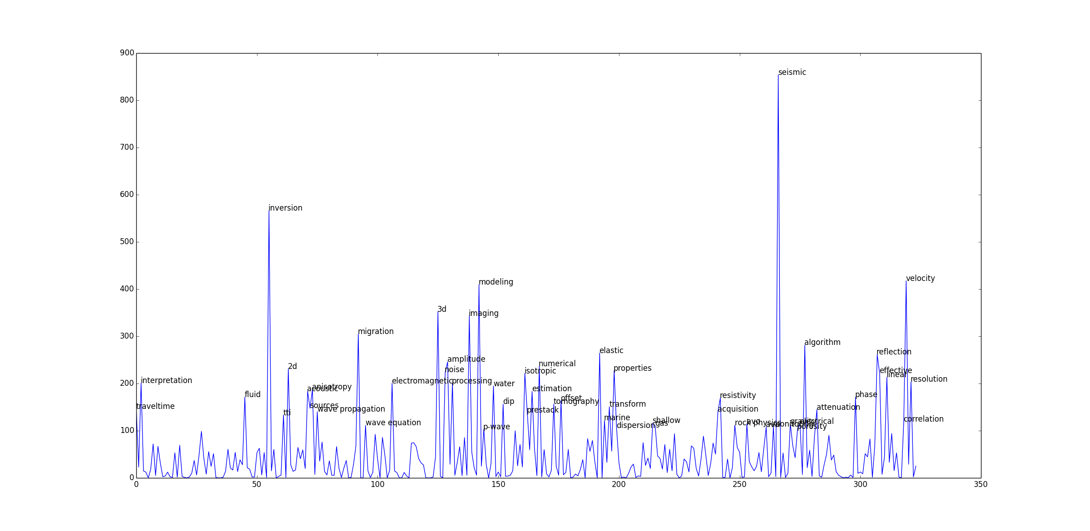
Keyword Frequency

Slide 5
Principle Component Analysis
Reduce 324 dimensions (keywords)
to 3 dimensions

Slide 6
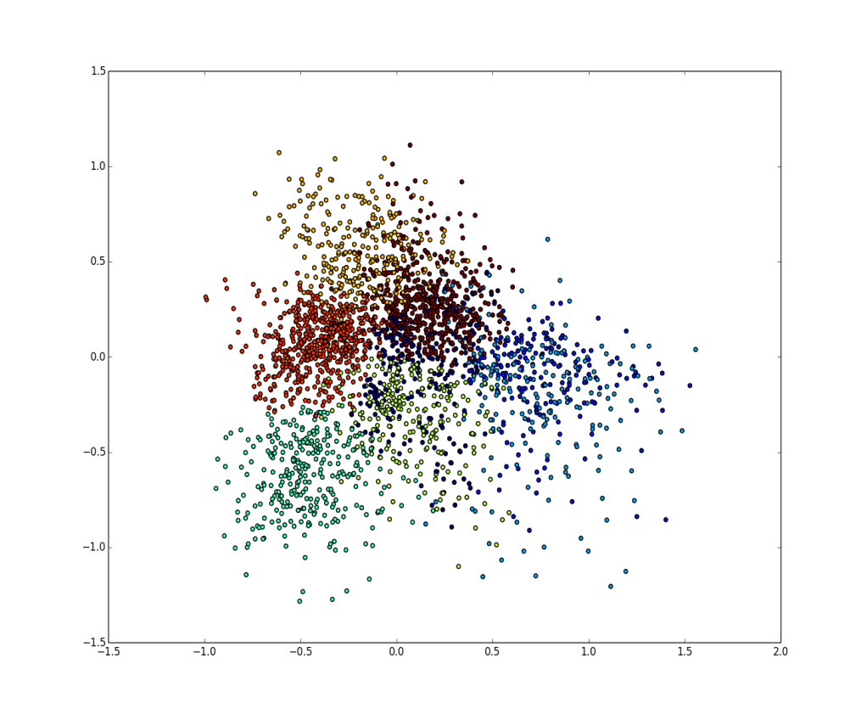
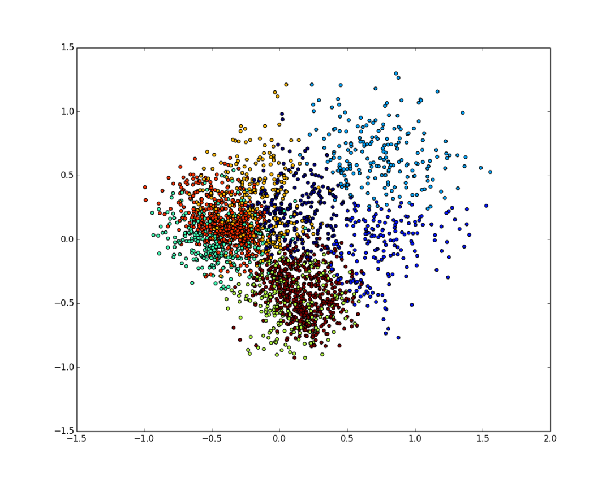
K-means Clustering
Performed on first 3 principle components
8 clusters

Slide 7
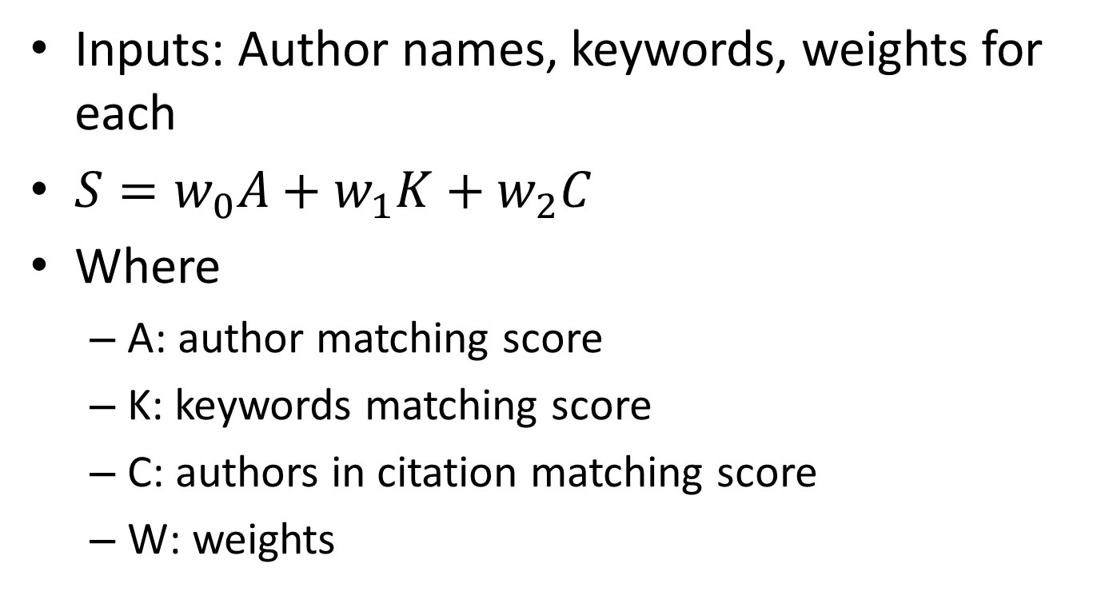
Determining relevant articles
Inputs: Author names, keywords, weights for each
$S=w_{0}A+w_{1}K+w_{2}C$
Where
A: author matching score
K: keywords matching score
C: authors in citation matching score
W: weights

