Slide 1
nashville women programmers presents
You Down with SVG?
a primer for developers

Slide 2
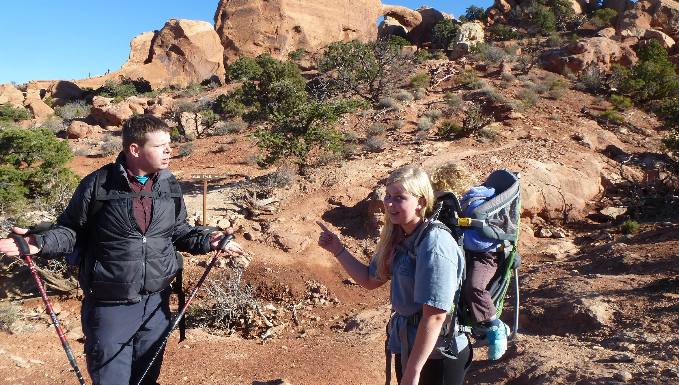
byline
Who is this guy?
I’m Ben Marks….
Notes:
Belve Marks
Nashville Software School Cohort 16 – Python
Jacobs Technology, Inc.
Angular and .NET

Slide 3
As a developer,
WHY SHOULD I CARE?
Communication leads to community, that is,
to understanding, intimacy, and mutual valuing.
- Rollo May

Slide 4
What are SVGs?
Scalable Vector Graphics – a w3c standard
    “...a modularized language for describing two-dimensional vector and mixed vector/raster graphics in XML.”
That standard is not fully implemented anywhere.
Vector images get:
  A path (where to draw)
  A stroke (how to draw)
  Often they can also get a fill
Raster images are encoded pixel by pixel – location and color

Slide 5
The
Bad
Things
No Bitmaps*
Slow animations*
Complicated format*
Canvas-like activities

Slide 6
The
Good
Things
Small size
Scalable
Responsive
Reusable
Animatable
Constructable
DOM Interface

Slide 7
BAD THINGS

Slide 8
SVGs can't do “Bitmappy things”*
* Well, actually they can.
Raster images can be embedded into SVGs, and often times are optimized when doing so. Wanna see?
More later when we discuss the <image> element.
Graphic artists can do wonders with SVG beyond line drawing.
I can Prove it!

Slide 9
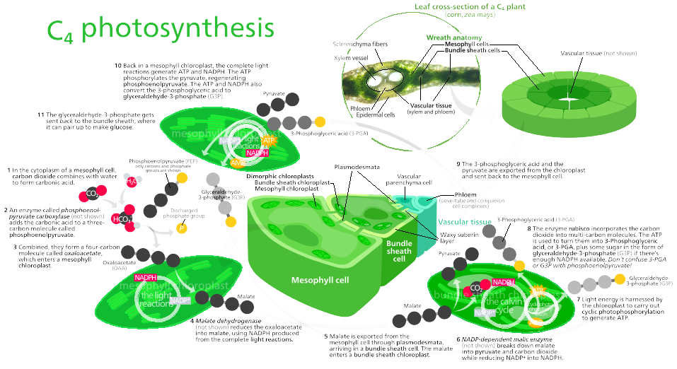
External Example of embedded JPG

Slide 10
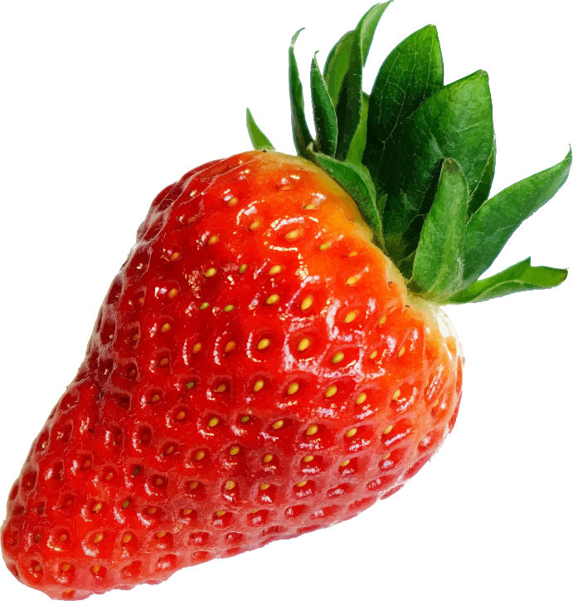
Yes, this is an SVG
with NO embedded rasters.

Slide 11
Slow Animations
Animations in SVG perform quite well...
...on one element at a time!

Slide 12
An Example of What I'm Talking About...
Complicated Animations
from the MDN

Slide 13
“It Has a Complicated Structure!”
So does your app (ZING!)
Seriously though… the strawberry example from earlier:

Slide 14
<?xml version="1.0" encoding="UTF-8" standalone="no"?>
<svg id="svg2" xmlns:rdf="http://www.w3.org/1999/02/22-rdf-syntax-ns#" xmlns="http://www.w3.org/2000/svg" height="1600pt" width="1526pt" version="1.1" xmlns:cc="http://creativecommons.org/ns#" xmlns:dc="http://purl.org/dc/elements/1.1/" viewBox="0 0 1525.7446 1600">
<g id="g37000" transform="scale(.3518)">
<path id="path4-3" fill="#70ac7c" d="m2959 0h0.93c8.16 2.57 22.25-2.1 24.83 9.22-9.54 3.08-23.29 0.93-28.63 11.36-7.05 12.93-17.85 22.95-26.07 34.97-3.08 7.2-8.04 14.28-15.38 17.54 1.22 12.93-11.18 20.51-15.73 31.2-24.55 43.48-40.94 88.36-60.55 133.3-1.47-12.74 9.86-24.17 8.88-38.2 7-2.08-0.83-13.38 7.47-9.02 1.76-5 6.01-10.36 2.79-15.63 4.73-0.42 4.85-5.76 5.45-9.41 3.84-11.8 9.24-23.05 16.38-33.4-8.55 2.72-3.26-2.26 0.88-5.12-4.28-7.12 10.67-8.22 5.35-16.55 8.56 2.38 4.37-20.14 16.62-17.98-2.79-8.27 1.87-11.42 7.72-15.43-8.5-4.4 1.61-3.94 3.9-8.81 1.23-4.89 4.01-9.99 9.45-6.16-3.06-7.02 3.01-15.44 10.1-16.93-3.73-4.07-1.91-6.38 2.16-8.78-8.53-6.67 11.9-4.08 0.35-10.33-8.68 0.63-4.34-8.11-9.64-10.25 11.47-4.26 20.89-12.37 32.74-15.63z"/>
<path id="path6-9" fill="#96be6f" d="m2890 27.3c13.73-0.01 24.31-10.57 37.08-11.67 5.3 2.14 0.96 10.88 9.64 10.25-4.53 4.85-12.32-1.43-15.41 4.9-3.9 5.03-11.09 5.25-15.91 8.95 9.65 3.65-4.14 8.61-8.16 3.73-0.74 1.3 5.22 9.61 0.35 11.37-0.17-4.22-4.2-9.62-3.71-0.51-1.52 7.9-4.2-0.33-4.01-4.58-3.9 4.46-5.06 10.19-4.51 15.95-1.93-1.75-8.13-3.69-6.09 0.36 7.95 8.1-14.63 0.37-10.31 7.61 5.54-3.51 8.31 7.25 2.36 4.63-2.19-9.02-13.05 7.06-3.12 3.19 5.6 7.2-21.05 3.09-7.37 8.29 2.23 6.58-9.66-1.92-7.9 4.81 9.09-0.94 0.99 10.84-4.12 2.25 6.97 9.13-15.46 9.23-4.25 13.75-0.23 2.69-5.38 6-5.95 10.42-3.75-5.44-7.22-0.61-10.53 2.73 1.05 6.27-7.99 12-0.78 17.16-10.12-0.53-9.06 14.91-20.5 10.28-3.97 2.65 3.51 2.71 5.69 3.72-15.63 5.73-14.33 25.69-28.85 31.34-5.87 2.82-0.52 15.41-9.17 13.28 0.73 3.54 3.31 8.69-2.51 6.93-0.91 5.88-1.14 12.94-6.48 16.67 2.13 1.09 6.02 6.1 1.25 5.54-6.73-1.02 0.5 8.78-2.92 11.6-4.4 3.42-2.3 13.29-9.5 9.22-0.14 5.45-0.82 10.56-7.31 10.97-5 3.87 6.3-0.3 4.14 4.71-7.37-0.86-6.86 7.65-5.63 12.59-5.15-4.65-7.19 13.91-1.34 13.06 4.04-5.01 8.3-10.11 14.44-12.64-1.27 6.42-9.51 8.56-9.22 15.98-8.21 10.24-7.73 22.16-7.44 34.87-0.03 1.85 0.09 3.7 0.26 5.56l0.08 0.93c-0.01 4.46 0.68 8.9 1.27 13.33-1.57 2.99-2.19 6.29-1.58 9.63l-0.27 0.76c-1.5 1.87-2.61 4.67-5.35 4.73 5.12-19.75-6.25-40.13 0.54-59.61-5.27-5.38 3.73-11.94 0.05-18.11 4.29-4.72 5.62-17.35-3.42-16.6 9.06-13 0.13-29.17 0.11-43.13 3.36-5.84 3.28 10.15 6.73 5.33 3.46-11.36 4.59-22.26 4.04-33.93 2.23-10.67 1.19 2.22 5.06 0.78 0.77-11.23 5.34-22.53 3.28-33.71-0.84-0.61-1.66-1.17-2.48-1.7 2.06-10.65 14.75-15.24 16.78-26.64 7.06-1.32 1.96-10.69 8.92-9.44 3.8 0.2-6.54-9.78-1.04-6.75 5.46 4.24 2.37-7.17 8.29-5.16 2.3-9.66 15.04-11.73 13.97-22.49 5.21-0.54 6.52-4.81 1.42-6.06 12.71-1.87 15.35-17.95 26.99-22.58 5.87-8.87 17.67-10.74 20.48-22.07-5.12-7.39-13.93 5.67-14.83-1.98 3.62-4.14 9.15-4.96 14.36-4.04 4.7-12.47 24.66-6.03 28.83-18.17 6.75-2.56 3.37 15.45-3.57 13.98 0.06 12.45 14.49-0.81 19.13-4.57z"/>

Slide 15
Canvas-like Activities
Canvas and SVG are two different things
Canvas is for complicated drawing and animation
SVG is primarily a static 2D containment
        The specifications seem to cover a whole lot more…
        …except most devices are 2d surfaces

Slide 16
GOOD THINGS

Slide 17
Small File Size
SVG is just a text file containing XML
  directions
  paint methods
  groupings
No pixel-by-pixel specification in binary
Human readable

Slide 18
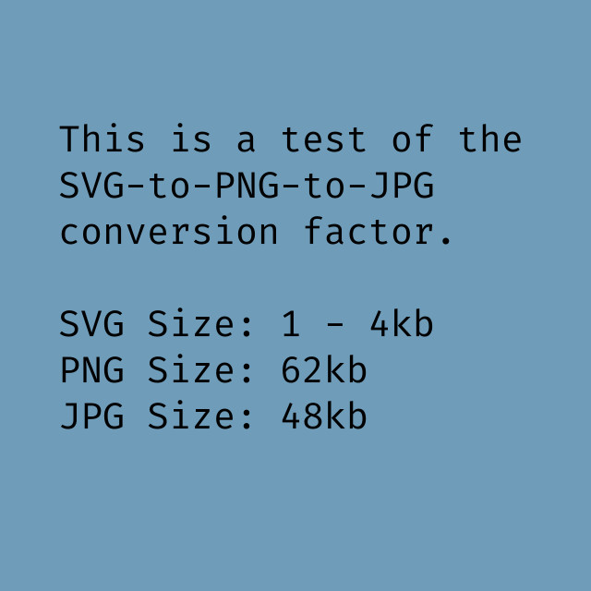
SVG
to
PNG
to
JPG

Slide 19
Scalable
There are no absolute dimensions in SVGs
They can be scaled nigh-infinitely
Let’s check it out!

Slide 20
Responsive
As you might have noticed in the example:
Using a relative dimension for the parent element has a side effect of responsiveness.
The scalar nature allows the image to lose none of the detail.
Let’s see again

Slide 21
Reusable
Another side effect of scalability is reuse.
Why have multiple copies of graphics when you can scale the ones you have?
Think branding on headers or footers
Let’s see that too!

Slide 22
Constructable
Since these are just collections of XML, they can be constructed wholesale via Javascript, or whichever language you prefer.
In fact, this is what most SVG libraries help you do.
D3.js is the queen of them all!
Let’s do it!

Slide 23
DOM Interface
SVG is XML, and therefore has a DOM Interface
This makes it easy to manipulate individual nodes, or groups of nodes
via Javascript or CSS

Slide 24
Elements!
Mozilla Developer Network makes reasonable divisions
descriptive elements
structural elements
shape elements
graphics and HTML elements
gradient elements
animation elements
filter primitive elements

Slide 25
Descriptors
Generally accessibility-related. Not directly rendered, but can be indirectly rendered, such as a tool-tip!
<desc> - Descriptions
<metadata> - Information about data. Should be elements from other XML namespaces.
<title> - The title, generally the first child of its parent.

Slide 26
Structural Elements
<svg> - the main container for the image
<g> - a grouping element
<symbol> - used to define a reusable shape
<defs> - used to define a reusable element (like a gradient)
<use> - implements <symbol>s or <defs>

Slide 27
Shape Elements
<circle> - A circle
<ellipse> - A squished circle
<line> - the points between two defined points
<polygon> - a closed shape, not necessarily regular
<polyline> - an open shape, made of little lines. That means they do not scale well, unless you like seeing the little lines.
<rect> - a regular four-sided rectilinear shape
<path> - This is the magical element. An open or closed shape composed of lines, or curves. these scale very well.

Slide 28
Graphics and HTML Elements
All of these elements are ways to embed elements not normally found in SVG, for instance audio or video.
<image> - This is how we get JPGs and PNGs into and SVG
<audio> - Sound in an SVG? Yep!
<video> - And moovin’ pitchers!
<canvas> - And yes, this is a way to make your canvas responsive, or add filters to the canvas.
<iframe> - embed anything!

Slide 29
Gradients
These are all special fills. The <mesh> element is used as a container for the <meshgradient> element. Keep in mind that gradient definitions can contain multiple <stops>s.
<linearGradient> - Just your standard gradient, one color to another
<meshgradient> - This is a new gradient, proposed in SVG 2.0
<radialGradient> - Standard radil gradient
<stop> - This defines a color or saturation point in the gradient.

Slide 30
Animation Elements
This is the surprising part of the standard. With these, you can define animations, without JS and without CSS.
<animate> - Generic animate element
<animateMotion> - Animates motion along a path
<animateTransform> - Animates transform, scale, skew, and rotate
<discard> - Allows a programmer to remove unused elements, saving resources!
<mpath> - This is the element to specify a motion path to other animate elements
<set> - Sets a given attribute to a given value for a set amount of time.

Slide 31
Filter Primitives
These are all super cool. They are visual filters to apply to SVGs or parts of SVGs, like a blur or tiling. Please play with these.
<feBlend> <feColorMatrix> <feComponentTransfer> <feComposite> <feConvolveMatrix> <feDiffuseLighting> <feDisplacementMap> <feDropShadow> <feFlood> <feFuncA> <feFuncB> | <feFuncR> <feGaussianBlur> <feImage> <feMerge> <feMergeNode> <feMorphology> <feOffset> <feSpecularLighting> <feTile> <feTurbulence> <feFuncG>

Slide 32
Oh yeah... CSS
All of these components are elements with attributes
They can be manipulated and formatted with CSS!
Change colors
More complex animations
Manipulate the viewbox

Slide 33
Did I mention the viewbox?
This is an attribute of the original <svg> tag
It defines the “window” through which we view an SVG.
The SVG can be x units by y units
The viewbox can be defined as w by z units
Allows you to crop and zoom in on different parts of the image.

Slide 34
Check out the map!
SVGs are used extensively in GIS
Each county is made of its own path…
Each state is made of its own path…
The Country is made up of one path…
By manipulating the viewbox and component visibility it looks like different components.

Slide 35
Alpha Masks
SVGs also have an alpha channel -- they can have variable transparency.
You can use this property, along with the <mask> element, to make complicated shapes in web design. Recall that <path>s can take almost any shape!

Slide 36
Pointer Events
Wowee-zowee. There are internally defined events?!
Yes. Yes there are. they are Pointer events.
I have an example from Wikipedia

Slide 37
The begin Attribute
This is where the animation… begins, and is key to making it happen.

Slide 38
Further Reading
MDN - specifically the SVG section:
https://developer.mozilla.org/en-US/docs/Web/SVG
Sarah Drasner’s Excellent talk SVG can do THAT!?
http://slides.com/sdrasner/svg-can-do-that#/
Here’s a link to the map she made:
https://codepen.io/sdras/full/dXoLEJ/

