Slide 1
Artificial Intelligence and
Machine Learning
Artificial intelligence and machine learning have many exciting applications, from computer vision to automatically playing video games. But what do we mean by the terms "artificial intelligence" and "machine learning", and what tasks are these tools capable of?

Slide 2
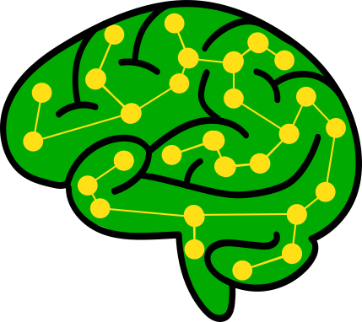

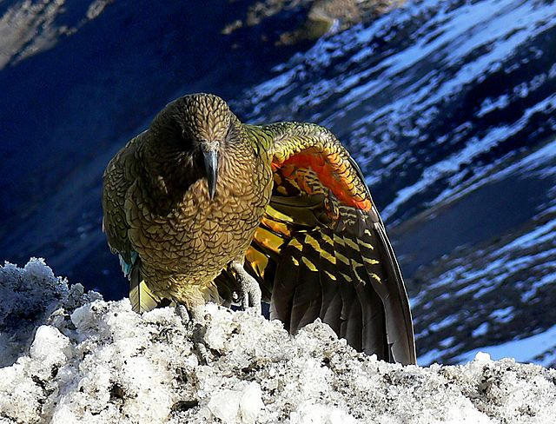

Artificial Intelligence (AI)
A general term for any software that makes "intelligent" decisions based on its inputs.
Input
General AI
AI that adapts to any task with "human-like" intelligence. Often seen in science fiction, but not in science reality (so far).
AI
Narrow AI
AI that is designed to perform a specific task. Used to solve real problems today!
Output
Machine Learning (ML)
An approach for narrow AI where software "learns" from patterns in data to perform a task without manual programming.
Supervised ML
Providing example inputs and expected outputs to "train" the machine to predict outputs for new inputs.
Unsupervised ML
"Learning" directly from patterns in data without examples of expected inputs and outputs.
Classification
Using Supervised ML to train a machine to predict category/label outputs.
Clustering
Identifying groups of similar objects in a dataset.
Weight
Classification
Kea
Wingspan
Reinforcement Learning
Improving at a task by "learning" which actions result in positive feedback.
Regression
Using Supervised ML to train a machine to predict numeric outputs.
RL
1. Input
2. Action
No. rooms,
Location, etc.
Regression
House Price($)
3. Feedback
Models
A model is a simplified, digital representation of a concept - the "knowledge" learned through machine learning. A decision-making model is sometimes called an algorithm, but the machine learning technique that produces the model is also an algorithm.
Deep Learning
Recent advances in machine learning from text and image data have come from very large, many-layered neural networks referred to as deep neural networks.
If colour = black:
bird = tui
If flies = false:
bird = kiwi
colour = black?
yes
no
bird = tui
flies = true?
yes
no
bird = kiwi
bird = kea
Rules
Linear Models
Decision Trees
Neural Networks

