Slide 1
Computer Languages
Just like how there are many human languages are many different computer languages that we use when working with computers. These include programming languages for writing software programs, as well as languages for representing content (like web pages) and other data. Each language has its own purpose, though some languages allow us to use different approaches to completing similar tasks. Most developers will only work with one or a few languages that are relevant to their goals. Let's take a look at some commonly used or otherwise interesting computer languages.

Slide 2


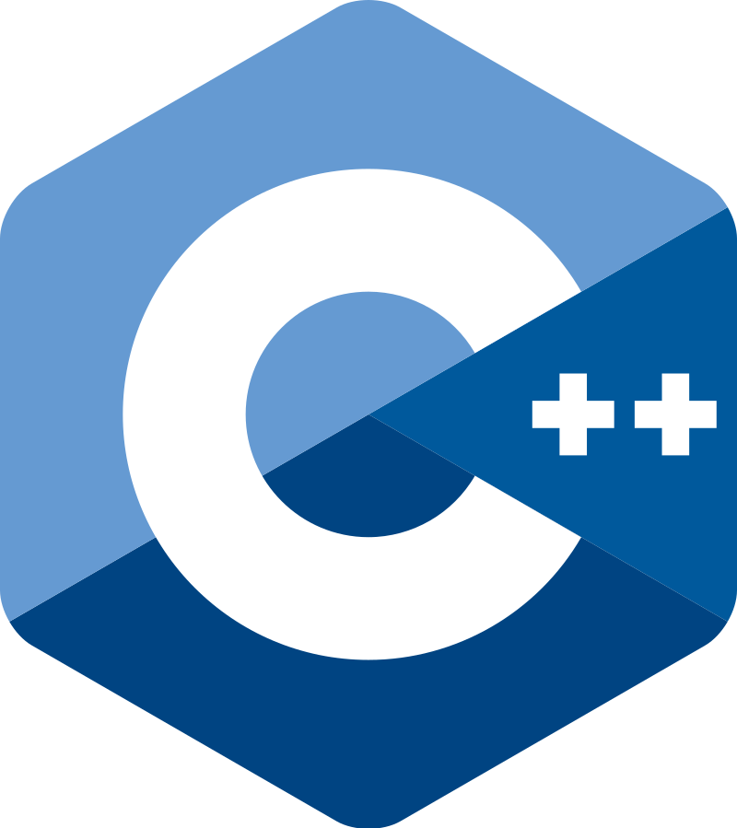

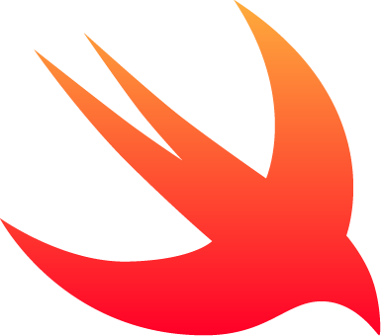
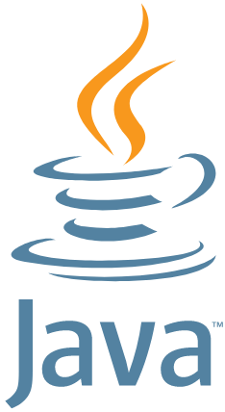
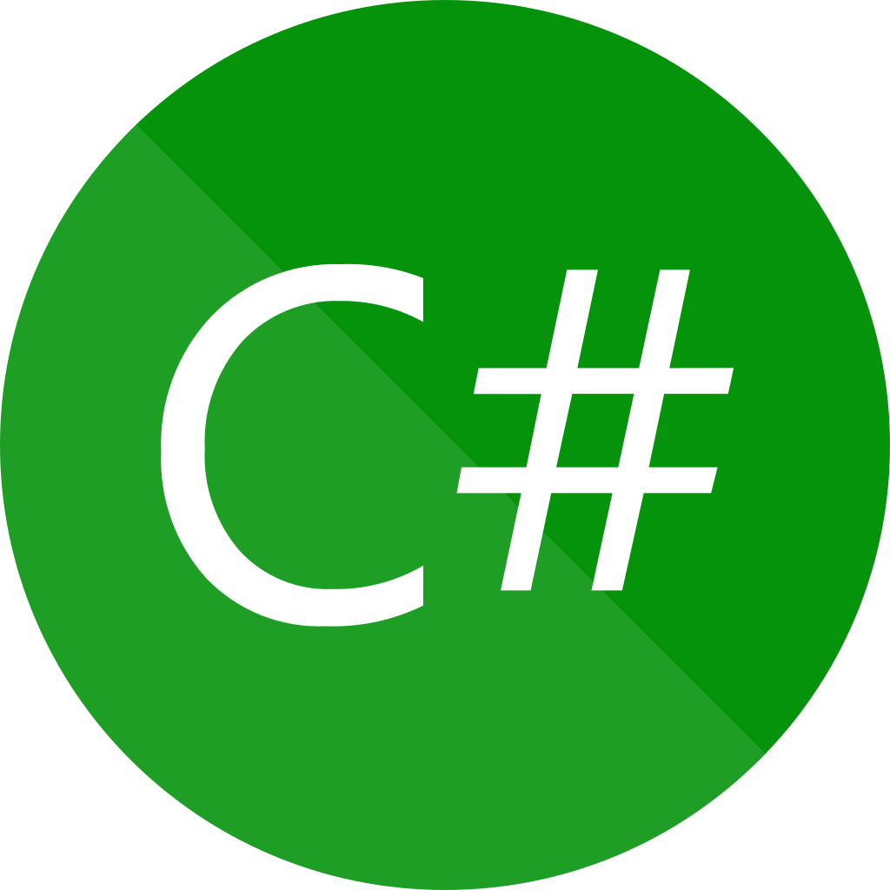
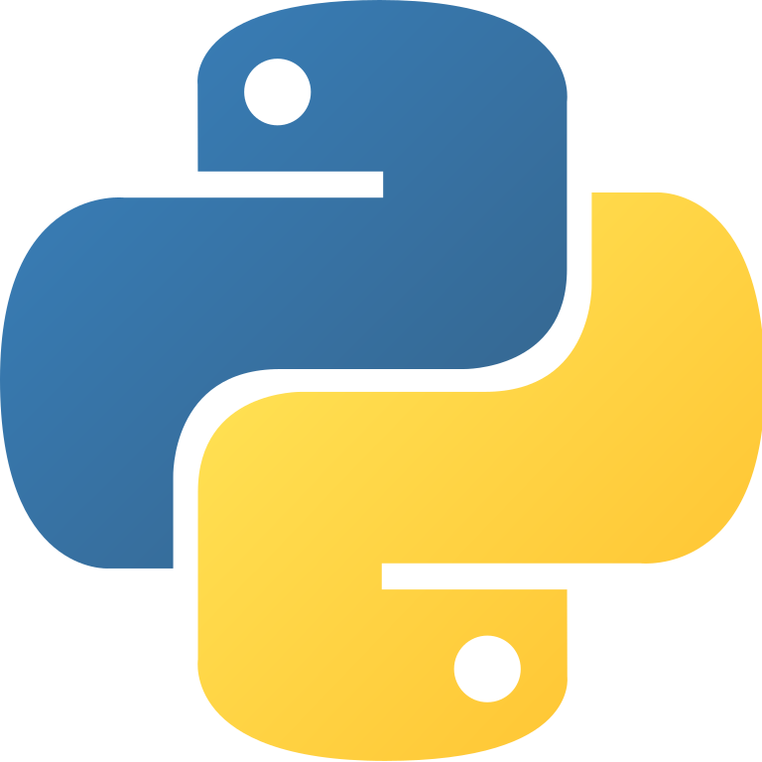
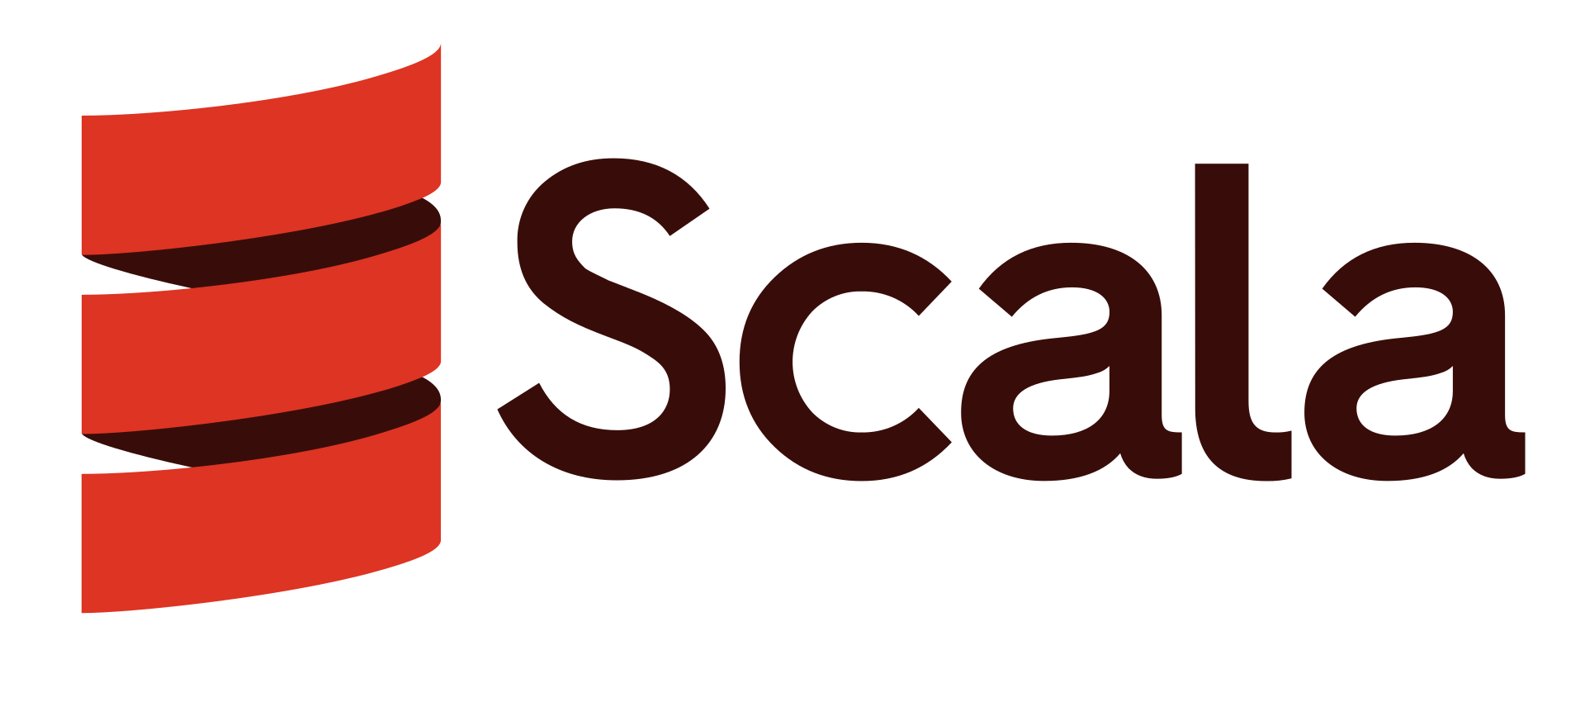





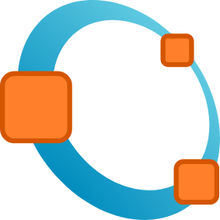

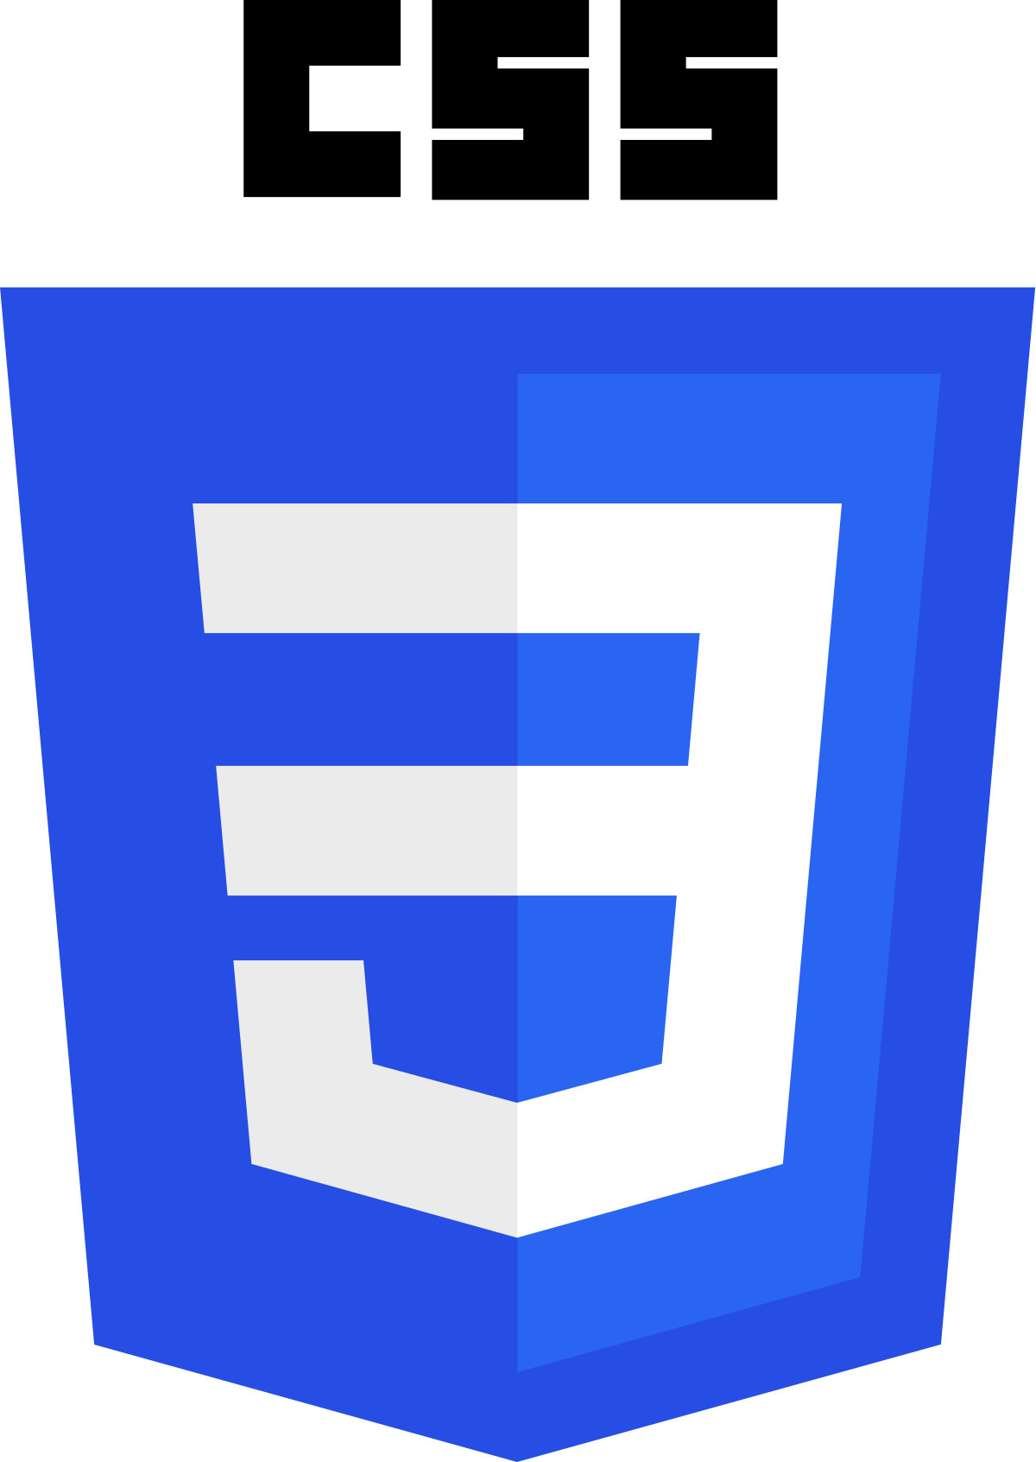
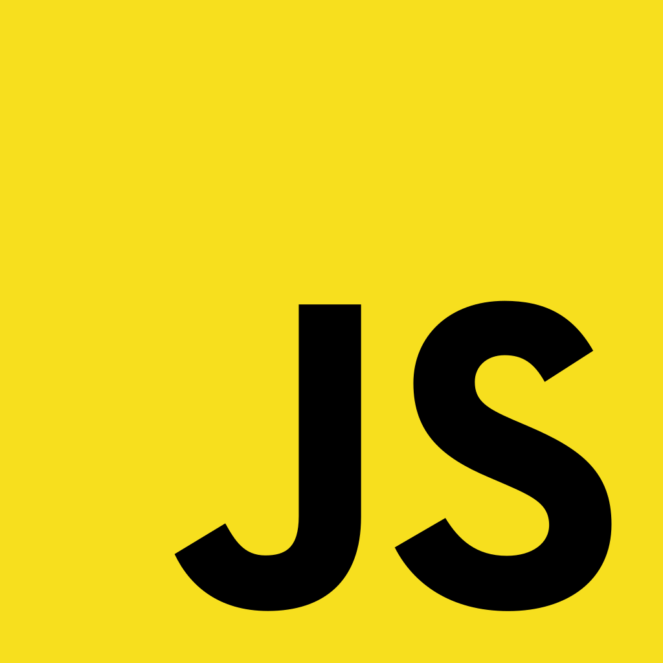
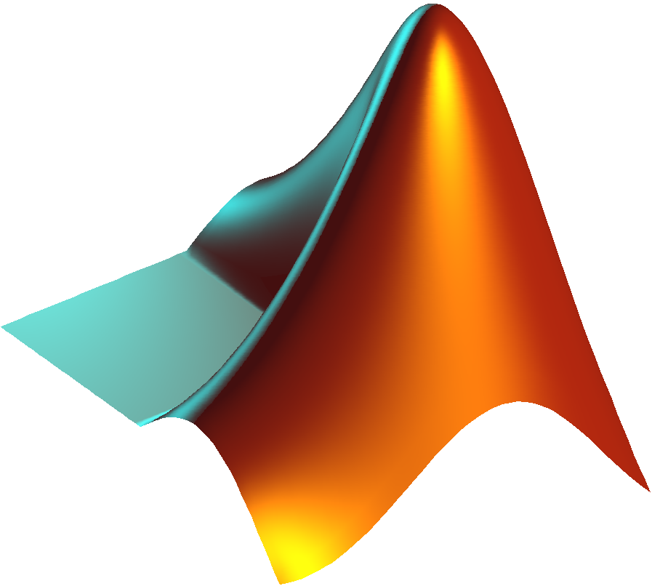
General-Purpose Programming Languages
General-Purpose languages can be used to write software in many domains, such as web and desktop applications, web services, and data processing.
Object-Oriented Languages
Object-oriented languages are designed around objects that interact with each
other while managing their own attributes/properties and methods/behaviours.
Functional Languages
Functional languages are designed around functions that pass simple values to each other.
Rust
Kotlin
Swift
Python
Lisp
Haskell
Elixir
System Languages
These fast and lightweight languages are often used for system software and embedded systems
Mobile Development
These languages are used to develop Android and iOS mobile applications.
Web Development
These languages have popular libraries for building the server-side components of web applications.
Other Kinds of Language
Visual Programming
Programming in languages like Scratch is done with blocks or other visual elements instead of text.
Domain-Specific Languages
Domain-specific languages are specialised for writing software in specific application domains.
Web Languages
Web pages are written in 3 languages that are interpreted by a user's web browser:
HTML: Provides the content of a web page.
CSS: Controls page layout and formatting.
JavaScript: For programming interactivity.
Command Languages
The languages of shells like Bash and PowerShell are used to write scripts that automate common tasks on a computer.
Mathematics
Languages like R, Matlab, and Octave are designed for advanced maths.
Data Formats
Data format languages like JSON, XML, YAML are commonly used when transmitting data between systems.
SQL
Structured Query Language (SQL) is used to read and write data in many databases.
Assembly Language
Used to write very fast programs by giving low-level instructions directly to a computer's processor.

