Slide 1
Event-Driven Programming
Programming languages like Scratch are based on the idea of "Event-Driven Programming", where we can code actions that should be performed when certain events occur. Let's look at the basic ideas involved in event-driven programming.

Slide 2
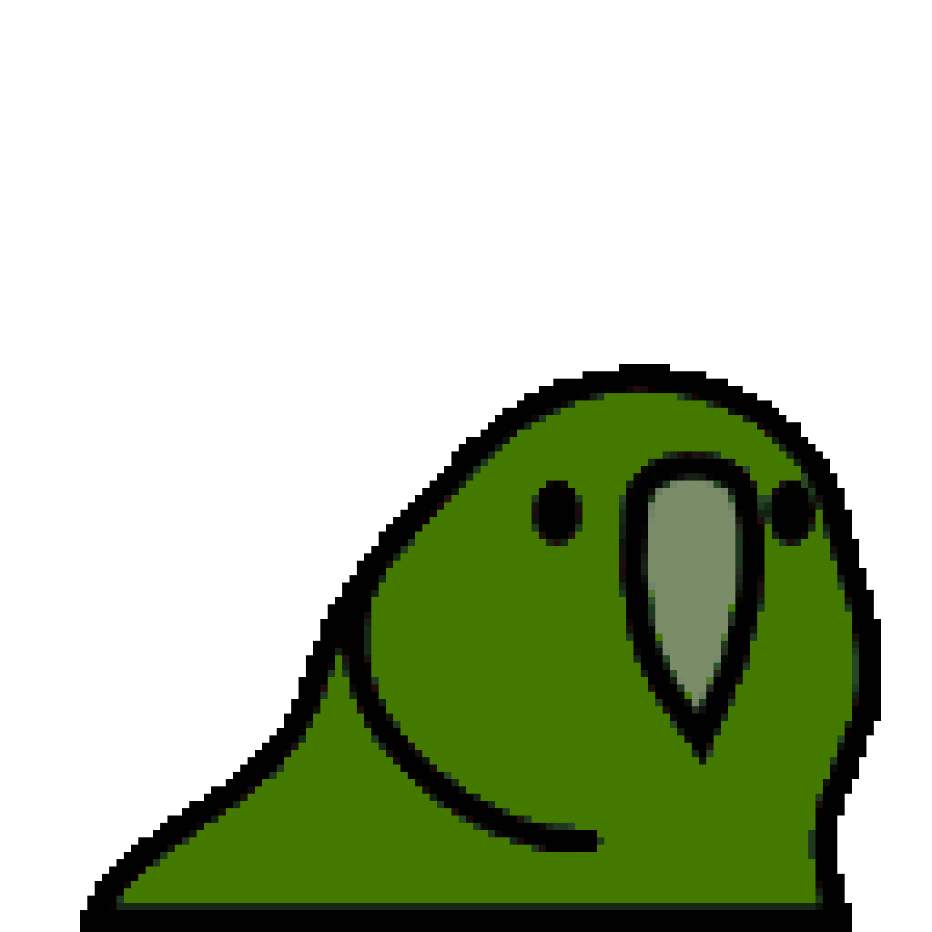
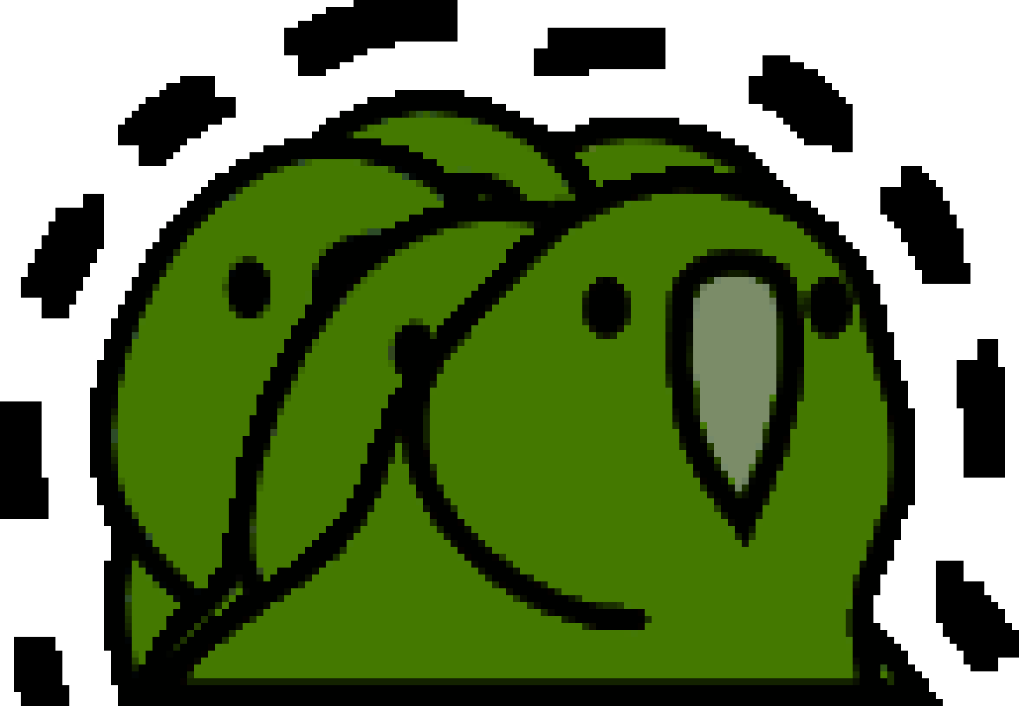
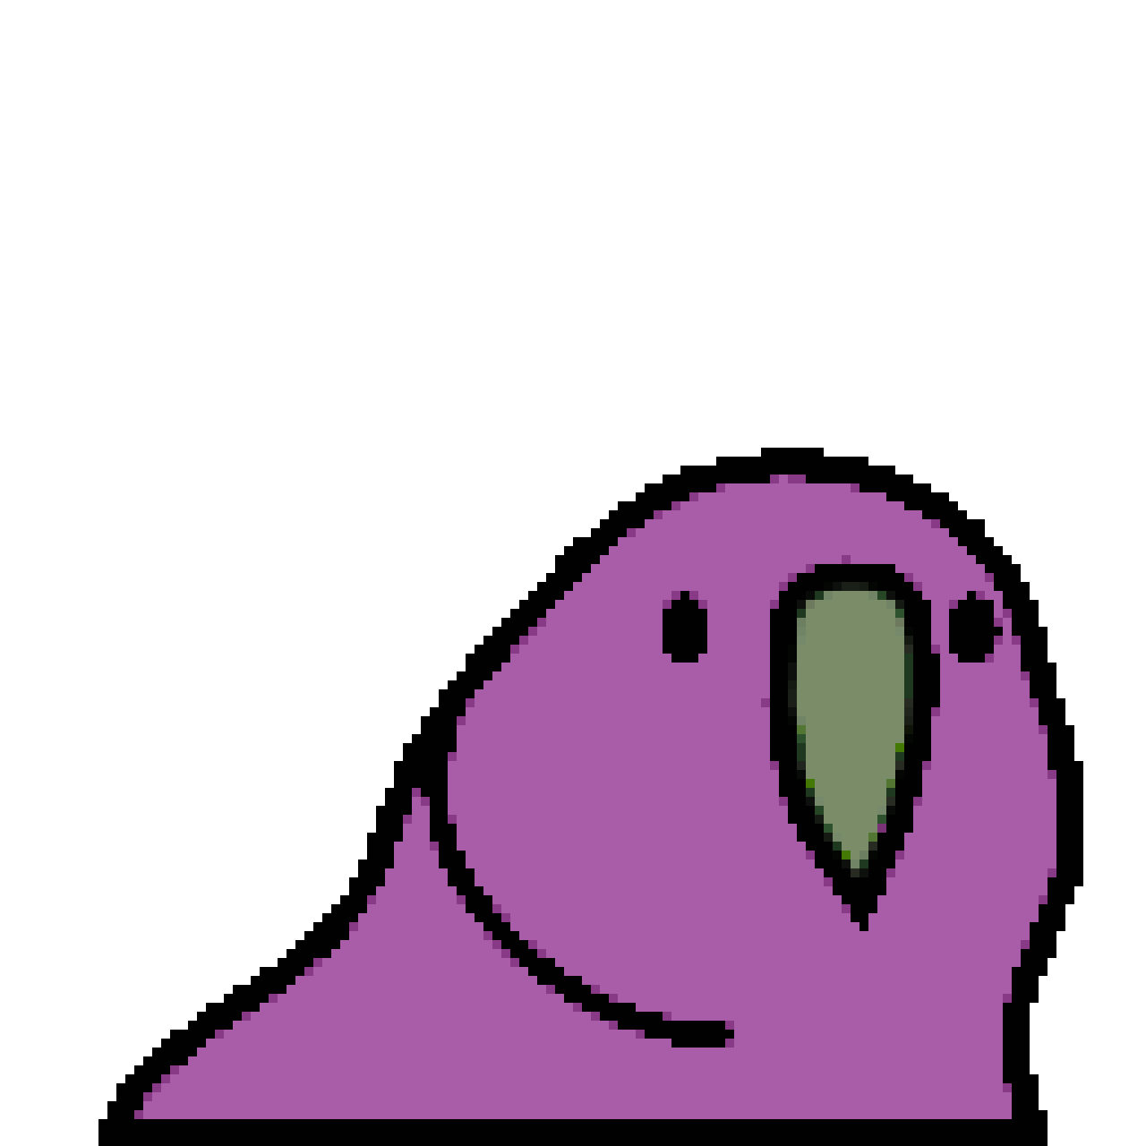
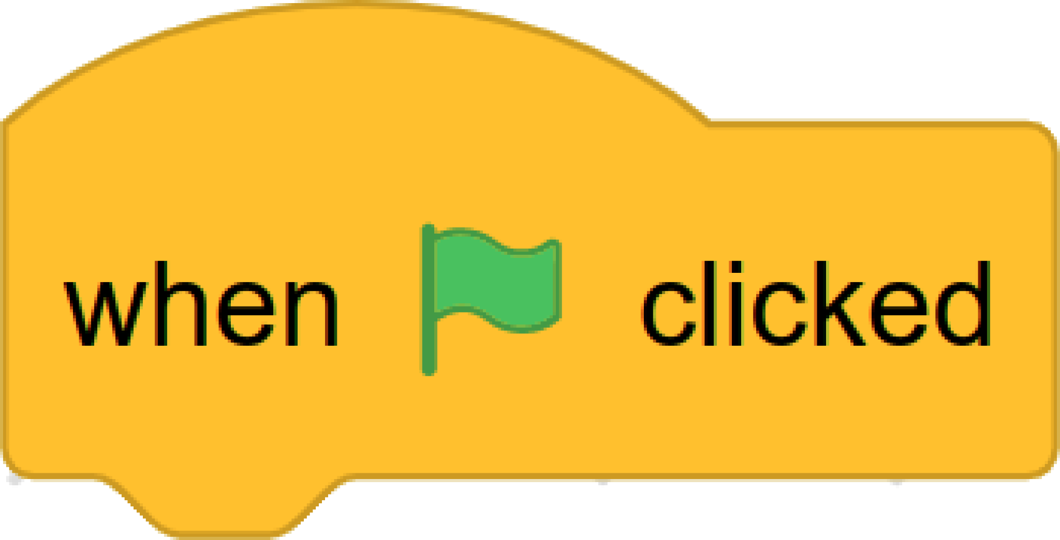
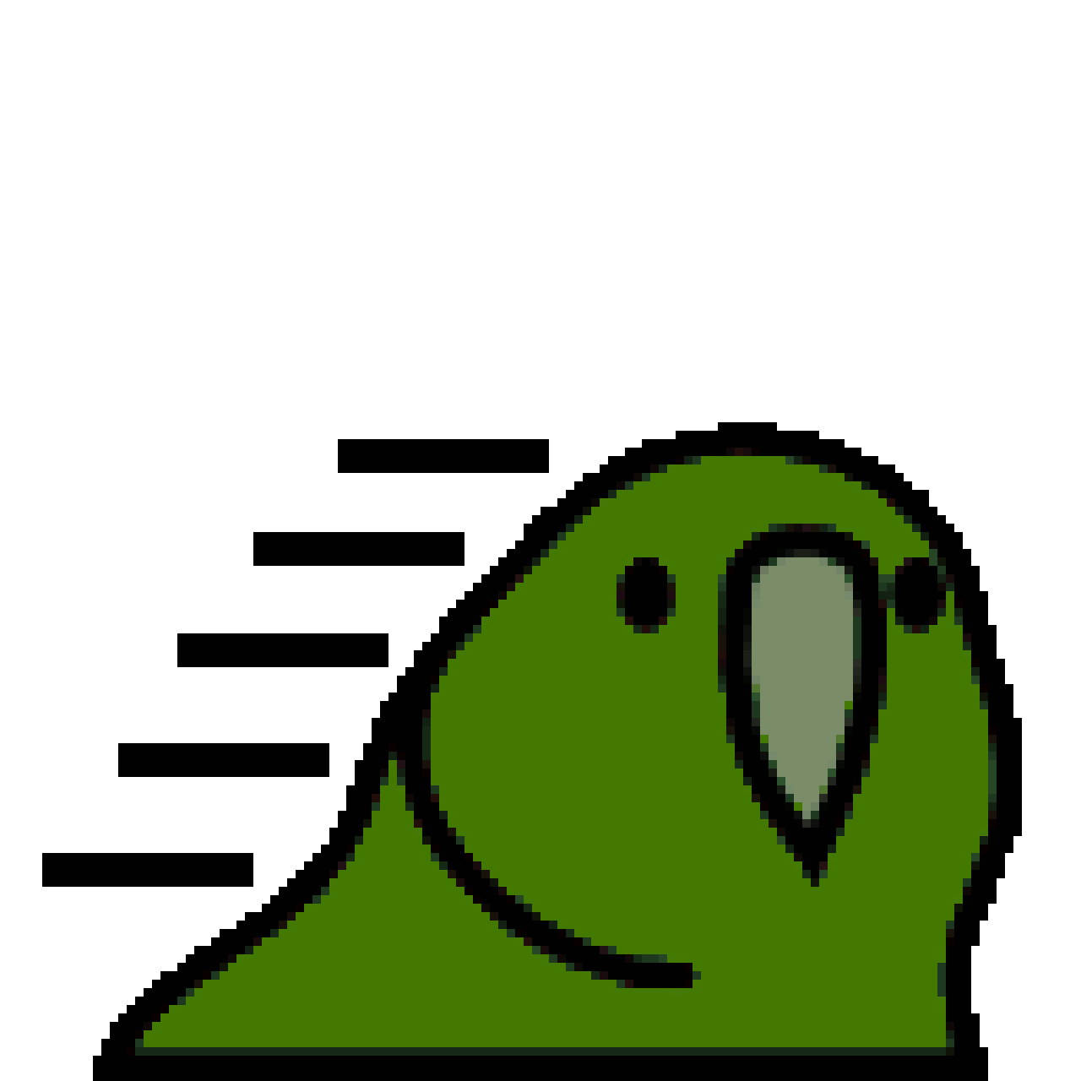
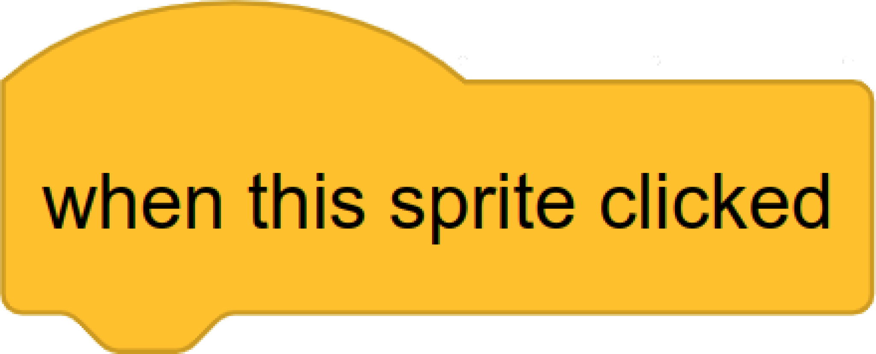
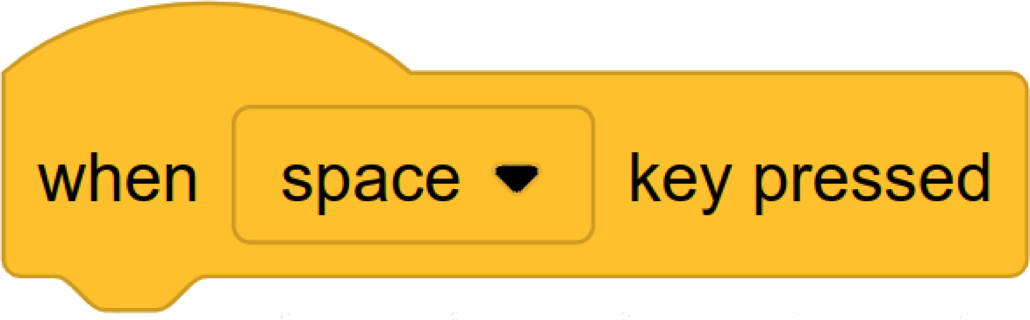
Sprite
A single image within a larger scene, often representing a character or object.
Behaviour
An action that a sprite can perform.
Property
A characteristic of a sprite. Properties may determine the appearance or behaviours of a sprite.
Event
An input that signals some action has been performed, often by a user.
Animate / Change costume
Name | Party Kakapo
Colour | dark green
X-Position | 167
Y-Position | -45
Flag Click Handler
Sprite Click Handler
Space Press Handler
Change colour
Event Handler
Code that specifies what behaviours and other actions (such as changing property) should be performed whenever a certain event occurs.
Move to a new position

