Slide 1
IT Thinking Hats
You will often need to think about IT problems from a variety of perspectives. Each perspective is like "hat" that you can wear to help you focus on a particular aspect of a problem. Different "hats" are helpful at different stages of development. Let's look at a few of the different "hats" that can help you achieve your goals with IT.

Slide 2
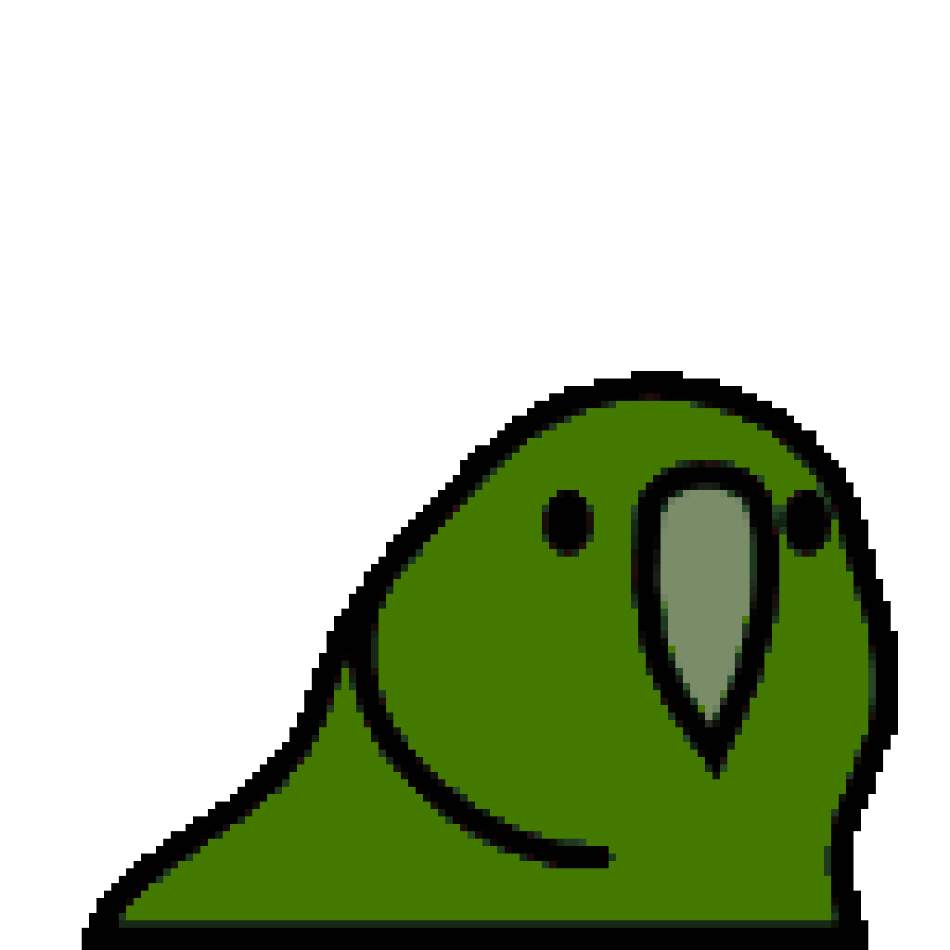
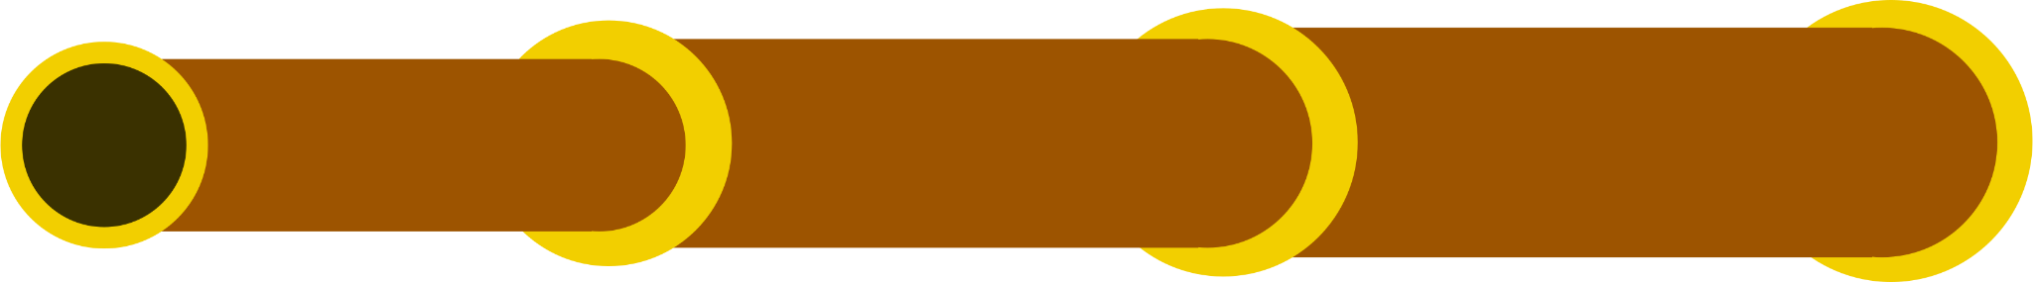
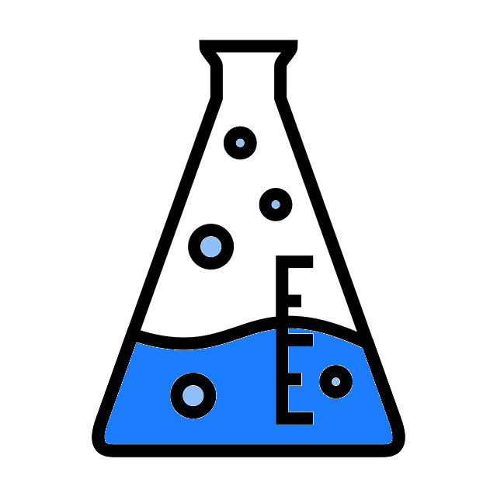
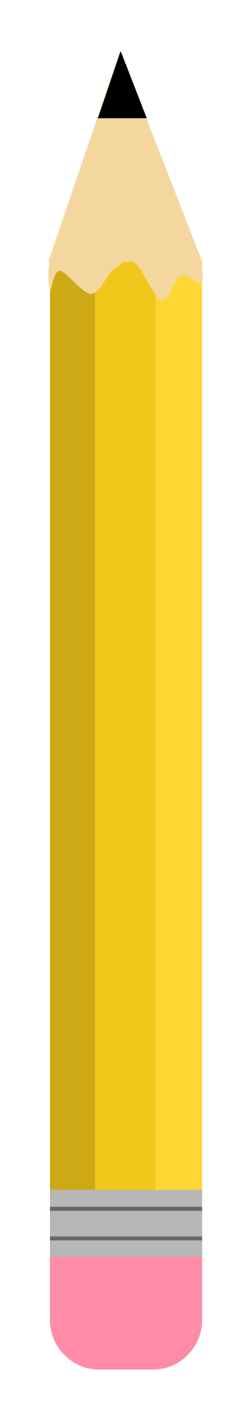


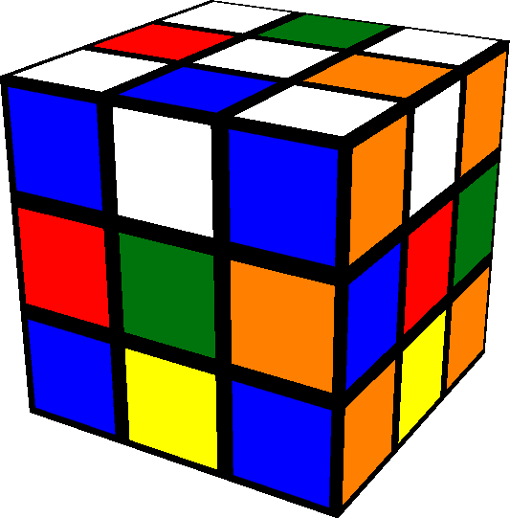
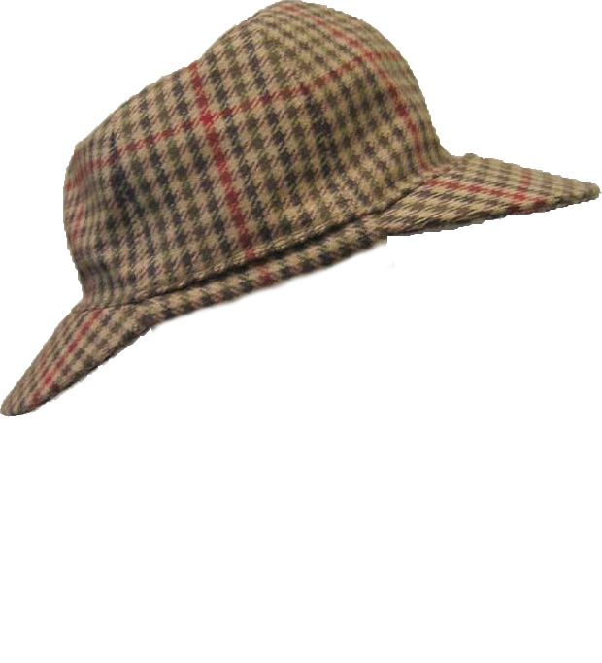

Outcome-Focussed
Will the planned solution meet users' needs? Could we solve this problem with a simpler solution?
Scientist
Which of these alternative algorithms is the fastest? What changes could I make to my machine learning system to make it more accurate?
Problem &
Requirements
Architect
What software and hardware will be needed to build this system? How should the pieces of software involved interact with each other?
Design &
Source Code
Communicator
How can I explain my planned solution to users? How can I make this source code readable and documented so that other developers can maintain it?
Puzzle Solver
What abstraction can I use so that I do not need to repeat this section of code? What algorithm would solve this problem efficiently?
Testing &
Debugging
✓|✘
Reviewer
What inputs would cause this software to produce incorrect outputs? Are there any potential security vulnerabilities?
Detective
Why does my software act differently to how I think it should be acting? What is the cause of this bug?

