Slide 1
Types of Software
There are many different kinds of software that developers make. Some software is intended for end-users, while other software is designed to help other developers like us write our own software more easily! Let's take a look at some of the different kinds of software.

Slide 2
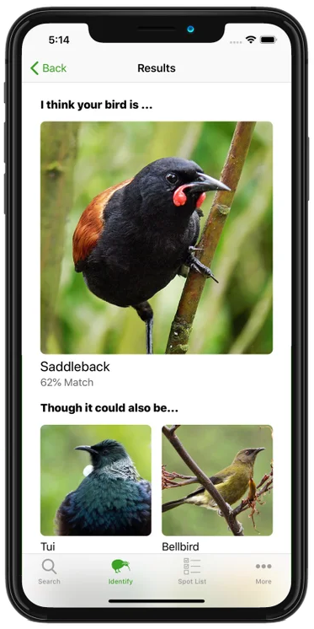


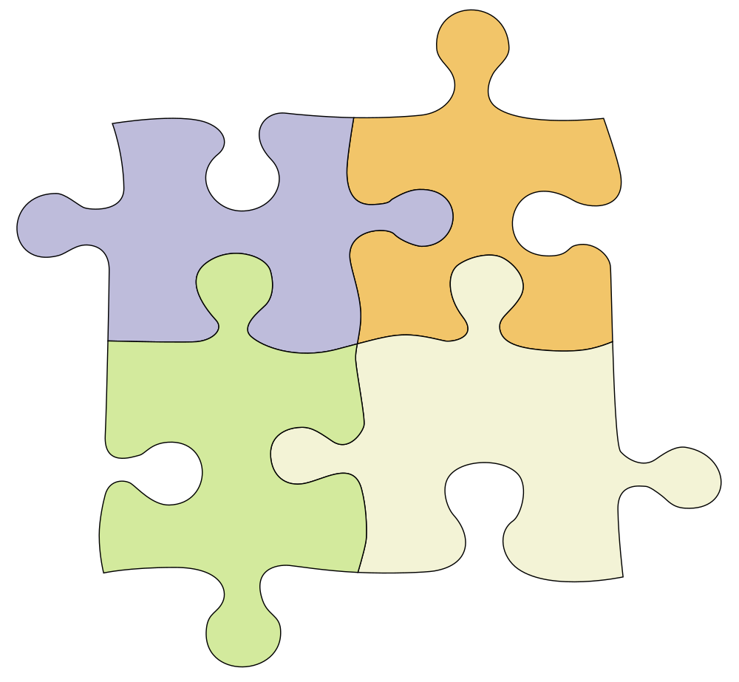
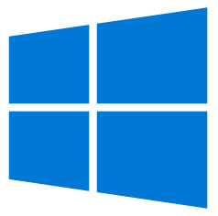


Applications
Provide functionality to human users. Includes desktop and mobile apps, as well as web apps that are served over the Internet.
Embedded Software
Runs directly on a simple computer known as a microcontroller. Reads input from sensors and controls physical outputs (e.g. lights, motors).
Software Re-used to Build New Software
Services
Provide functionality to other programs through an Application Programming Interface (API). Delegating some functionality to a service can make your own software simpler.
Software Libraries
Components that can be reused in other pieces of software. Using a library can save you from coding common functionality yourself.
System Software
Software that is responsible for managing the hardware and basic functionality of a computer. Provides a platform for running applications and services. The Operating System is the primary collection of system software on most computers.

